Slide 1

Introduction to WeVideo
Podcasting & video Stories Intensive
November 4, 2020

Slide 2
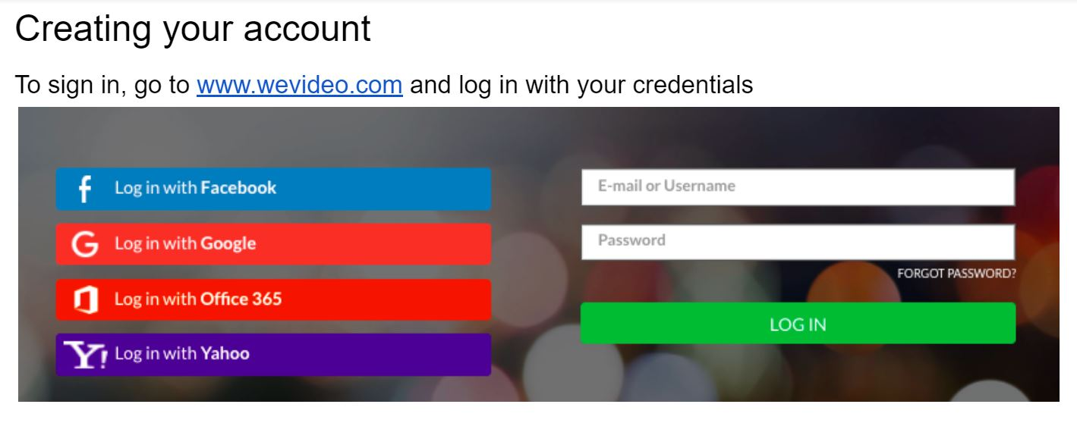
Creating Your WeVideo Account
Go to https://www.wevideo.com.
Click the Log in with Office 365 button.
Log in using your BMC email address and password.

Slide 3
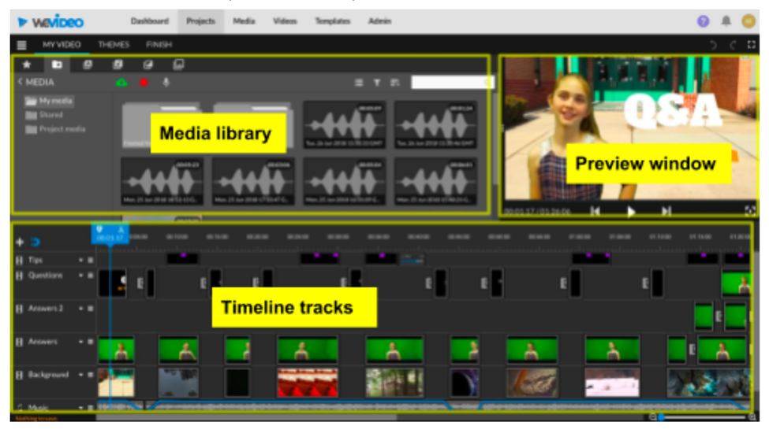
The WeVideo Interface

Slide 4
How to Create a Digital Story.
Brainstorm your story idea and fill out a story canvas.
Write your script: recommended length is ~300 words.
Storyboard your script with possible visuals to support the narration.
Record your narration using Audacity and upload the file into WeVideo.
Locate other media clips you will use for your story.
Assemble your video in the WeVideo timeline.
Get feedback and edit.
When you have a final product, export the video as an MP4 file for sharing.

Slide 5
Creating a New WeVideo Project
Log in
Log in to your WeVideo account and click on the Projects tab.
Create New Project
Click on the blue-and-white “+” icon in the bottom right and choose Create new project.
Give it a Title
Give your project a Title and a short Description.
Choose Project Type
Choose a Project type. Project types determine who can edit the project and when (individual, collaborative, or shared).

Slide 6
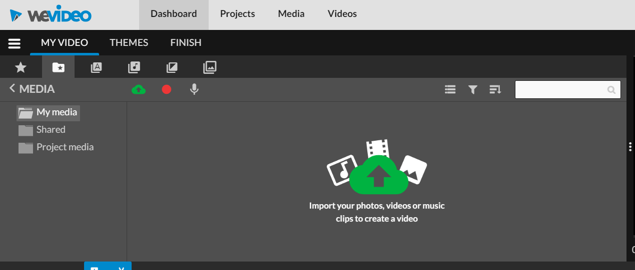
Creating a New Project, Continued
Click Next after selecting the project type.
You will be prompted to Add Media from a list of existing clips; you will do this later from the Media tab so skip this step and click Next.
Click Finish.

Slide 7
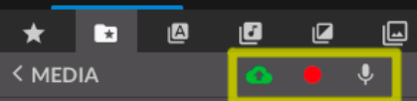
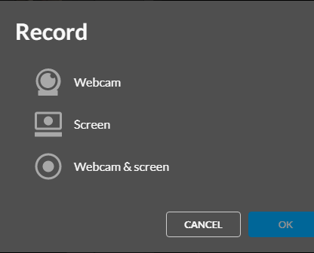
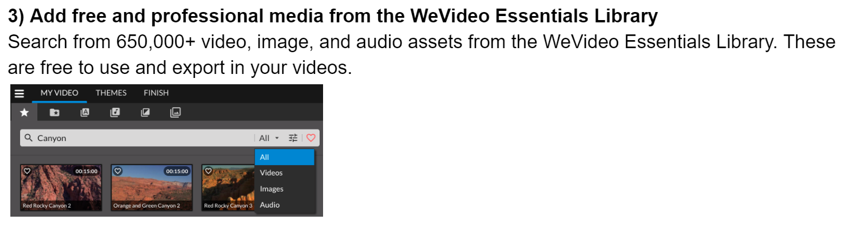
Add Media Files to Your Timeline
Import pre-recorded media from a device/location (i.e. Google Drive, Box)
Record media directly in WeVideo
Add free, professional media from Stock Media

Slide 8
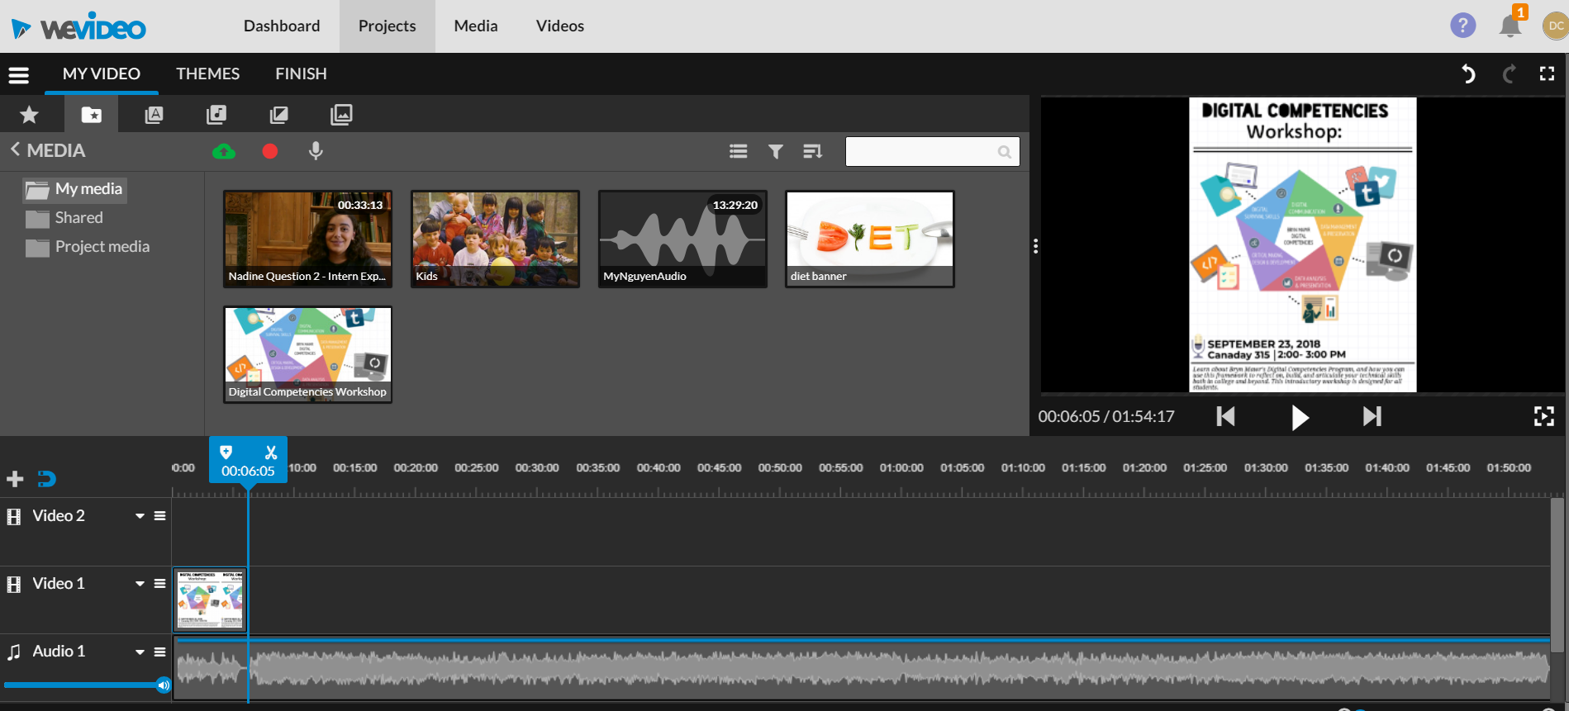
Editing Visual Media in the Timeline
To edit a video clip or image, click on its thumbnail (an orange outline will appear) and choose the appropriate icon to edit the clip, trim the clip, balance the color, or animate it.
Fade (timeline): Dissolve or fade your visual
FX : Add visual effects (e.g., filters, etc.)
Trash Can: Delete the clip from the timeline.

Slide 9
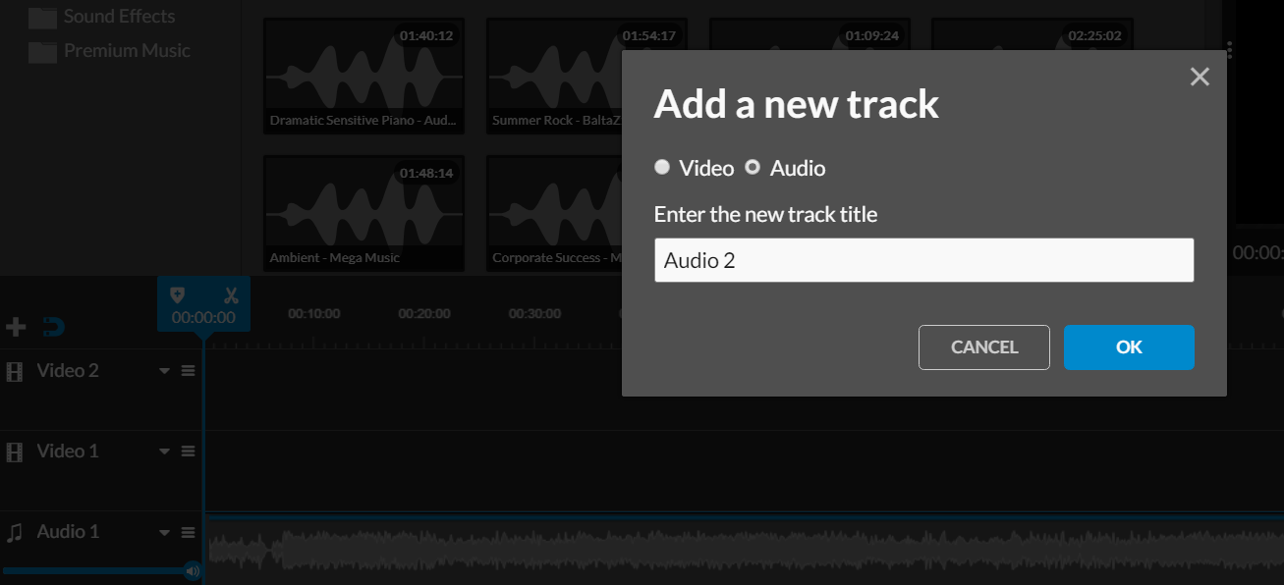
Adding Audio and Video Tracks
All projects will have at least one audio and one video track in the timeline. You can add additional tracks to superimpose sounds and images or to create effects such as dissolves or fades. Click the “+” at the far left of the timeline to add tracks.
Click on the name of a track (e.g. Audio 2) to rename it.

Slide 10
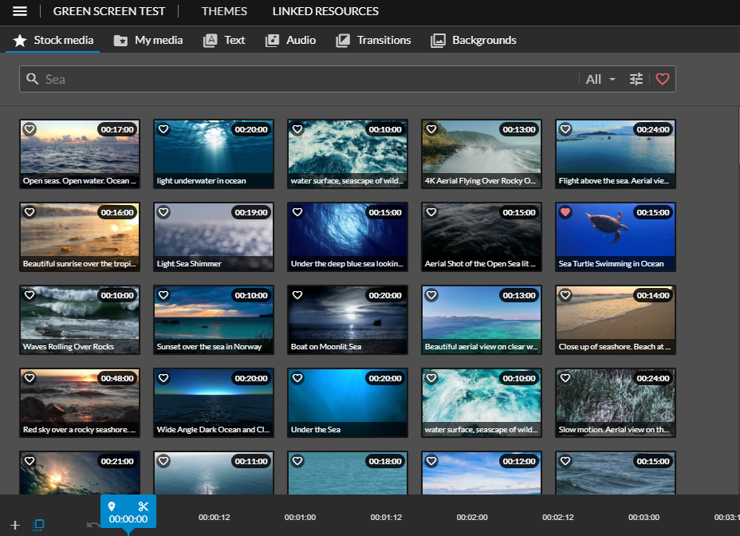
Media Libraries in WeVideo
Bryn Mawr’s license includes access to the WeVideo Stock Media, with 650,000+ royalty-free videos, images, and audio assets you can use in your projects and finished videos.
Click the Stock Media tab (star icon) in the media library area of the video editing screen to access it.

Slide 11

Exporting Your Completed Video
Go to your Dashboard, find the project and click Edit.
Click the Finish tab.
Give the finished video a title.
Select a resolution. Keep in mind that the higher the resolution, the larger the storage size.
Choose the screen image from the video that you want to be the thumbnail.
Click Finish.

Slide 12
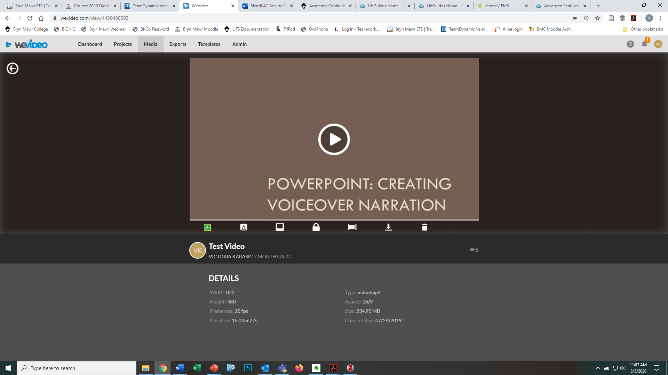
Sharing Your Exported Video
Click on the Exports tab.
Double-click on the video to open it.
Click the appropriate Share button to share to Facebook, Twitter, or to get a link or an embed code that you can paste into a Moodle site, web page, etc.
You can also click the Download icon to download the video file to your device and then upload the file into a video streaming site (e.g. Youtube) or file sharing site (e.g. OneDrive) to share it.

Slide 13
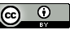
A Note about Copyright…
creative commons licenses and citing sources
Where to find reusable media?
Search for media that have flexible copyright licenses, such as Creative Commons
Choose “safe search” option in search engines for images that you can use and adapt
Create a “credits” section at the end of your video, providing links/references to any sources you’ve used
Videos/Audio
Harvard’s guide to finding public domain media
Moving Image Archive (via Internet Archive)
YouTube (Use Creative Commons filter)
Images
Google Images (use Usage Rights filter)
Flickr Commons
Unsplash.com
Wikimedia Commons

Slide 14
Further WeVideo Help and Tutorials
https://www.wevideo.com/academy
http://techdocs.blogs.brynmawr.edu/category/working-with-multimedia-files/wevideo
https://www.linkedin.com/learning/teaching-future-ready-students/advanced-editing-with-wevideo?resume=false&u=76958498

