Slide 1
Chapter 1: Science, Society, and Social Work Research

Slide 2
Reasoning About the Social World
Was Burt typical of the homeless?
What is it like being homeless?
Why do people become homeless?
How do homeless people adapt to temporary shelter?
What programs are effective in ending homelessness?

Slide 3
Reasoning About the Social World
Our decisions are driven by:
Personal Biases
Previous Experiences
Differing Expectations
Cultural Background

Slide 4
The Social Scientific Approach
Scientific research is designed to avoid ‘every day errors’ (such as resistance to change, selective/inaccurate observation, overgeneralization)
This approach can be used to investigate:
Treatment effectiveness
Social conditions
Organizational behavior
Social welfare

Slide 5
Definition: Social Science
“The use of scientific methods to investigate individuals, groups, communities, organizations, societies, and social processes; the knowledge produced by these.”

Slide 6
Social Work & the Social World
Social work responds to negative conditions present in our social world.
Through scientific investigation, we can understand the causes of social problems and implement better interventions.

Slide 7
Social Work & the Social World
Intervention models can be tested as well.
Social workers can learn what models are most effective.
Research allows us to understand real people and not rely on stereotypes.

Slide 8
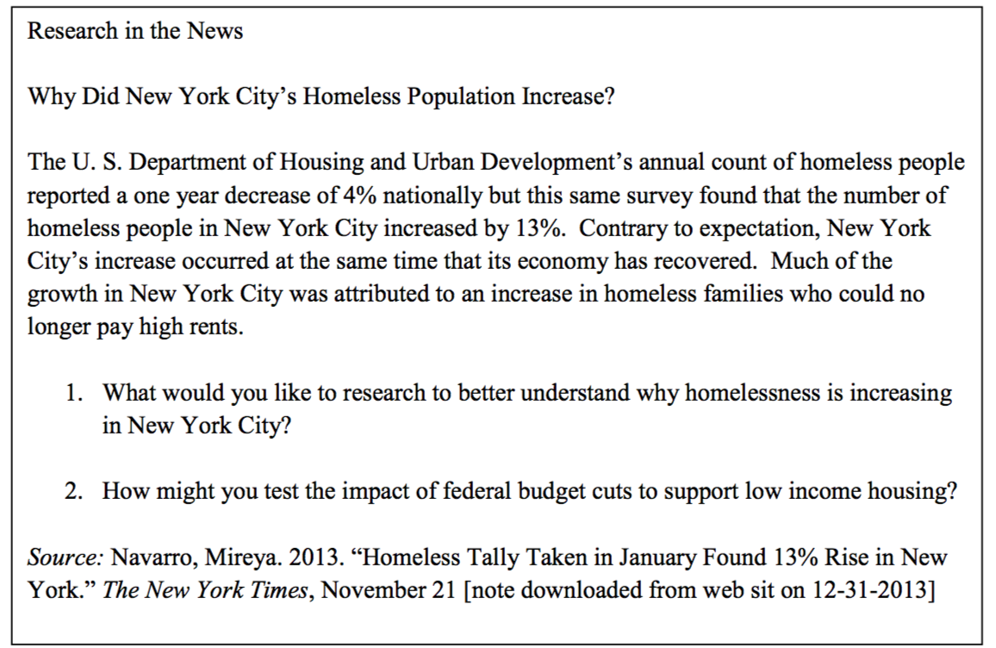
Research in the News: Why Did NYC’s Homeless Population Increase?

Slide 9
Social Work Research and Evidence-Based Practice
Evidence-Based Practice includes:
Best Current Research Evidence
Client Values
Client Circumstances
Clinical Expertise

Slide 10
Social Work Research and Evidence-Based Practice
EBP Decision Making Process:
Convert need for information into an answerable question.
Locate the best clinical evidence to answer question.
Critically evaluate the research evidence.
Combine critique with clinical expertise with client values and circumstances.
Evaluate effectiveness in decision-making process to improve future use.

Slide 11
Social Work Research and Evidence-Based Practice
Barriers to EBP Implementation:
Inadequate Agency Resources
Inadequate Research Skills
Restrictive Agency Guidelines
Attitudes towards Research
Inadequate Supervision

Slide 12
Social Work Research in Practice
Descriptive Research
Gathering the facts
Ex: Who are the homeless?
Exploratory Research
Understanding a social phenomenon
Ex: How do the homeless adapt to shelter life?

Slide 13
Social Work Research in Practice
Explanatory Research
Identify relationships between phenomenon
Ex: What community-level factors cause homelessness?
Evaluation Research
Outcome assessment to improve interventions
Ex: Should housing or treatment come first?

Slide 14
Research Orientations
Quantitative and/or Qualitative
Researcher or Participatory Centered

Slide 15
Quantitative vs Qualitative
Attribute | Quantitative | Qualitative
Aims | Precision; Generalizability; Testing hypotheses | Deeper understandings; describing contexts; generating hypotheses
Nature of data emphasized | Number | Words
Types of designs and methods commonly used | Experiments; Quasi-experiments; Single-Case designs; Surveys | Ethnography; Case studies; Life history; Focus groups
Data-gathering instruments emphasized | Closed-ended items in questionnaires and scales | Open-ended items and interviews with probes
Data analysis process | Calculate statistics that describe a population | Search for patterns and meanings in narratives

Slide 16
Community Based Participatory Research
Encourage partnerships between academic researchers and community members.
Helps to strengthen validity of findings and translate research findings into relevant practice/policy changes.
Community is involved from question development to analyzing data to disseminating findings.

Slide 17
Asset Mapping as a Research Tool for Community-Based Participatory Research in Social work (Lightfoot et al, 2014)
Asset Mapping: procedure used in CBPR
Also aligns well with strengths-based approach used in SW
Originated in community development
“In the ABCD approach, a community explores, describes, and maps its assets and then uses these assets to develop solutions to a specific social issue within the community…” (pg 59).
Differs from deficit orientation

Slide 18
Social Work Research in a Diverse Society
Cultural norms impact the research process:
Identifying participants
Ascribing meaning to abstract terms and constructs
Collecting data
Interpreting findings

Slide 19
Research as Social Justice (Lorenzetti, 2013)
Confidentiality vs invisibility
Going beyond traditional approaches (e.g. interviews) to include other forms of research interaction
Reflect on one’s social positioning (reflexivity – biases, struggles, and intent)
Promote “people to be self-empowered to speak for themselves and provide guidance on how to address social issues from the standpoint of having lived the experience that is being studied” (p 454).

Slide 20
Research as Social Justice
Environmental Racism:
One example: Trash incinerators
Research demonstrated instances of lead among other toxins and related health effects
Research combined with activism
(https://www.wbur.org/hereandnow/2016/04/22/destiny-watford-goldman-prize / https://www.wbur.org/hereandnow/2019/04/25/baltimore-waste-incinerator-garbage )

Slide 21
Research as Social Justice
ER IDT recognized physical, emotional, and social needs of young people exposed to violence as a public health crisis
Saw high rates of re-injury and retaliation among youth in Philadelphia and found “The time after traumatic injury is referred to as the ‘golden hour.’ While in the emergency department, those who have been violently injured report that their thoughts are to either change their way of life or to retaliate.”
Developed Healing Hurt People which connects individuals with a range of services from medical follow-up; to counseling and mentoring; to housing, job placement, and substance abuse treatment.
(https://drexel.edu/medicine/about/departments/emergency-medicine/healing-hurt-people/)

