Slide 1
Chapter 2: The Process of Social Work Research

Slide 2
Social Work Research Questions
Identifying SW Research Questions
  Sources:
    Personal Encounters
    Professional Experience
    Academic Discussion
    Social Theory
    Already Published Research

Slide 3
Social Work Research Questions
Gradually Develop Your Question
Refining SW Research Questions
  A successful research inquiry must be:
    Workable
    Testable
    Narrow

Slide 4
Social Work Research Questions
Evaluating SW Research Questions:
  Does the question have:
    Social Importance
    Scientific Relevance
    Feasibility

Slide 5
Diversity in Question Formulation
When creating a research question, be aware of:
  Personal biases
  Weakness-based language
  Demographic stereotypes

Slide 6
Foundations of Social Work Research
Searching the Literature
  Peer Reviewed Scholarship
  Use the Internet to Your Advantage
Reviewing Research

Slide 7
Searching the Literature
Specify Research Question
Identify Appropriate Databases
Create Broad Keywords List
Narrow Search
Use Boolean Search Logic
Use Appropriate Subject Descriptors
Check Results
Locate Articles

Slide 8
Reviewing Research
Two Step Process:
  Describe and Assess Each Article Separately
  Review the Implications of the Entire Set of Articles;
    Write a Literature Review

Slide 9
Writing the Literature Review
A Literature Review Contains:
  Background on the Social Issue
  Summary of Prior Research
  Critique of Prior Research
  Presentation of Pertinent Conclusions

Slide 10
Systematic Reviews
Integrate a scientific methodology into the literature review process
Goal: provide better information about the impact of an intervention

Slide 11
Theory and Social Work Research
Theories provide additional frameworks and ideas to test and evaluate.
Popular theories in SW:
  Behavior theory
  Cognition theory
  Resource mobilization theory
  Resource dependency theory
  Human capital theory

Slide 12
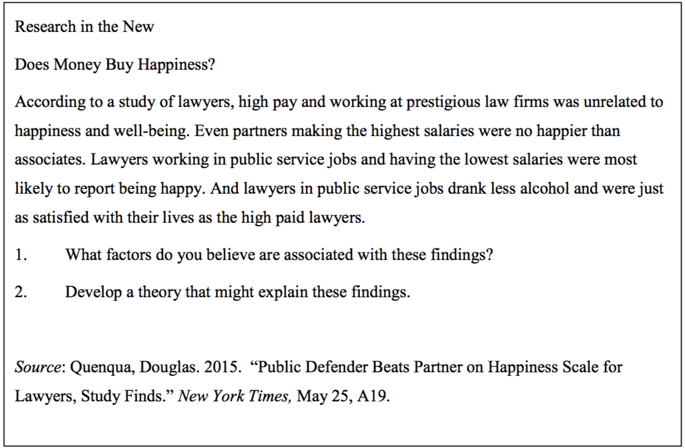
Does Money Buy Happiness?

Slide 13
Research Strategies
Deductive Research
Inductive Research
Descriptive Research

Slide 14
Research Strategies
Deductive Research
  Tests implications of pre-existing theory
  Quantitative focus
  Hypothesis testing

Slide 15
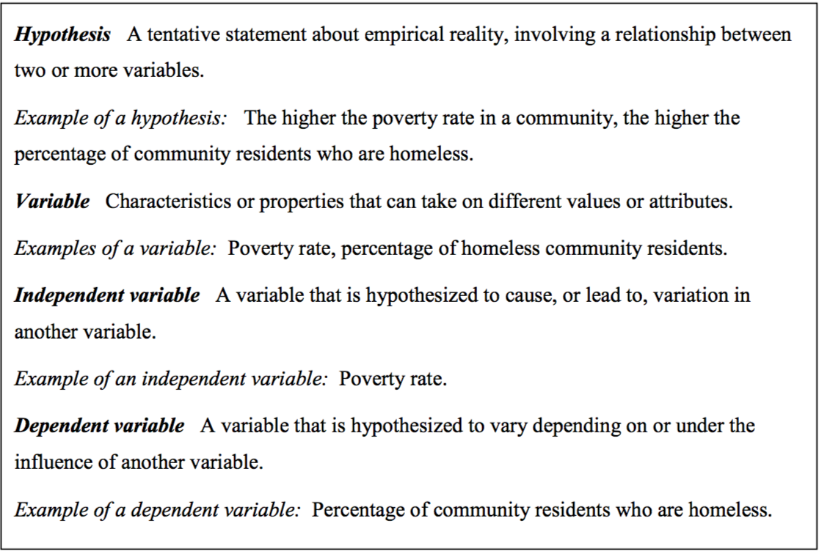
Deductive Research

Slide 16
Domestic Violence and the Research Circle
[1984] Sherman and Berk
Testing a Theory
Analyzing Data to
Develop Theory

Slide 17
Research Strategies
Inductive Research
  Creates theory from collected data
  Qualitative focus
  Serendipitous findings
  Exploratory research
Descriptive Research
  Deepens understanding of an issue

