Slide 1
Chapter 4: Measurement

Slide 2
Concepts
Concepts: Mental images that summarize similar observations, concepts, or ideas.
⬇
Conceptualization: Working out what our key terms mean in research.

Slide 3
From Concepts to Observations
Operationalization: the process of understanding what is measured, how the indicators are measures, and the rules used to assign a value to what is observed and to interpret the value.

Slide 4
Example: Concept to Observation
Alcohol Abuse -> define using DSM diagnosis -> measure using Michigan Alcoholism Screening Test (MAST)
What is another example of a concept, general definition, and measure?

Slide 5
From Concepts to Observations
Scales: a composite measure based on a sum or average of responses, creating a more complete measure of the concept than any single component question.

Slide 6
Examples of Scales
The ASSIST provides information about: the substances people have ever used in their lifetime; the substances they have used in the past three months; problems related to substance use; risk of current or future harm; level of dependence; and injecting drug use.
Beck Anxiety Inventory is a 21-item self-report measure of anxiety.

Slide 7
Cautionary Scales
Understand the scale:
  Each question might not be measuring the same concept.
  Some questions in a scale may cluster together in subsets.
  Questions can be weighted unevenly in a scale.

Slide 8
Popular Scale Types
Likert scales
  Measure the extent to which respondents hold a particular attitude or feeling. The scores are summer or averaged.
  Beck Anxiety Inventory
  Unable to relax 0 1 2 3
  Nervous 0 1 2 3
  Hands trembling 0 1 2 3

Slide 9
Treatment as a Variable
Treatments must be explicitly detailed and defined nominally.
Descriptions of treatment must also provide a full synopsis of the actual operationalization of the intervention.

Slide 10
Gathering Data
Direct measures
Inference measures
  Interviews, self-administered scales and questionnaires
Previously collected quant. data
  Government and large research bodies

Slide 11
Gathering Data
Data derived from primary documents
  Longhand client records; clinical documents
Unobtrusive measures
  Physical traces of past behavior and content analysis of social media and popular culture

Slide 12
Combining Measurement Operations
Triangulation: Use of two or more different measures of the same variable; can make an even more accurate measurement by utilizing multiple sources and methods to draw conclusions.

Slide 13
Measurement in Qualitative Research
Inductive approach to the process of conceptualization
  Data is collected
  Data is reviewed
  Reorganized to craft a theory

Slide 14
Levels of Measurement
Levels of measurement become more and more informative
Nominal Level
Ordinal Level
Interval Level
Ratio Level

Slide 15
Nominal Level of Measurement
Groupings/categories
Categories must be mutually exclusive and exhaustive
Nominal measures can be counted
Example: Eye color, yes/no questions, relationship status

Slide 16
Ordinal Level of Measurement
Assigned in a specific order
No standard measurable difference between response options
Categories must be mutually exclusive and exhaustive
Can be counted (frequency/percent can be reported)
Example: Education – Less than high school, high school graduate, some college, college graduate; likert scale

Slide 17
Interval Level of Measurement
Fixed measurement units and ordered responses with no “absolute zero”
Standard measurement between points (Gaps between numbers on the scale are meaningful)
ME&E
Data collected can be used in higher statistical analysis
Example: Temperature in F, wealth

Slide 18
Ratio Level of Measurement
Fixed measuring units with an absolute zero
ME&E
Data collected can be used in higher statistical analysis
Example: Number of children in a family, years of education, income

Slide 19
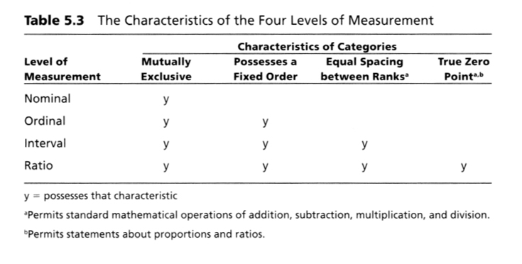
Summary characteristics of the four levels of measurement
(Sullivan, T.J., & Dejong, C.R. (2007). Applied social research: A tool for the human services. 7th Ed. Florence, KY: Brooks/Cole/Cengage, p. 109)

Slide 20
Special Cases and Words for the Wise
Dichotomies: Variables with only two possible values.
Try to measure variables at the highest level possible as it will provide the largest number of statistical and analytic options.

Slide 21
Measurement Error
Systematic error: consistent bias, can be accounted for with mindfulness and awareness during research.
vs.
Random error: unpredictable in terms of effects.

Slide 22
Table 5.1 Elements in the Process of Measurement (X = T +E)​
X​ Observation​ | =​ =​ | T​ True Phenomenon​ | +​ +​ | E​ Error​ | ​
Reading on a weight scale​ | =​ | Your actual weight​ | +​ | Clothing you are wearing​ Heavy object in your pocket​ | ​
Grade on an examination in social research class​ | =​ | Actual knowledge you acquired in social researchclass​ | +​ | Heat and humidity in test room​ Distraction due to fight withpartner​ | ​
Score on a scale measuringself-esteem​ | =​ | Your actual level of self-esteem​ | +​ | Incorrectly marking a self-esteem scale​ Questions on self-esteemscale that are difficult tounderstand​ | ​

Slide 23
Types of Systematic Errors
Social desirability
Acquiescence bias
Leading questions
Differences in subgroup responses based on gender, age, or race

Slide 24
Assessing Measurement Accuracy
Reliability: measurement procedure yields equivalent scores when the phenomenon being measured is not changing.
Types: Test-Retest Reliability, Internal Consistency, Alternate-Forms Reliability, Inter and Intrarater Reliability

Slide 25
Test-Retest Reliability
How closely related are the measurements of a fixed phenomenon at two points in time?
Strong score: .7
Very strong score: .8+

Slide 26
Test-Retest Reliability
Assumptions:
  Nothing affecting the phenomenon of interest changes in the time period between tests.
  The subject isn’t affected by testing conditions (testing effect).

Slide 27
Internal Consistency
How closely associated are separate measures of a single concept in a scale?
Ways to test internal consistency:
  Split-half reliability
  Summary scores
  (Cronbach’s alpha)

Slide 28
Alternate-Forms Reliability
How closely do the responses to similar questions correspond?
The higher the level of correspondence, the higher level of reliability, the better the scale is.

Slide 29
Interrater Reliability
Different observers, using the same instrument, rate the same phenomenon.
How similar are these ratings?
Higher levels of similarity gives the researcher higher levels of confidence in the scale itself.

Slide 30
Intrarater Reliability
Single observer assesses an individual at two or more points in time.
How consistent is the observer over time?
Higher levels of consistency gives the researcher higher levels of confidence in the scale itself.

Slide 31
Measurement Validity
Definition: the extent to which measures actually measure what they’re supposed to.
Types: Face Validity, Content Validity, Criterion Validity, Construct Validity

Slide 32
Validity: Face and Content
Face Validity: Are we confident the measure appears valid?
Content Validity: Does the measure cover the full range of the concept’s meaning as understood by experts and the literature?

Slide 33
Validity: Criterion
Are our measure’s scores similar enough to scores of already validated measures of the same phenomenon?

Slide 34
Validity: Construct
Is our measure related to other measures as specified in relevant theory?

Slide 35
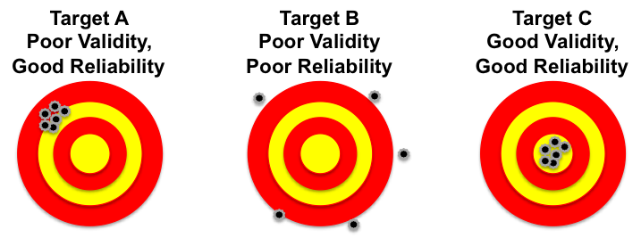
Validity & Reliability

Slide 36
Ways to Improve Reliability and
Validity of Existing Measures
Engage potential respondents in group discussions about the questions to be included in the survey.
Audiotape test interviews during the pretest phase of the survey.

Slide 37
Using Scales to Identify a Clinical Status
Cut-off score: defines the presence of absence of a particular condition.
Validity determined by comparing scale’s classification with established evaluation methods or to an already-known conclusion.

Slide 38
Using Scales to Identify a Clinical Status
True Negative: scale and evaluation agree client doesn’t have the condition.
True Positive: scale and evaluation agree client has the condition.
Try to minimize false negatives and positives (where scale and evaluation disagree on diagnosis).

Slide 39
Using Scales to Identify a Clinical Status
Sensitivity: Number of people assessed to have a condition divided by the actual number of people with the condition.
Specificity: Number of people assessed to not have the condition divided by the actual number of people who don’t have the condition.

Slide 40
Outcomes of Screening Scale Versus Clinical Assessment
Actual diagnosis for the clinical condition
 | Client does not have clinical condition | Client has clinical condition
Assessed as not having condition | True negative | False negative
Assessed as having the condition | False positive | True positive
Screening Results

Slide 41
Measurement in a Diverse Society
Conceptual equivalence
Operational equivalence
Item equivalence
Scalar equivalence

Slide 42
Measurement Implications for Evidence-Based Practice
Administration of the Scale
Cost
Sensitivity to Change
Acceptability

