Slide 1
Chapter 5: Sampling

Slide 2
Sample Components and the Population
Population: Entire set of individuals (or other entities)
Sample: A subset of the population of interest
Element: Individual members or other entities of the sample

Slide 3
Sample Components and the Population
Sampling frame: list that contains all the elements of the population that are selected.
Enumeration units: units that contain 1+ elements that are listed in the sampling frame.

Slide 4
Sampling Units
Sampling Units: units listed at each stage of the multistage sampling design.

Slide 5
Evaluate Generalizability
Sample Generalizability
Cross-population Generalizability
Depends on sample quality, determined by the amount of sampling error.
Projecting findings onto groups or populations much larger than/different from those actually studied.

Slide 6
Assessing Population Diversity
Representative Sample: a sample whose characteristics are distributed similarly to that of the overall population.

Slide 7
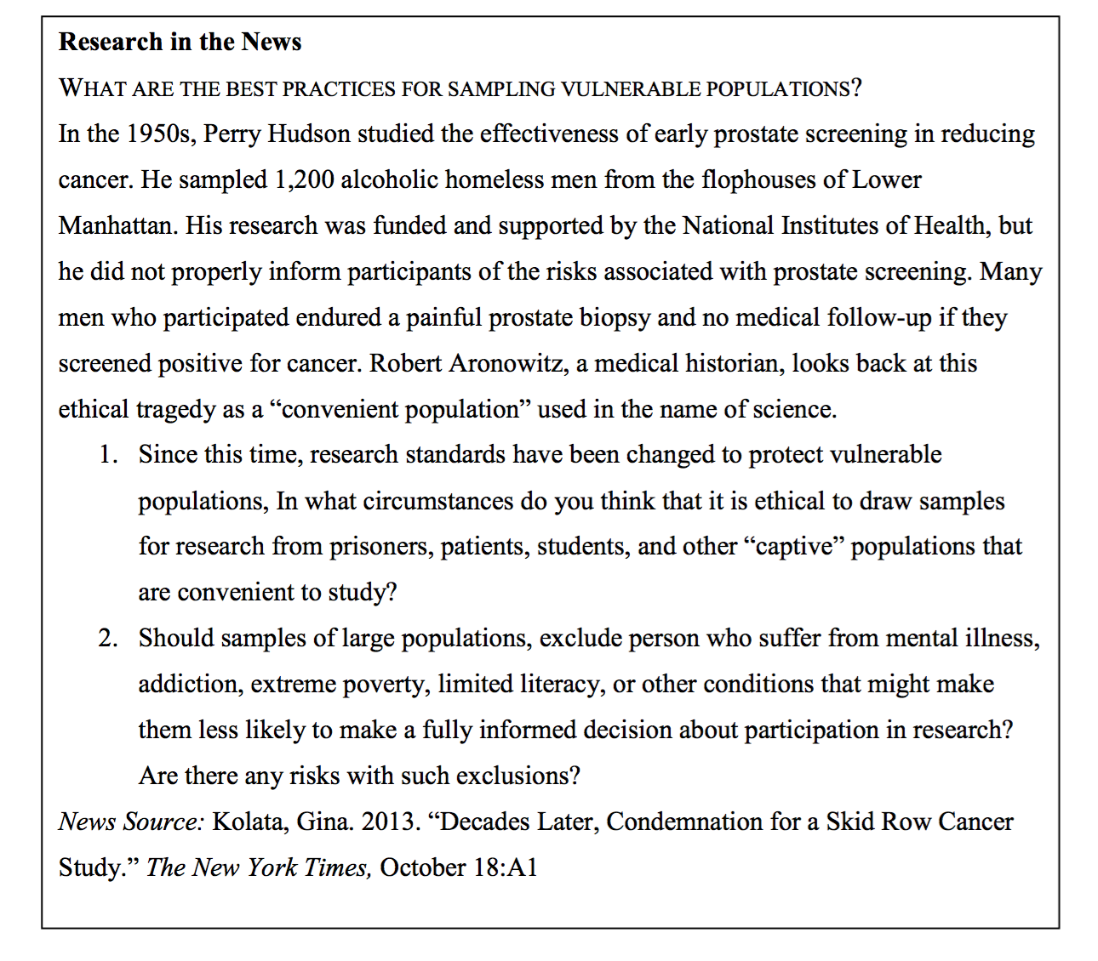
Research in the News
What are the best practices for sampling vulnerable populations?

Slide 8
Sampling Methods
Random Sampling
Probability Sampling Methods
Simple Random Sampling
Systematic Random Sampling
Stratified Random Sampling
Cluster Sampling

Slide 9
Random Sampling
Random Sampling: elements are selected only on the basis of chance (the probability of selection).
Systematic Bias: elements other than chance that are present in the selection process.

Slide 10
Probability Sampling & Methods
Probability Sampling: How likely is it that any element of a population will be selected for the sample?
Probability Sampling Methods: Those in which probability of selection is known and not zero.

Slide 11
Probability Sampling Methods
Larger the sample, the more confidence we have in the sample’s representativeness.
More homogenous the population, the more confidence we have in the representativeness of a sample of any size.

Slide 12
Probability Sampling Methods
Simple Random Sampling
Systematic Random Sampling
Stratified Random Sampling
Cluster Sampling

Slide 13
Simple Random Sampling
Sample Random Sampling: some procedure generates numbers or otherwise identifies cases strictly on the basis of chance.
ex: random numbers table, random digit dialing
Key characteristics: probability of selection is equal for each element.

Slide 14
Systematic Random Sampling
Variant of simple random sampling
Step 1: Total # of cases in population are divided by # of cases required for the sample (sampling interval).
Step 2: # inside sampling interval is randomly selected.
Step 3: Every nth case is selected, beginning with the randomly selected value plus the sampling interval.

Slide 15
Stratified Random Sampling
Related to simple random sampling; elements are grouped based on prior known population strata, chosen randomly within each group.
Types:
Proportionate stratified sampling
Disproportionate stratified sampling

Slide 16
Cluster Sampling
Elements selected from 2+ states, random selection of naturally occurring clusters and random selection of elements within clusters.
Cluster: naturally occurring, mixed aggregate elements in a population.

Slide 17
Comparing Probability Sampling Methods
What is the best type of sampling to use?
Depends on research goals AND data being collected.

Slide 18
Nonprobability Sampling Methods
Availability Sampling: elements chosen out of convenience to researcher.
Quota Sampling: sets element-based quotas to ensure better population representation.
Purposive Sampling: elements each chosen for specific reason or purpose.
Snowball Sampling: early elements lead researcher to more elements.

Slide 19
Nonprobability Sampling, Qualitative Research, and Generalizability
In order to increase generalizability in nonprobability sampling, a researcher must:
Study the typical, not the convenient or unusual.
Perform multisite studies to confirm localized results.

Slide 20
Determining Sample Size
Larger sample sizes decrease sampling error.
Samples of homogenous populations can be smaller than samples of diverse populations.
More analysis anticipated from research, the larger the sample must be.

Slide 21
Recruitment Strategies with Diverse Populations
Build credibility by involving key community members and organizations
Use culturally adapted procedures
Demonstrate community benefit in research
Recognize and account for cultural barriers and differences

