Slide 1
Theory in Research

Slide 2
Theory in your research proposal
In the conceptual framework section of your proposal, you will connect your area of research with a theory informing this area of inquiry.
You should use a trauma theory in this section, and if there is not a specific trauma theory applicable to your area of interest (for example, war refugee trauma), you can combine it with one additional theory for a total of two integrated theories articulated within one conceptual framework informing your approach.
In writing this section, you will connect your proposal’s specific aims, variables and their operationalization, with the theory informing this area of research.

Slide 3
Theory and Frameworks
Theory: a coherent group of principles, concepts and ideas organized to explain some observable occurrence or trend.
  Explain some aspect of social life or enrich our sense of how people conduct and find meaning
Paradigm: A model or frame of reference that shapes our observations and understandings

Slide 4
Example: Embedding caregiver support in community-based services for older adults: A multi-site randomized trial to test the Adult Day Service Plus Program (ADS Plus)

Slide 5
Common Conceptual Models & Frameworks
EcoBioDevelopmental Framework
Ecological model (Bromfrenbrenner)
Intersectionality

Slide 6
Ecobiodevelopmental Framework
The Ecobiodevelopmental (EBD) Framework was developed to account for a larger ecology of development. EBD illuminates that exposure to stress can impact both the emotional, educational, and economic outcomes of an individual in their lifetime, and have a detrimental effect for generations to come.
The EBD framework suggests three key findings:
  The influence of early risk/protective factors impact capacities and coping skills needed to deal with later challenges;
  The impact of significant adversity that emerge in early childhood;
  The preventative benefits of stable, responsive relationships which assist children in developing a sense of safety, thereby facilitating the restoration of their stress response systems to baseline.
Notes:
“The EBD framework suggests three key findings:
Early experiences with significant stress are critical, because they can undermine the development of those adaptive capacities and coping skills needed to deal with later challenges;
The roots of unhealthy lifestyles, maladaptive coping patterns, and fragmented social networks are often found in behavioral and physiologic responses to significant adversity that emerge in early childhood;
The prevention of long-term, adverse consequences is best achieved by the buffering protection afforded by stable, responsive relationships that help children develop a sense of safety, thereby facilitating the restoration of their stress response systems to baseline.”

Slide 7
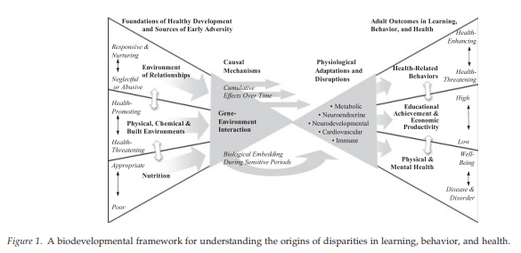
(Shonkoff, 2010)

Slide 8
Eco Model
Concept from Systems Theory & Ecological Perspective
Systems theory is used to describe and analyze people and other living systems and their interaction
Also recognizes the importance of the person in their environment
Microsystem: The system closest to the person in which they have the most direct contact
Mesosystem: The interactions between the different parts of a person’s microsystem
Exosystem: A setting that does not involve the person as an active participant, but still affects them
Macrosystem: The cultural environment in which the person lives and all the other systems that affect them
Chronosystem: The dimension of time in relation to a person’s development

Slide 9
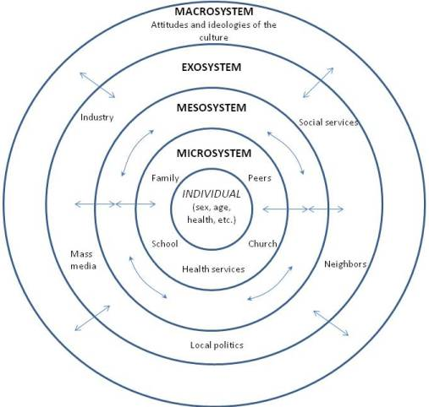

Slide 10
Intersectionality
Intertwined factors create overlapping systems of discrimination and disadvantage that affect individuals' experiences.
Crenshaw proposed the term intersectionality, a framework for examining how factors of social stratification, such as gender, age, race, class, and sexual orientation, are not separate, but are intertwined.
The effects of these multiple, overlapping social forces cannot be fully understood independently but must be understood in combination.

Slide 11
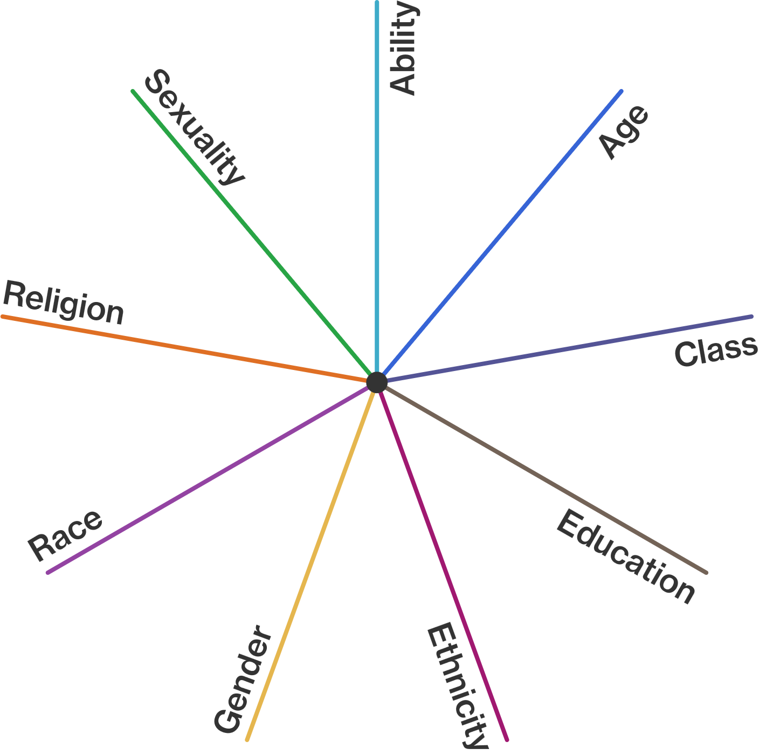

Slide 12
Trauma Theories (Psychodynamic/humanistic)
Herman (1992): “Examined the possible developmental reasons as to why processing of traumatic events may be impossible for some people”
  Herman suggests abuse in childhood is an important vulnerability factor in the subsequent development and maintenance of adult psychopathology.
Janoff-Bulman (1992): Assumptive World Theory
  Three sets of assumptions (1) the benevolence of the world; (2) meaningfulness of the world (3) worthiness of the self.
  These concepts may be ‘shattered’ by exposure to an uncontrollable and shocking traumatic event. The inability to integrate the new ‘world view’ produces psychopathology

Slide 13
Trauma Theories (Psychodynamic/humanistic)
Horowitz (1976, 1979): Built on Freud’s work
  Proposed an information processing model, suggesting that until traumatic memories can be assimilated and successfully integrated, the cognitive and affective elements of the event would remain in the active memory storage.
  This could lead to “representations of the traumatic event on all levels of cognitive functioning, sometimes breaking through as emotionally upsetting, intrusive and uncontrolled images.”
Elliott et al (1998): Start with understanding how drastically the client’s perceived world has been transformed by the trauma
  Life divided into three phenomenological ‘moments’: before, during, and after
  Two conceptual components:
    emotional processing conflict model : re-experiencing is seen as the human tendency for a need to resolve and master important painful or interrupted emotional experiences
    trauma-related emotion schemes model: comprising changes in the client’s views of the world, others, and self in terms of dangerousness, unpredictability, vulnerability…

Slide 14
Trauma Theories (Contemporary cognitive/behavioral)
Rachman (1980): Model of Emotional Processing (not specifically related to traumatic memory processing)
  Understands emotional processing as a process whereby “emotional disturbances are absorbed, and decline to the extent that other experiences and behavior can proceed without disruption” … “if an emotional disturbance is not absorbed satisfactorily, some signs become evident…”
  Signs can include obsessions, nightmares, difficulty with concentration…
Foa, et al (1989): Uses Cognitive Theory
  Examine the meanings individuals attach to events
  Suggest that the trauma causes the individual to lose their basic assumptions the world is safe and predictable
  Propose an information processing model where individuals strive to give meanings of the event by interpretation of the traumatic event and attribution of blame.
  Traumatic event often forms a fear network in memory – for successful resolution of the trauma the information in the fear network must be integrated with existing memory structures.

Slide 15
Trauma Theories (Neuroanatomical)
Neuroanatomical research is providing empirical evidence for the theoretical basis
https://developingchild.harvard.edu/science/key-concepts/toxic-stress/

Slide 16
Resources
(You are not limited to these theories/models)
Eco Model:
  Bronfenbrenner, U. (1979). The ecology of human development. Cambridge, MA: Harvard University Press.
Intersectionality:
  Crenshaw, Kimberle (1989). Demarginalizing the Intersection of Race and Sex: A Black Feminist Critique of Antidiscrimination Doctrine, Feminist Theory and Antiracist Politics, University of Chicago Legal Forum: Vol. 1989: Iss. 1, Article 8
Biodevelopmental Framework:
  Shonkoff, J P. 2010. Building a New Biodevelopmental Framework to Guide the Future of Early Childhood Policy. Child Development 81(1): 357–67
Trauma Theory:
  Rose, S (2002) Theoretical approaches to psychological trauma: Implications for research and practice. Counselling and Psychotherapy Research 2: 61-72.

Slide 17
Questions to ask
In the research I’m reading is there a common theory applied? Or are there competing theories (a variety of theories referenced)?
How do the main concepts in my research question fit in to the theory?
When I research the theories are there critiques to consider?

