Slide 1
Research Methods
Overview
Mini Lecture
Preparing the Research Methods Section for the Final Research Proposal
Fall 2020

Slide 2
This section is composed of three sub-sections:
• Measurement/s
• Sampling/study participants
• Recruitment Measurement
In this sub-section you will write about the way in which you will measure the variable/s you conceptualized in the Conceptual Framework section

Slide 3
Measurement
In this sub-section you will write about the way in which you will measure the variable/s you conceptualized in the Conceptual Framework section.
You will:
describe the standardized scales that you propose to use, including information about its potential sub-scales (or sections), items, scoring, and application to your population of interest
include information about the scale reliability and validity. All this information should be supported by references

Slide 4
Sampling and study participants
In this section you include detailed information about:
who will participate in your study (inclusion criteria)?
who will not participate (exclusion criteria)?
what is your sampling strategy?

Slide 5
Recruitment measurement
In this sub-section you will describe:
how will you actually collect the data for your study (including the study design)
describe when, where, and by whom will your data be collected
information about your consent process
information about the qualifications and training of the research assistants helping with your project (if any)

Slide 6
Let’s apply our understanding
Examples

Slide 7
Descriptive Study example

Slide 9
Sample & Recruitment
“Using purposive sampling, a total of 145 street youth (ages 18–24) were recruited in Los Angeles, California (n = 50); Denver, Colorado (n = 50); and Austin, Texas (n = 45) from host agencies as part of a larger study on homeless youth."
“Agency recruitment sites included drop-in centers offering case management, referral services, and basic subsistence items (food, hygiene supplies); shelters offering short-term (40 days) residential services, counseling, and General Educational Development (GED) preparation courses; and transitional housing offering temporary (6 months) apartment-style residential services. Human participants’ approval was received by each principal investigator’s (PI) university Institutional Review Board.”

Slide 10
Inclusion & Exclusion Criteria
“Inclusion criteria comprised (a) being 18 to 24 years of age, (b) spending at least 2 weeks away from home in the month before the interview, and (c) providing written informed consent. “
“Youth were excluded if they were incapable of comprehending the consent form because of cognitive limitations (psychotic symptoms or developmental delays) or if they were noticeably intoxicated or high at the time of the interview.”

Slide 11
Other Relevant aspects
Youth were compensated with a US$20 gift card for a local food vendor.
Graduate research assistants were trained by the PIs at each site on interviewing techniques, particularly approaches to interviewing homeless youth, to ensure consistency in the data collection process.

Slide 12
Standardized measure
“The Childhood Trauma Questionnaire, a standardized 25-item measure, asked youth to indicate how often specific traumatic experiences had happened to them before leaving home (Bernstein, Fink, Handelsman, & Foote, 1994). Four subscales included (a) Physical Neglect (e.g., I didn’t have enough to eat; I had to wear dirty clothes), (b) Emotional Abuse (e.g., I felt that someone in my family hated me; I thought my parents wished I had never been born), (c) Physical Abuse (e.g., I was punished with a belt, board, cord, or some other hard object; people in my family hit me so hard it left me with bruises or marks), and (d) Sexual Abuse (e.g., someone molested me; someone tried to make me do sexual things or watch sexual things). Responses to each item were recorded as 1 = never, 2 = rarely, 3 = sometimes, 4 = often, 5 = very often, with higher numbers indicating more frequent abuse or neglect. In reporting results for individual items, items were dichotomized such that 0 = never and 1 = rarely or more often. The Cronbach’s alpha for each subscale ranged from .75 to .96.”

Slide 13
Experimental Research example

Slide 14
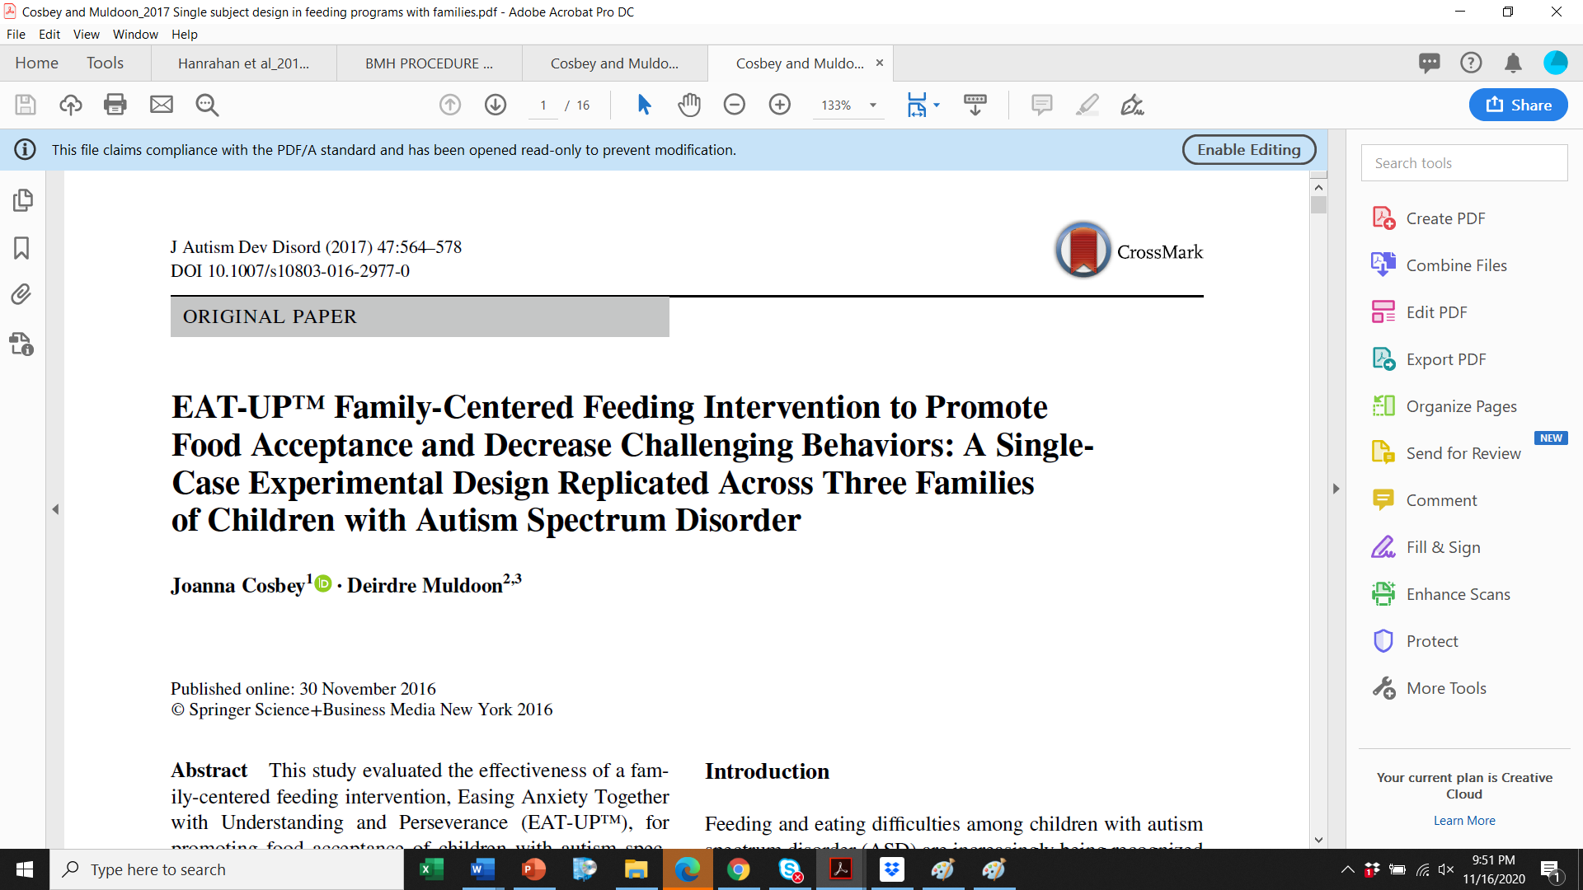

Slide 15
Problem – issue statement & Purpose statement – primary data example
Feeding and eating difficulties among children with autism spectrum disorder (ASD) are increasingly being recognized as an integral part of the disorder.
There is limited information regarding the efficacy of multicomponent interventions that are implemented by parents using these established evidence-based practices.
The purpose of this preliminary study was to expand on the research previously done and to determine the efficacy and perceived intervention acceptance (social validity) of EAT-UP ™, a parent-implemented multicomponent intervention package designed to improve the mealtime performance of children.
This study specifically examined the efficacy of EAT-UP ™ with children with autism spectrum disorder (ASD).

Slide 16
Measurement – primary example data
Parent’s behaviors were collected during every session throughout the study.
Researchers developed coding sheets to document the food available to the child and the interception of the child with the food.
To assess the acceptability of the intervention strategy by the child’s parent, a goodness-of-fit survey was distributed to parents before and after the intervention.
The Family Quality of Life scale was used to evaluate the quality of life for families.

Slide 17
Measurement continued – primary example data
Significant behavior difficulties were assessed using the Brief Autism Mealtime Behavior Inventory (BAMBI).
Once completed screening and approved for study, participants were then provided with more information and consent form provided to voluntarily participate in this study.
The study used a mixed-method quantitative design where single-case experimental design and pre-/post- measure to document changes in child and parent behavior over time were measured.
These two types of data collection allowed for triangulation of findings, providing support for the conclusion through parent report and direct observation.
Prior to the onset of intervention and again after the completion of the intervention phase, each child’s mother completed questionnaires, the child behavior was assessed using BAMBI and the Behavioral Pediatrics Feeding Assessment Scale (BPFAS).
Child’s food acceptance was measured through the use of a Food Frequency Questionnaire and a 24-hour food recall.

Slide 18
Sample – inclusion criteria – primary data example
Three boys from diverse backgrounds
Diagnosed with ASD, prior to their third birthday by interdisciplinary teams
Met criteria for autism according to the World Health Organization, ICD*-10
To be included in this study:
Family had to live within 30 miles of the clinic
Have a least one parent who was proficient in English
Child had to have a multidisciplinary diagnosis of ASD
Child had to be between the ages of 2 and 9 years old
Have no medical contraindications for oral feeding
Have significant behavioral difficulties around meal-times
*International Classification of Disease (ICD)

Slide 19
Sample recruitment – primary data example
The children were recruited from a statewide interdisciplinary feeding clinic. Families were provided information about the study and completed a screening to determine eligibility for participation.
Because of the age and language abilities, the children were not asked to provide assent. Otherwise, consent forms were obtained from all individual participants included in the study.

