Slide 1
Lecture Series:
Preparing your Research Proposal Paper
Background/Problem Statement
Research Informed Practice I
Mary Florence Sullivan

Slide 2
Agenda
Review the Paper Assignment Guidelines
Core Components of Background/Problem Statement
Example to analyze the Background/Problem Statement
Practice developing Background/Problem Statement
Importance of Background/Problem Statement in social work research

Slide 3
Review of Paper Assignment Guidelines: Background/Problem Statement
2 pages
This section outlines what is known about your area of research as it relates to your focus of practice (macro or clinical) and population of interest.
For the literature review, you will need to review and include information about the following topics:
  Primary sources reporting demographic data related to your population of interest (e.g., US Census Bureau). You can use up to two primary sources for this information.
  Primary sources reporting epidemiological data related to your main trauma- related variable/s of interest (e.g., prevalence) in your population of interest. You can find these data in health, research, advocacy or other related sources (for example, CDC). You can use up to two primary sources for this information.
  Primary sources describing previous research about your topic of interest. Include only peer-reviewed publications. Your review could be positive or negative, depending on the quality of this research. For example, you can then point out limitations/recommendations from an article that you plan to address in your research proposal. You can use up to three primary sources for this section.
  At least one paragraph integrating points (a), (b), and (c), and highlighting gaps in the previous knowledge that justify the need to do your research.

Slide 4
Goals of Background/Problem Statement
Overview of your sources and introduce the reader to information you gathered while researching your topic
How does your research fit into the larger field of social work research? Show why your research proposal is important!

Slide 5
Core Components
Again, the Background/Problem Statement should generate a literature review that outlines what is known about your area of research as it relates to your focus of practice (macro or clinical) and population of interest.
To do this you need to…
Give a critical overview of the sources you are using
  What is missing? If you’re looking at research about your topic, what is the author’s goal? What did they miss? What did they focus on? Why?
  Don’t only summarize the sources
Demonstrate how the sources you’re using fit into your topic of research
  This may not be clear to your readers – make those connections!
  This includes demonstrating the limitations of the sources
You’re not just restating information and prior research – you’re assessing the research with a critical lens and using it to lead into your research question
Purdue Writing Lab (2020)

Slide 6
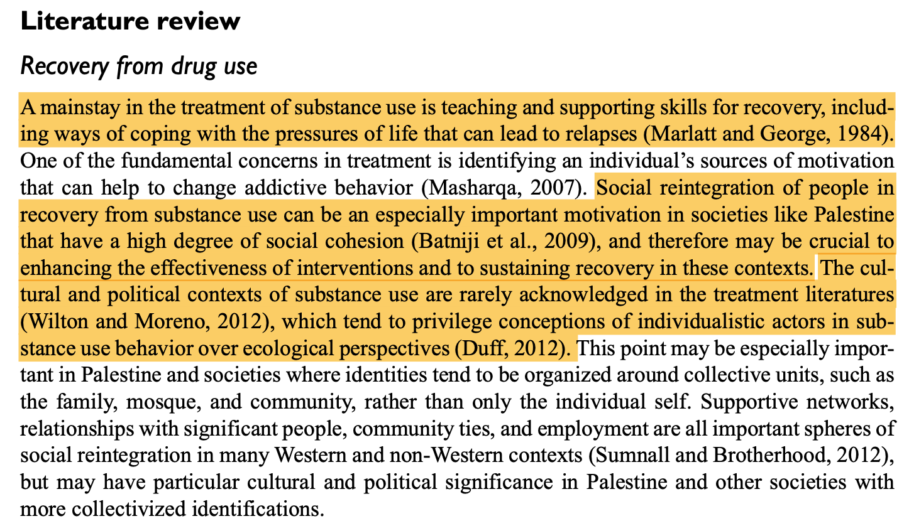
Example
Hreish, et al. (2019)

Slide 7
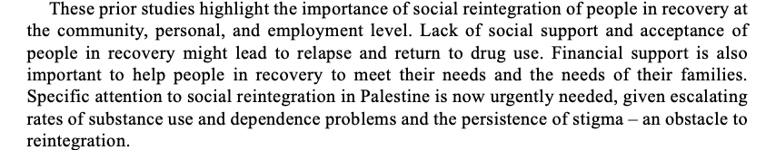
Example
Hreish, et al. (2019)

Slide 8
Practice: Developing Background/Problem
Statement
If you have already started to work on your Background/Problem Statement section…
What is your research question (or topic area) and what are some questions you will be using to guide your background research/literature review?

Slide 9
Why is the Background/Problem Statement important in social work research?
You’re examining and assessing what other researchers have found or haven’t found
You’re giving credit to prior research and developing the foundation for your topic
You’re demonstrating why your research is important – what questions haven’t been answered?
You’re developing new ideas and new questions for future research!

Slide 10
TAs are here to help!
Mary Florence Sullivan
msullivan@brynmawr.edu
https://calendly.com/maryflorencesullivan

