Slide 1
Lecture 9
Cultural Issues in CBT

Slide 2
Overview of Today’s Class
Discuss cultural factors and CBT

Slide 3

CBT and Aspects of Culture
Cultural relativity
Cultural messages about rules, attitudes, and one’s worth
Cognitive approaches to oppression
Notes:
facets of culture to consider (above)
Will discuss each separately, but first want to look at the messages that culture sends to people that they may then internalize

Slide 4
Cultural Relativity
Albert Ellis stated, ‘‘What is deemed ‘rational’ by one person, group, or community can easily be seen as being ‘irrational’ by another person or group.’’
Notes:
Don’t assume anything. Always ask the client for their perspective, as well as the cultural messages they’ve received.
(1995, p. 85)
Examples:
Emphasis on separation/individuation vs. collectivists cultures’ ideas of normal adolescent development
Assertiveness training vs. respect training
Autonomy vs. interconnectedness
Logic vs. intuition
“For example, Euro-Americans value assertiveness and have determined that a certain degree of it is essential for one's mental health, and not having enough of it constitutes a problem. Thus, psychotherapists offer assertiveness training for clients who are "deficient" in this important quality. Although there are ethnic groups, including many Native American, Latino, Asian, and Arab cultures, in which the quality of respect is more highly valued than that of assertiveness, psychotherapists have yet to develop "respect training" for individuals who lack this quality in their interactions with others.” P 313, hays 1995
ASK: WHERE DO WE RECEIVE MESSAGES ABOUT OTHER CULTURES?
Fables and fairy tales
Parents and other family
School
Media (advertisements, movies)
Religion
Celebrities

Slide 5

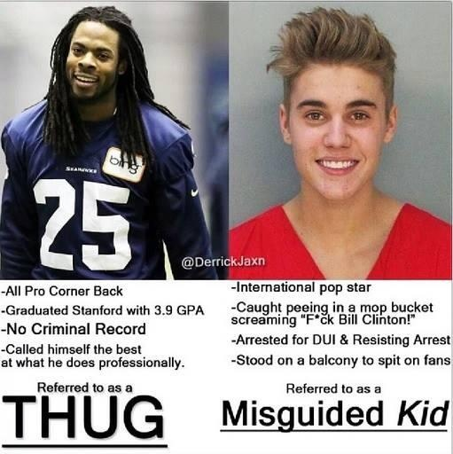
Cultural Messages
http://mic.com/articles/80797/watch-how-fox-news-really-talks-about-black-america

Slide 6
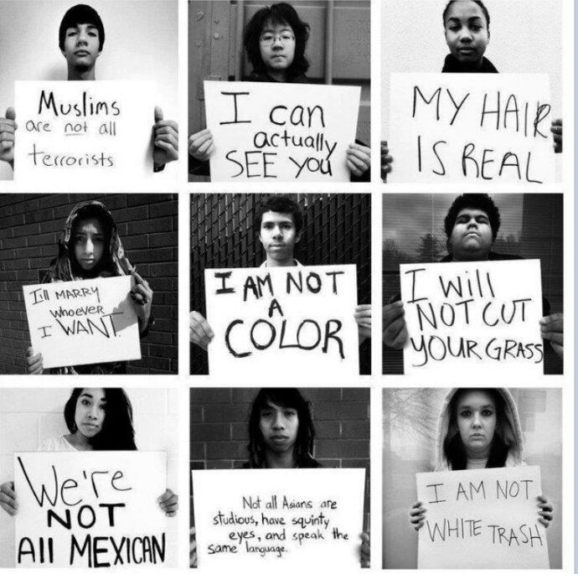
Cognitive Approaches to Oppression
“-isms” (racism, heterosexism, sexism, etc.) generally arise from cognitive distortions
  Overgeneralizations
  All-or-nothing thinking
  Labeling
Oppressed groups may internalize such messages
http://afrocentricityunleashed.files.wordpress.com/2012/12/wpid-screenshot_2012-12-27-23-32-31-1.png
Notes:
Xenophobia, racism, sexism, homophobia and other forms of discrimination or hatred rely on “logical fallacies” – “cognitive errors” – and those are overgeneralization and all-or-nothing thinking (met one “bad” person from a group so all are bad)
Review Handout

Slide 7
Please review your assigned article.
What intervention was presented in your article and how does it connect to CBT?
What are some key takeaways and key terms?
What are some of the strengths/weaknesses of this article?
What are some of the implications or reflections for us as social workers?
Notes:
Let’s look at some specific intervntions

Slide 8

What are the pro’s and con’s of using CBT with marginalized and oppressed communities?
http://mpadegree.org/what-are-the-pros-and-cons-of-a-career-in-public-administration/
Notes:
BREAK INTO DISCUSSION GROUPS – with people you’ve not been with yet
From readings (Ford-Paz & Iwamasa):
“This belief that CBT is universally applicable, culture-free, value-neutral, or color-blind…has come about from practice-oriented research that historically has focused on people of middle class, heterosexual orientation, and European American descent.” (p. 80).
Pros:
Empowerment oriented
Collaborative
“Short-term, problem-focused, present-oriented nature also may be appealing to cultural and ethnic minority groups” (p.. 81)
View behaviors as functional or dysfunctional, not good or bad
Cons:
Lack of effectiveness studies with cultural minorities
“CBT’s emphasis on cognition, logic, verball skills, and rational thinking as therapeutic tools is influenced by American and European cultural values” (p. 80) – other cultures may “attend more to context and relationships, rely on more experience-based knowledge instead of logic, and show more tolerance for contradiction”
Focus on individual (vs. collectivism)
Assertiveness skills, disputation, and direct expression of thoughts may conflict with cultural values
Incorporation of written assignments and bibliotherapy not ideal for people for whom English is a second language or people with little formal education
Focus on present might “prematurely discount the client’s history, such as the experience of racism, and neglect useful information about culture-based life experiences” (p. 81)
CBT has “not directly addressed the impact of racism and oppression on ethnic minority clients by creating explicit strategies to deal with these negative sociocultural influences” (p. 82)
Emphasis on “changing individual-level variables (thoughts and behaviors) in order to effect therapeutic change and adapt to current environmental conditions…neglects unfair, discriminatory environmental factors” (p. 82)
ALSO:
Emphasis on rational vs. irrational can lead to people being expected to change thoughts instead of situation – BUT distressing thoughts might not be irrational. The reading (p. 100) gives example of a Latino student thinking, “It’s not fair that the teacher gives me detention when I speak Spanish in school” and correctly notes that this is not a cognitive distortion, but instead an accurate label of oppression. So then problem solving, not cognitive restructuring, can ensue. Or cognitive restructuring can be used to generate a coping skill and productive self talk – NOT to change cognitions.

Slide 9
Resources
https://www.youtube.com/watch?v=nXIrlxub1FY

Slide 10

Questions?
Comments?

Slide 11

End of class exercise
Notes:
Graditude

