Slide 1
Comparing Descriptive Statistics
Normal Distribution & Z scores
Research Informed Practice II

Slide 2
Agenda
Survey Responses/Review Measures of Central Tendency
Normal Distribution
Z-Scores

Slide 3
Measures of Central Tendency & Variability
Central Tendency
Typical values of a variable in a dataset
Mode = value with the highest frequency
Median = value in the middle
Mean = average value
Variability
How values vary from typical values
Range- difference between highest and lowest value, plus one
Interquartile range = distance between 75th and 25th percentile
Standard deviation

Slide 4
Comparing Central Tendency & Variability – Years SW Experience
 | 2017 |  | 2018 |  | 2022
 | Num | Comment | Num | Comment | Num | Comment
Mode | 20 |  | 6 |  | n/a | No mode (no repeating responses)
Median | 10.5 | Median is lower than the mode | 6 |  | 10
Mean | 16.17 | Mean is higher than the median, strong positive skew. | 5 | Mean is slightly lower than the median. | 10.4 | Mean and Median are close
Range | 49 | 50-2=48 +1= 49 | 9 | 9-1=8 +1=9 | 21 | 25-1+1 = 25
Standard Deviation | 14.13 | Wide curve | 2 | Narrow curve | 8 | Wide curve
Sample Size (n) | 12 |  | 15 |  | 7
Notes:
Mean pulled higher then the median, high range and high standard deviation considered together indicate we likely have a high number outlier.

Slide 5
Class Responses - Anxiety
*Rounded to whole numbers

Slide 6
Temperature Outside – Possible Outlier
Survey Number | Temperature Outside
1 | 98
2 | 90
3 | 100
4 | 100
5 | 93
6 | 99
7 | 95
8 | 95
9 | 90
10 | 90
11 | 98
12 | 95
13 | 1,000,000,000
14 | 93
15 | 102
Mean: 66,666,756
Median: 95
Mode: 90 & 95

Slide 7
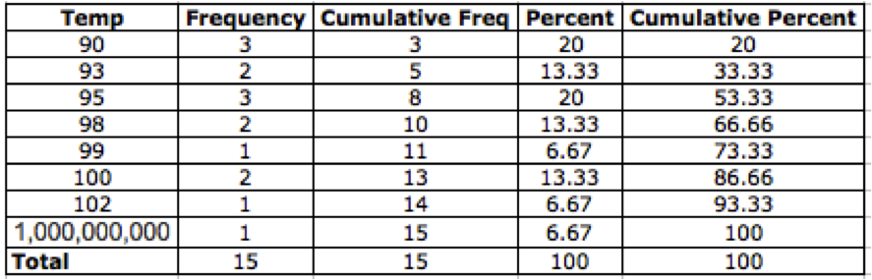
Range: Max-Min+1
1,000,000,000 - 90 + 1 = 999,999,910
IQR: 75th percentile value – 25th percentile value
100 – 93 = 7
Temperature Outside – Possible Outlier Cont

Slide 8
Questions with no variation in answer
Question 7: Did you complete high school?
“yes”
Question 8: What is your level of education?
“Some graduate or finished graduate school”
Notes:
We need variation to be able to run statistical analysis so these questions would not be able to be utilized.
Serves as a reminder to know as much you can about your population. Generally if you are doing a survey for a MSS program you can know that those you are sampling have completed high school and are in process of completing graduate school.

Slide 9
Normal Curve

Slide 10
Normal distributions (or curves)
N is equal to or greater than 30
If a distribution is normal one can:
Determine how many cases fall between two points
Assess relative standing (percentiles)
Compare values from two different samples
Basis for inferential statistics
Can estimate probability of an event happening
Notes:
Image of normal curve on next slide

Slide 11
Properties of a normal curve
Mean = median = mode (represented at highest center point of the curve)
Symmetrical – 50% of data above and below the mean
Bell-shaped
Tails extend toward the X axis
Can be divided into six units that correspond with standard deviation units
3 above and 3 below the mean

Slide 12
Empirical Rule
Given a normal distribution, we can make the following assumptions about values of a variable:
68.26% of values will be within 1 SD unit of the mean (34.13% on either side)
95.44% of values will be within 2 SD units of the mean (47.72% on either side)
99.74% of values will be within 3 SD units of the mean

Slide 13
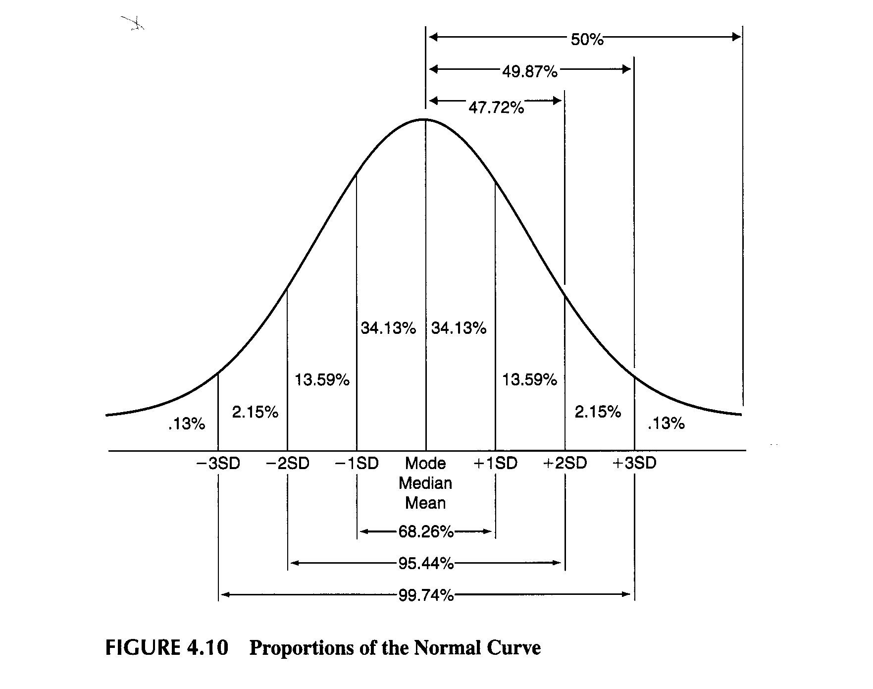
Notes:
What are the properties of a normal distribution?
The mean, median, and mode fall at the same point. Because they fall at the same point, they split the distribution into two equal parts. 50% of the data fall below these values and 50% fall above.
What is the empirical rule?
Describes the proportions of the normal curve. If we have a normal distribution, we know that 68.26% of our data fall within +/- 1 SD, 95.44% fall within +/- 2 SDs, and 99.74% fall within +/- 3 SDs

Slide 14
Using normal curve
Replace SD markers with raw values
To find percent cases between 2 points:
Add/subtract known areas under the curve
To find percentiles:
% of cases equal to or below a particular point
If raw value is above mean → Add 50 to percent between mean and point
If raw value is below the mean → Subtract percent between mean and point from 50
Comparing two groups
Compare percentiles
Notes:
Reminder from last week about how we will be using a normal curve
Reminder from last slide:
Some things to note about the normal curve: The mean, median, and mode are the same and are the highest center point of the distribution.
In a normal distribution, 50% of the data fall above the mean (because it is at the median) and 50% fall below.
It has one mode – uni-modal
It is bell-shaped

Slide 15
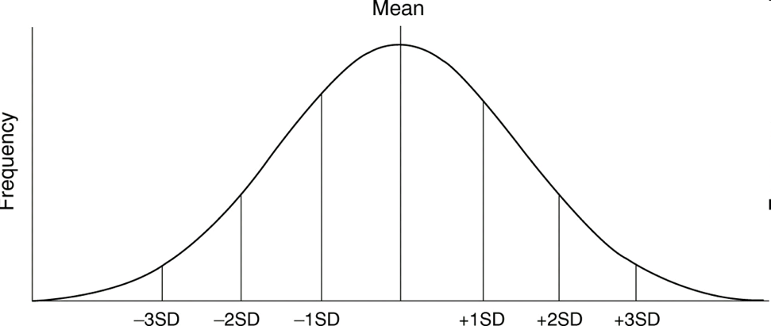
How Can We Use the Empirical Rule?
Sample completes emotional support scale
Mean = 30, SD = 5
.13% 2.15% 13.59% 34.13% 34.13% 13.59% 2.15% .13%
15 20 25 30 35 40 45
Notes:
68.26% of people score between 25 and 35 on the scale
95.44% of people score between 20 and 540 on the scale
2.28% of people score higher than 40
84.13% of people score 35 or less

Slide 16
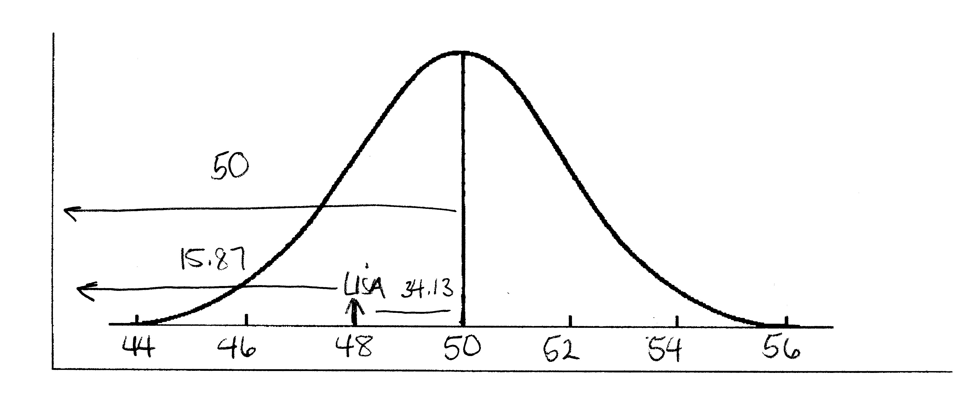
Determining Percentiles – Below Mean
Sample of students complete Anxiety Inventory
Lisa’s Score = 48 (Mean = 50, SD=2)
50 – 34.13 = 15.87
16th percentile
15.87% score the same or less than on the scale
84.13% score higher

Slide 17
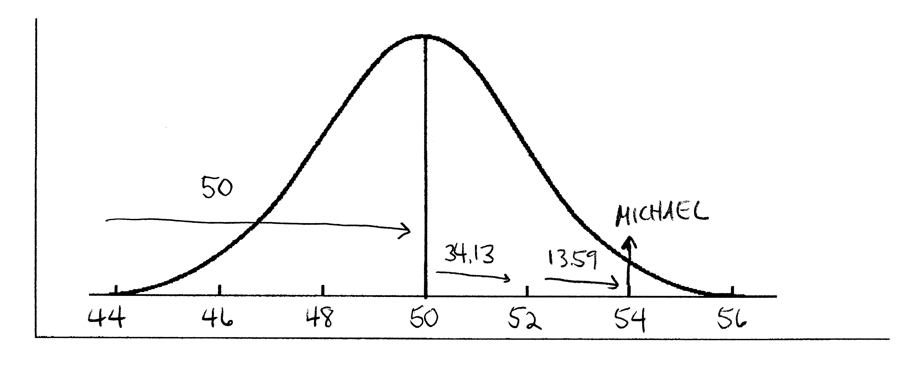
Determining Percentiles – Above Mean
Michael’s Score = 54 (Mean = 50, SD=2)
50 + 34.13 + 13.59 = 97.72 OR 100 – 2.15 - .13 = 97.72
98th percentile
97.72% of people score equal to or less
2.28% of people score higher

Slide 18
Z Score
For when we cannot use the empirical rule.

Slide 19
Z Scores
Z scores use the assumption of the normal curve to turn raw data into standard deviation units
We use z scores to:
Convert scores into percentiles
Find out how many observations fall within a particular range of scores
Compare values from different samples/scales

Slide 20

Z scores
When raw values do not fall exactly on SD markers, MUST calculate a z-score
Positive z score = value that is higher than the mean/area to the right of mean
Negative z score = value that is lower than the mean/area to the left of mean
Formula:
Subtract mean from raw value
Divide by standard deviation
Notes:
Another way to use a normal curve is with z-scores.
A z-score is a measure of standard deviation units. Its value represents how many SD units a value is above or below the mean.
Z-scores are especially important when we want to examine points that do not fall exactly on an SD marker.
For example, if we have a mean value of 20, an SD of 10, and an X value of 22 – at what exact percentile is the value of 22?
Here we would need to calculate a z-score to find out.
In this case, we would take 22-20/10 = .2. So, we have a z-score of .2. We will use a z-score chart to find the corresponding percentage of data that fall between the mean of 20 (z-core of 0) and 22 (z-score of .2).

Slide 21
Steps to z-scores
Before you get started: Draw your curve and mark the value on the curve.
Step 1: Calculate your z-score
Step 2: Find the % associated with your z-score (using the z-table)
Step 3: Mark the percent on the curve (add/subtract as needed)

Slide 22
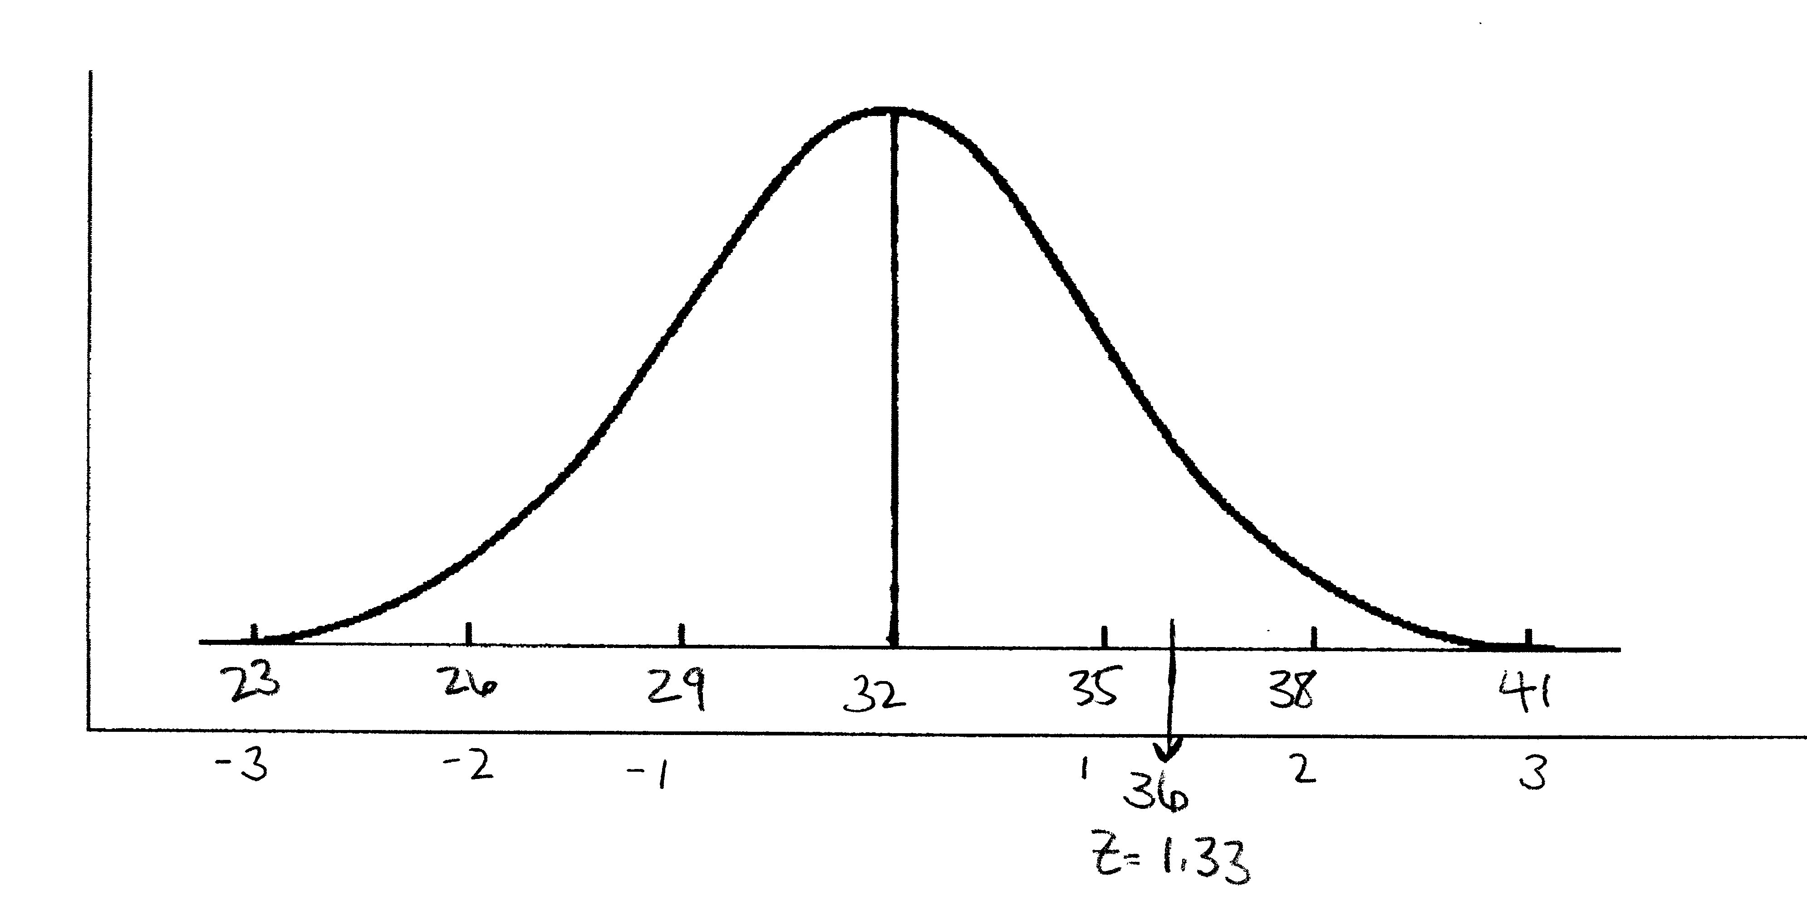
Convert Scores into Percentiles (Step 1: Calculate a Z-Score)
Self-esteem scale (Mean = 32, SD = 3)
Adrian score = 36 (At what percentile is Adrian?)
Z = (36-32)/3 = 1.33 Z-score (or SDs)
Notes:
Practice
Use blank normal curve handouts

Slide 23
Convert Scores into Percentiles (Step 2: Reading a Z-Table)
Z score = 1.33
Find the row for score through 1st decimal point
1.3
Find the column for score from 2nd decimal point
.03
The cell on the table shows % area under the curve between mean and Z score

Slide 24
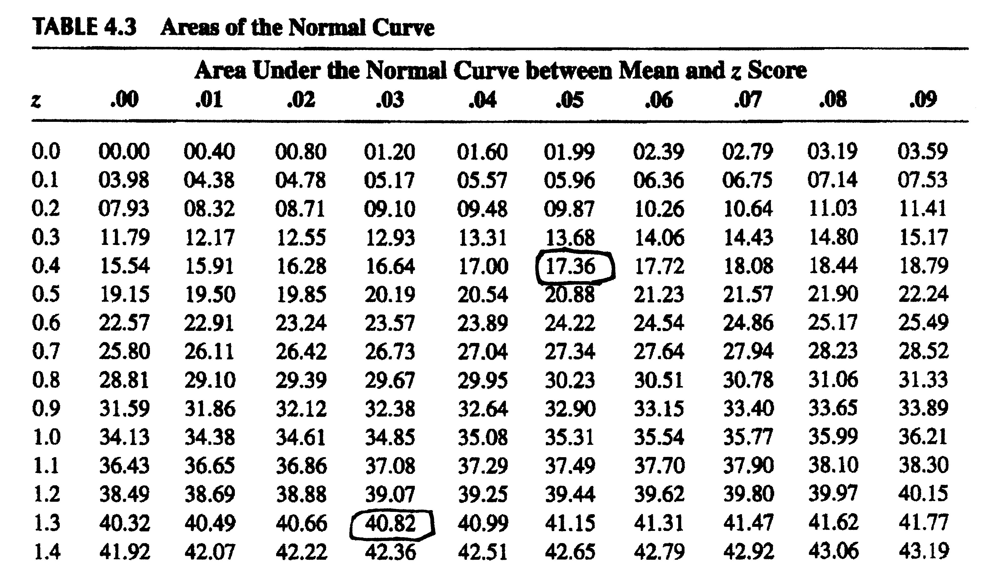
Results
40.82% of cases fall between the mean and a z score of 1.33
Additional Practice: find 0.45
First find “0.4” in the column below “z” then find “.05” in the row next to ”z”
Notes:
To check our answers…

Slide 25
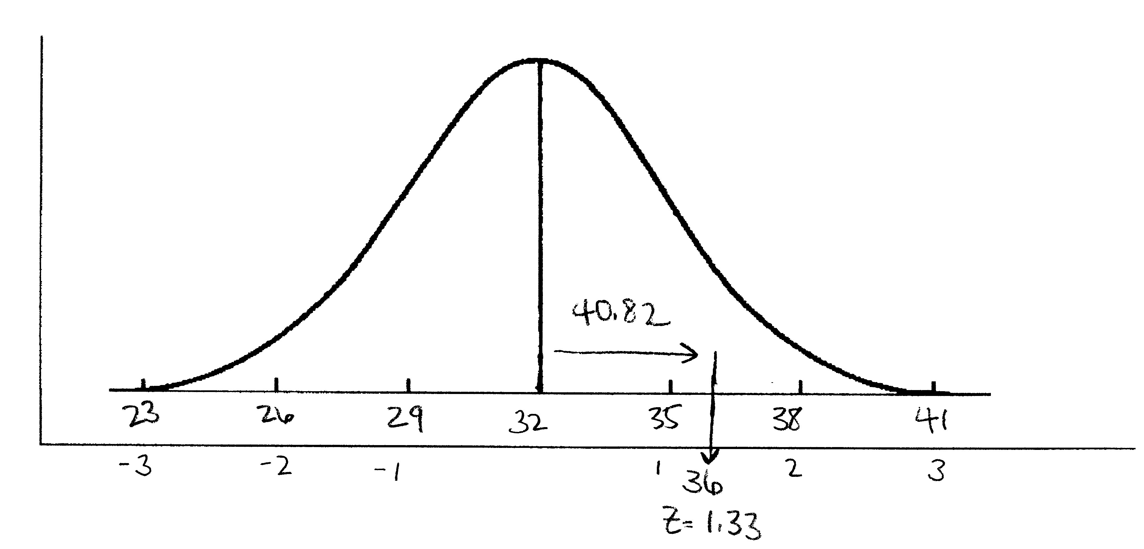
Convert Scores into Percentiles (Step 3: Find overall percent)
40.82% of clients score from mean of 32 to Adrian’s score of 36 on the self-esteem scale
Adrian’s scores places him at the 91st percentile
50 + 40.82 = 90.82%
91% score equal to or lower than Adrian
Only 9.18% score higher than Adrian’s score of 36
<________50%_______>
Notes:
Adrian has a z-score of 1.33 which corresponds to 40.82%. What percentile is Adrian at? We need to add 40.82% to 50% to get this information. We add 50% because Adrian is above the mean of 32. His z-score is also above the mean, it’s a positive number.
When we do this we get 90.82%, rounding we get 91. Adrian is at the 91st percentile, which means that 91% in the sample score equal to or lower than Adrian. We can also say that only 9% score higher than Adrian (or, without rounding, 100-90.82 = 9.18%).

Slide 26
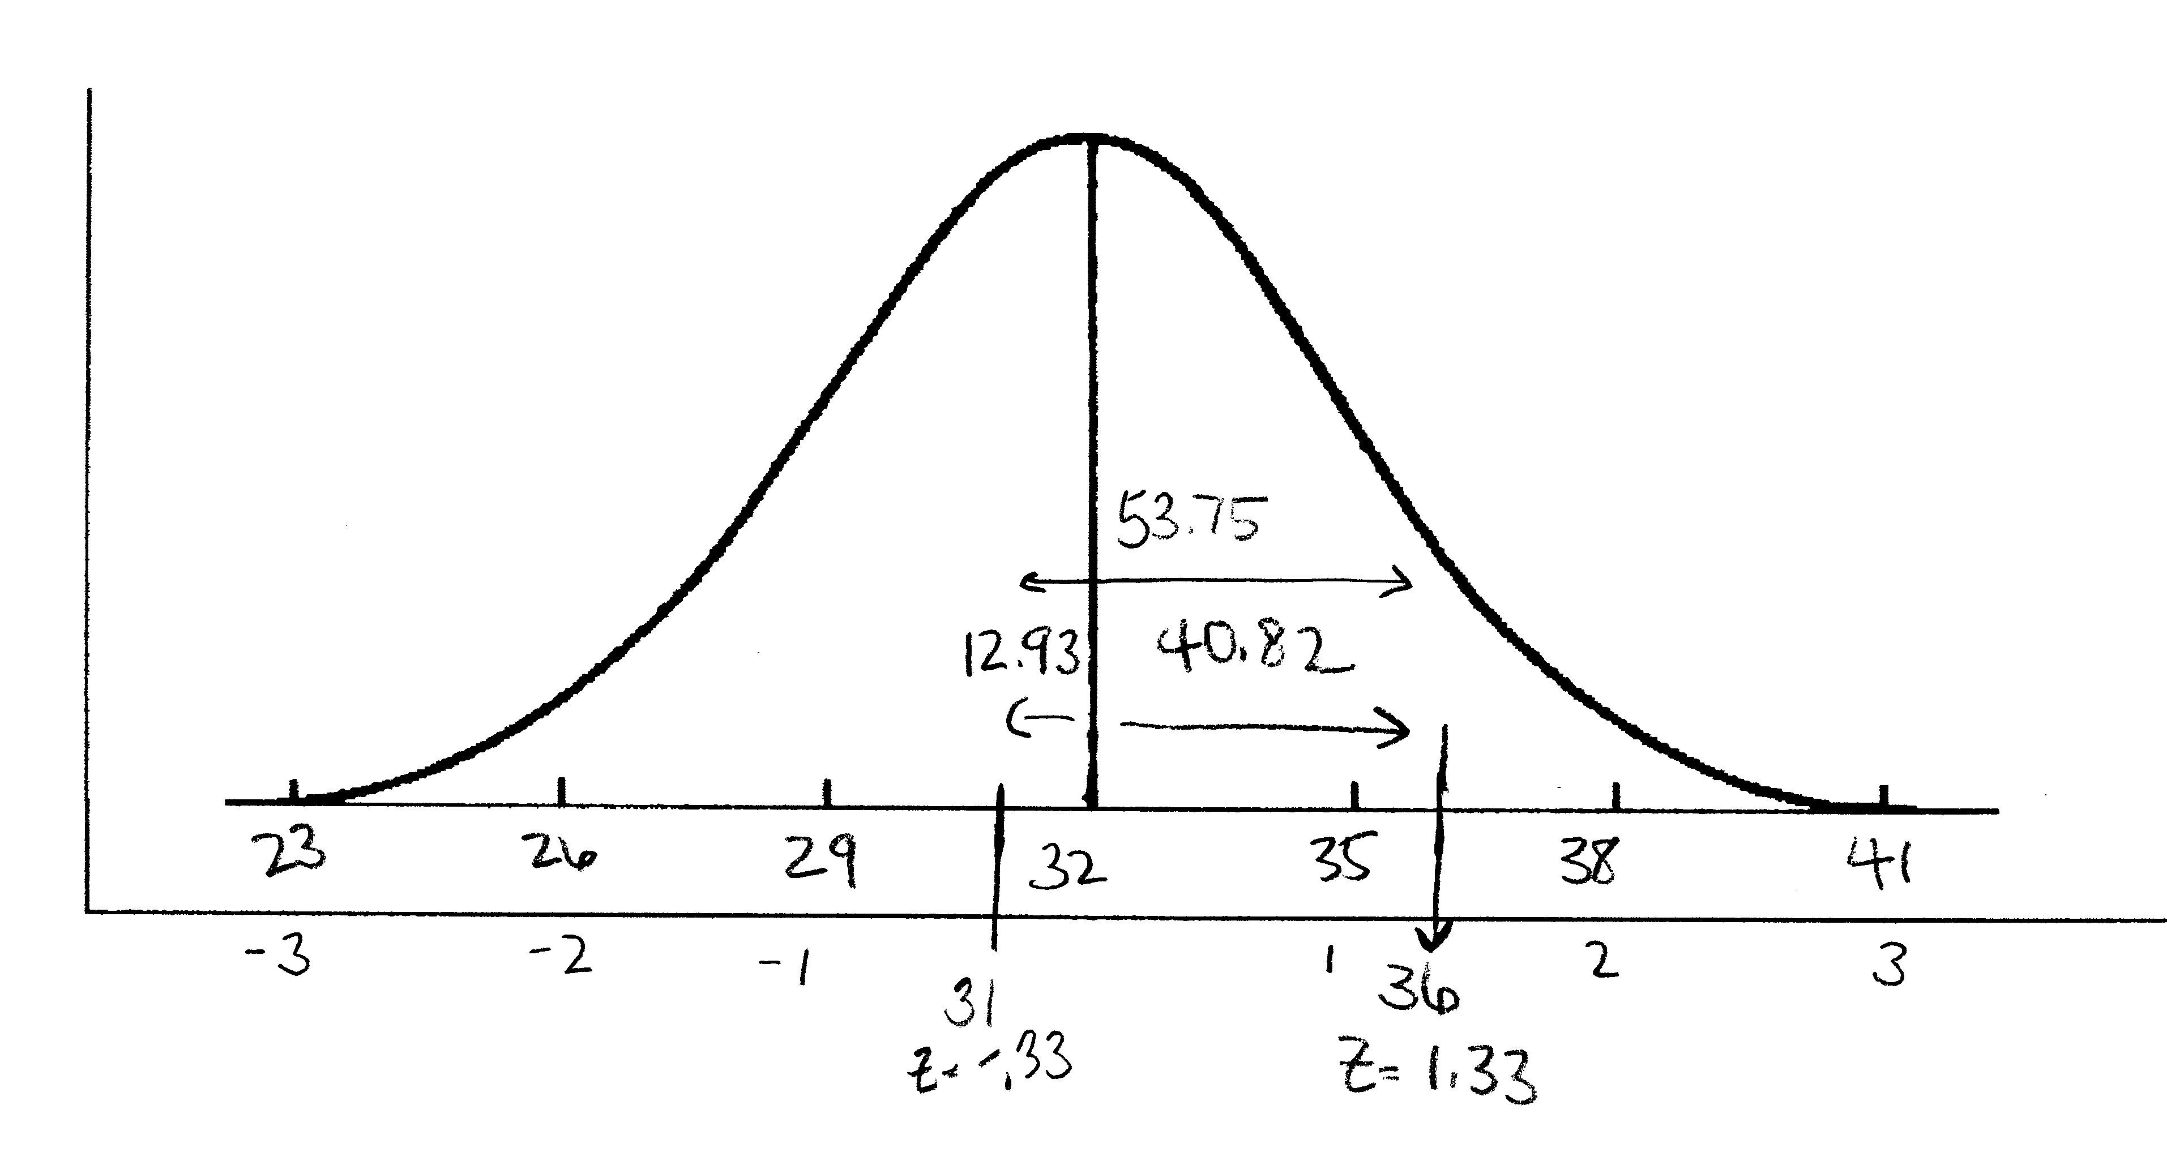
A Second Example: A Score Below the Mean & Percent of Cases Between Two Z Scores
Self-esteem scale (Mean = 32, SD = 3)
Jandy’s score = 31
Z = 31-32/3 = -.33
12.93% of the cases fall between the mean of 32 and Jandy’s score of 31
Jandy is at the 37% of this self-esteem scale (50-12.93=37.07)
Percent cases between self-esteem scores of 31 (Jandy) and 36 (Adrian) is 53.75% (12.93 + 40.82)
Notes:
Now we have some potentially more difficult examples.
We can also find the percentage of data that falls between two z-scores.
Jandy has a score of 31. This is below the mean of 32, so we can expect a negative z-score. When we calculate the z-score we get -.33. When we look up the corresponding value using our z-score table, we see that 12.93% of cases fall in between the mean and Jandy’s z-score.
To get information on Jandy’s percentile, we need to SUBTRACT 12.93 from 50. We subtract from 50 because our score is BELOW the mean. 50-12.93% = 37.07%. Jandy is at the 37th percentile. Or, 37% of people scored at or below 31.
Now, to determine the percent of cases between Jandy’s score of 31 and Adrian’s score of 36, we use their corresponding z-scores.
Jandy had a negative z-score (-.33), or a score below the mean. Adrian had a positive z-score (1.33), or a score above the mean. These scores are on either side of the mean of 32. Remember that our z-score table gives us the percentage of data between the mean and a particular z-score. So, we can find the percentage that falls between these two z-scores by adding their corresponding percentages. If you have z-scores that fall on either side of the mean, add the corresponding percentages together if asked to find percent of cases between them.
By adding 40.82 to 12.93, we find that 53.75% of cases fall between scores of 31 and 36.

Slide 27
Assessing Concerns About Self-Esteem
Who are you more concerned about – Adrian or Jandy?
High values on the scale correspond with high self-esteem
Adrian scores a 36, 91st percentile
Jandy scores a 31, 37th percentile
Notes:
Now, we can make comparisons between percentiles. If higher scores correspond to higher levels of self-esteem, who are you more concerned about?
This might be more difficult to tell when only looking at scores without understanding where they fall in the distribution of scores.

Slide 28
Example 2: Determining Eligibility for Program
Must score in 30th percentile or below on scale
2 students, 2 different scales
Self-esteem scale A (Mean=32, SD=3)
Self-esteem scale B (Mean=5, SD=1)
Student scores on respective scales
Student A = 30
Student B = 4.5
Calculate and compare percentiles to determine who is eligible for the program.
Notes:
Applications to social work practice
Determining program eligibility
Even though we are using two different scales (and scores) here, we can still use percentiles to make comparisons.
For example, we have two distributions. One with a mean score of 32 and an SD of 3. The second has a mean score of 5 and an SD of 1.
We can still compare a score of 30 on the first scale to a score of 4.5 on the second.
Scale A’s score and percentile are calculated on the next slide.

Slide 29
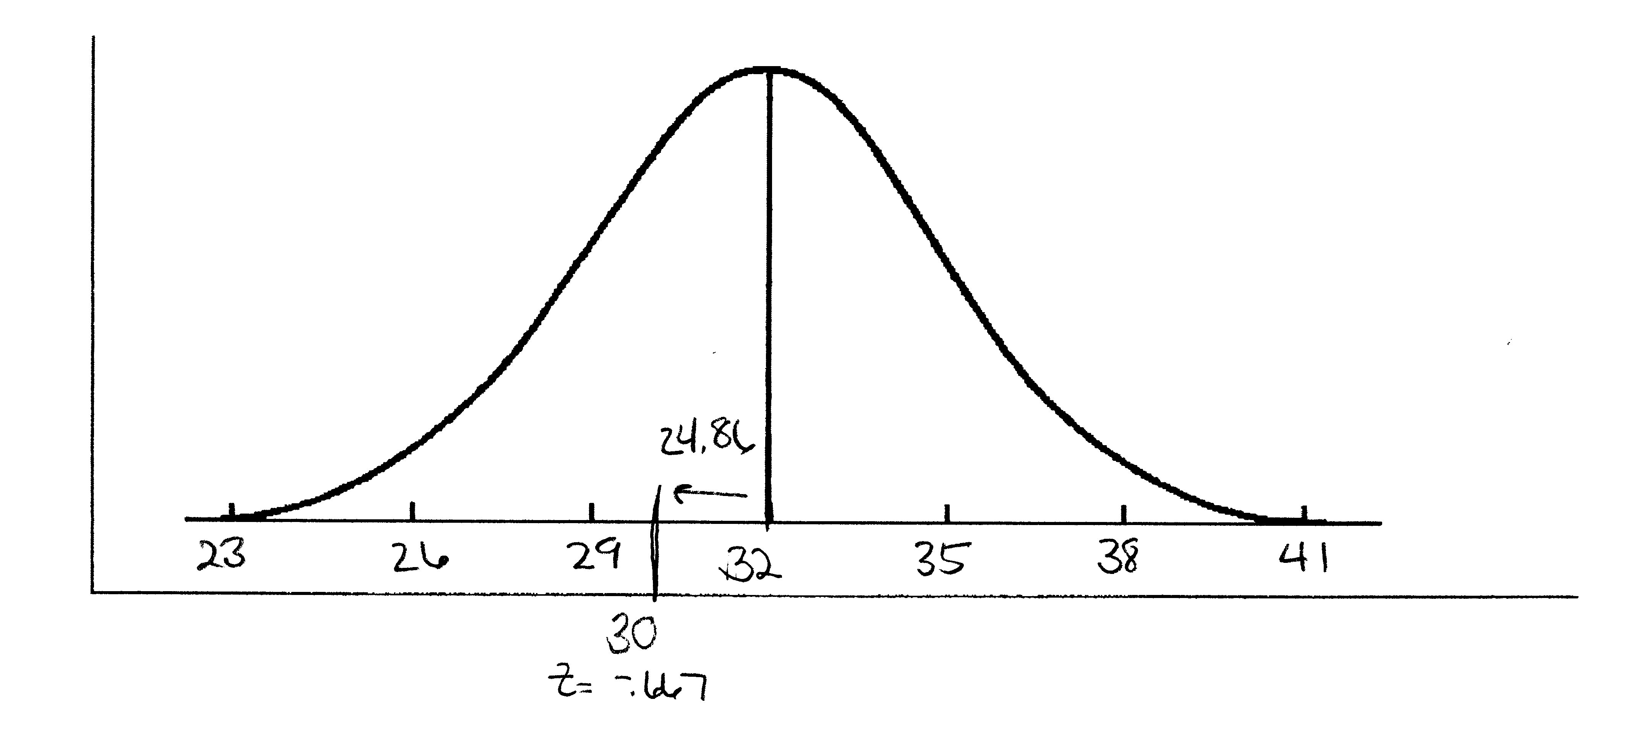
Student A percentile
Student A = 30 (Mean=32, SD=3)
Z = 30-32/3 = -.67 = 24.86%
25th Percentile
50-24.86 = 25.14
<_________50%_________>
Notes:
We use the information on this slide to determine a z-score. To do so we take the x-value – the mean value/ the SD. We get a z-score of -.67. Our score of 30 is below the mean of 32, so we have a negative z-score.
We find that 24.86 corresponds to a z-score of -.67. Remember, we are below the mean, so instead of adding this value to 50%, we will SUBTRACT.
50-24.86% = 25.14% or the 25th percentile.
According to our eligibility criteria, this student is eligible for services.

Slide 30
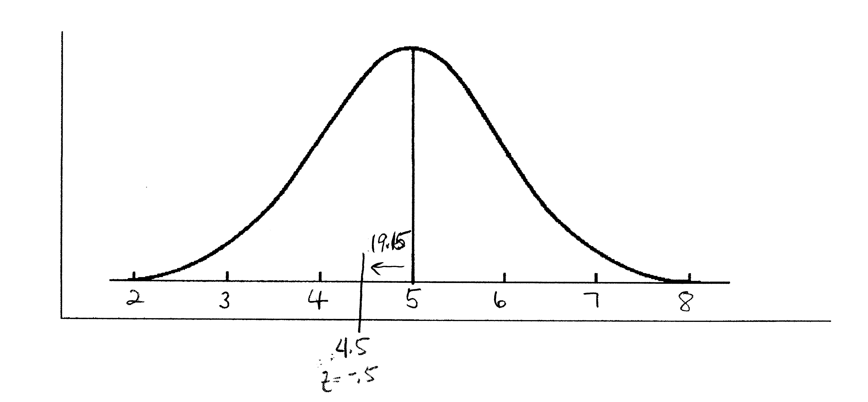
Student B percentile
Student B = 4.5 (Mean=5, SD=1)
Z = 4.5-5/1 = -.5 = 19.15%
31st percentile
50-19.15 = 30.85
<_________50%_________>
Notes:
We’ll go through the same process for student B. Note that this student’s score is also below the mean.
We calculate our z-score, x value – mean value/ SD and get a z-score of -.5. We look up -.5 and find it corresponds to 19.15%. We are BELOW the mean, so we will SUBTRACT this value from 50.
We find this student is at the 31st percentile. So, this student is not eligible.

Slide 31
Who is eligible?
Must be in 30th percentile or below
Student A = 25th percentile
Student B = 31st percentile

Slide 32
Extra Practice

