Slide 1
Multivariate OLS Regressions
& OLS Regression with Log DV
Research Informed Practice II
Notes:
1

Slide 2
Agenda
Multivariate-OLS Regressions
Class Practice (computer assignment)
OLS Regressions with Log DV
Article Example
Extra Practice
Notes:
2

Slide 3
OLS regression
Use regression line (line of best fit) to make predictions
Determine where line crosses y axis (a, intercept)
  The value of the DV when the value of the IV is 0.
Determine the slope of the line (b)
  I/R: For every unit increase in [IV], [DV] is predicted to increase/decrease by [b amount].
  Nominal: [Those who are included in the model] are predicted to have [DV] value that is [b amount] higher/lower compared to [those who are excluded].
Determine significance of slope/b
  Is the IV helpful in predicting the value of the DV?
Use regression equation to make predictions
  Y’ = a + b(x)
Notes:
Regression Line provides the “line of best fit” which takes into account each of the points and determines the line with the “least sums of squares” (more detail provided on later slides)
Slope: generally the change in y over the change in x
See slide for specific I/R vs Nominal interpretation of this value
Regression line: Y=a +b(x)
You may have seen previously as y=mx+b
3

Slide 4
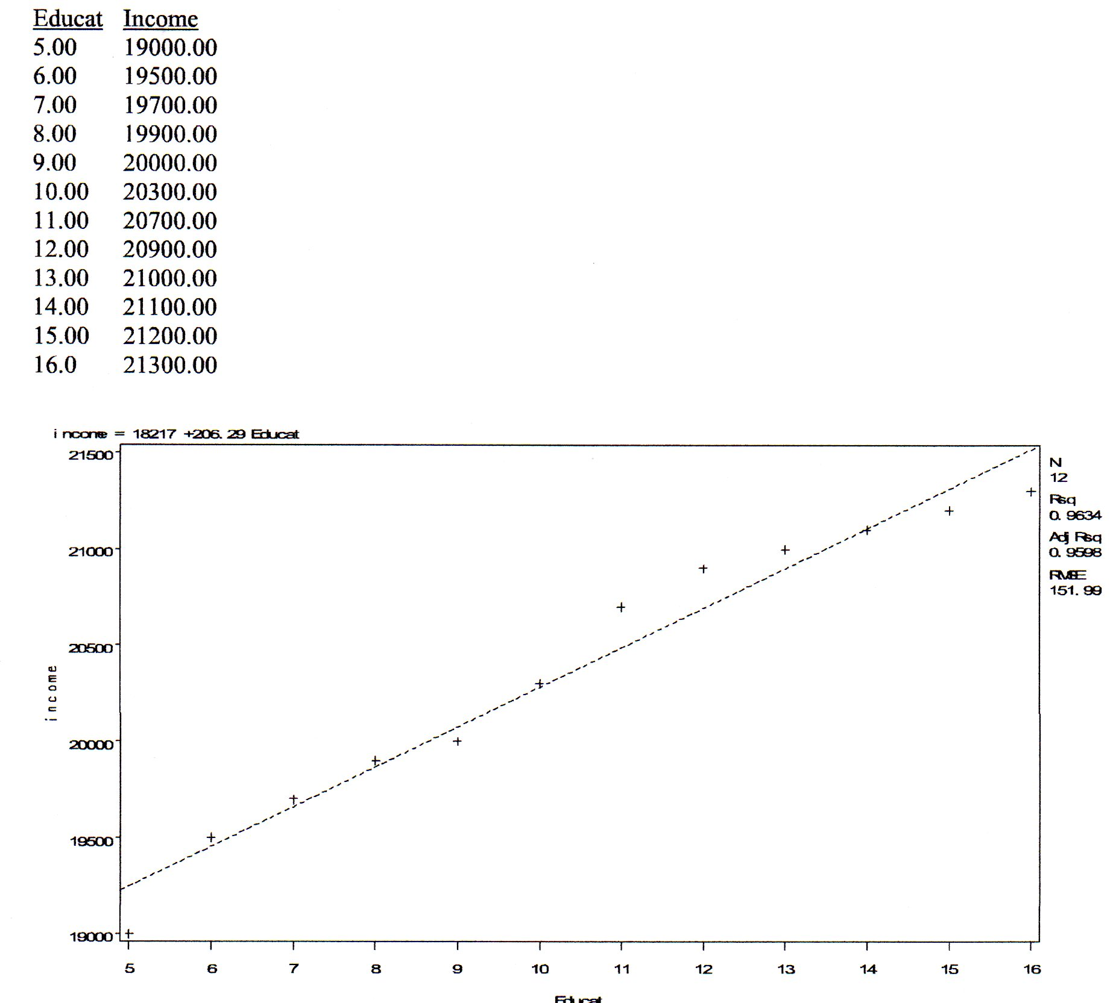
Regression line
Line of best fit
  Find line that fits all the data points all at once
    Sum of squared distance between each data point and line
    Use line with least sum of squares
Intercept (a) = $18,217
  In value of DV
Slope (b) = $206.29
  In value of DV
Notes:
Here looking at education(IV) & income(DV)
Note y-axis is the vertical axis (in this case income) and x-axis is the horizontal axis (in this case years of education)
Regression line provides the equation that can assist in making the most accurate predictions for your DV.
Determined through finding the line that is closest to all of the data points.
What we mean by “least sums of squares” is that your stat program finds the difference between each individual data point and the line and squares each point (because if you don’t square it, and add them all up you get zero)
Reminder: our regression equation is Y’ = a + b(x)
a = intercept (point where the line crosses the y-axis (when x=0)
b = slope (change in y/change in x)
4

Slide 5
Multivariate regression (Adding controls)
Notes:
5

Slide 6
From bivariate to multivariate
Multiple correlation
  Amount of variation in dependent variable explained by a set of variables
Multivariate regression
  2+ independent variables in the model
  Control variables (to make estimates more precise)
  Can include both Interval/Ratio and Dummy IVs
Significance of coefficients and the model as a whole
Make predictions using all the significant variables in the prediction equation
Notes:
Multiple correlations
The “adjusted” r square value I had mentioned last week
Multivariate regression
For a multivariate we need at least two IVs.
We are now adding in additional independent variables in an effort to better explain our DV.
Will be discussing control variables more on the next slide.
Significance
We are able to identify significance of both individual coefficients (t-values & looking @ p-values) and the model as a whole (f-test & looking at p-value)
Predictions
Able to make predictions using a set of independent variables rather than just one – aiming to be more accurate in considering multiple contributing factors
6

Slide 7
Control variables
Other variables that may influence the DV
  And the relationship between the main IV and DV
Partial out the effects of these variables from the other IVs
Find a more accurate and less biased b coefficient
  May uncover or eliminate a relationship
  May change the direction of a relationship
Can influence significance
Example: Income and education
  Predict that more education leads to more income
  BUT age, gender, and occupation also influence income
Notes:
It is important to consider what other variables may influence the DV you are looking at.
These variables can be identified by considering practice experience and looking at prior research (which is why literature reviews are important!)
Multivariate regressions allow us to find the influence of each individual variable
We get a b-coefficient for each variable so can see which are significant and how much they influence the DV
When you include control variables you may find that the relationship you anticipated to be significant is no longer significant after controlling for other variables.
When you do find significance and demonstrate that you have strong control variables, it helps support your argument that your primary IV/IVs are important variables to consider.
What are some additional variables to consider when looking at poverty and health outcomes?
Draw diagram on board (circle diagram)
7

Slide 8
We are able to explain more of DV(Y) when we include additional IVs(X)
Notes:
8

Slide 9
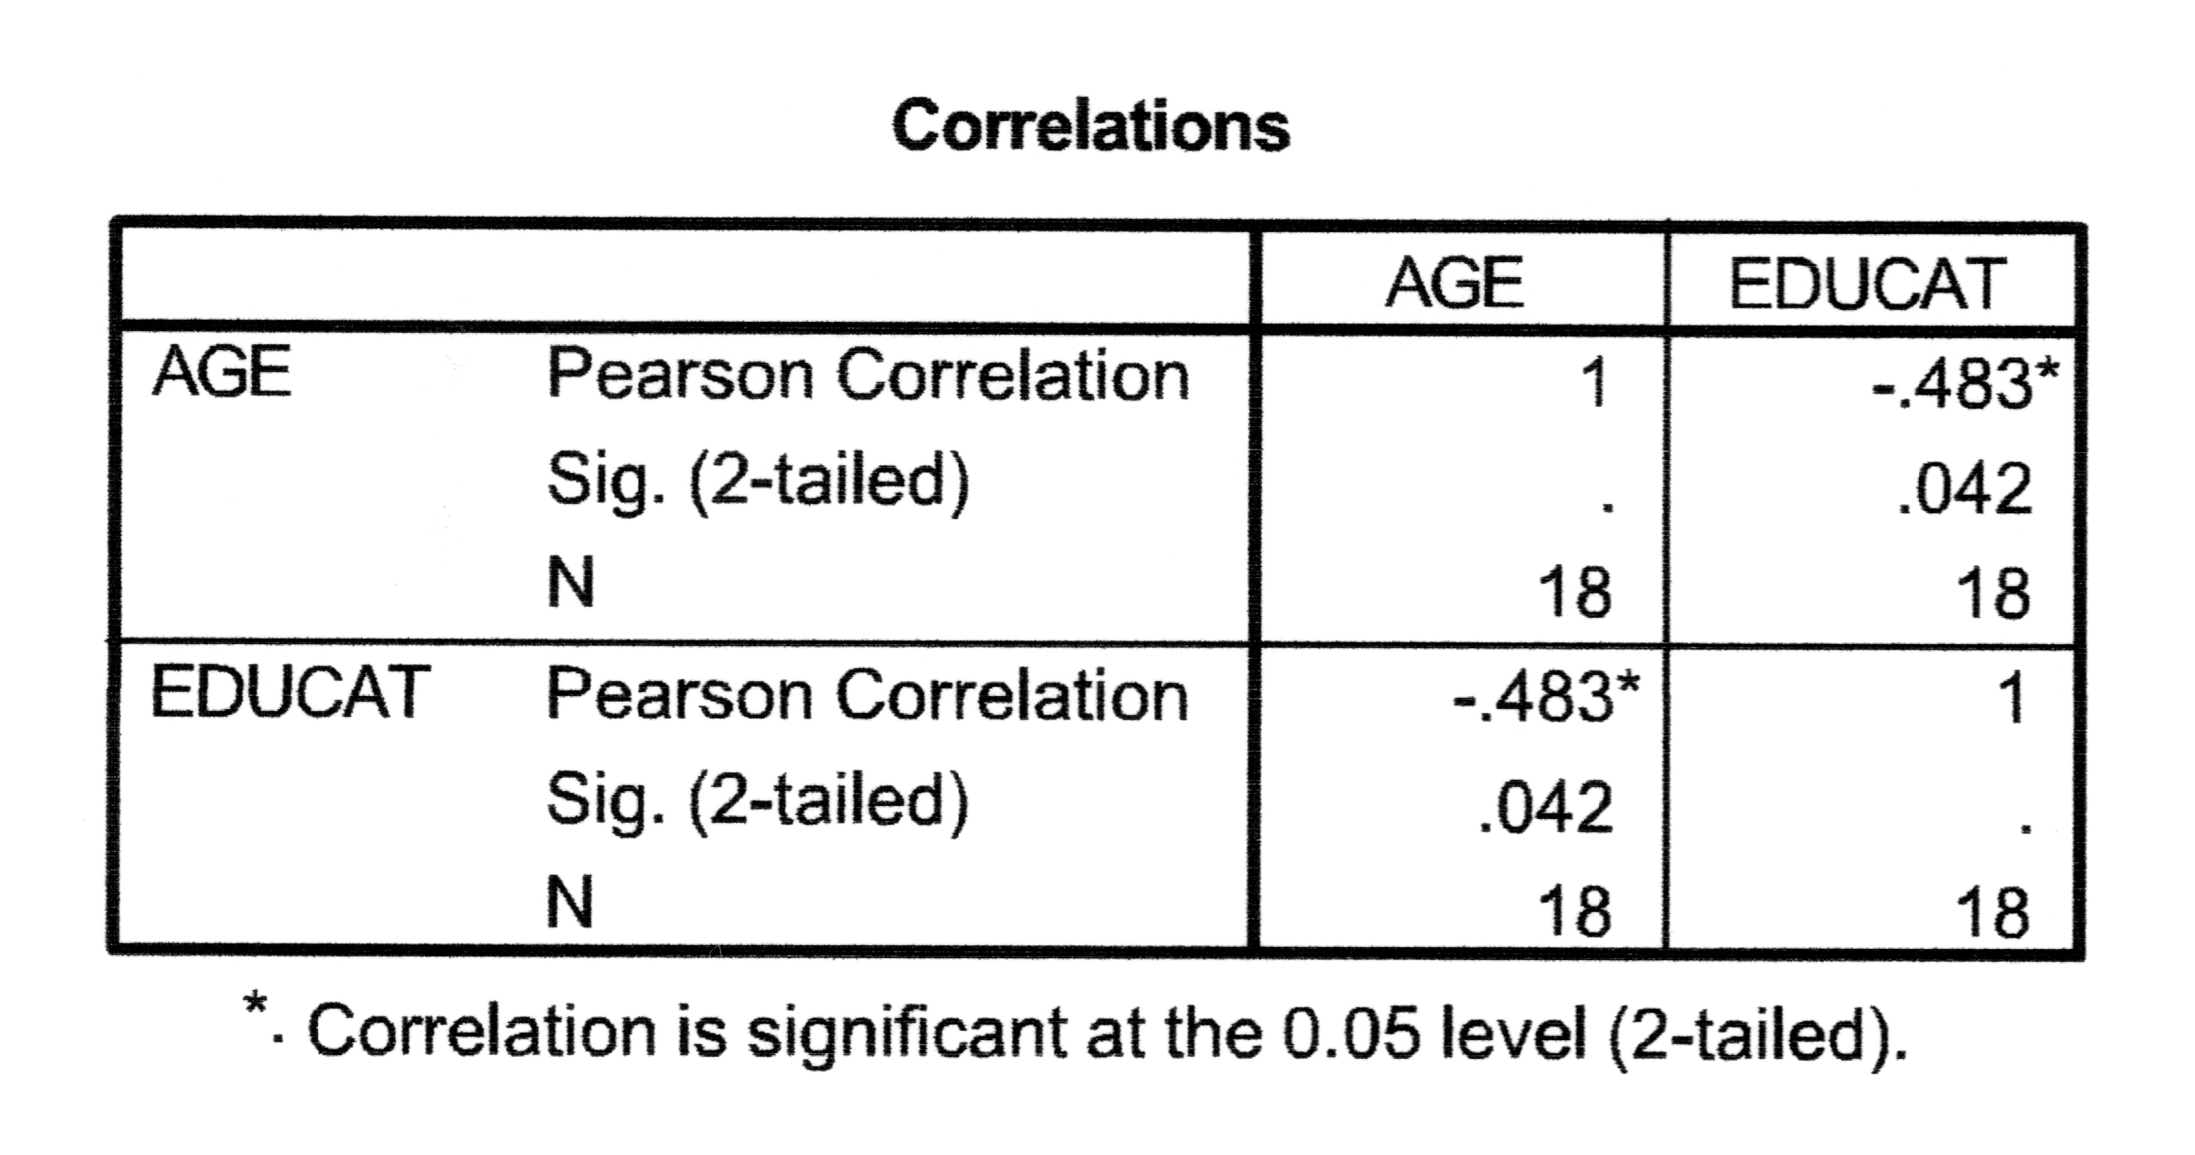
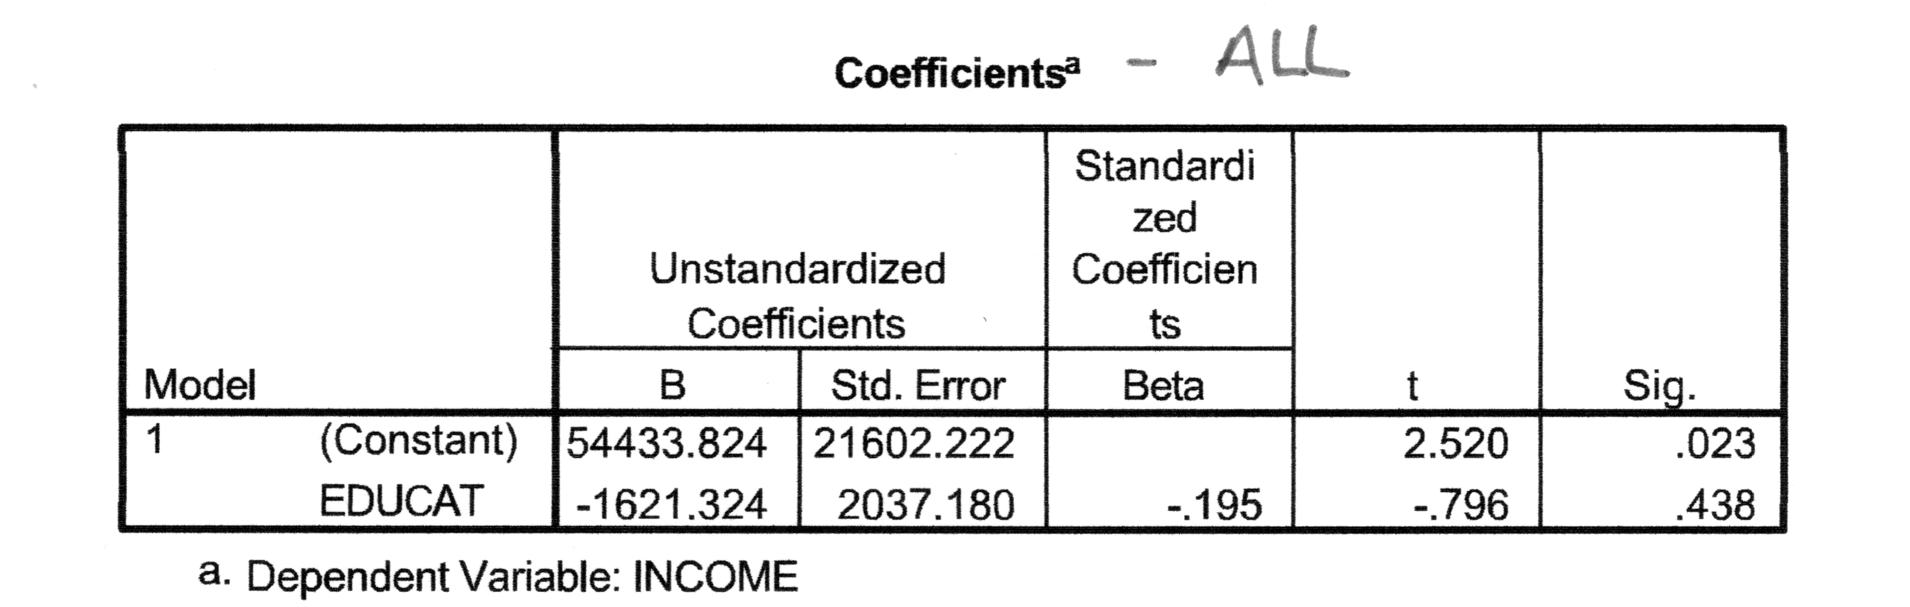
Example – Income and Education
(w/o age in regression)
Correlation between age and education
Impact of age on the relationship between income and education?
Bivariate regression (all)
  Education has negative effect on income
  Not significant
Notes:
Here we are first looking at the correlation between age and education.
Note that when you look at the blocks with age & age / education & education you have a value of 1 which indicates perfect correlation, we ignore these boxes and look at the boxes where age & education intersect to see the strength and direction of their relationship.
A negative value indicates a negative relationship.
A significance level of .042 is lower than .05 so we have significance at the .05 level for a two-tailed test. (Note: You can also see the significance level indicated by the *)
We see a significant negative relationship between age & education.
Next we have a bivariate regression (for all ages)
We can see noted our DV is income and our IV is education.
Looking at our B-coefficient we can see that the model predicts a negative relationship
Looking further over we can see that the significance for level of education is .438, which is not lower than .05 so we do not have a significant relationship.
9

Slide 10
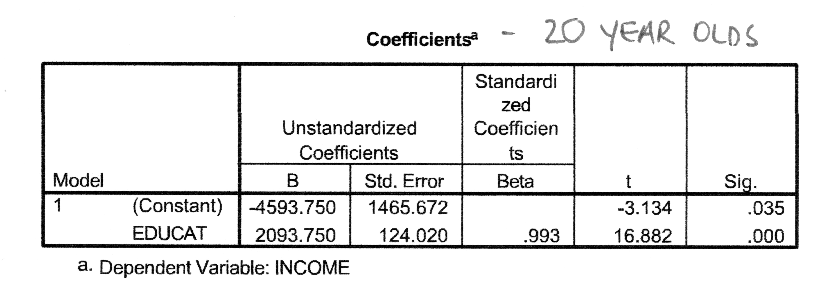
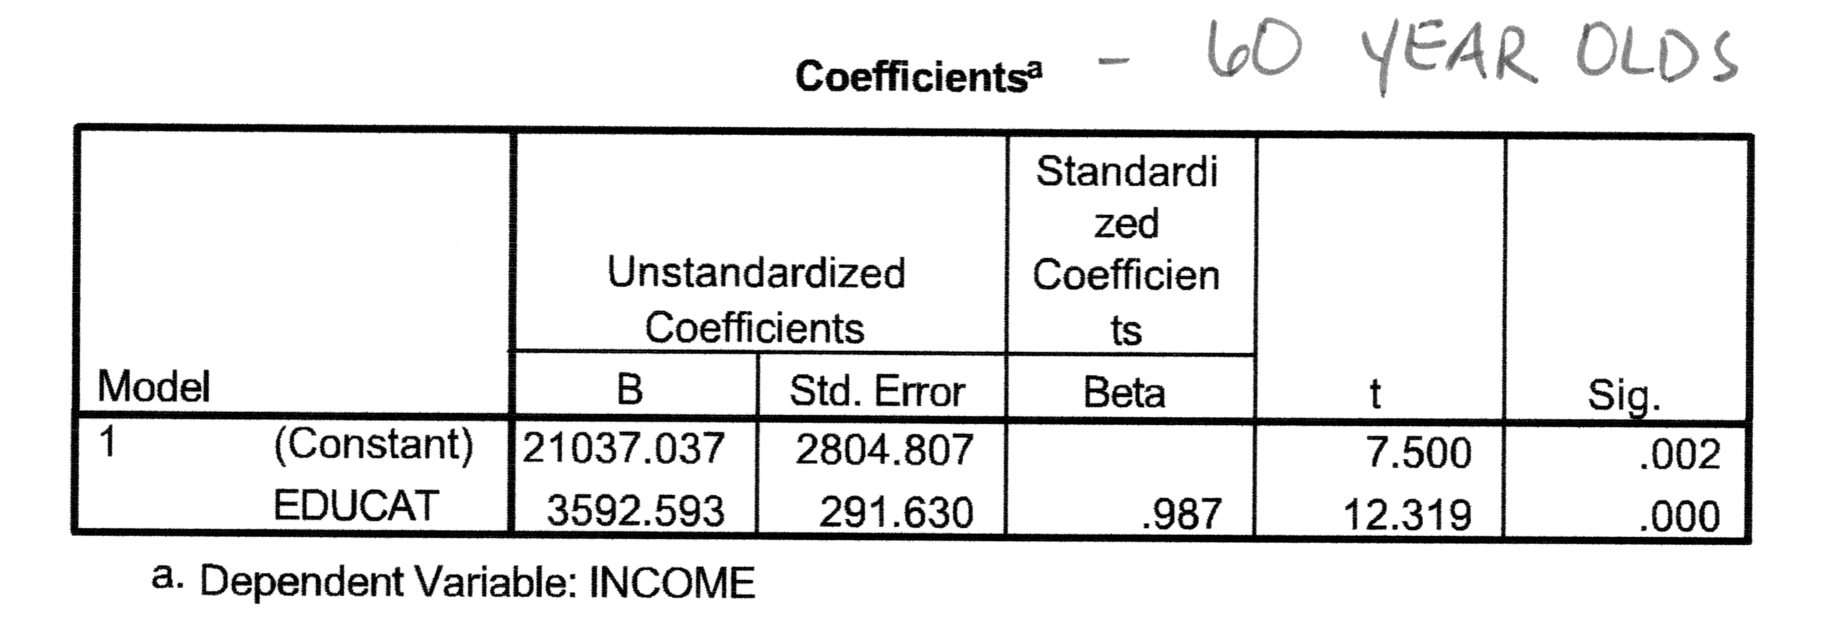
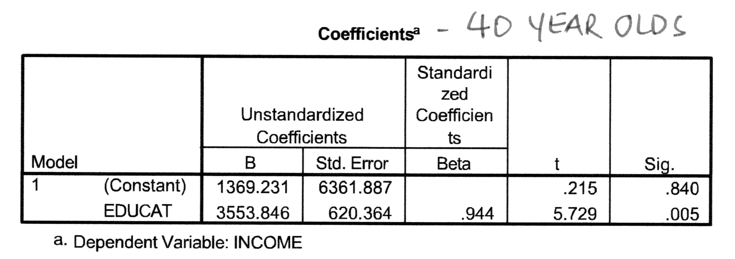
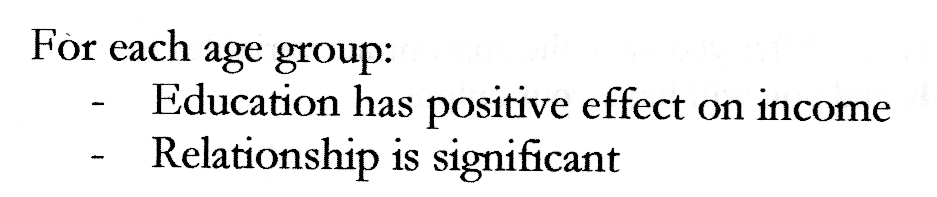
Income & education for different ages
Notes:
By running separate models for age, we can see how age might influence our results.
We have run three different models (20 year olds, 40 year olds, and 60 year olds)
We can see that education predicts a positive effect on income (but at different levels for the different ages) and that it is significant for each of the three models.
Remember our model on the last slide that included all ages? … it indicated a negative relationship and it was not significant. Maybe we should consider the impact age has on the relationship between our IV (education) and our DV (income)
10

Slide 11
Sometimes our two independent variables relate to both each other and the DV.
In this case X1 would be Education and X2 would be Age with Y being Income.
By including both variables in the model we are able to have a more accurate prediction.
Notes:
11

Slide 12
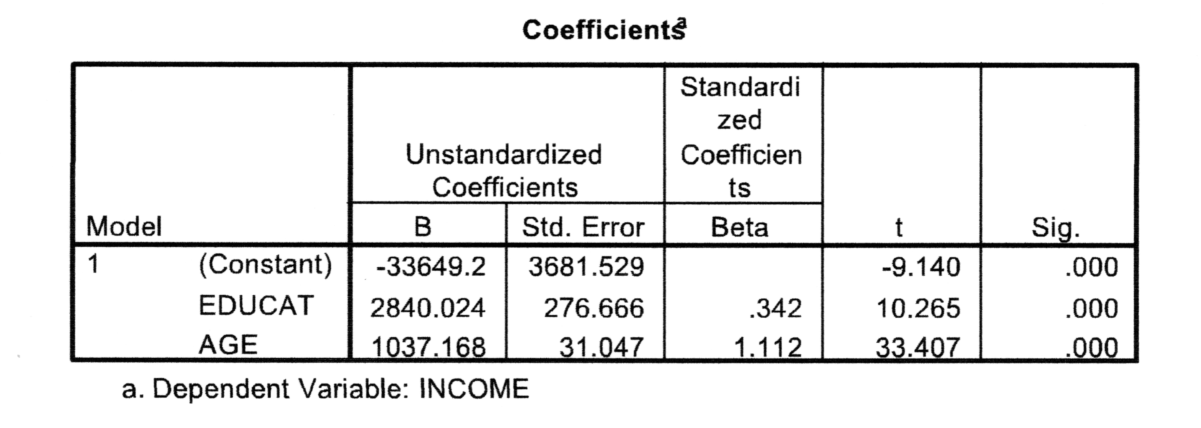
Income & education, controlling for age
Bivariate (all)
  Negative relationship
  Not significant
Controlling for age (all)
  Education
    Positive relationship
    Significant
  Age
    Positive relationship
    Significant
Notes:
Bivariate: As a reminder we found a negative relationship but it was not a significant relationship.
Multivariate: We are looking at the effect education has on income, controlling for the influence of age.
We now see that this model predicts that education has a positive (Look at your b-coefficient), significant (sig. level) effect on income.
This is an example of why it is important to think about and include control variables.
Note our coefficient estimate for education is the relationship between education and income controlling for age.
All IVs in our model control for one another.
12

Slide 13
Steps for Interpreting Multiple Regression Output
Step 1: Model Summary - What is the Adjusted r² value? What % of the DV is this set of IVs explaining?
Step 2: ANOVA (F-test) – Is r² significant? Does this set of IVs or “the model” explain “enough” of the DV?
Step 3: Sample size? If not given, then N= Df +1
Notes:
Output example (slide 15)
Model Summary
Adjusted R-Squared value takes into account including more than one variable to make a prediction.
Similar to the r-squared value we multiply by 100 to tell us the percentage of the DV our model (set of IVs) is explaining.
ANOVA
Look over to the F and sig. columns
The F statistic has an associated significance level and tells us if our model is significant.
Sample Size
We can look at our df column under ANOVA and look at the “total” at the bottom.
13

Slide 14
Steps for Interpreting Multiple Regression Output
Step 4: Coefficients Column B – Get values for the Intercept or Constant (a) and all IVs B-coefficients
Step 5: Coefficients Column Sig. – Is this IV’s B-coefficient significant while controlling for all other variables ?
Step 6: Use regression equation to make predictions
  Y’ = a + b₁x₁ + b₂x₂ + b₃x₃ + …..
Notes:
Output example (slide 15)
Coefficients
Column “B”
Intercept/Constant provides the number you will plug into your regression equation as “a”
Each IV will provide the value for your b-coefficients (b1, b2, b3 etc).
Significance
Look to your t and sig. columns.
Compare your p-value to your critical p-value
Regression Equation
Plug in your values to make a prediction.
14

Slide 15
Notes:
We can see our model explains 9.3 percent of our DV.
We can see the model is significant by looking at the ANOVA, F-test, and significance value.
We can see that some, but not all of our IV’s are significant.
Using this our prediction line would look like….
Y= -38354 + 3462.6(kids) + 8579.9(edhd) + 33.4(uncy) – 621.5(emothwyrs)
15

Slide 16
Adjusted R² Instead of R²
Amount of variation in the dependent variable explained by the set of independent variables
  Impact of their combined variation on the DV
  (R^2*100)% of the variation in the dependent variable is explained by the set of variables (or the variables included in the model)
When adding variables, R² may increase
  High R² = model doing a good job predicting value of DV
Adjusted R²
  Takes into account how much a new variable is adding
  Will decrease if new variable not adding much
  If quite different from R², then there may be many superfluous variables in the model
Notes:
When adding variables, your adjusted r-squared may increase or decrease depending on how much the additional variables are adding to the explanatory power of your model.
Be mindful of comparing your r-squared and adjusted r-squared. If your adjusted r-squared is lower than the r-squared, then there may be superfluous variables in the model.
16

Slide 17
Model significance (F-test)
Testing significance of R²
H0 – Value of R² occurred by chance
Test
  Calculate test statistic (f)
  Determine whether enough units away from the H0 for significance
Look at ANOVA significance
Notes:
F-test tells us if our model as a whole is significant. Or, is our model explaining enough of the variation in the DV to be statistically significant?
We want to demonstrate the adjusted r-squared value did not happen by chance and that our model is a significant predictor of our DV.
You can calculate your f-test statistics
Or let SPSS do the work for you and look at the ANOVA significance
Again, we are using p-values to determine statistical significance
17

Slide 18
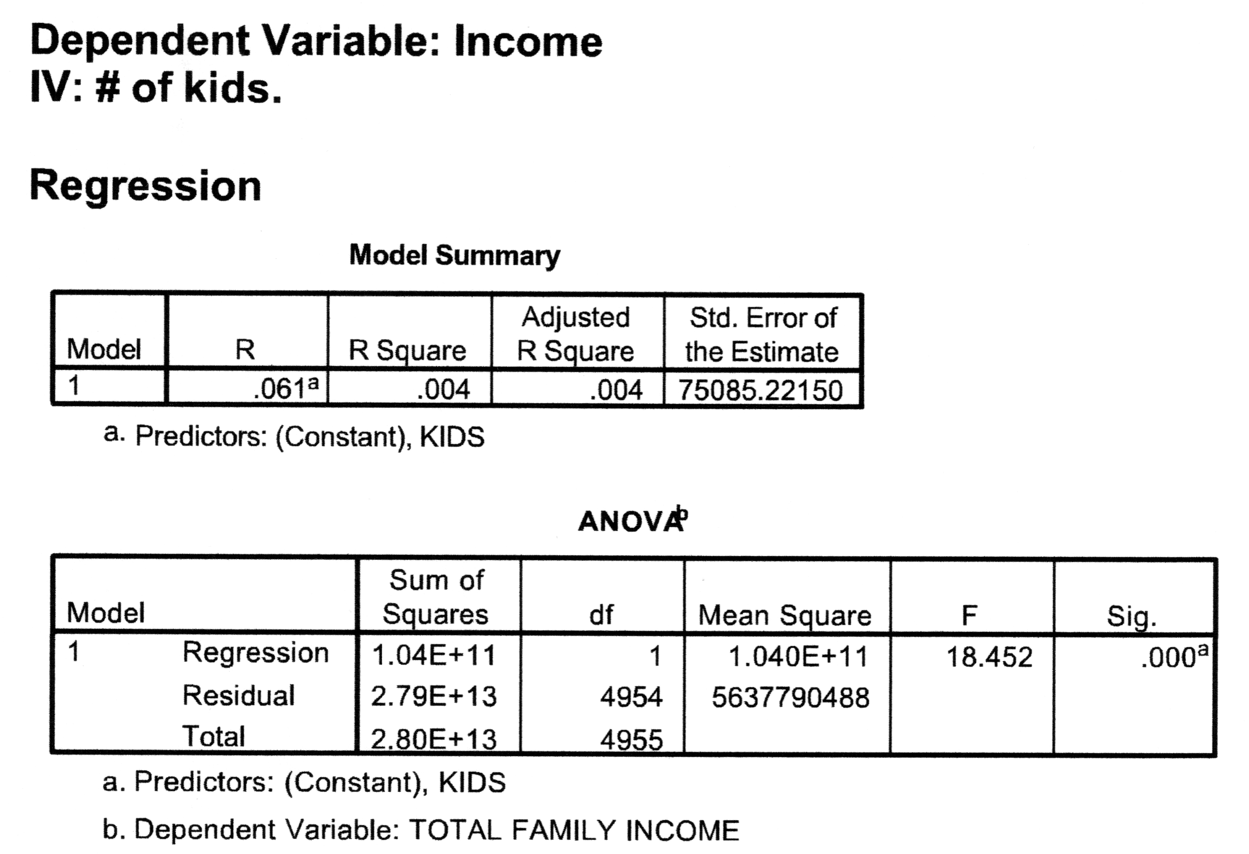
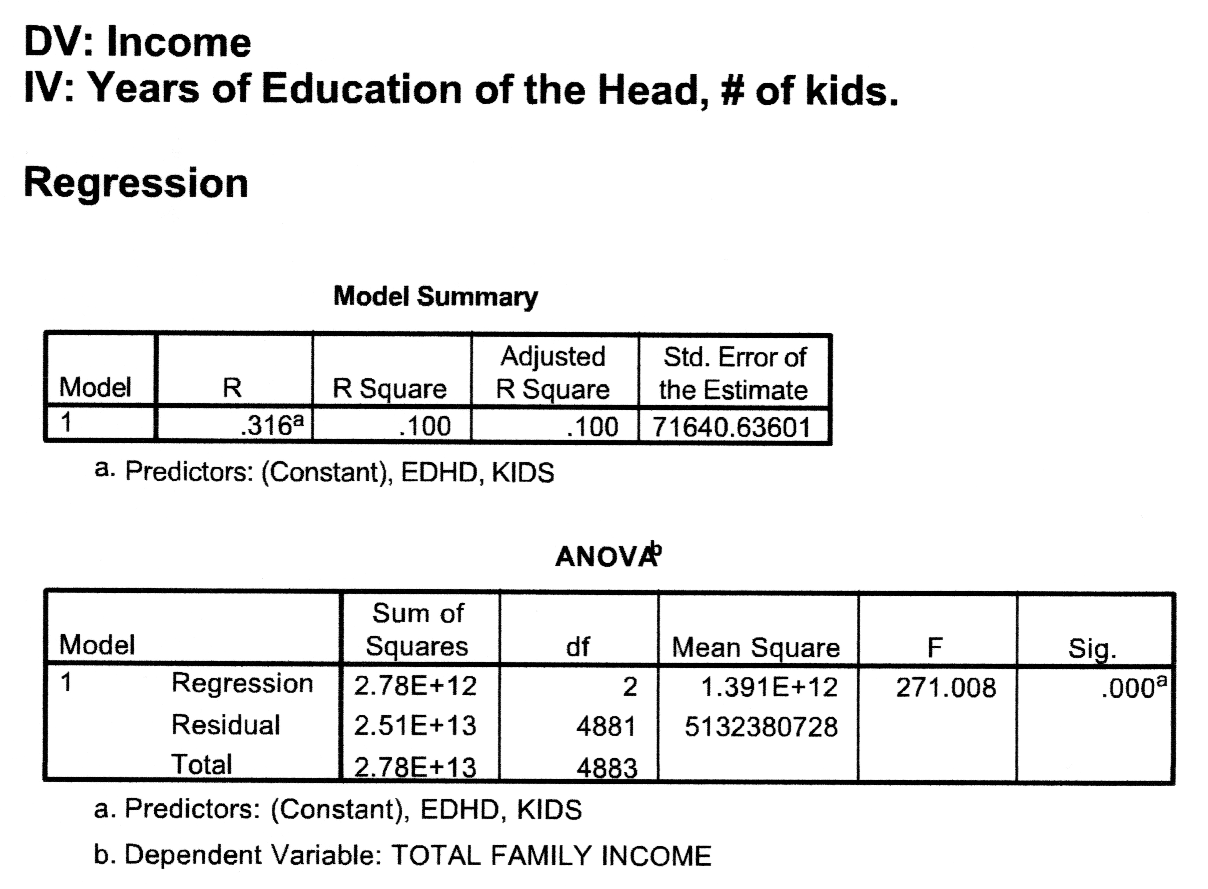
R² and F across two models
Notes:
We see in the first model, that the r-square and adjusted r-squared are the same. This is what we would expect for a bivariate regression. We only have one IV. In the second model, we see that the r square and adjusted r square values are the same, indicating that there are no superfluous variables included (here, we’ve only added years of education of head of household).
If we compare our r square value for the first model to the adjusted r-square for the second model, we see that it increased. Adding in years of education of the head helped us to explain more of our DV.
We look down to the ANOVA and see our F-test indicates model significance in both models (a significance level of .000)
Note that our F statistic increased from 18.452 to 271 (271 is more significant that 18.452)
18

Slide 19
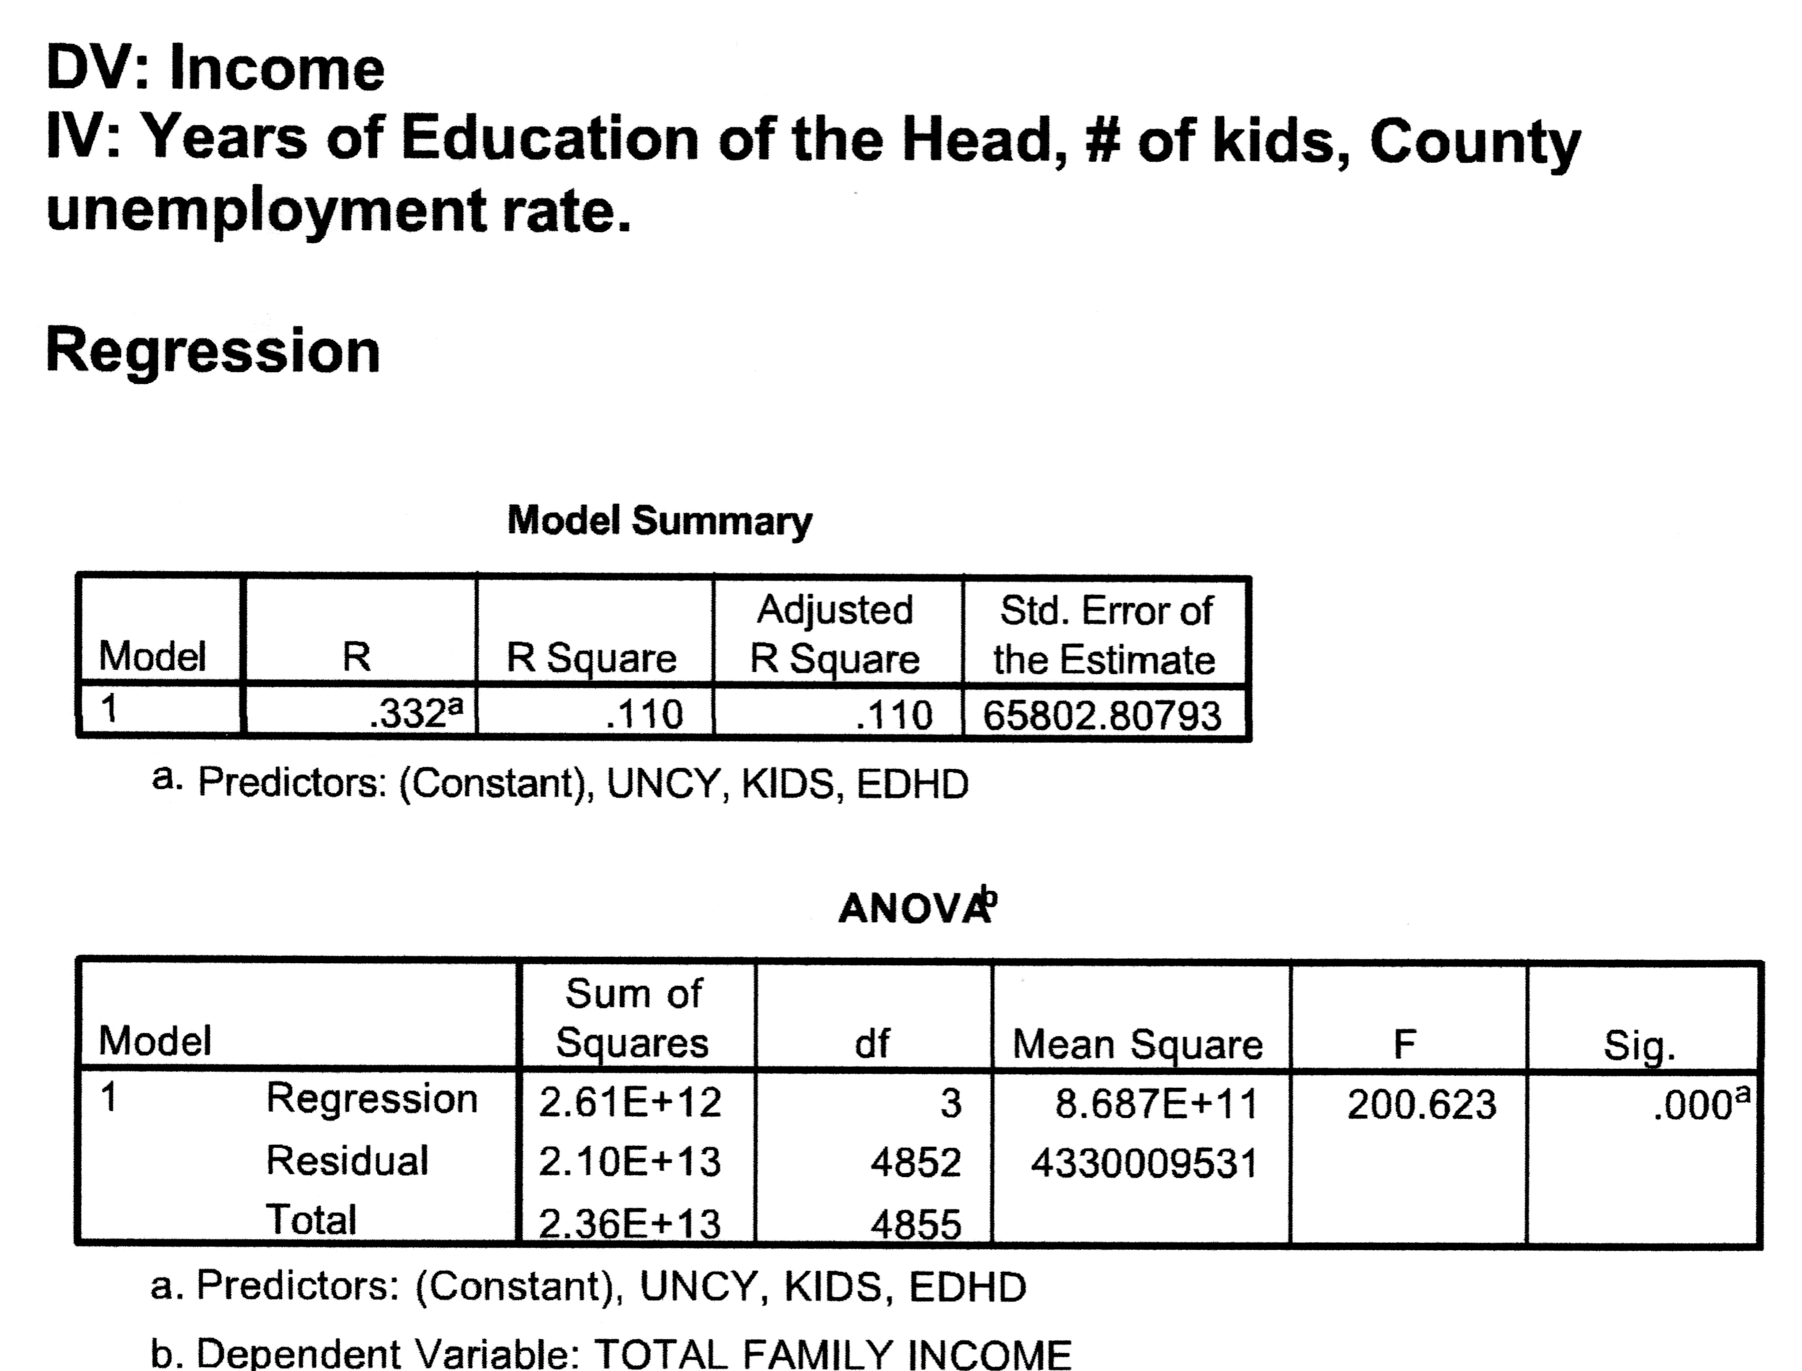
And a third….
Kids
  R² = .004 (Adj R² = .004)
  F = 18.45 (Sig = .000)
Kids, years of ed
  R² = .10 (Adj R² = .10)
  F = 271 (Sig = .000)
Kids, years of ed, unemployment rate
  R² = .11 (Adj R² = .11)
  F = 200.62 (Sig = .000)
Notes:
Here we’ve added a third IV, county unemployment rate. Our adjusted r-squared is .110. This is higher than the adjusted r-squared from the second model. So, this model explains more of the variation in our DV (income), than the previous two models.
19

Slide 20
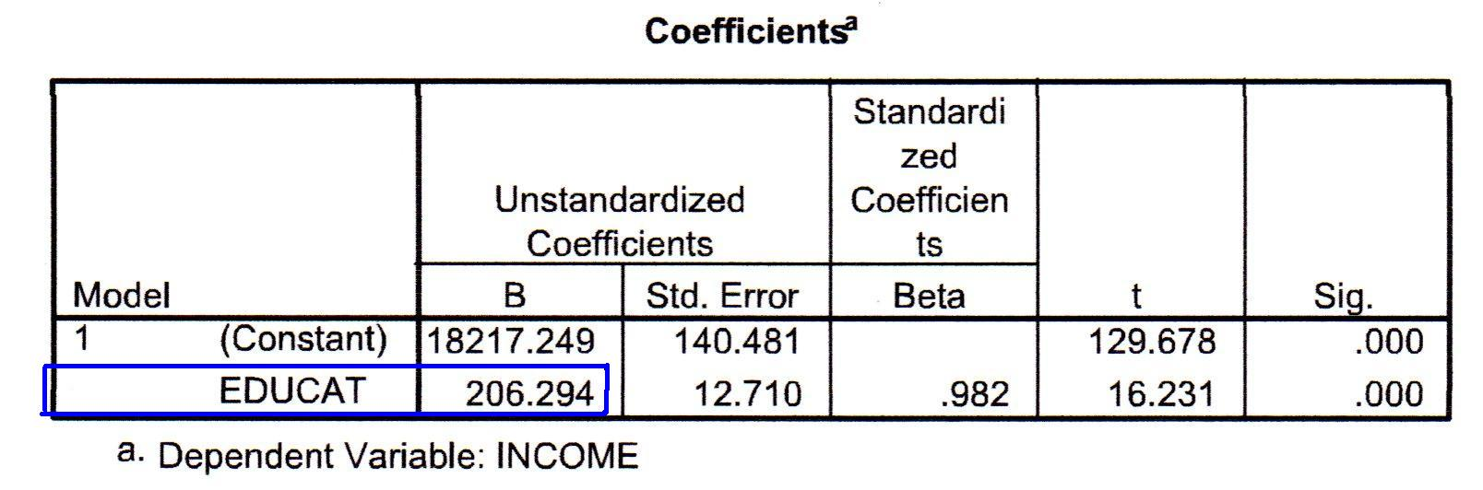
Slope (b) – I/R independent variables
Amount and direction of the change in y (DV) for each unit change in x (IV)
  Positive b = x ↑, y ↑
  Negative b = x ↑, y ↓
b = $206.294
For each year increase in education, an individual is predicted to earn $206.30 more.
Notes:
We look to our b-coefficients to tell us the amount and direction of change in the DV.
A positive coefficient indicates an increase in y(DV) for each 1 unit increase in x(IV)
A negative coefficient indicates a decrease in y(DV) for each 1 unit increase in x(IV).
“For each 1 unit increase in x, the model predicts a b-coefficient increase/decrease in y”
“For each 1 year increase in education, the model predicts a 206.294 dollar increase in income.”
20

Slide 21
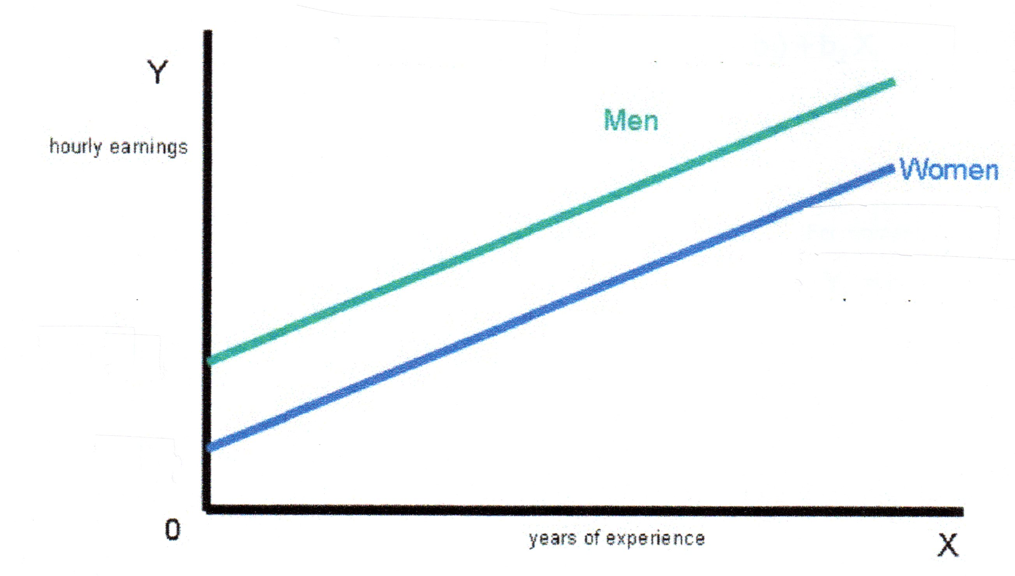
Dummy variables in regressions
Variable has values of 0 and 1
  1= included & 0=excluded
Comparing DV mean values for both groups
  Those included in the model vs. those excluded from the model
  Cross y axis at different places
  Same slope
b = Change in mean value for included group
  Intercept for included group
  IV value = 1 (x = 1)
Notes:
1 indicates included 0 indicates excluded
Ex if looking at the influence of graduating college: 1= those that graduated college & 0= those that did not graduate college
The b-coefficient would tell us the change in the DV expected for those that graduate college compared to those who did not graduate college.
Remember our prediction line is y=a + b1x1
If we plug in “0” for our IV value (X) for the excluded group we are left with y=a (or the prediction for those in the excluded group)
If we plug in “1” for our included groups we are left with y=a+b
(b is the difference between the included and excluded group)
21

Slide 22
Dummy variables – Interpreting results
Single Parent Households (excluded)
  Single Parent Households are predicted to receive $369.53 in food stamp income.
  Y’ (FSI For SPH) = 369.53 + -304.74(0) = 369.53
Two Parent Households (included)
  Two parent households are predicted to receive $304.74 less in food stamp income compared to single parent households.
  Y’ (FSI for TPH) = 369.53 + -304.74(1) = 64.79
  Two parent households are predicted to receive $64.70 in food stamp income.
Notes:
It is important to remember to note in your b-coefficient interpretation sentence what the excluded group is.
We compare our included group to the excluded group.
Prediction of 369.53 (single parent HH) vs 64.79(two parent HH) = difference of 304.74
22

Slide 23
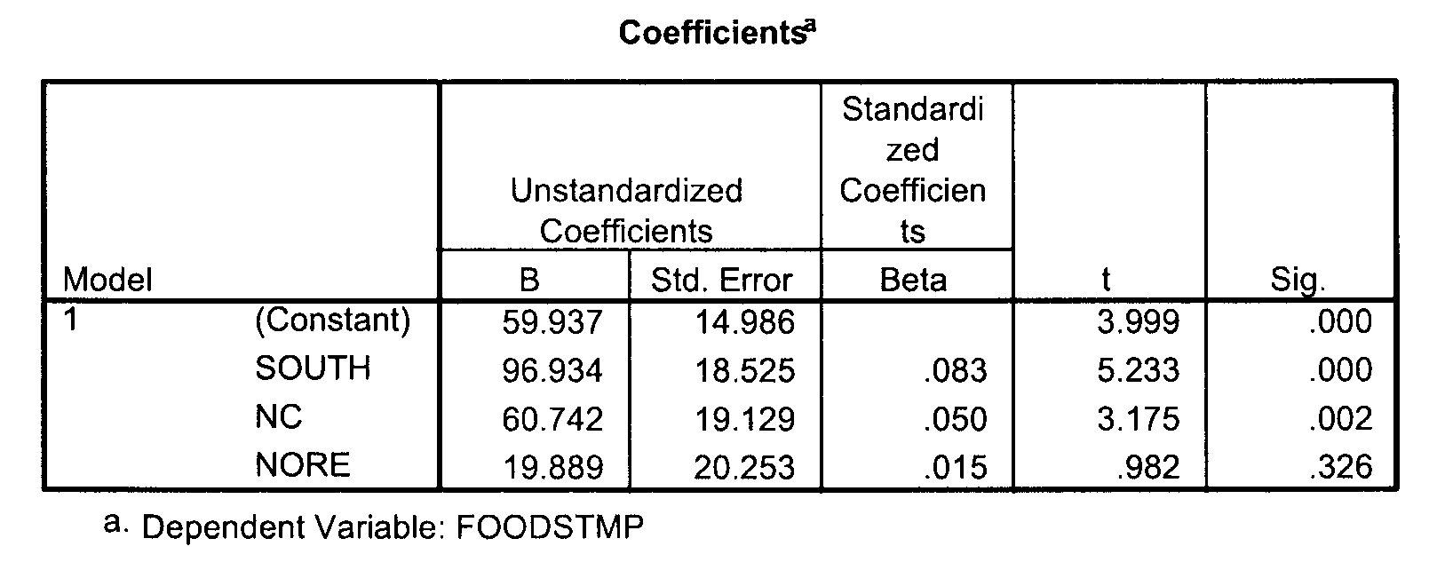
Dummies with 2+ value options
IV = region (South, North Central, Northeast, Northwest)
    Northwest – excluded, comparison group
Those who live in the south are predicted to have food stamp income that is $96.93 more than those in the northwest.
Those who live in north central are predicted to have food stamp income that is $60.74 more than those who live in the northwest.
Those who live in the northeast are predicted to have food stamp income that is $19.89 more than those who in the northwest.
Notes:
This carries over to variables with than two value options. They are still assigned values of “0” or “1.”
The key is to remember you always need an excluded value and this is what each of your predictions is in comparison to. You compare each of the included groups to the excluded group.
Note: Just because there is a set of dummy variables (in this case region) some can be significant, while others are not. It is not the set as a whole that will have significance, but each individual variable. In this case South & NC are significant, but NORE is not.
23

Slide 24
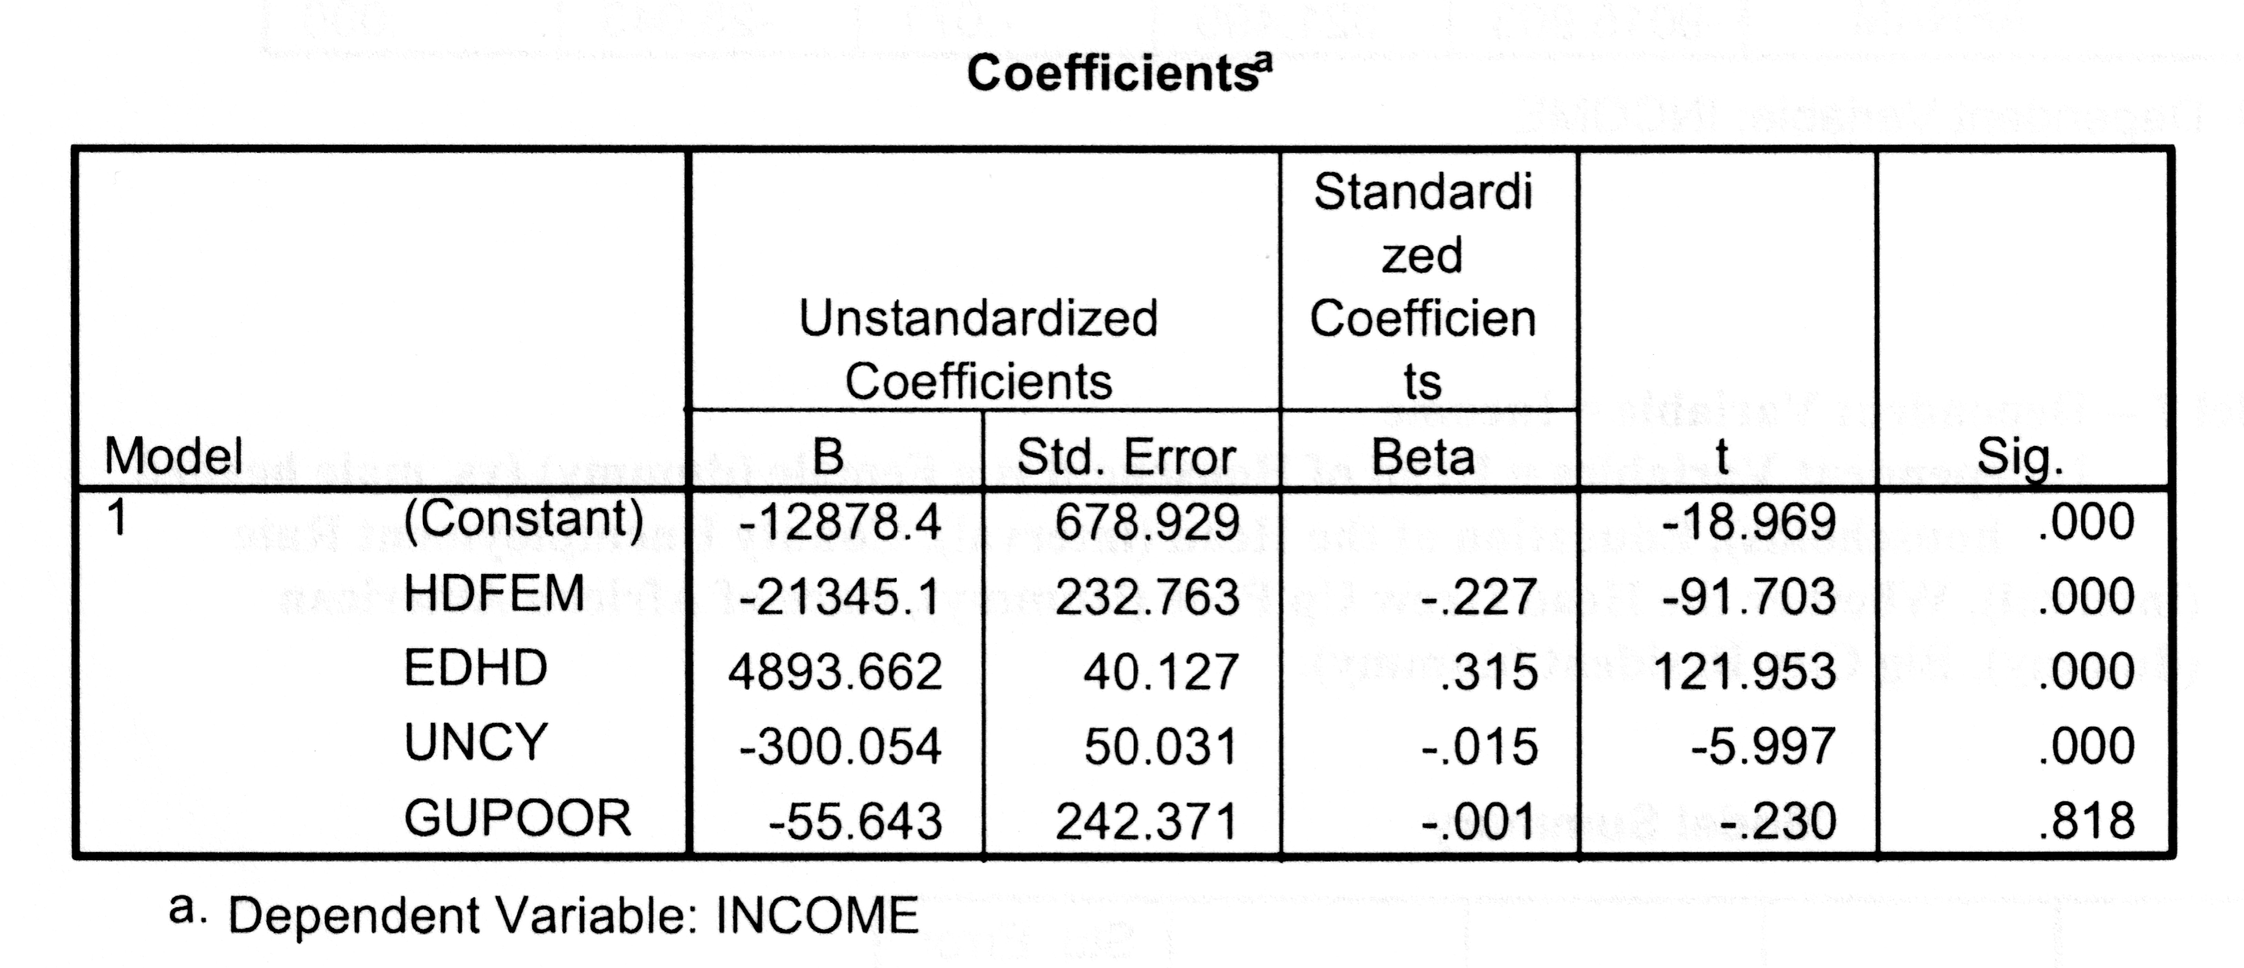
Interval-Ratio & Dummy B-coefficients
Those in female-headed households are predicted to earn $21,345 less than those who are not in female-headed households, controlling for all other variables in the model.
For each additional year of education, income is predicted to increase by $4,893.66, controlling for all other variables in the model.
For each additional % increase in the county unemployment rate, income is predicted to decrease by $300.05, controlling for all other variables in the model.
Do not interpret grew up poor variable – not significant
Notes:
When interpreting your variables pay attention to whether or not they are I/R or dummy (nominal) variables!
Remember to note that your b-coefficient estimate is controlling for all other variables.
Dummy(Nominal):
Those in (included category) are predicted to earn (b-coefficient) more/less(look at sign of b-coefficient) than those who are in the (excluded category), CFAOV.
I/R:
For each additional (I/R IV) the model predicts (DV) to increase/decrease(look at sign of b-coefficient) by (b-coefficient), CFAOV.
24

Slide 25
Significance of B-coefficients
Standard error
  Amount of variation around regression line
Test statistic (t)
  # of standard error units from H0
  H0 = IV is not helpful in predicting the value of the DV
  T_{n-k-1} = b/SE_{b}
Low standard error = easier to find significance
  Less variation, easier to find relationship if it exists
  b divided by lower number → t becomes larger → easier to surpass critical value
High standard error = hard to find significance
  More variation, harder to find relationship if it exists
  b divided by higher number → t becomes smaller → harder to surpass critical value
Notes:
Look at a coefficient table on your SPSS output and be familiar with where the items above are located.
25

Slide 26
Significance of B-coefficients
Look in the “Sig” column for the p–value
Compare the p-value to critical p-values
  .05
  .01
  .001
If our p-value is less than the critical p–values we can reject the H0.
Notes:
26

Slide 27
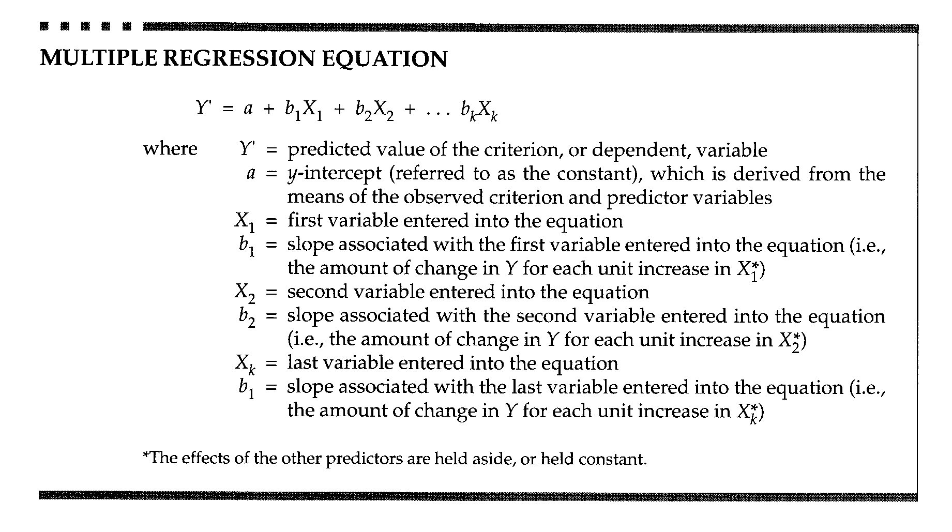
Predictions
Notes:
This equation is similar to our bivariate regression equation with the addition or more variables (more b-coefficients and corresponding values for “X”)
Example on next page
27

Slide 28
Example – Income (DV)
Predicted income for someone in female-headed household, 14 years of ed, living in community with 7% unemployment rate. (we did not include ”GUPOOR” because it is not significant.
Y’ = -12,878.4 + (-21,345.10)(hdfem) + 4,893.66(ed) + (-300.05)(uncy)
Y’ = -12,878.4 + (-21,345.10)(1) + 4,893.66(14) + (-300.05)(7)
Y’ = -12,878.4 – 21,345.10 + 68,511.24 – 2,100.35
Y’ = $32,187.39
Notes:
Notice that all of the information you need to make predictions is given to you.
Because our included variable was the head of household is female and our prediction is for someone who is a female head of household we will include “1” here. If it was someone who was in a male headed household we would replace “1” with “0”.
GUPOOR is not significant so it is not included in the prediction
28

Slide 29
Predictions – 2+ dummy categories
Y’ = a + b₁x₁ + b₂x₂ + b₃x₃
Y’ (south) = 59.94 + 96.93(1) + 60.74(0) + 19.89(0) = $156.87
Y’ (nc) = 59.94 + 96.93(0) + 60.74(1) + 19.89(0) = $120.68
Y’ (nore) = 59.94 + 96.93(0) + 60.74(0) + 19.89(1) = $79.83
Y’ (norw) = 59.94 + 96.93(0) + 60.74(0) + 19.89(0) = $59.94 (intercept)
Notes:
Remember 1 = included & 0= excluded.
Plug in a 1 for the value you want to find and a 0 for the remainder of the other values.
29

Slide 30
Log transformations
Notes:
30

Slide 31
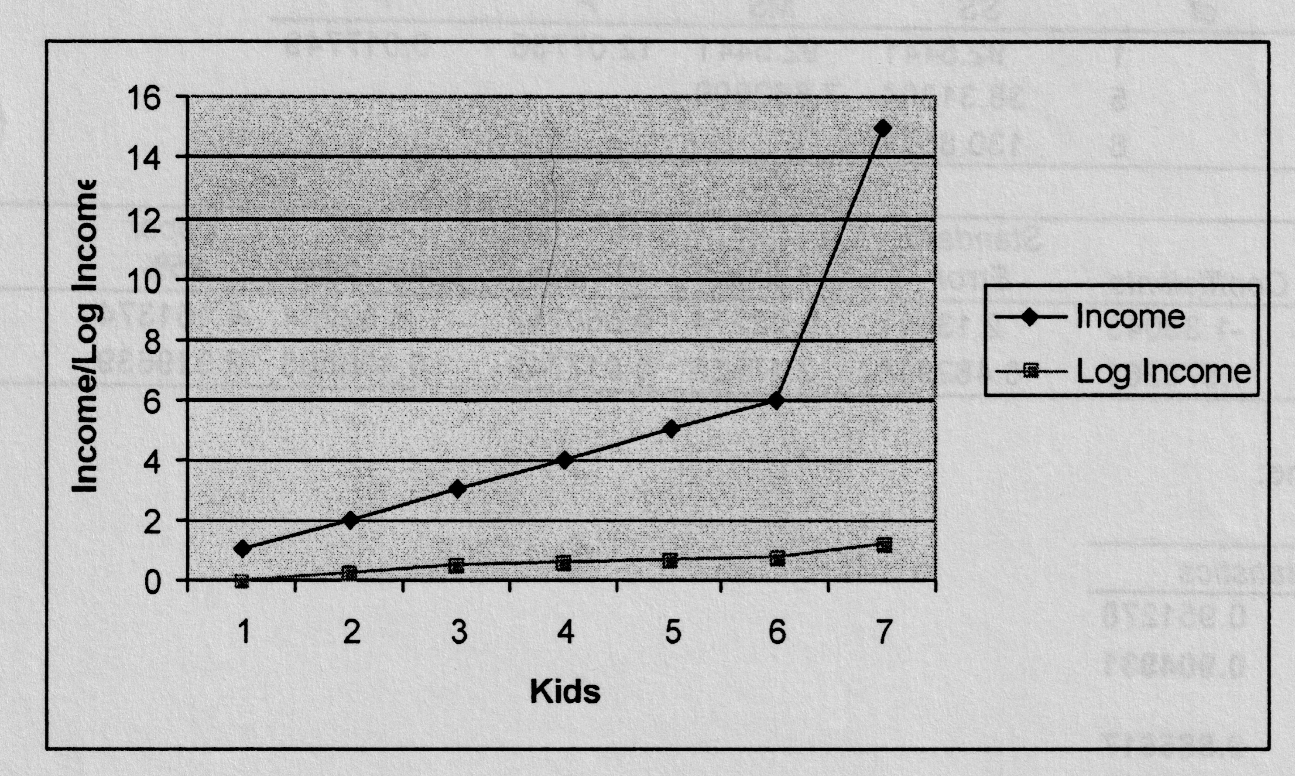
Log transformations
Pulls in outliers to minimize their effects
Make scales more meaningful to interpret.
Convert b to %
  Multiply b by 100
Example:
For each additional kid, income is predicted to increase by 12%.
Those who have kids are predicted to have income that is 3% lower than those who do not have kids.
Notes:
We use logged variables to manage outliers in our data or to make results more meaningful (such as for scaled)
Because we are using a statistic during our analysis we must then covert our results to be able to interpret them.
To interpret, you will multiply your b-coefficient by 100.
31

Slide 32
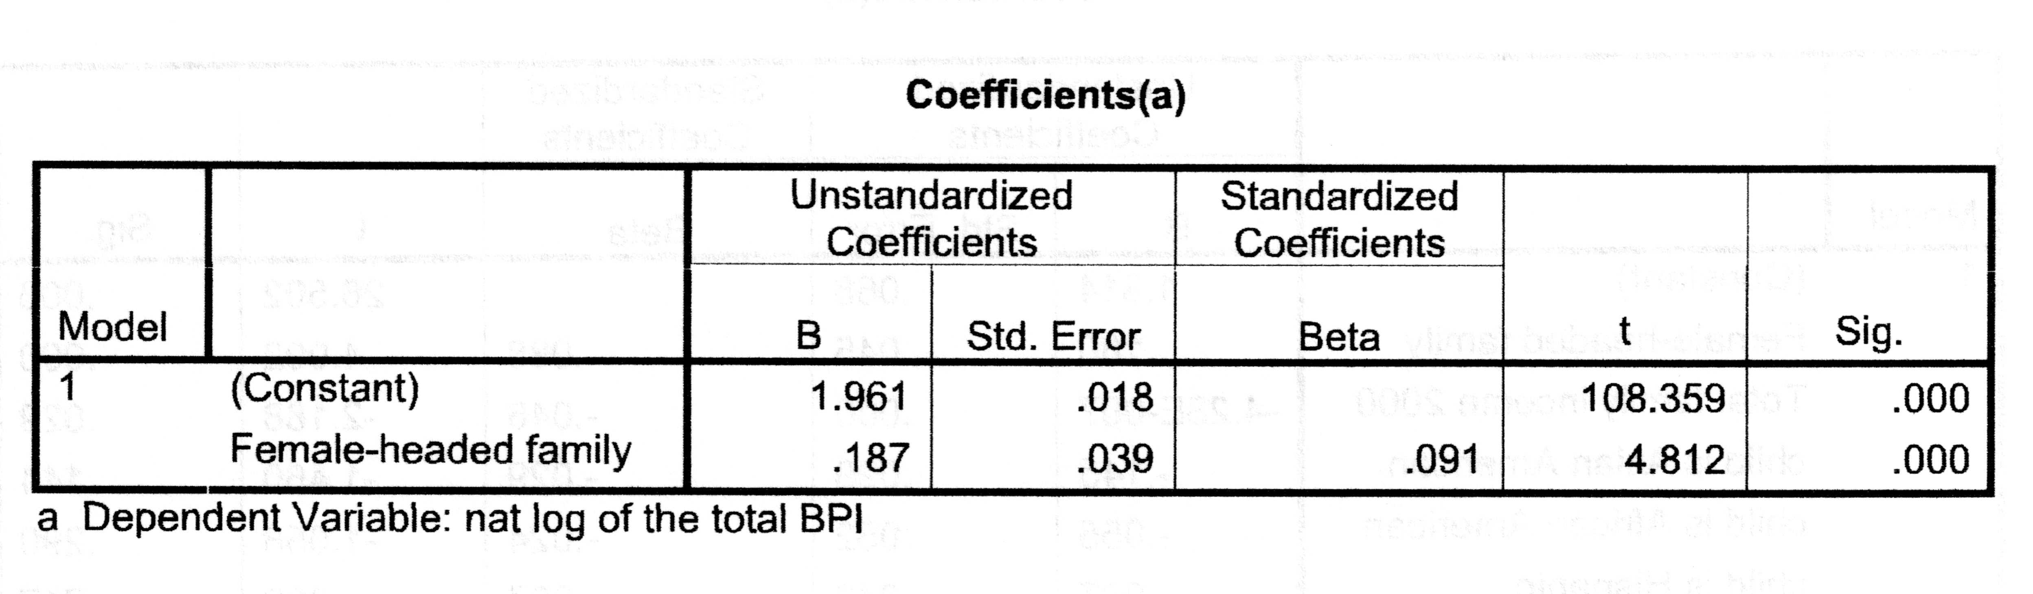
Log example 1 - Dummy
Effects of living in a female-headed household on children’s behavioral problems (higher BPI values = more problems)
b = .187 → .187 x 100 = 18.7%
Children in female-headed households are predicted to have BPI scores that are 18.7% higher than children who are not in female-headed households.
Notes:
Here we are looking at Female-headed families with a log DV of total BPI (behavioral problems).
We see our b-coefficient is .187
To transform our b-coefficient we multiply by 100 to transform our variable to be able to interpret it.
Because we have a dummy IV we want to remember to have our prediction indicate that the female-headed family prediction is relative to those households that are not female-headed
32

Slide 33
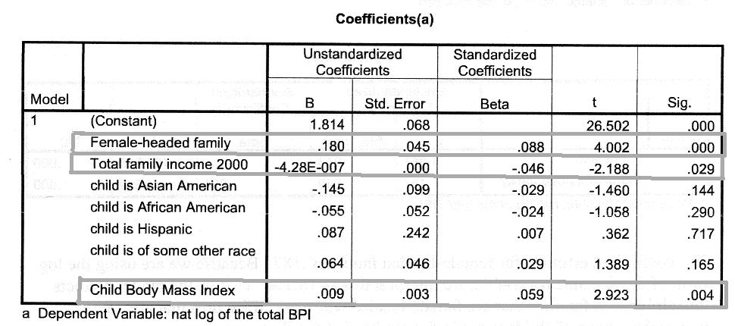
Log example 2 – I/R and Dummy
For each unit increase in the child’s BMI, BPI scores are predicted to increase by .9%.
Children in female-headed households are predicted to have BPI scores that are 18% higher than children who are not in female headed households.
For each unit increase in total family income, BPI scores are predicted to decrease by .000000428% OR for every $10,000 increase in family income, BPI scores are predicted to decrease by .00428%.
Notes:
Here we are looking at female-headed families, total family income in 2000, race, and BMI as our independent variables with logged BPI scores as our DV.
We see that only female-headed family, family income, and BMI are significant.
Note the difference in interpretation for I/R and Dummy variables.
For dummy variables we must compare our included groups to the excluded group. That is, the % change for the included group relative to the excluded group. In this case it is the % change for children in female-headed households as compared to those who are not in female headed households.
For I/R variables logged variables are a percent change for a 1 unit increase in the IV. In this case a % increase in BPI score for a 1 unit in family income or BMI.
33

Slide 34
Regression Language
OLS (interval/ratio DV)
  I/R IVs - For each unit increase in X, Y is predicted to [decrease or increase] by [b coefficient]
  Dummy IVs - Those in [included group] are predicted to have a Y value that is [b coefficient] [higher or lower] than [excluded group]
OLS with log dependent variables (log DV – would be noted as “log”)
  Same basic language as regular OLS BUT
  Multiply b coefficient by 100
  Interpret as percentage increase or decrease
Notes:
Examples for language
34

