Slide 1
T-Tests and ANOVA
Research Informed Practice II
Spring 2022

Slide 2
ANOVA

Slide 3
ANOVA
DV = I/R
IV = Categorical variables with 2+ options
Poverty as child = poor, average and rich
Marital status = never married, married, divorced/widowed
Do the means of the different groups differ?
Two parts:
ANOVA/f test to determine if there is a difference in means
If f test is significant, Scheffe post hoc test to determine where the difference lies
Notes:
ANOVA allows us to determine difference between categorical with two or more options.
We again are looking at difference between means of the groups.
We again have multiple steps. This time we start with an f-test to determine if there is in fact a difference in means, and if we find significance, we use the Scheffe test to see where that difference is.

Slide 4
Step 1: ANOVA
H0: Mean value for the dependent variable is the same regardless of group membership
F test:
Does group membership help predict value of DV?
p < .05 = significant, reject H0 → group means differ
Run Scheffe post hoc test
p > .05 = not significant, accept H0 → group means don’t differ
No need to run Scheffe post hoc test
Test is comparing:
Variance due to difference between observations within a group
Variance due to differences between groups
Notes:
The f-test allows us to support our alternative that group membership helps to predict the value of DV (that group means differ) or helps us determine that we fail to reject our H0 of mean values for the DV being the same regardless of group membership.
Remember that we only run the Scheffe post hoc test(Step 2) if we find a p-value lower than .05 and reject our H0.

Slide 5
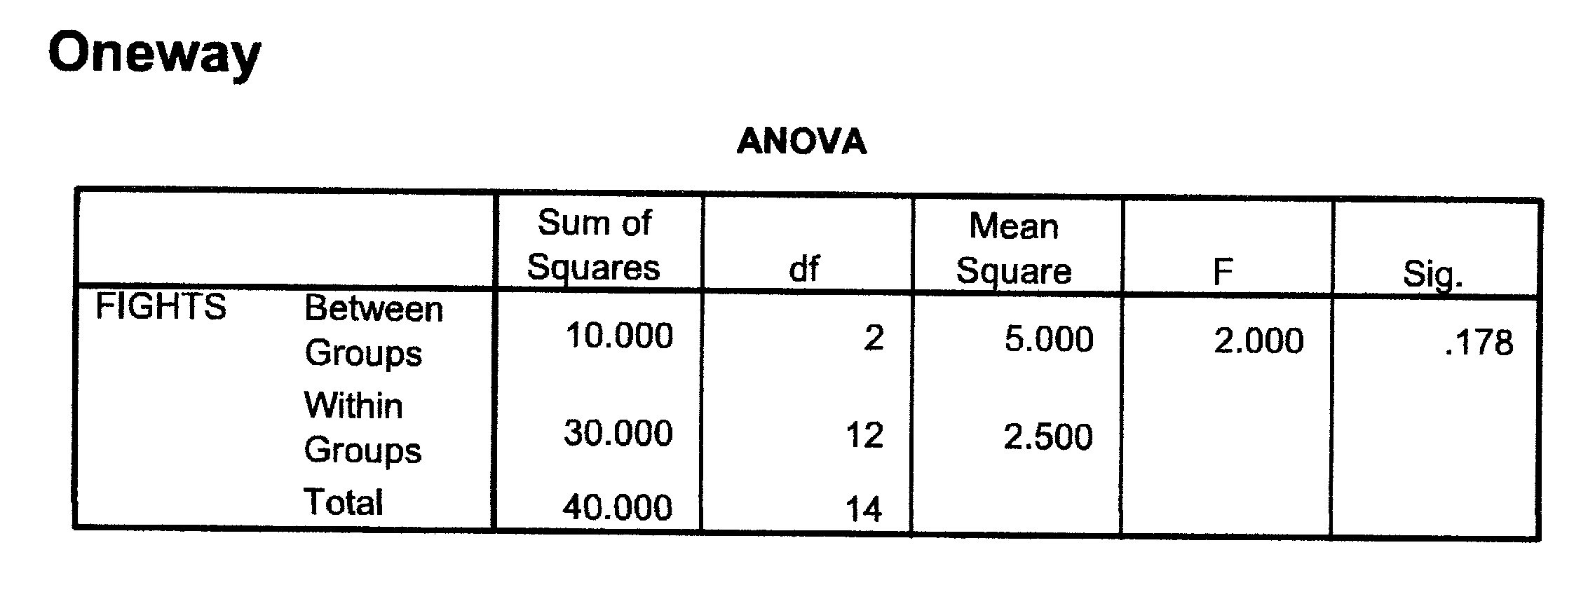
If Step 1 ANOVA not significant
p = .176 → not significant
There is no difference in number of fights between the three income levels as a child
Level of childhood income doesn’t help explain number of fights
No need to run Step 2 - Scheffe post hoc test
Notes:
.176 is not lower than .05
(we continue to use the critical p-value of .05)

Slide 6
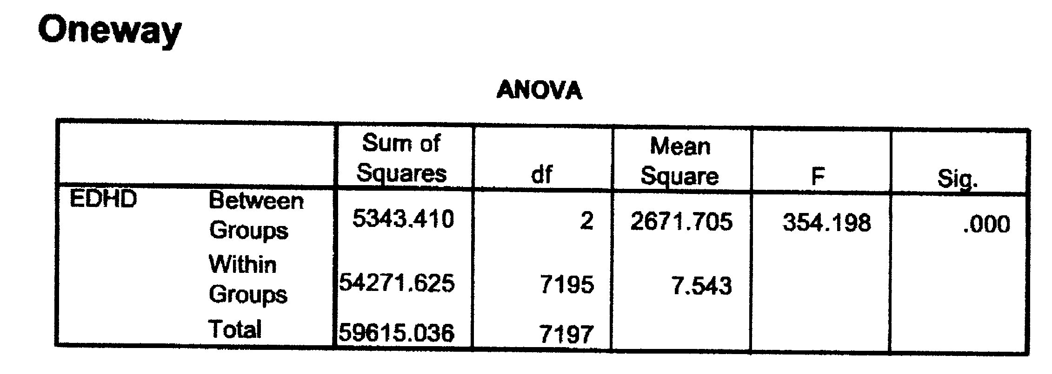
If Step 1 ANOVA IS significant
DV: Years of education of head
IV: 1=Grew up poor; 2=Grew up average; 3=Grew up rich
HO: The level of income while you grew up is not related to years of education
p < .001 (.000) → reject H0 → level of income as child is related to years of education
Run Scheffe post hoc test to find out where the relationship lies
Notes:
Because we found a significant difference and were able to reject H0 we will now go on to step 2.

Slide 7
Step 2: Scheffe post hoc test
If ANOVA, F-test is significant
There is a significant difference in means based on group membership
Are all groups differing from each other?
Does one group differ from the others?
Where does that difference lie?
Not all groups may have significant mean differences from all others
Notes:
What step 1 tells us is that there is a significant difference in means based on group membership. The first test does not tell us if there is just one group that is different or if all groups are different from each other. The Scheffe post hoc test helps us to determine where the differences lie.

Slide 8
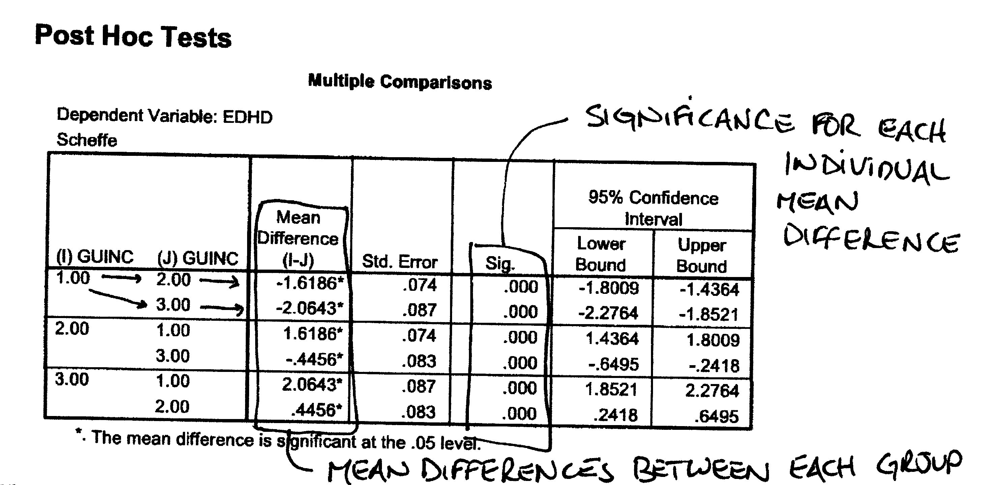
Scheffe test – orientation to output
1st “column” of column 1 – Group of interest (I)
2nd “column” of column 1 – Comparison group (J)
2nd column – Mean difference between I and J (I minus J)
Positive difference = group of interest has higher mean than comparison (more than)
Negative difference = group of interest has lower mean than comparison group (less than)
3rd column – standard error of difference between means
4th column – significance of difference in means between group of interest and comparison group
Notes:
Sample language for interpretation is on the next page
Here we have all of the different possibilities of comparison. We will interpret each group "relative" to each other. We are able to look at the sig. column to determine if all relationships or just some are significant. If only some are significant, that is important to note.
The Mean Difference column tells you the direction (positive/negative) and difference in the means in (I) relative to (J).

Slide 9
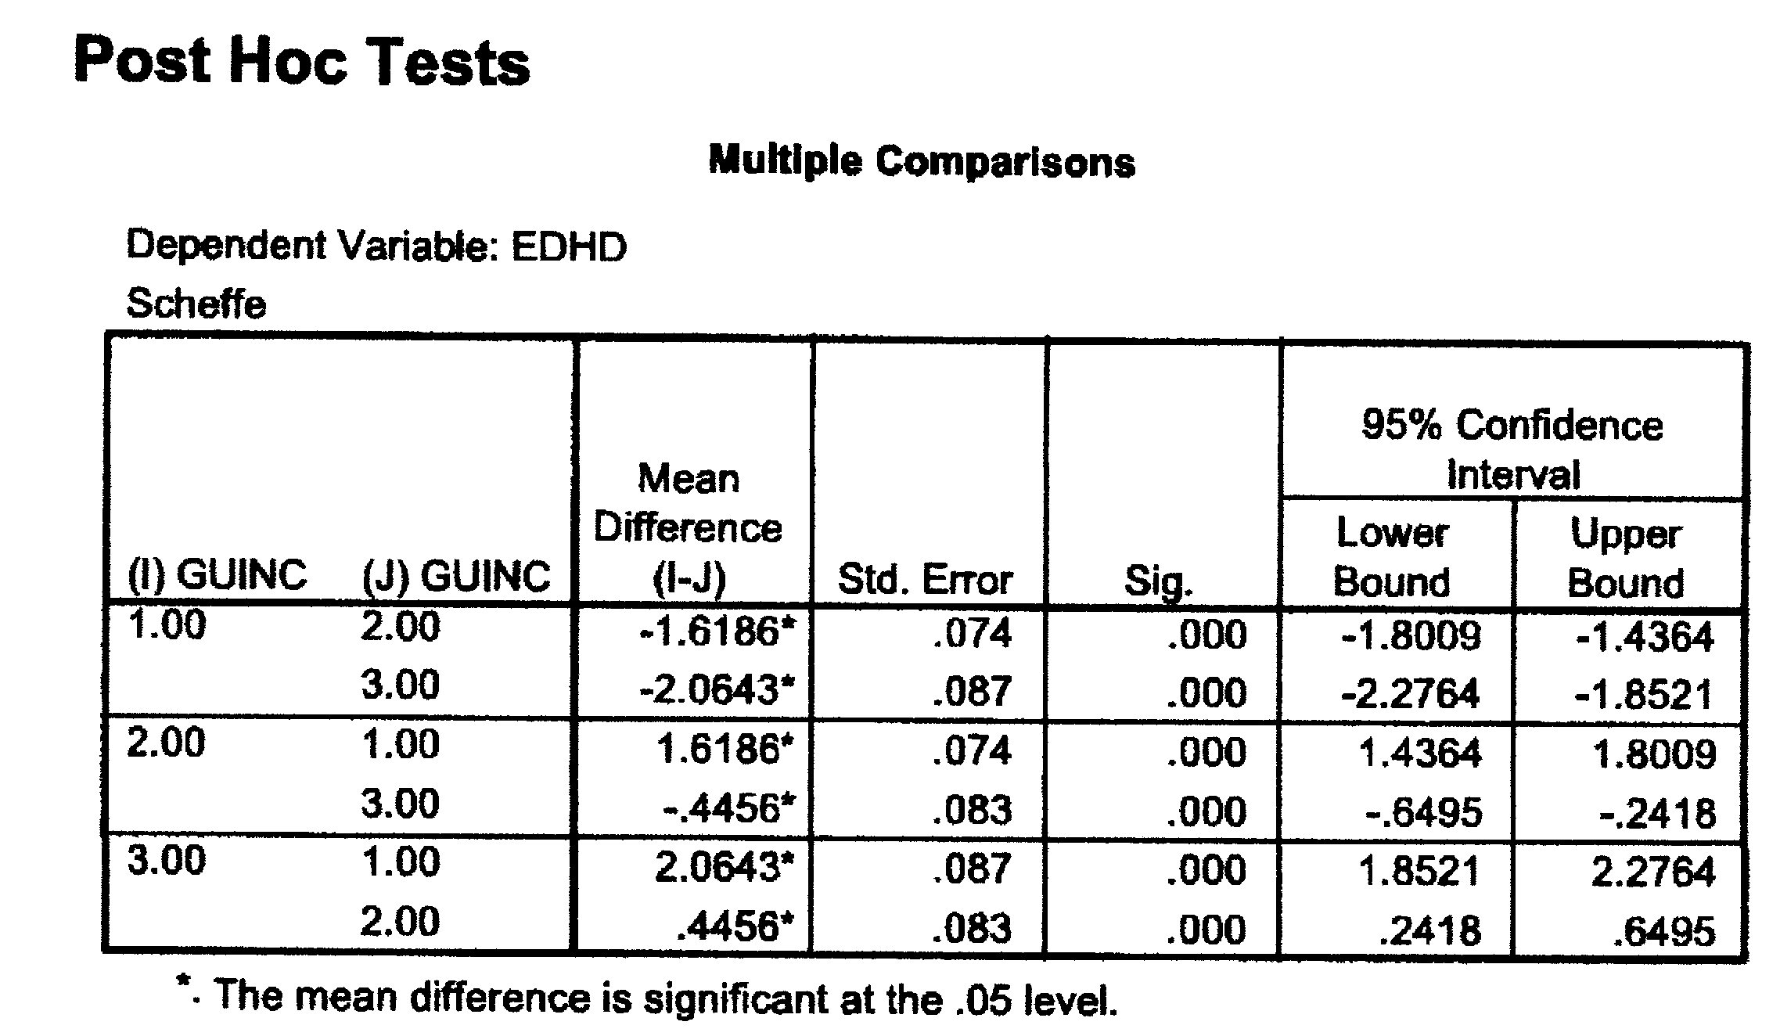
Those who grew up poor (1/I) have 1.62 fewer years of ed than those who grew up average (2/J).***
Those who grew up poor (1/I) have 2.06 fewer years of ed than those who grew up rich (3/J).***
Those who grew up average (2/I) have 1.62 more years of ed than those who grew up poor (1/J).***
Those who grew up with average (2/I) have .446 fewer years of ed than those who grew up rich (3/J). ***
Those who grew up rich (3/I) have 2.06 more years of ed than those who grew up poor (1/J).***
Those who grew up rich (3/I) have .446 more years of ed than those who grew up average (2/J).***
Notes:
To interpret you note what group in column I (reference) you are starting with and compare it to the column J group based on the positive/negative relationship and mean difference.

Slide 10
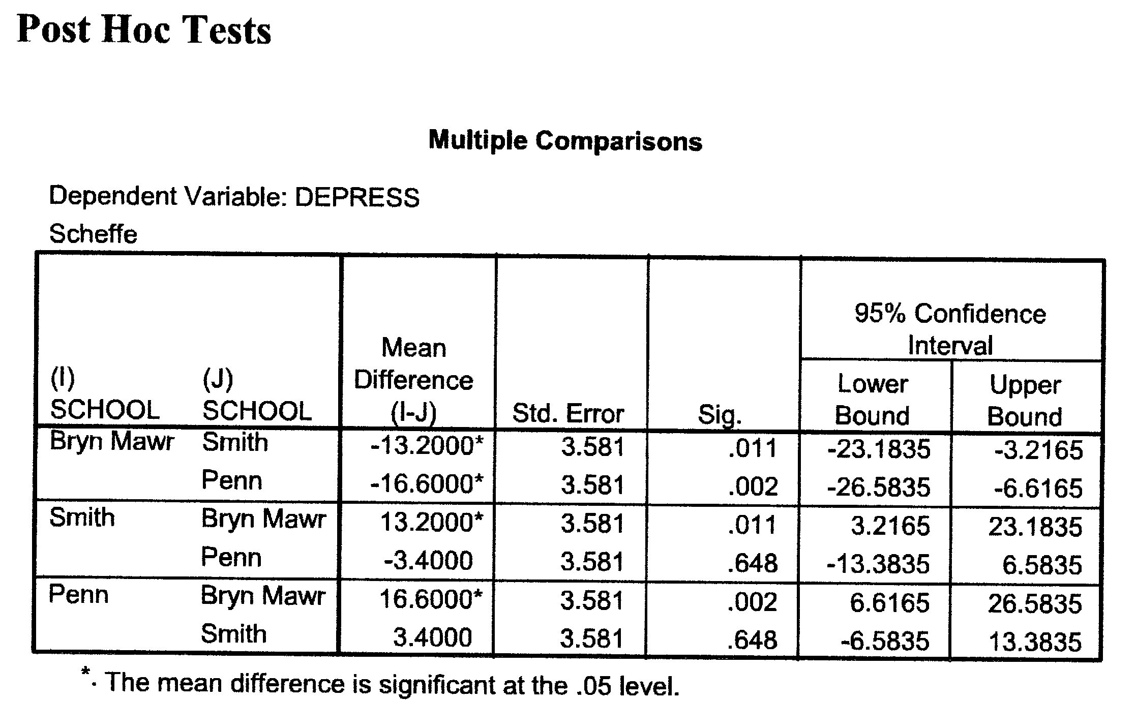
Practice
DV = depression scores; IV = social work school
F test: p =.001
Notes:
We see above that our F test(ANOVA) was found to be significant. This indicates we can interpret the Scheffe test.
Start with identifying significance. We see that all but the relationship between Smith and Penn are significant.
Some examples:
Those at Bryn Mawr have 13.2 lower depression scores compared to those at Smith.
Those at Bryn Mawr have 16.6 lower depression scores compared to those at Penn.
Note that you will get the reverse relationships. We compare Bryn Mawr to Smith (negative 13.2 lower depression scores) and when we have Smith as our reference group and compare it to Bryn Mawr it finds that Smith has 13.2 higher depression scores compared to Bryn Mawr).

Slide 11
T-Tests (Recorded Lecture Available – This will NOT be on your exam)

Slide 12
T-Tests
DV = I/R
IV = Dummy (only 2 options)
Testing difference in means between two groups
Significance
H0: Means of the two groups are equal
Test statistic = difference in means divided by standard deviation of the full group
Group standard deviation varies based on whether the individual SDs are significantly different or not
Levene’s Test for Equality of Variance
Testing whether the SDs for each group are significantly different or not
Notes:
You would use this test if you anticipate that two groups are different. The test allows you to find if there is a significant difference between two groups.

Slide 13
Two null hypotheses tested for T-tests
H0: The means of the two groups are the same.
Ultimate hypothesis that is being tested
H0: The standard deviations of the two groups are the same.
Sub-step needed to determine which row of the output to read to determine the difference in means
Levene’s test used to determine if the variances between the two groups is equal or unequal.
Notes:
We are taking into consideration two different areas. We are testing if the means of the two groups are significantly different as well as if the standard deviation of the two groups are different.

Slide 14
Steps for Interpreting T-tests
Step 1: Look at means for each group
Step 2: Use Levene’s Test to determine if the groups have equal variances (SDs). Do you accept or reject the null?
Step 3: Find significance for difference in means
If Levene’s test IS significant (less then 0.05) use “unequal” or “not assumed” row for difference in means
If Levene’s test is NOT significant (accept null) use “equal” row for difference in means
Step 4: Determine the difference between the means
Notes:
See next several slides for additional details for each of these steps.

Slide 15
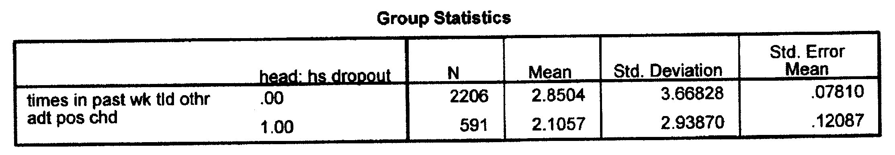
Step 1: First look at means
DV = Number of times parents said something positive about child
IV = Head is a high school dropout (1) or not (0)
Mean # of comments (head high school dropout) = 2.11
Mean # of comments (head not high school dropout) = 2.85
Cannot say whether these means are significantly different or not
Notes:
Remember our IV's have to be dummy variable with just two categories.
0 indicates the head is not a dropout.
1 indicates the head is a dropout.

Slide 16
Step 2: Levene’s Test for Equality of Variances
Testing whether the standard deviations for each group are statistically different from each other
Precursor to determining if there is a significant mean difference
H0: Standard deviations are the same
If accept Levene’s H0:
Equal variances assumed
Read the significance given in “assumed” or “equal” row
If reject Levene’s H0:
Equal variances not assumed
Read the significance given in “not assumed” or “unequal” row
Notes:
The Levene's Test for equality of variances tells us if the standard deviations for each group are statistically different from each other. We need to know this to identify what chart to go to next. This directs us where we need to go to find if there is a significant difference in our means.
Remember our H0 is that the standard deviations are the same. If do not find a significant difference we fail to reject/accept H0. This indicates we assume equal variance and will thus read that chart.
If we do find a significant difference in standard deviations we would reject our H0 and use the chart noting equal variance is not assumed/unequal.

Slide 17
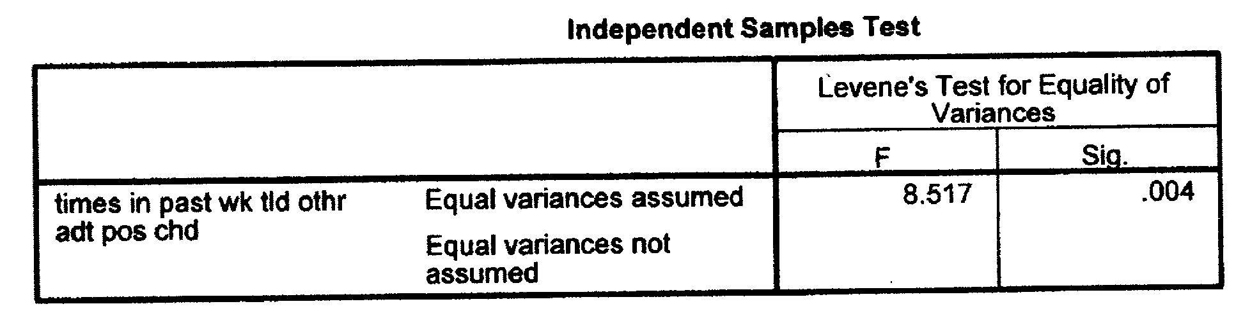
Levene’s test
Levene’s H0: Groups have the same standard deviations
p = .004
Disregard the assumed/not assumed distinction in this table
.004 < .05 → reject H0 → SDs are not the same
Variances not assumed equal or variances unequal
Notes:
On your printout look for the Independence Samples Test and go to the rows that are noted Levene's Test for Equality of Variances.
DISREGARD THE ASSUMED/NOTASSUMED DISTINCTION ON THIS TABLE
We will continue to use the critical p-value of .05. For the test to be significant our p-value must be below .05.
If we find significance we reject our H0 of SDs being the same.
In this case we find significance indicating that variances are not assumed to be equal.
We will thus look at the "equal variances not assumed" when comparing means.

Slide 18
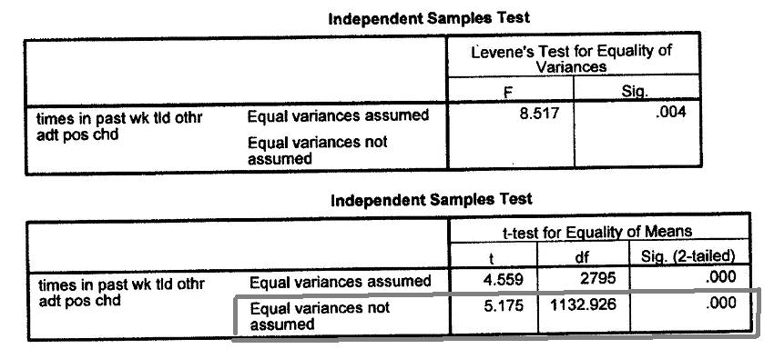
Stp 3: Mean difference significance
Levene’s p = .004 → equal variances not assumed (top box)
Determining significance of the mean difference (bottom box)
H0: The two groups have the same mean value
Look to significance in the row “equal variances not assumed” (bottom row)
p < .000 < .05 → reject H0 of similar means → means are different
Notes:
In the prior slide we used the Levene's test to determine that we will look at the equal variances not assumed row for comparing means.
We see our p-value is .000, which is less than .05. This supports rejecting our H0 of means being not different.

Slide 19
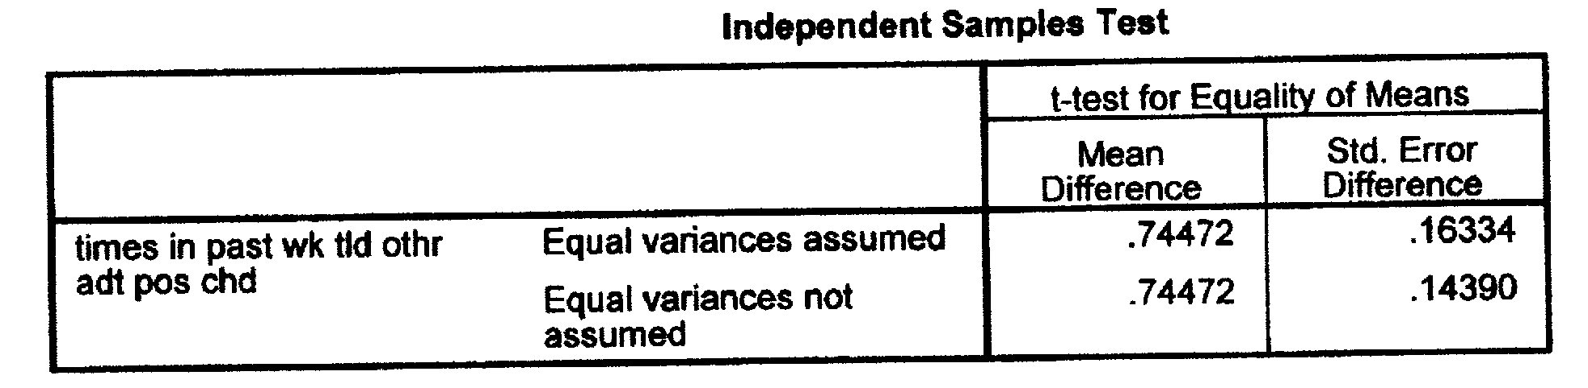
Stp 4: What is the mean difference?
Difference in means = .74472 (top table here)
Determining who has higher or lower mean (bottom table here)
Go back to table with the means for each group
Heads who are not drop outs have the higher mean
On average, high school graduates are predicted to speak positively about their children .745 more times in a week than dropouts.
Notes:
The table provides the difference in your means. To determine which mean is higher/lower you can go back to the initial table where we were looking at the means (You can also subtract these values).

Slide 20
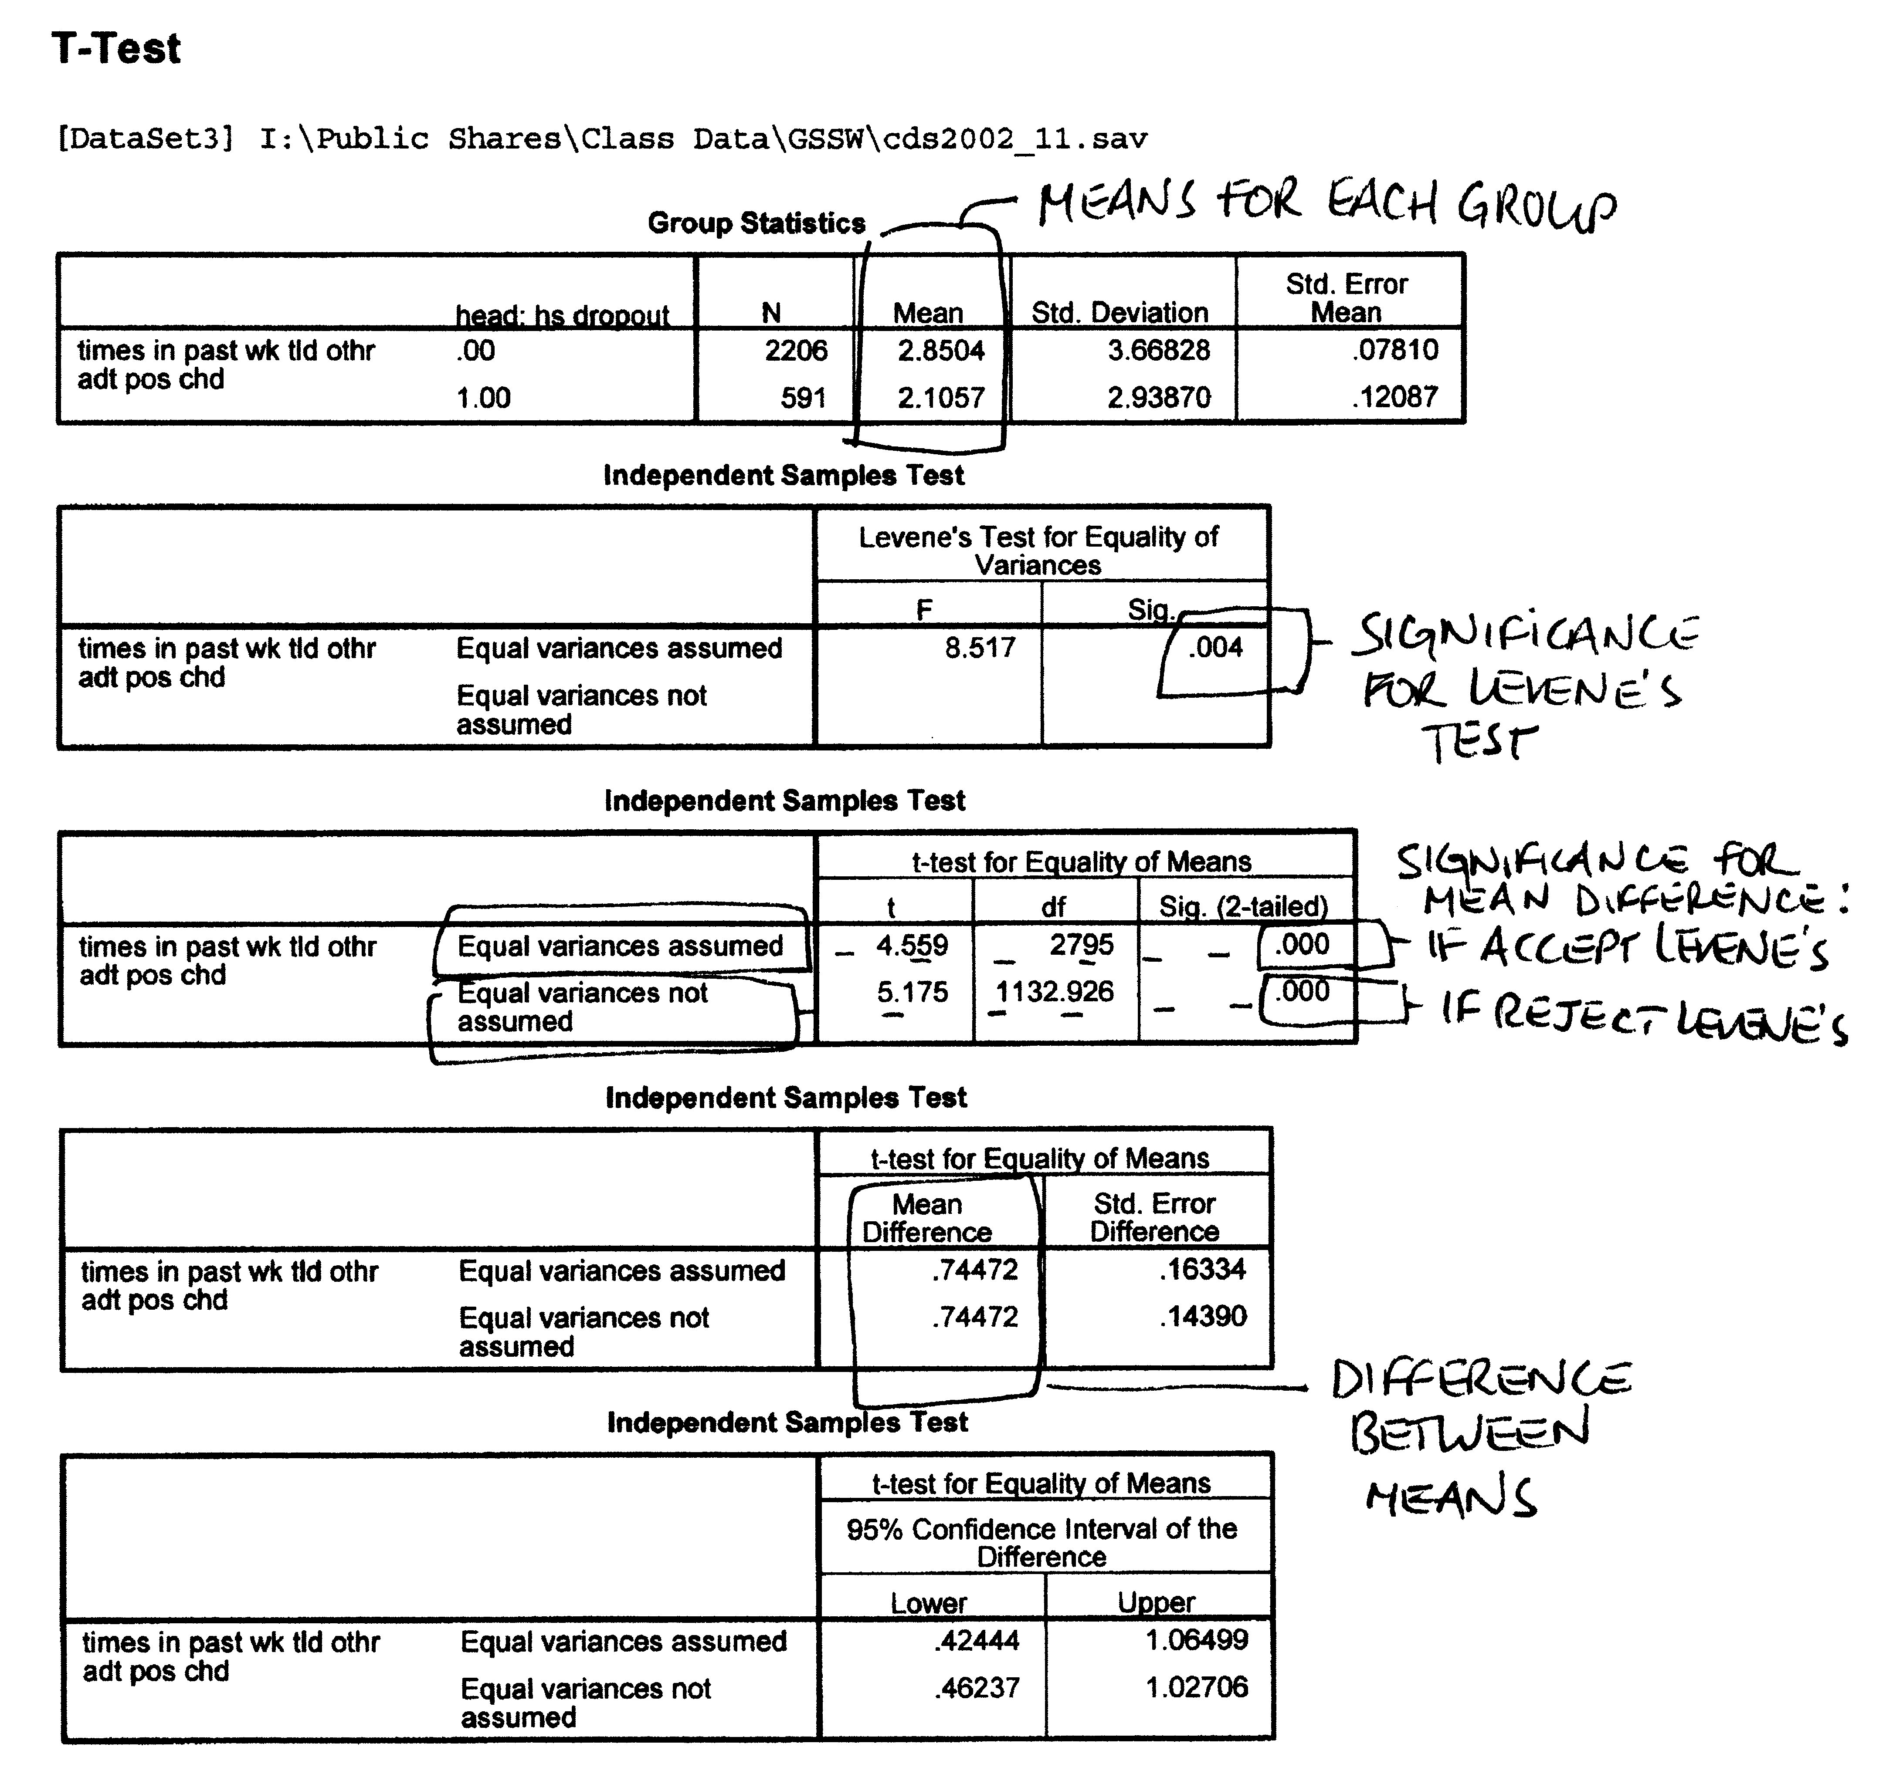
Notes:
This is what your printout might look like.
The first block is where you get your two means.
The second is where you test for significant different in variance. (Remember, ignore the labels of equal variance assumed/equal variance not assumed here – if it is significant you reject your H0).
The third is where you apply what you discover from the second table. This indicates if you have a significant difference in your means or not.
The fourth table is where you find the difference in your means.
The fifth table lets you have fun with Confidence Intervals again!

Slide 21
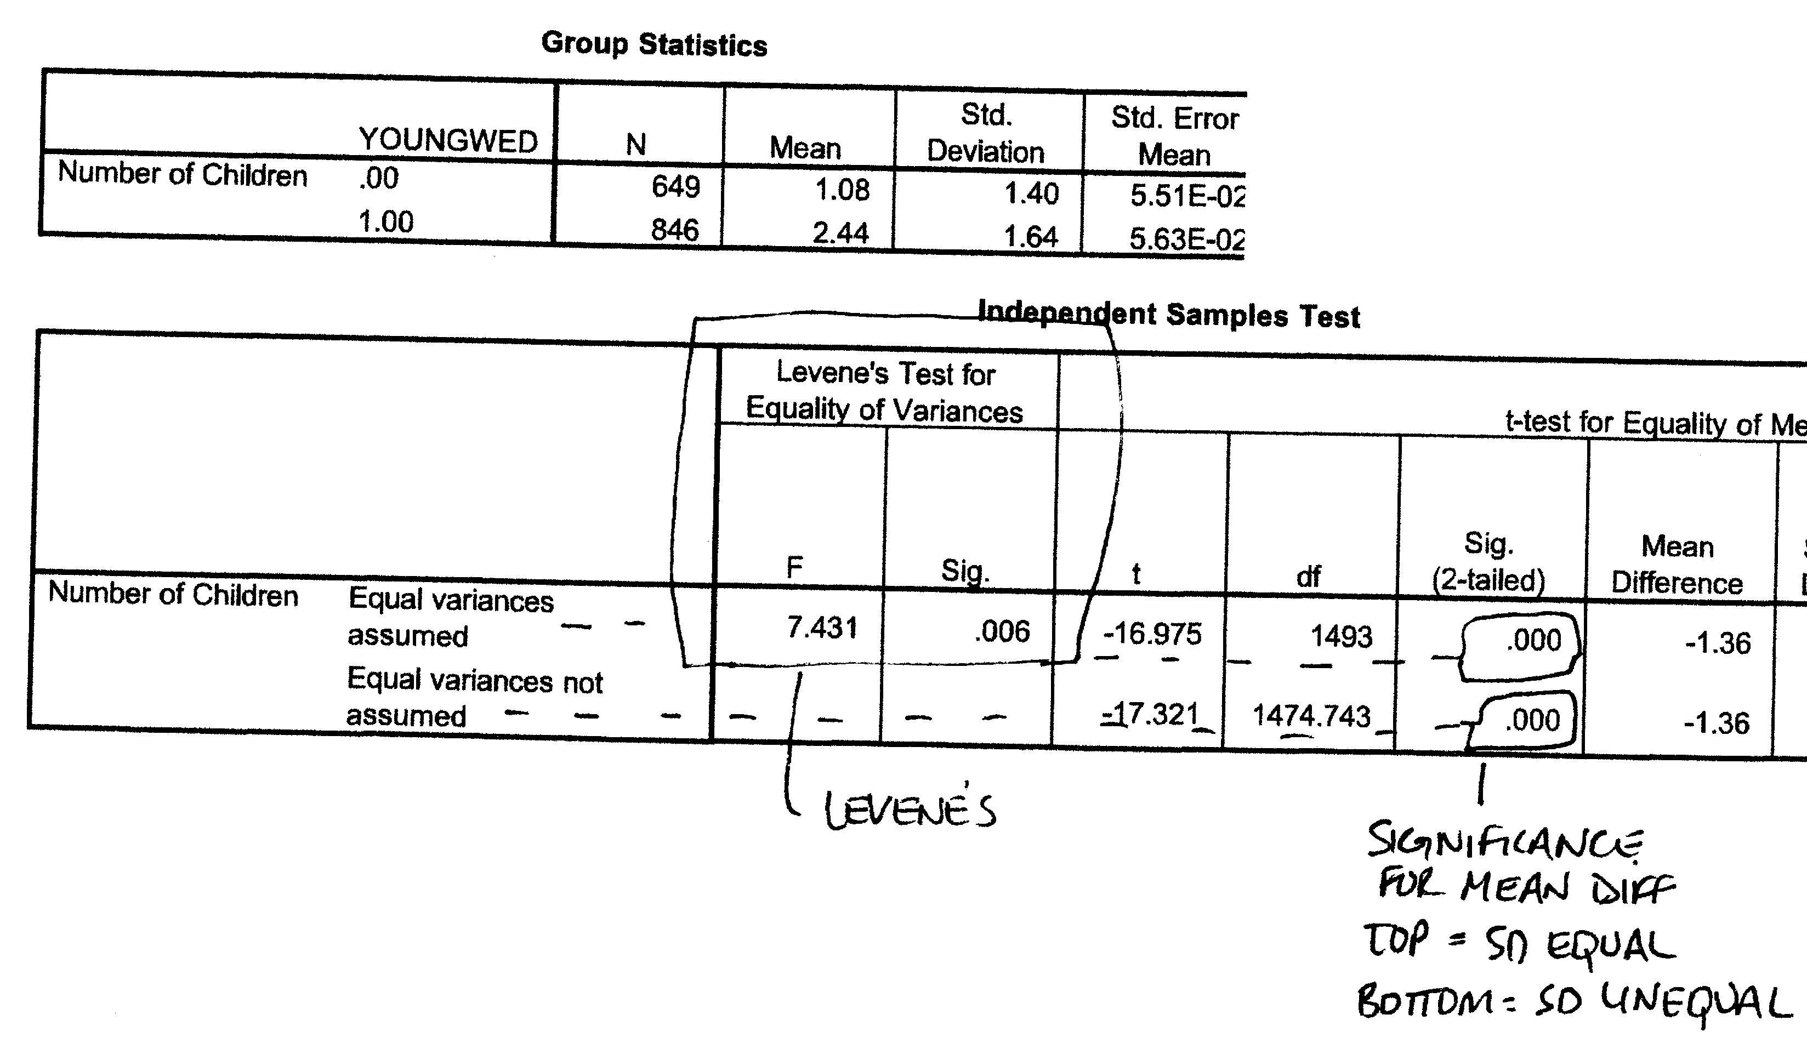
Example 2
DV = Number of children; IV = Those who marry young (1) and those who don’t (0)
Levene’s = .006 → reject H0 that SDs are the same → read “equal variances not assumed” row
Difference in means is significant at the p <.001 level (bottom .000)
Difference in means is 1.36
Those who wed young have 1.36 more kids than those who do not marry young.
Notes:
You might also have a printout that combines information. The second chart here has the same information but just in columns.
The first two columns provide the Levene's Test, the second three provide the significance of difference between means, and the last gives us the mean difference.

Slide 22
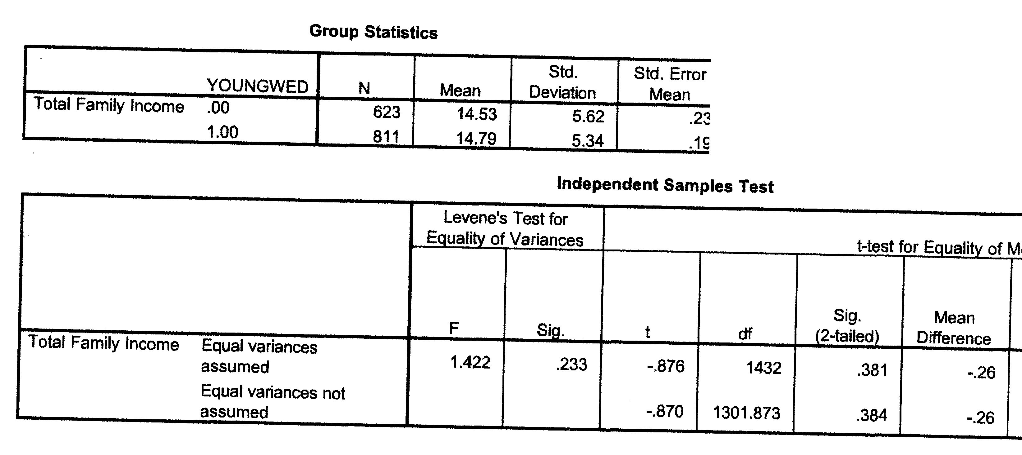
Practice Problem
DV = Family income; IV = Those who marry young (1) and those who don’t (0)
Interpret Levene’s
Significance of mean difference - equal variances “assumed” or “not assumed”?
What is the exact significance of the mean difference?
What is the mean difference, in narrative form?
Notes:
Levene's:
.233 is NOT lower than .05 - this indicates equal variance is assumed.
We will then look at the equal variance assumed row to the sig. level for difference in means
.381 is NOT lower than .05 - this indicates there is not a significant difference between our means
Mean difference
.26
Narrative form
Those who wed young have .26 less mean income than those who do not marry young.

