Slide 1

Development and Assessment in Childhood: Considering Trauma and Other Developmental Factors
Andrea October, MSS

Slide 2
School and Psycho-Social Development
Helps build comfort w/secure base separation
Assists w/developing pro-social behavior
Can raise stress levels and anxiety as adaption occurs
Sometimes a source of dysregulation

Slide 3
What Can Play Tell Us?
Developmental exploration
Sources of role modeling and exposure
Expression of stress and frustration
Curiosity and exploration
Pro-social development, thinking skills, etc.
Caution regarding gendered assumptions

Slide 4
Examining the Stress Regulation Study (Laurant)
Parents are beneficial to supporting co-regulation
Child adaptive responses develop over time and in response to environmental conditions
Sensitivity vs intrusiveness matters
Theory and this body of research proves the importance of attachment relations

Slide 5

Trauma and Child Development
Important to note developmental warning signs
Can occur as an impact of childhood neglect and abuse
ACEs study, most significant large-scale study examining the long-term effects of childhood trauma
Can affect cortisol levels
Tolerable vs toxic stress

Slide 6
ACE Indicators
Abuse
Household Challenges
Neglect
Physical
Mother treated violently
Physical
Substance abuse in the household
Emotional
Mental health challenges in the household
Separation from parent by divorce, death, or abandonment
Emotional
Sexual
Incarcerated household member

Slide 7
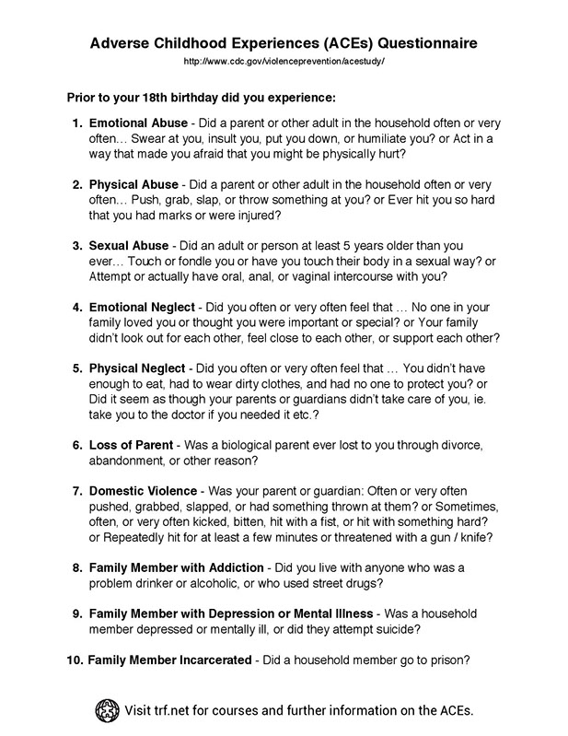
Notes:
Developer Notes
Write out example questions and have them pop out, can be an opportunity for a knowledge check
Example, identify some topics assessed in ACES questionnaire, can mix factual and false question
Outline + adult learning principles
Script:

Slide 8
Philadelphia Urban ACES
33.2% of adults experienced emotional abuse and 35% experienced physical abuse as children
35% lived in a household with someone struggling with substance use
40.5% witnessed violence during childhood (i.e. stabbing, shooting, etc.)
34.5% reported experiencing discrimination based on their race or ethnicity
27.3% reported feeling unsafe in their neighborhood or not trusting their neighbor
Over 37% experienced four or more ACES
Public Health Management Corporation (PHMC) Research and Evaluation Group (2013)
Notes:
Developer Notes
Photo skyline of Philadelphia w/each stat popping out of it
Script:

Slide 9
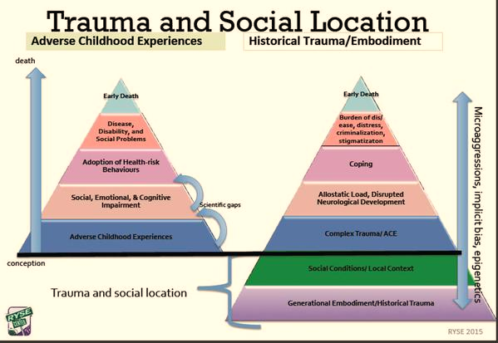
Notes:
Developer Notes
Each layer as a button w/scripting, will have to build each part of the pyramid
Separate pyramid as two slides
Script:

Slide 10

Neurological coping Resource

Slide 11
Resilience and Neuroplasticity
The brain is wired to adapt
Kauai study findings reflect experience does not equal destination
At least one trusted adult is key to fostering resilience
Think back to sensitivity vs intrusiveness…how does that foster resilience?
School environment can help foster self-regulation (although some may heighten stress levels)
Activities that promote critical thinking and problem solving
Offering opportunities for children to describe, express, and identify emotions

Slide 12
Tools for Screening, Assessment, and Recovery
Early intervention and head start programs
Age-appropriate screening tools
Community and cultural resources
Appropriate caregiver/family responses

