Slide 1

Le faux discours du colonialisme Français dans l’art
Notes:
(Come up with a better title)
Make a theme/argument more about how art/media is used to present the history that France wants to promote?
Exaggeration in art and omission of the truth

Slide 2
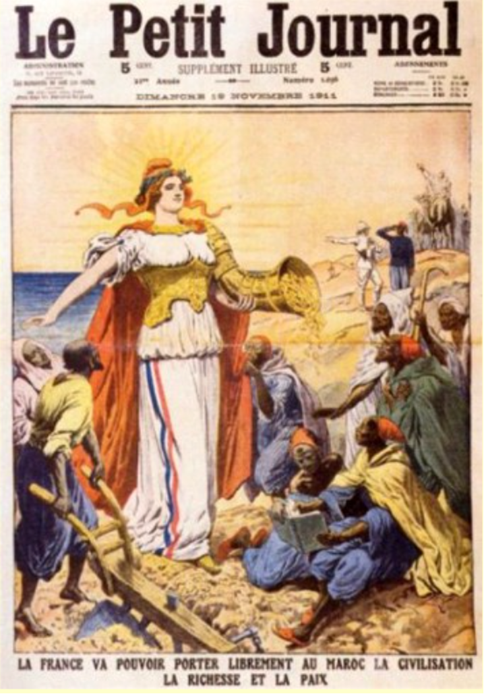
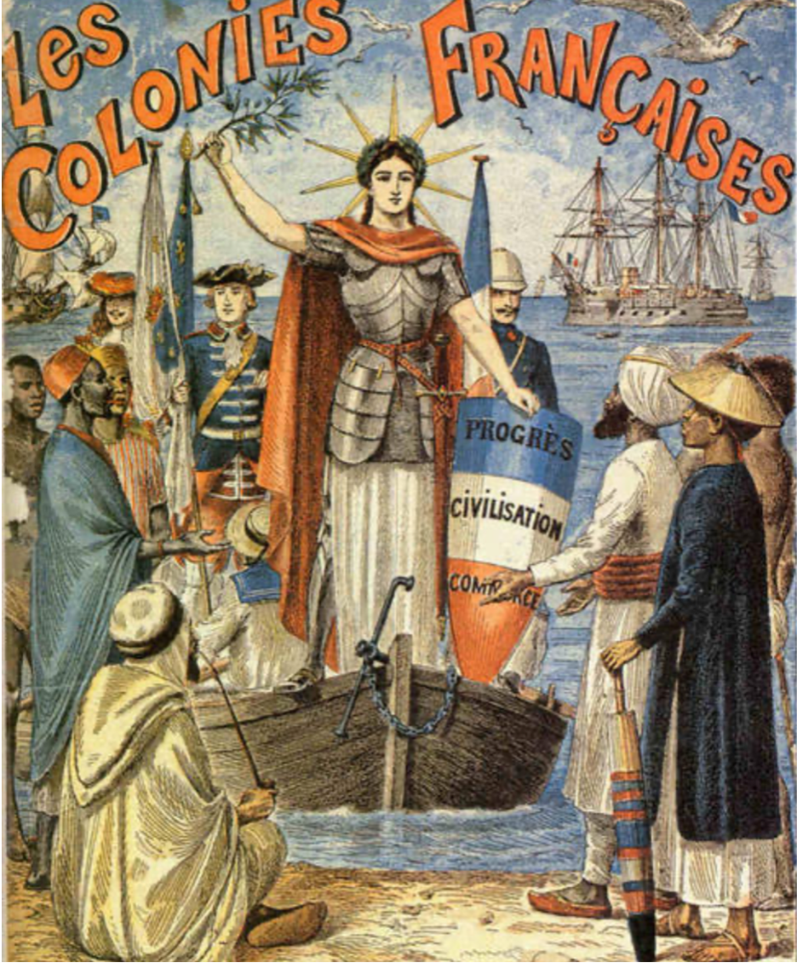
Marianne
Notes:
How France portrayed the colonized people
Weak/complacent/loyal/welcoming/desperate
Language: made it seem like they are simplistic

Slide 3

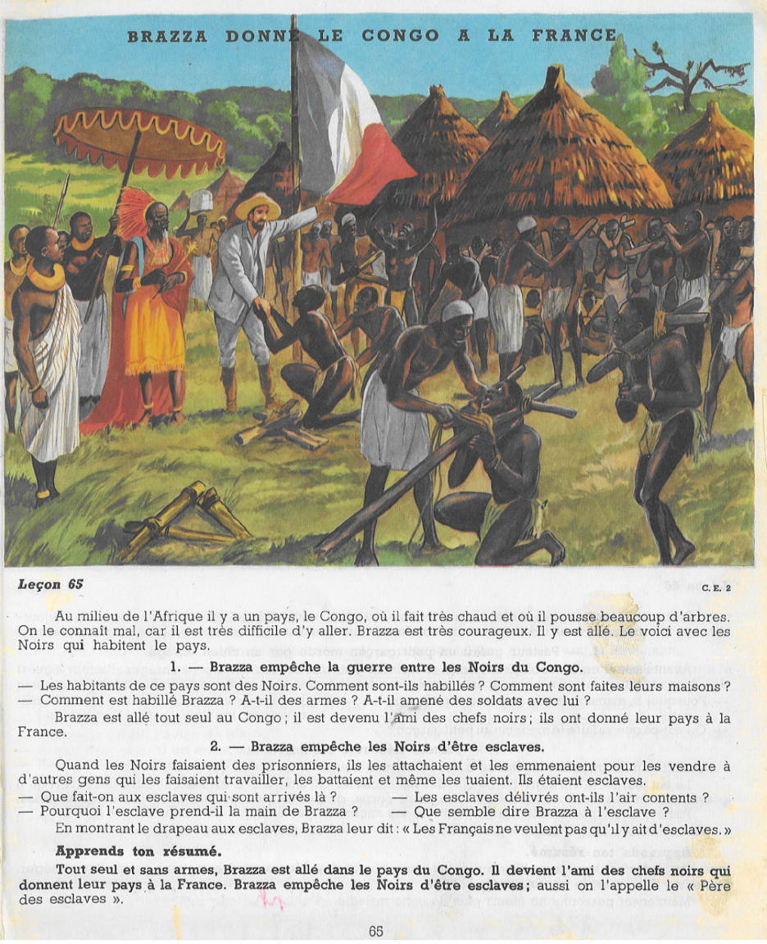
La Représentation des Noirs
Notes:
How France portrayed the colonized people
Weak/complacent/loyal/welcoming/desperate
Language: made it seem like they are simplistic

Slide 4
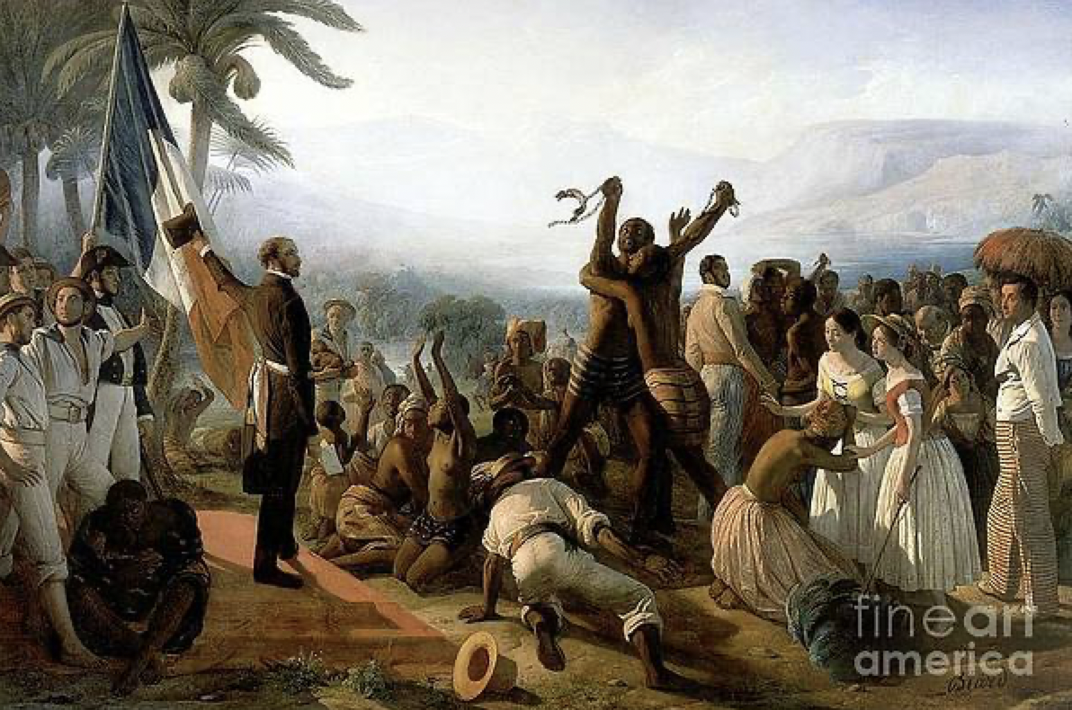
La Représentation des Noirs
Notes:
How colonized people were portrayed as…
It is supposed to be about their freedom but they are shown kneeling with their hands up as if they should be thankful to the white guys.

Slide 5
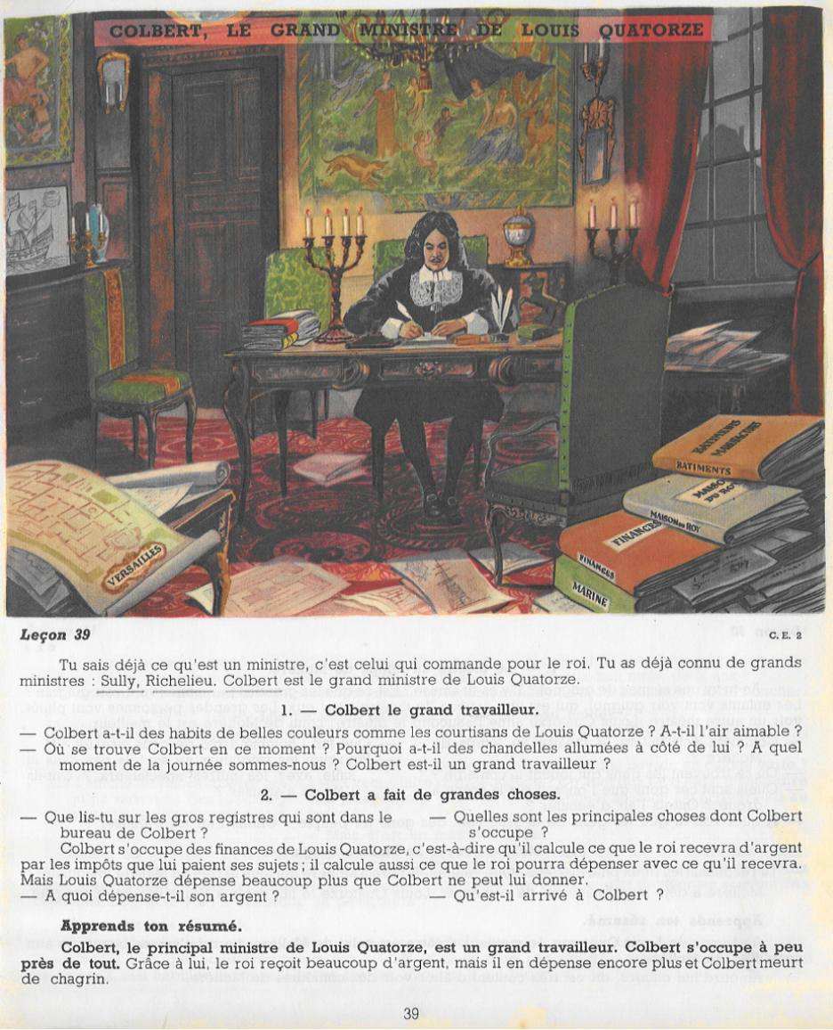
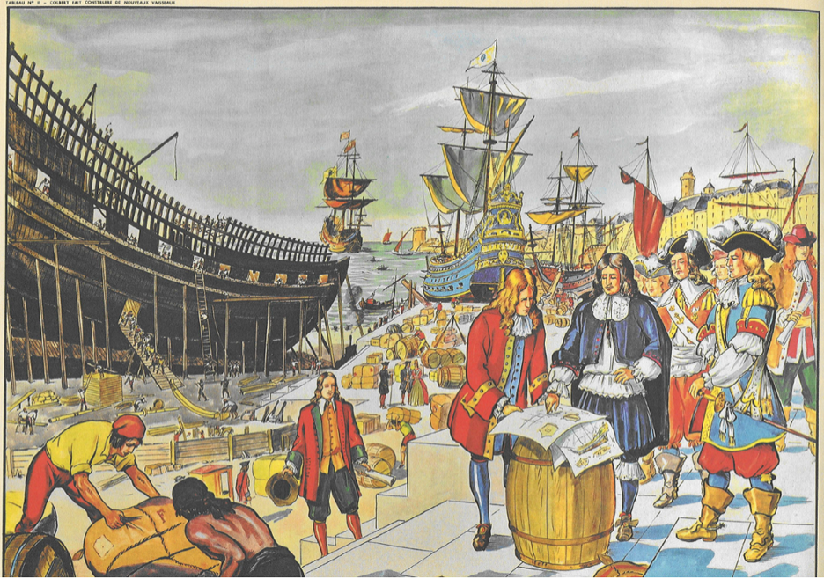
Jean-Baptiste Colbert
Notes:
Colbert - how he was portrayed as good person doing great things
The books are really big--to show all of his good works

Slide 6
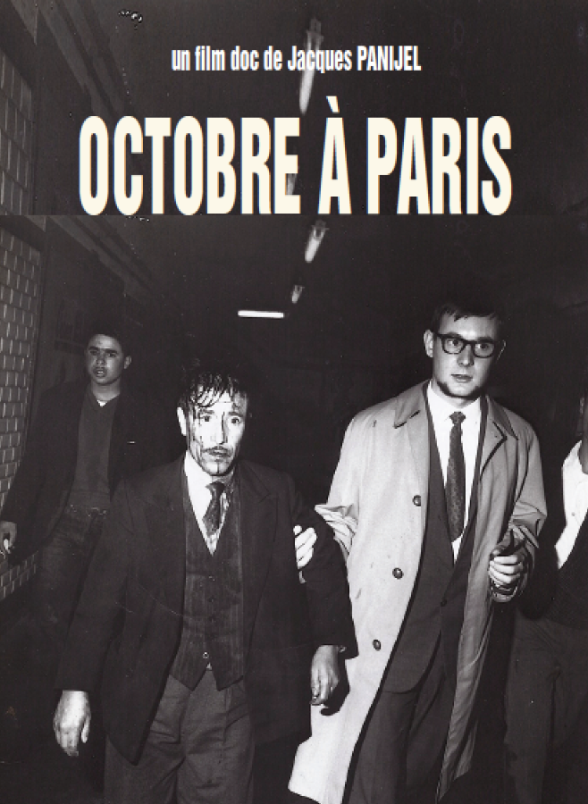

Les Films Réalistes
Notes:
Films have been censored if they criticized France’s colonial past.

Slide 7

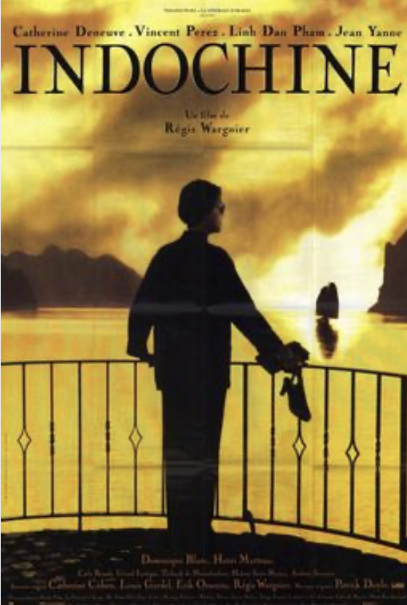
Les Films Idéalistes
Notes:
Films have been censored if they criticized France’s colonial past.

Slide 8
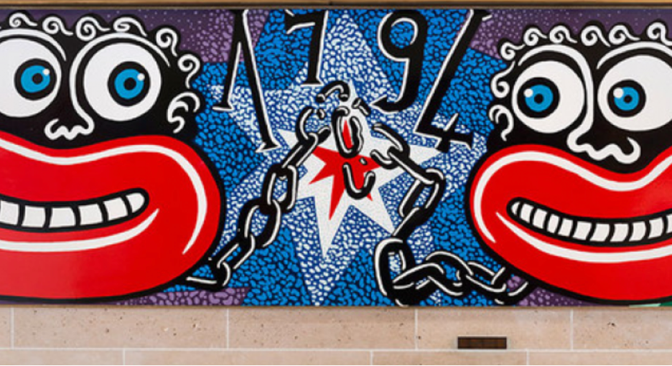
La Fresque
Notes:
Read about this in the link in the document
Modern efforts to show how they are coming to terms with their past (failing at it)
Omitting the second date when slavery was abolished
Blackface
Exaggerated features: Only have exaggerated features on white people (Marianne) to show dominance, while exaggerated features on black are used to mock.
Omitting the white oppressive power

Slide 9
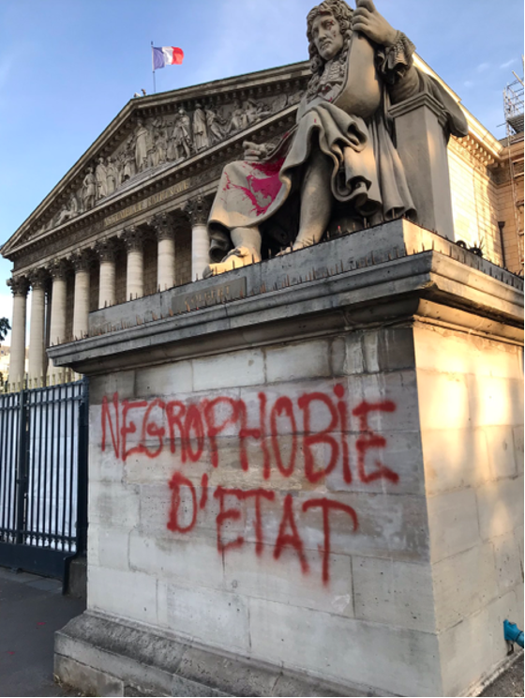
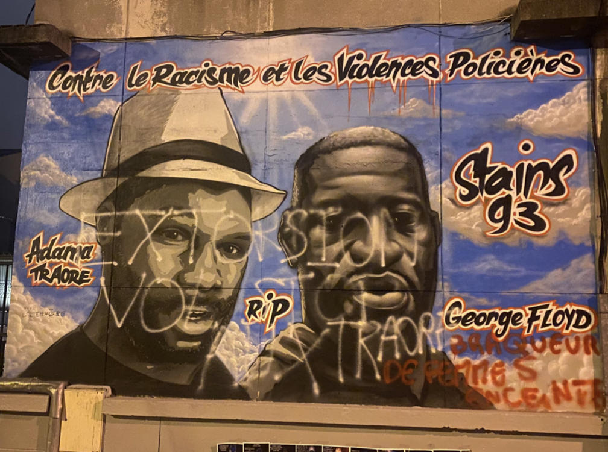
La Résistance
Notes:
French people fighting back and bringing awareness of the rampant racism
Left: martyrs, light
Right: More official, placed in front of the National assembly
(How fast was the graffiti taken off of the painting versus take off Colbert statue?)

Slide 10
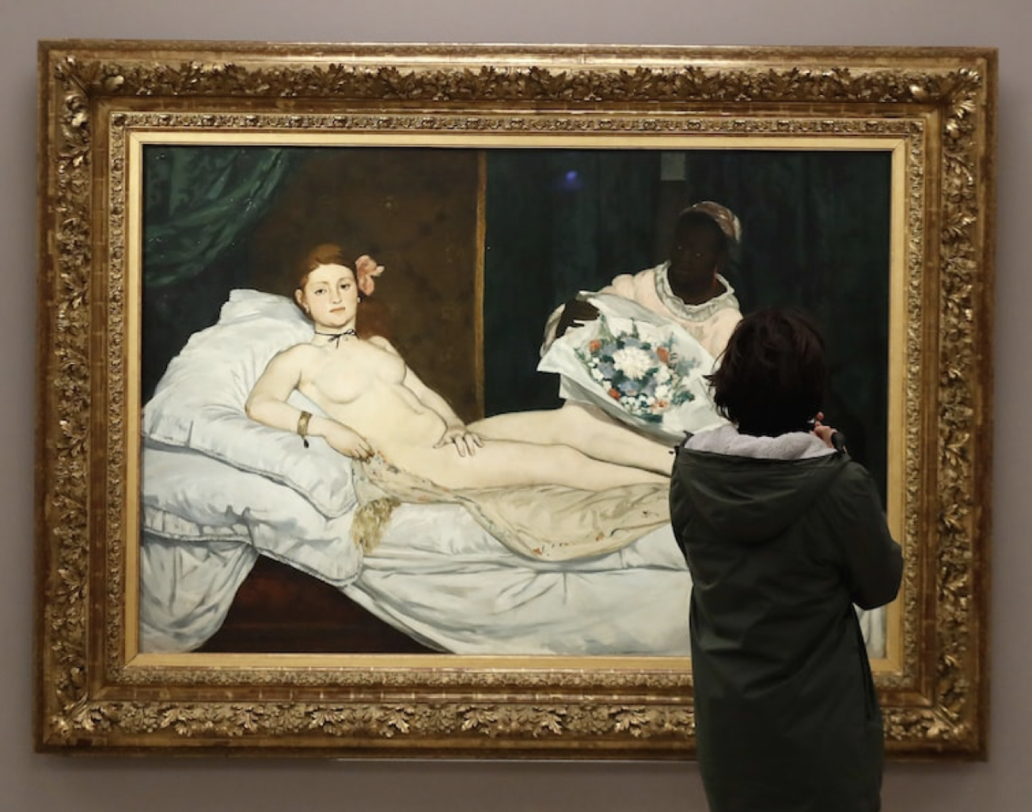
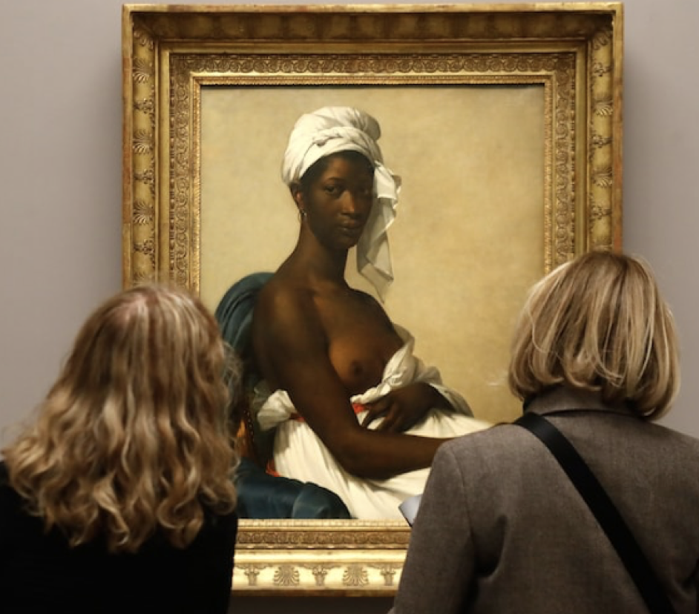
Voix Noires
Notes:
French people fighting back and bringing awareness of the rampant racism
Left: martyrs, light
Right: More official, placed in front of the National assembly
(How fast was the graffiti taken off of the painting versus take off Colbert statue?)

Slide 11
Bibliographie
Benneyworth, IJ. « The Ongoing Relationship Between France and its Former African Colonies. » E-International Relations. https://www.e-ir.info/2011/06/11/the-ongoing-relationship-between-france-and-its-former-african-colonies/ Accès 21 novembre 2021.
« Chocolat. » Wikipedia. https://en.wikipedia.org/wiki/Chocolat_(1988_film. Accès 21 novembre 2021.
Collins, Lauren. « Le Meneur Une Campagne Retirer une Troublant Peintre De L'assemblée de Français de Nationale. » New Yorker
https://www.newyorker.com/culture/cultur al-comment/the-campaign-to-remove-a-shocking-painting-from-the-french-national-assembly Accès 22 novembre 2021.
Donadio, Rachel. « France is Officially Color-blind. Reality Isn’t. » The Atlantic. https://www.theatlantic.com/international/archive/2020/07/france-race-racism-grande-ecoles/613924/. Accès 23 novembre 2021.
« France won’t ‘erase’ history by removing colonial-era statues, Macron says. » France 24. https://www.france24.com/en/20200614-macron-vows-that-france-won-t-take-down-statues-or-erase-history. Accès 23 novembre 2021.
« Indochine. » Wikipedia. https://en.wikipedia.org/wiki/Indochine_(film) Accès 23 novembre 2021.
« L'abolition de l'esclavagisme dans Les Colonies Français. » fineartamerica. https://fineartamerica.com/featured/the-abolition-of-slavery-in-the-french-colonies-francois-biard.html Accès 21 novembre 2021.

Slide 12
Bibliographie
« Le rameau d'Olivier Le Définition et Signification: » Merriam-Webster, Merriam-Webster, https://www.merriam-webster.com/dictionary/olive%20branch Accès novembre 23 2021.
McAuley, James. « A Paris art exhibit renames paintings to put the focus on their black subjects. » The Washington Post. https://www.washingtonpost.com/world/europe/a-paris-art-exhibit-renames-paintings-to-put-the-focus-on-their-black-subjects/2019/03/26/16a48a02-8268-4fee-9173-c20ca860913b_story.html. Accès novembre 23 2021.
« Marianne et le Divise de la République. » Gouvernement. https://www.gouvernement.fr/en/marianne-and-the-motto-of-the-republic. Accès 20 novembre 2021.

