Slide 1

Development and Assessment in Childhood and Adolescence: Disorders Diagnosed in Adolescence
Andrea October, MSS

Slide 2
Physical Growth and Development
“growth spurts”
Changes in hair, acne, voice deepening, reproductive organ development, breast development
General hormonal shifts
Body shape
Frontal lobe remains underdeveloped

Slide 3
Psycho-social Changes
Erickson: Identity vs Confusion, greater importance towards peer groups and identity exploration
Deeper concern w/oneself
Struggle between self-acceptance and gaining the approval of others
Interest in love and romance
Values emerge separate from parental beliefs
May engage in substance use and sexual exploration
Potential for gravitating towards socially deviant activities or groups-out of exploration or parental opposition

Slide 4
Development or Diagnosis?
Struggles w/managing emotions and mood
Remember frequency, setting, and level of disruption as a guide
Impact of hormonal growth and changes
Use DSM, PIE, and professional collaborations
Give attention to co-occurring factors

Slide 5
Mental Health Disorders in Adolescence
Anxiety and Mood Disorders
ADHD, Conduct D/O, and ODD
New research indicates Borderline Personality Disorder emerges during adolescent yrs but is not formally dx until 18+
Suicide risk is a concern, leading cause of death for young people 15-24: important to distinguish suicide from non-suicidal self-injury

Slide 6
Risk Factors
Family hx of mental health
Stressful home environment
Struggles w/grief, lost, frequent adjustment changes
Challenges at school, both academic and social
In-utero exposure
Neighborhood conditions
Minority Stress Theory

Slide 7
Culture, Race, and Gender
Different cultures and communities recognize this development shift in unique ways
Challenges w/gender and sexual identity-risk factors for LGBTQIA+ youth
Role of unconscious bias w/overdiagnosis of disruptive bx for youth of color (Atkins et al., 2015)
Stigma and attitudes towards help-seeking: family influences
Gender differences w/internalizing vs externalization as well as risk for mental health stress and help-seeking behaviors
Co-occurring dx w/developmental, cognitive, or intellectual conditions

Slide 8
Treatment options
Psychopharmacology-important to monitor side effects
Outpatient MH, Partial Hospitalization Programs, in-patient facilities
Evidence-based interventions (e.g. TF-CBT)
14+ can make decisions regarding clinical care and medication

Slide 9
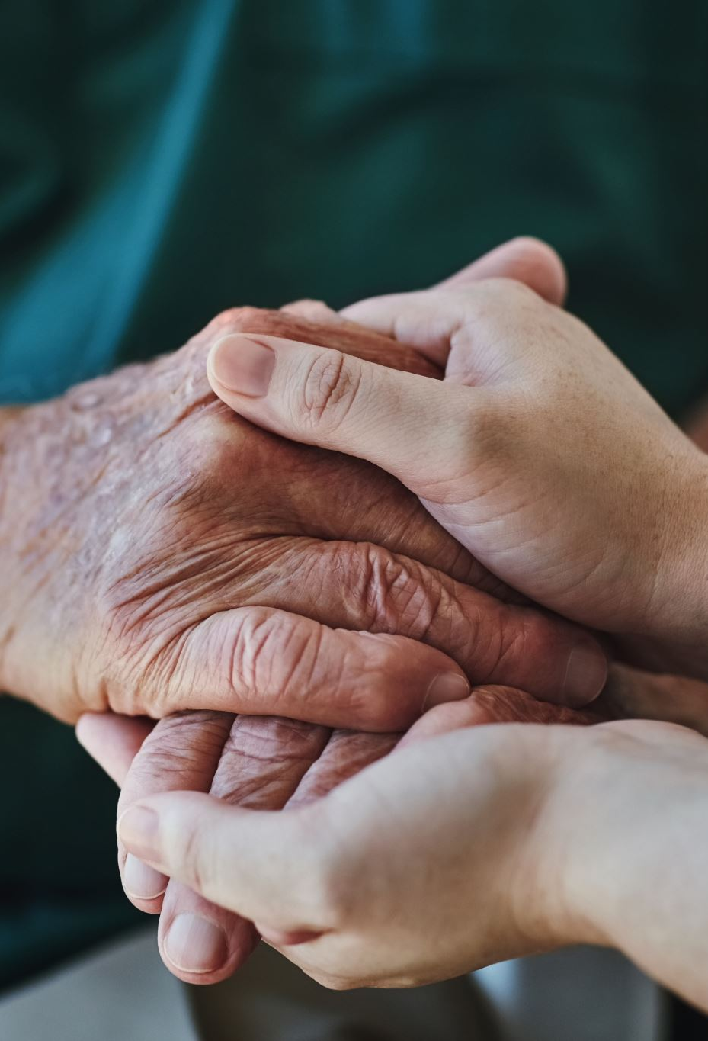
Protective factors
Trauma-informed care practices are helpful (Shapiro et al., 2018)
Affirming environments that support/permit identity development
Connection w/social spaces outside of school
Mentoring and support resources
Boundaries and structure

Slide 10

Reflection about MH Recovery

