Slide 1
Bioplastics
Week 1 : Synthesis
Week 2: Characterizaiton

Slide 2
Bioplastics
Advantages
Disadvantages

Slide 3
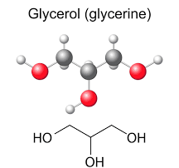
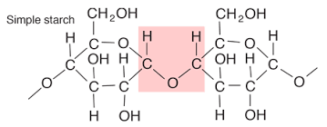
Synthesis of starch/glycerol bioplastic

Slide 4
Starch/Glycerol Bioplastic

Slide 5
Chitosan/Alginate Bioplastic
Sodium alginate

Slide 6
Chitosan

Slide 7
Chitosan/Alginate Polymer

Slide 8
Beer’s Law Review
A = εcl

