Slide 1

Depressive Disorders, Anxiety Disorders and Obsessive-Compulsive Disorders and Bipolar Disorders
Andrea October, MSS

Slide 2
Depressive Disorders
Separated from Bi-Polar and Related D/O in the DSM update from IV to V
All reflect degrees of mood impact, somatic responses, and cognitive processing
Differences related to timing, length, and source of disruption
Major Depressive Disorder: https://dsm-psychiatryonline-org.proxy.brynmawr.edu/doi/full/10.1176/appi.books.9780890425787.x04_Depressive_Disorders#BCFJBIIA

Slide 3
The Surveillance of Depression
Increased diagnosis by primary care physicians, especially in the elderly
Vast market of screening tools, and huge research industry
https://healthymindsphilly.org/screening/
Fueled by pharmaceutical industry-framed as a brain disorder
Fueled interest in short-term psychotherapeutic interventions
  CBT (amenable because of the connection to negative self talk)

Slide 4

Are we witnessing a loss of sadness and normal grief?

Slide 5
Why should we care about over-diagnosing Major Depression?
Pathologizing normative human reactions
Delaying grief processing and its social function
Over-medicalizing; denial of psychological, social, and developmental causes of sadness, which leads to over-simplification and stigma
Using research for those with MDD without cause, or those with very intense complicated grief reactions
  Greater specification in treatments

Slide 6
Risk Factors
Family hx
Struggles w/grief or loss
Hx of abuse
Degrees of psychological stress (e.g. conflict, work, interpersonal, etc.)
Significant life changes
Medication side effects

Slide 7
Treatments for Depression
Medications
Psychotherapy; psychodynamic, CBT
Group work
Hospitalization
Self-help strategies

Slide 8
Other Disorders
Persistent Depressive Disorder
https://dsm-psychiatryonline-org.proxy.brynmawr.edu/doi/full/10.1176/appi.books.9780890425787.x04_Depressive_Disorders#BCFHGBJG
Pre-menstrual (PMDD)
https://dsm-psychiatryonline-org.proxy.brynmawr.edu/doi/full/10.1176/appi.books.9780890425787.x04_Depressive_Disorders#BCFIEGFF
Unspecified Depressive Disorder
https://dsm-psychiatryonline-org.proxy.brynmawr.edu/doi/full/10.1176/appi.books.9780890425787.x04_Depressive_Disorders#BCFDHFGE

Slide 9
Bipolar Disorder
Bi-Polar 1:
https://dsm-psychiatryonline-org.proxy.brynmawr.edu/doi/full/10.1176/appi.books.9780890425787.x03_Bipolar_and_Related_Disorders#BABHFJAB
Bi-Polar II:
https://dsm-psychiatryonline-org.proxy.brynmawr.edu/doi/full/10.1176/appi.books.9780890425787.x03_Bipolar_and_Related_Disorders#BABCGEIE
Epidemiology (1-2%)
Family risk
Premature mortality due to suicide

Slide 10
Bi-Polar D/O Myths and Stereotypes
Presentation contains highs and lows frequently back-to-back
At times, used inappropriately in everyday language to describe someone struggling w/mood management
Individuals w/this condition are risky/dangerous
What are others you have heard?

Slide 11
Positive Psychological Traits
High levels of creativity and artistic expression
Ambitious and driven
Spirituality and resilience
Empathy

Slide 12

Differences: Bi-Polar I vs Bi-Polar II

Slide 13
Risk Factors for Development and Severity
Genetics
Childhood trauma
Stressful life events
Substance Use
Brain chemistry

Slide 14
Related Disorders
Unspecified Mood Disorder
https://dsm-psychiatryonline-org.proxy.brynmawr.edu/doi/full/10.1176/appi.books.9780890425787.x03_Bipolar_and_Related_Disorders#x59242.4649335
Cyclothymic Disorder
https://dsm-psychiatryonline-org.proxy.brynmawr.edu/doi/full/10.1176/appi.books.9780890425787.x03_Bipolar_and_Related_Disorders#BABIJIIA

Slide 15
What is anxiety?
Anxiety is a response to a threat. It alerts the individual to danger. It differs from fear in that the source is often unknown, although there are circumstances in which a specific identified stressor will result in situational anxiety that recedes when the stressful event is over. Anxiety is described as an unpleasant feeling, directed toward the future.
Anxiety is an anticipatory signal that there is a concious or unconcious threat to life, emotional stability, or equilibrium.
Notes:
Austrian page 12; “Anxiety is a response to a threat. It alerts the individual to danger. It differs from fear in that the source is often unknown, although there are circumstances in which a specific identified stressor will result in situational anxiety that recedes when the stressful event is over. Anxiety is described as an unpleasant feelings, directed toward the future. “
“Anxiety is an anticipatory signal that there is a concious or unconcious threat to life, emotional stability, or equilibrium.

Slide 16
Anxiety Disorders
Panic Disorder
Agoraphobia
Generalized Anxiety Disorder
Social Phobia
Specific Phobia
Obsessive-Compulsive Disorder

Slide 17
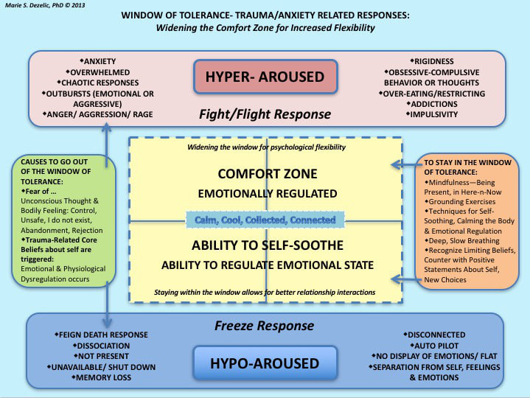

Slide 18
Assessing For Anxiety Disorders
Examine
  Physiological response
  Overwhelmed by concerns of harm (cognitive)
  Lack of logical reasoning in reducing anxiety
  Maladaptive coping strategies

Slide 19
Panic Disorder and Agoraphobia
http://dsm.psychiatryonline.org/doi/full/10.1176/appi.books.9780890425596.dsm05#BABEADGH
http://dsm.psychiatryonline.org/doi/full/10.1176/appi.books.9780890425596.dsm05#BABICDCA

Slide 20
Generalized Anxiety Disorder
Frequency, intensity, persistance, and duration
http://dsm.psychiatryonline.org/doi/full/10.1176/appi.books.9780890425596.dsm05#BABDFBHJ

Slide 21
Social Anxiety Disorder
http://dsm.psychiatryonline.org/doi/full/10.1176/appi.books.9780890425596.dsm05#BABHHJFI
This is not shyness

Slide 22
Obsessive-Compulsive Disorder
Difference between obsessions and compulsions
http://dsm.psychiatryonline.org/doi/full/10.1176/appi.books.9780890425596.dsm06#BABGHDGD
http://symptommedia.com/anxiety-assessment-5/

Slide 23
Anxiety Risk Factors
Childhood distress over new social situations
Exposure to negative life events and challenging environments
Family hx
Physical health or substance influenced

Slide 24
How is anxiety treated?
Psychodynamic perspectives
Cognitive perspectives (ACT is a newer EBP)
Biological perspectives
Systems perspectives
8 million+ prescriptions written every year, mostly by internists
SSRIs
Benzodiazepines

Slide 25
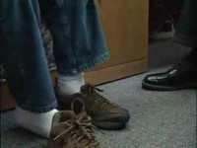
Treatment Example

Slide 26
Potential Co-Morbidities
Depression + Anxiety Related Diagnoses
Depression + Physical health or cognitive related condition
Depression + Anxiety+ Substance Use Related Diagnoses
Depression + Personality D/Os
Bi-Polar D/O + Substance Use
PTSD + Anxiety or PTSD + Depression
Important to consider causation and temporal nature of co-morbidity

Slide 27
Suicide
Language matters: death by suicide as opposed to commit, why?
Death by suicide more likely among men, but women have more attempts
Related to means
Significant risk factors include suicide in the family, and prior attempts
Assessment should be empathic, and not subtle, and assess for lethality other warning signs (e.g. giving away possessions, speaking as if not being around soon)
Kevin Hines Story
  Altruistic versus Aggressive Suicide

Slide 28
Developmental Considerations
Important to consider whether a child’s behavior can be explained by other diagnoses (e.g. behaviors similar to Bi-Polar or Anxiety may be related to ADHD, ODD, etc.)
Notion of “high functioning”
Assessment questions should align w/developmental and cognitive levels
Think back to growing pains or concerns?
May need to wait and observe before making diagnosis
Early intervention can go a long way

Slide 29
Overall Effects of COVID-19
A survey national survey of 3,300 students found close to 1/3 felt more unhappy and depressed than usual
28-37% of adults reported symptoms of anxiety between 2020 and 2021
20-31% of adults reported symptoms of depression between 2020 and 2021
Approximately 4x higher rates than 2019
Sharpest increases among males, young adults, parents w/children, and Asian Americans

Slide 30

Choose kindness, you never know what someone is going through

