Slide 1

Schizophrenia and Related Disorders
Andrea October, MSS

Slide 2
What are your thoughts, perspectives, and understanding about Schizophrenia?

Slide 3
Schizophrenia (F 20.9)
https://dsm-psychiatryonline-org.proxy.brynmawr.edu/doi/full/10.1176/appi.books.9780890425787.x02_Schizophrenia_Spectrum#CIHGHADF
Schizoaffective D/O
https://dsm-psychiatryonline-org.proxy.brynmawr.edu/doi/full/10.1176/appi.books.9780890425787.x02_Schizophrenia_Spectrum#CIHIDGCF

Slide 4
Statistical Prevalence and Considerations
1% of the population of persons over the age of 65
85% are living in the community
Associated with family history of schizophrenia
Often co-occurring with substance abuse (25%)
Must rule out organic cause for any psychotic symptoms

Slide 5
Positive and Negative Symptoms
Positive Symptoms-presence of
Negative Symptoms-absence of
Bizarre, complex delusions
Auditory hallucinations
Disorganized speech
Olfactory/tactile impact
Flat affect
Alogia
Social isolation
Anhedonia (lack of enjoyment)
Challenges w/ADLs

Slide 6
Clinician Tips for Symptom Management
Careful not to encourage/support the presenting delusion or hallucination
Fine line between reality testing and dismissing symptom struggles
Be open to learning and exploring origins (e.g. cultural or connected to dx?)
Balance empathy and intervention

Slide 7
Developmental Considerations
Childhood Schizophrenia is uncommon but possible
Note later slide about Dementia vs Schizophrenia
Pay attention to the specifiers and criteria

Slide 8
Early vs Late Onset
Late
  Early
    More common in men
    First symptoms in young adulthood
    More common in women
    First symptoms age 40-65
    Less negative symptoms
    Paranoid type more common
    Less cognitive impairment than early onset patients

Slide 9
Differentiating Dementia and Schizophrenia
Psychosis Related to Alzheimer’s Dementia | Schizophrenia
Visual Hallucinations | Auditory
Delusions Not Bizarre | Bizarre and Complex Delusions
Frequent Misidentification of Caregivers | Infrequent Misidentification of Caregivers
Past History of Psychosis Rarely Present | Common to Have Past History of Psychosis
Psychotic Symptoms will Remit or Disappear | Psychosis will be long-standing
Use environmental modification to maintain safety, behavioral therapy, structured day activities, avoid challenging delusions | Use environmental modification to maintain safety, encourage socialization, social skills training, structured day activities, avoid challenging delusions

Slide 10
Pharmacological Treatment of Schizophrenia
1952 Thorazine
Supported deinstitutionalization efforts in the 1970s
  1955-Half a million people in state hospitals
  1990-100,000 people in state hospitals
Typical Antipsychotics
  Haldol, Clozaril, Prolixin, Stelazine
    Side Effects-Tardive Dyskinesia,Blunted affect, slowness of motion
    Tardive Dyskinesia-involuntary facial tics, Parkinsonian symptoms
Atypical Antipsychotics
  Risperdal, Zyprexa, Seroquel
    Preferred to typical drugs because of less bothersome side effects
    Cause increased appetite, glucose intolerance, weight gain

Slide 11
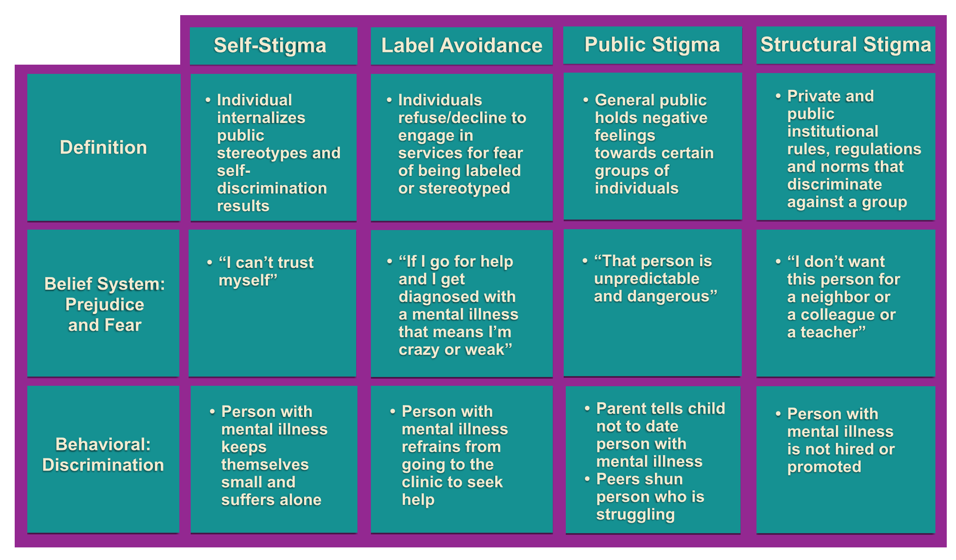
Stigma and Biases

Slide 12
Suicide Assessment and Prevention
Directly ask about suicidal ideation-reminder about suicide vs non-suicidal self-injury
Assess patient’s ability to die by or attempt suicide (i.e. firearms, access to medication)
Provide patient, family with support in the event of a crisis
Be familiar with process for voluntary or involuntary hospitalization (302 Commitment Process)
Utilize behavioral contract for suicide prevention should risk be present
  Should outline clear steps for how to react to suicidal ideation
  Gain support of your supervisor, team, etc.

Slide 13
Predictors of Physical Health Problems among Persons with Mental Disorders
Poverty, history of homelessness, or poor housing related to marked problems in functioning
Stigma against those with mental disorders lessens access to quality relationships with providers, as well as access to services
Morbid obesity caused by atypical antipsychotic medications, poor diet and nutrition, lack of exercise
Abuse of tobacco, alcohol, and illicit drugs (50% of the population has some history)
Utilize less health services than those without mental disorders (exception, those with anxiety disorders)
Have less access to quality health service (coordination, continuity, and comprehensiveness)

Slide 14
Using Community Mental Health Services
The following services are well-established in the community; although access to these services often requires a lengthy wait
Social milieu, psychosocial rehab, psychotherapy, case management
Residential Services (much overlap with homelessness services); personal care homes provide higher level of care, other congregate housing settings with or without staff on site
Intensive Case Management or Resource Coordination
Partial Hospitalization Programs, Intensive Outpatient Programs, Wellness Programs

Slide 15
The Role of Coordination of Care for Persons with SMI (Serious Mental Illness)
Coordination of care is a key issue for quality of care
  Although access to care may be possible, care is poorly coordinated among service sectors
Separation of the health, mental health, and aging service systems
  Care planning for these persons is exceedingly complex for providers, and equally complex for patients
  Requires effective interdisciplinary collaboration

Slide 16
Care Planning in Health and Mental Health Settings
Requires a great deal of work and resources at the beginning, but the pay off is greater stability
Care plans should be individualized and focus on the individual’s particular strengths and challenges, access to resources
Include clear goals for health or mental health problems in the care plan
  Might include outlining expectations in terms of self care, disease management, medication adherence, utilization of health or mental health services
  Focus on client-centered goals
  Monitor progress, implementation with these goals
  Reassess after key transition points such as a hospitalization
  Provide support to facilitate success

Slide 17
Patient Perspectives:Understanding Roles
Patients often confused about who does what
  May be particularly challenging working across health and mental health systems
Lack of familiarity/comfort with certain professionals
Over-reliance on one person in the team

Slide 18
Provider Perspectives:Understanding Roles
Professionals should
  Educate other professionals on what you do
  Educate other professionals on the ways in which your system of care or treatment context constrains your role with the patient
  Avoid too much rigidity, or too much flexibility in their role and responsibility to patient
    Don’t be everyone to everybody…
    Don’t be defensive…
  Don’t make assumptions about other team members

Slide 19
Effective Collaboration
Leadership
Trust is the most important predictor of effective team relations
In fragmented care systems, and under difficult time constraints, persons may have very negative experiences with working with other disciplines and systems of care
  Focus on building relationships with others in important systems of care
Respect for other disciplines
Conflict management skills

Slide 20
Promoting Treatment and Medication Adherence
Adherence; the extent to which persons’ use of medication coincides with health advice of professionals
Adherence is often facilitated through agency policies that mandate compliance with treatment goals
Medication adherence is of particular concern to mental health providers
Key issues for patients
  Drugs may interfere with daily activities
  Medication regimens unclear
  Changes in medication regimens often unclear, especially after a hospitalization
  Regimen may be too complicated
  Drugs may be perceived to be too expensive
  No perceived benefit

Slide 21
Promoting Medication Adherence
Use patient education to gain buy in
Respond to patient concerns when possible
Go for simplicity where possible
  Ask physician if there is any overlap in medications
  Use medications that can be taken as few times as possible
Use reminders, structure to aid adherence (i.e. pill boxes, caregiver support)
Consider injectable medications
Consider directly observed treatment (DOT)

Slide 22
Self-Help Coping Tools
Auditory distractions
Tight or restrictive clothing
Peer support resources
Avoid substances that may elevate symptoms

Slide 23

Living w/Schizophrenia

