Slide 1
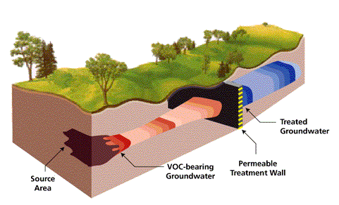
Permeable Reactive Barriers (PRB) to remove ground water contaminants
Treated
Groundwater
PRB
Contaminated
Groundwater
Contamination
Source

Slide 2
Carbon tetrachloride (CCl₄)
Established “maximum” level in drinking water is <5ppm
Consuming high levels of CCl₄ in drinking water can result in liver and kidney damage
How can we reduce the amount of CCl₄ in drinking water?

Slide 3
Iron PRB (aka Iron Walls)
Fe⁰ → Fe²⁺ + 2e⁻
CCl₄ + 2e⁻ + H⁺ → CHCl₃ + Cl⁻
CCl₄ + H⁺ + Fe⁰ → CHCl₃ + Cl⁻ + Fe²⁺
From Ch 103 oxidation and reduction (OIL RIG)
What species is reduced? What species is oxidized?

Slide 4
Iron Walls in the Lab
Use iron fillings
Use a non-toxic dye that absorbs in the visible region of EM spectrum
Use a dye that changes colors
when reduced
Indigo Carmine: AKA FD&C Blue #2

Slide 5
Controls to consider before kinetics experiment
What is an appropriate wavelength to use? How will you determine the wavelength used to measure absorbance?
Does the dye degrade in room light?
Does the dye degrade upon exposure to light of the wavelength used to measure the absorbance of the dye?
Is the concentration of dye used 20.0 ppm (fall in the linear range of the spectrophotometer?)

Slide 6
Goal of Part I
Using graphical methods (aka integrated rate laws) prepare 3 kinetics plots and determine reaction order with respect to dye
Determine kobs from graph after you have determined reaction order
Save all plots for report
Make sure you clearly explain how you addressed each control in data section

Slide 7
Integrated rate laws : Example zero order
-d[A]/dt = k [A]⁰ (differential rate law), -d[A]/dt = k
[A] = -kt + [A]₀ (integrated rate law)
Prepare a plot of [A] vs time if linear reaction is first order
Integrated rate laws in table for first and second order

