Slide 1
Understanding the scale-water equilibrium
Example: CaCO₃ (s) ↔ Ca²⁺ (aq) + CO₃²⁻ (aq), K = 3.4 x 10⁻⁹
If [Ca⁺²] is 0.0100 M and [Mg²⁺] is 0.0100 M in a water sample, will a precipitate form?
Q = [Ca²⁺][CO₃²⁻] , Q = 0.0100 x 0.0100 = 1.00 x 10⁻⁴
Q>K, equilibrium will shift?

Slide 2
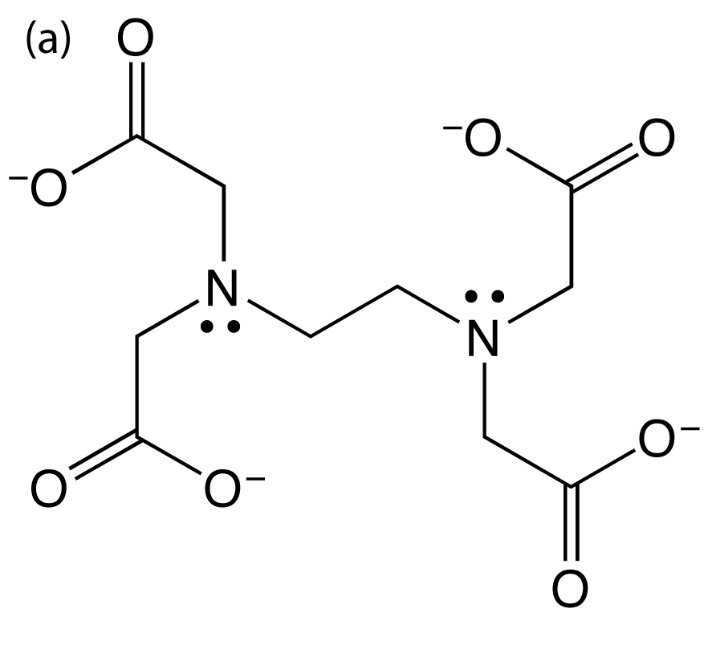
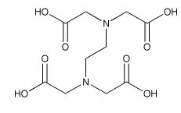
Ethylenediaminetetraacetic acid, or EDTA
Fully protonated form (H₄Y)
Fully de-protonated form (Y⁴⁻)
When pH > 10

Slide 3
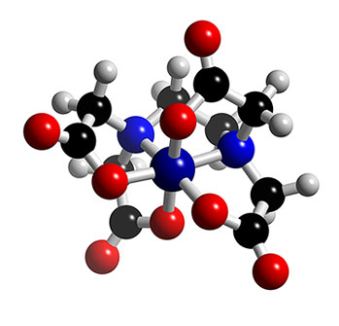
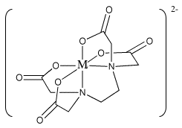
EDTA coordination
Complex Ion (MY)²⁻

Slide 4
Complexometric Titration
Titrant is EDTA
Analyte is your water sample
Indicator CAL
RED→PURPLE→BLUE

Slide 6
Example: If a 2.00 mL sample of pond water requires 750. µL of 0.00500 M EDTA, what is the concentration of hard water ions in the pond water?

