Slide 1
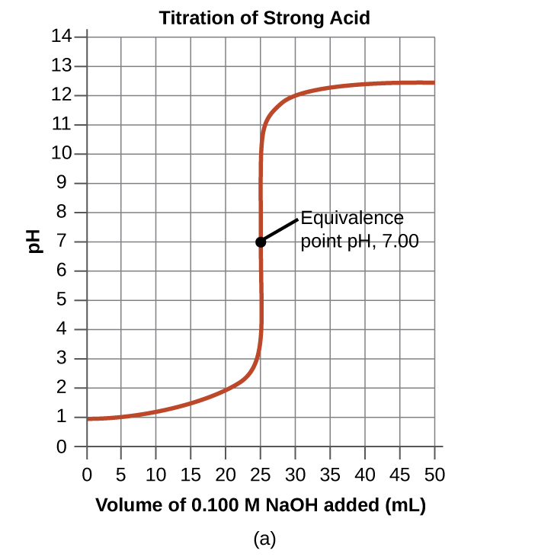

Slide 2
What is the pKa of acetic acid?
What is the volume at the equivalence point ?
What is the pH at the equivalence point?
Why is the pH>7 at the equivalence point

