Slide 1
Bio110: Introduction to Dr. Davis

Slide 2
My educational biography
B.A. in Molecular Biology, University of California, San Diego
Ph.D. in Molecular & Cell Biology, concentration in Genetics, University of California, Berkeley
Postdoctoral fellow, Developmental Molecular Genetics, University of Pennsylvania

Slide 3
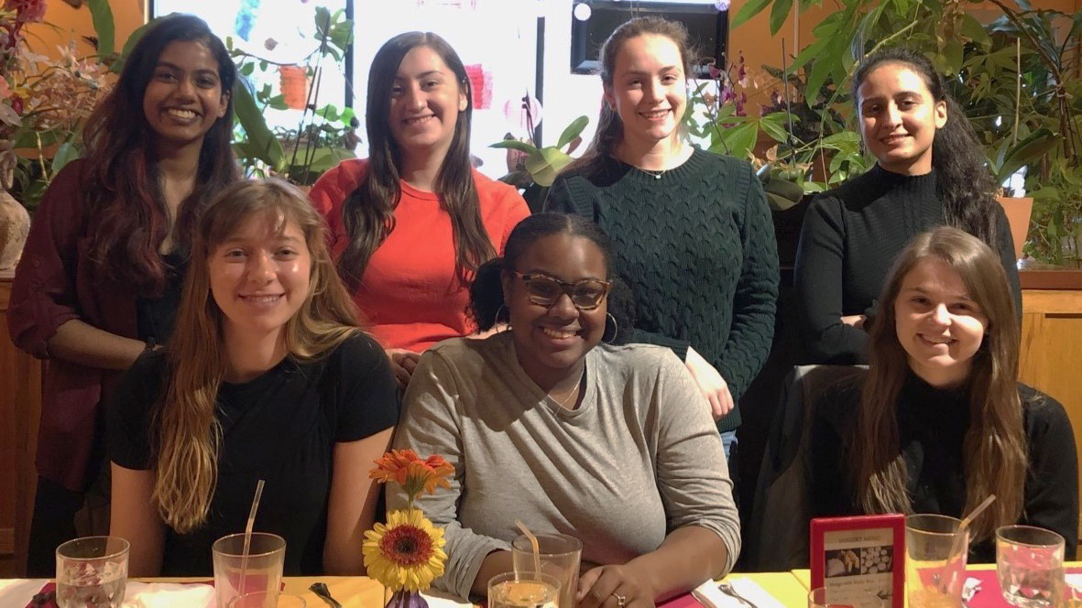
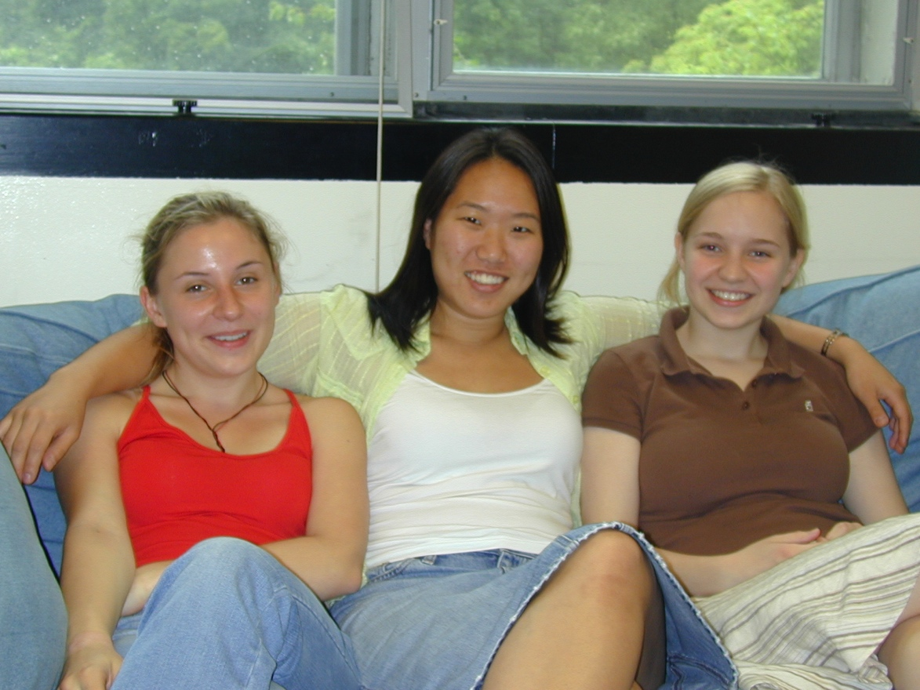

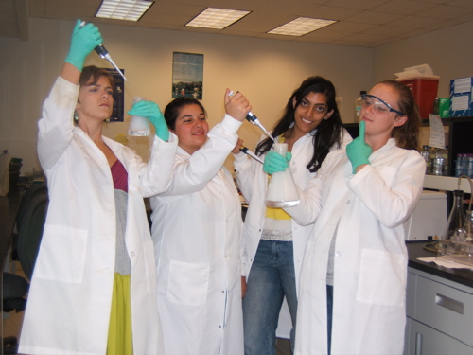
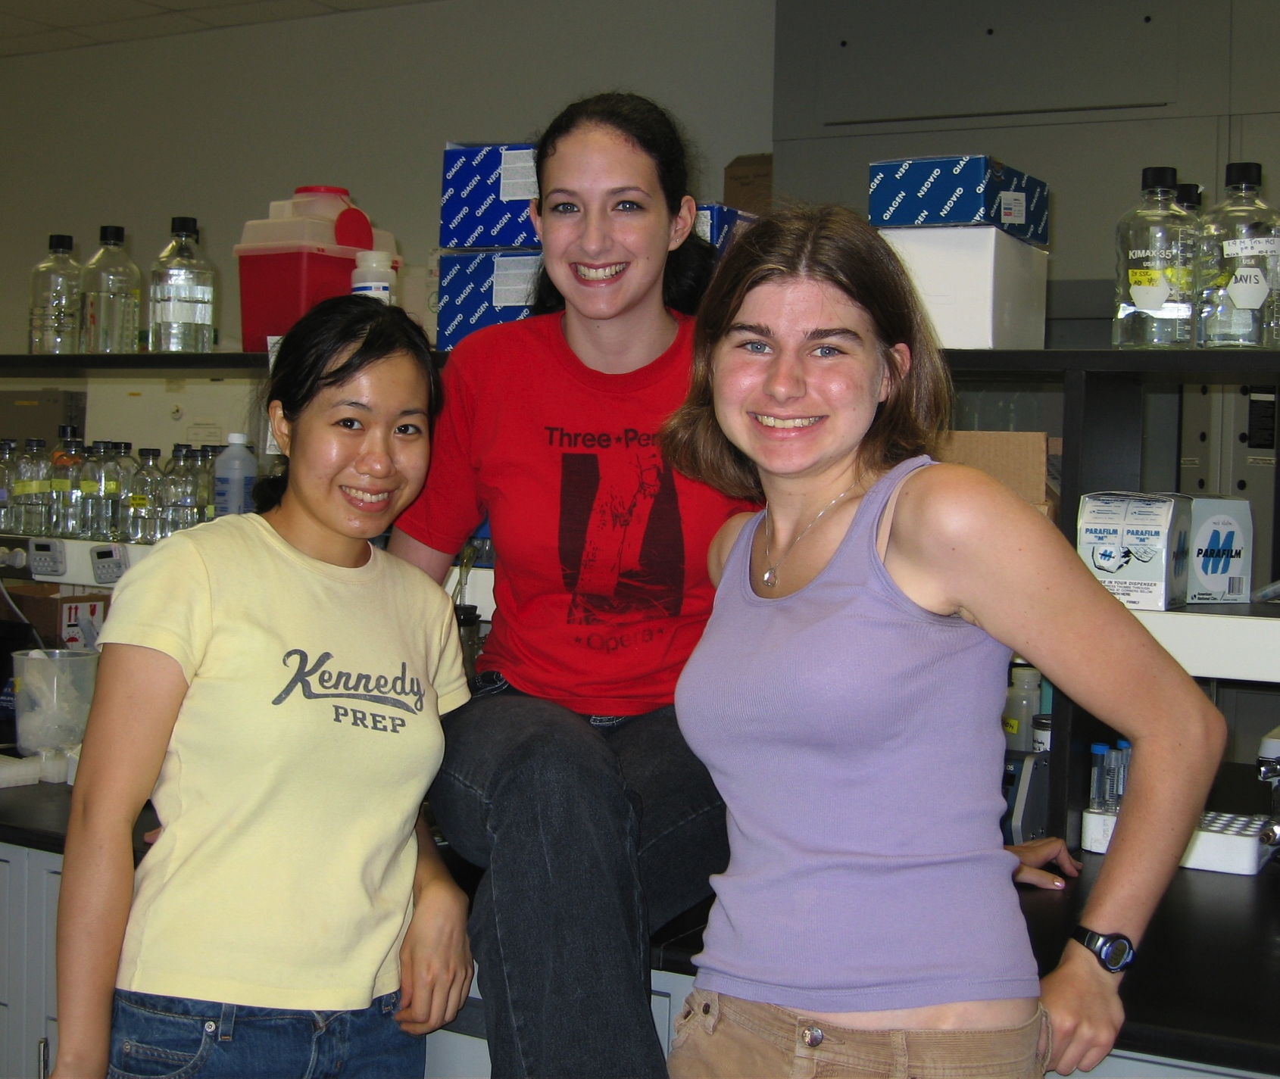
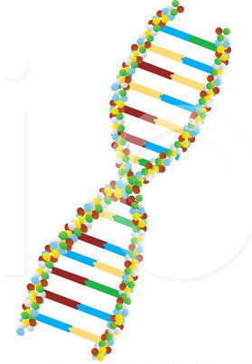
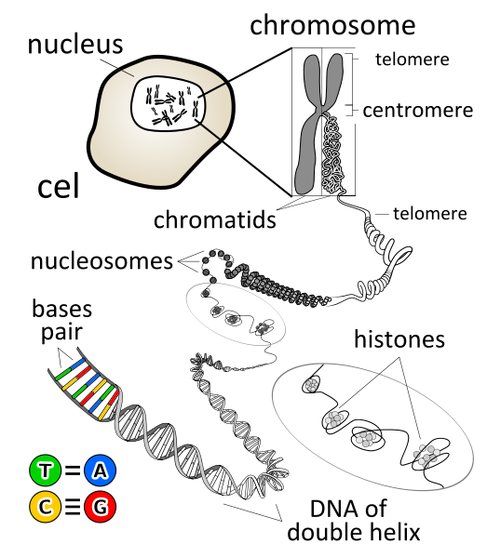
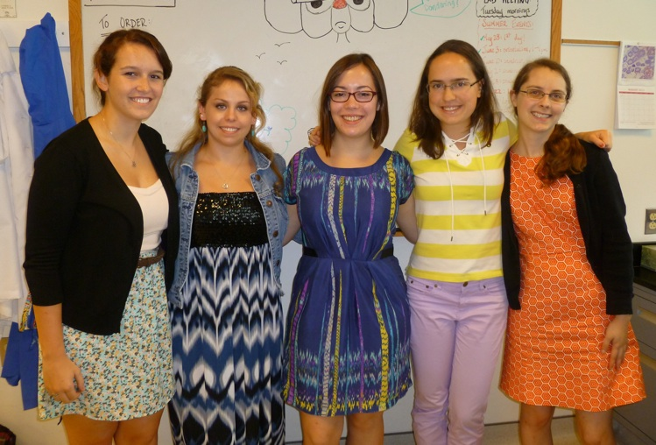
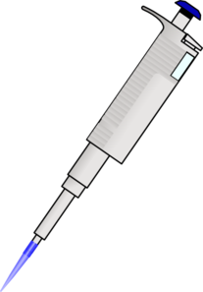
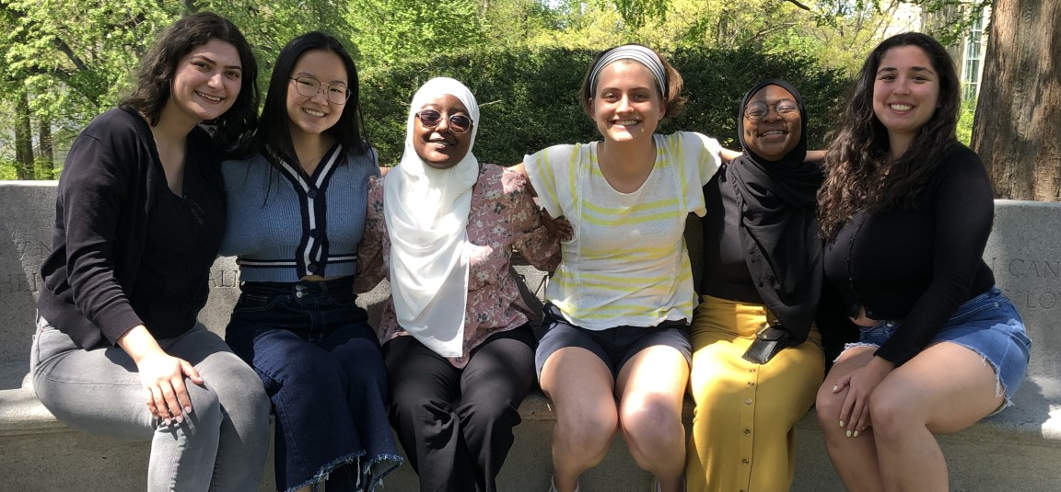
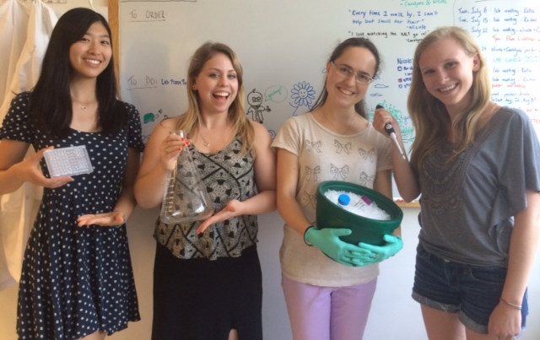
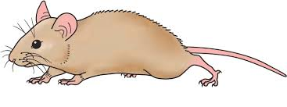
Bryn Mawr biologists in the lab

Slide 4
Dr. Davis’s contact information:
office: Park Science, room 222
office hours: Tuesdays, 8-9 pm & TBA
email: tdavis@brynmawr.edu

Slide 5
Learning goals for Bio110
Learn how to ask & investigate biological questions… what do we want to know, and how can we go about learning something about it?
Build a foundational knowledge in biology, particularly in cell biology, genetics & molecular biology.
Become familiar with methodological approaches used to investigate biological questions.
Apply foundational knowledge to new situations.
Draw connections between different sub-disciplines of biology & disciplines outside biology.

Slide 6
How to be successful in this course
study for 1-2 hours at least four days a week
  studying regularly will help you learn & retain the information better than cramming
form a small study group
  when you need to explain something to someone else, it helps you recognize what you understand (or don’t understand)
practice, practice, practice
  this is especially useful for problem-based content; the more experience you have solving problems & answering questions, the faster you will get and the better prepared you will be for exams
  many resources for additional practice problems are posted on the course Moodle site
come to office hours
  make it a habit - we are here to help you learn!

Slide 7
Mendelian genetics & concepts of dominance

Slide 8
What is heritable?
Based on what evidence?

Slide 9
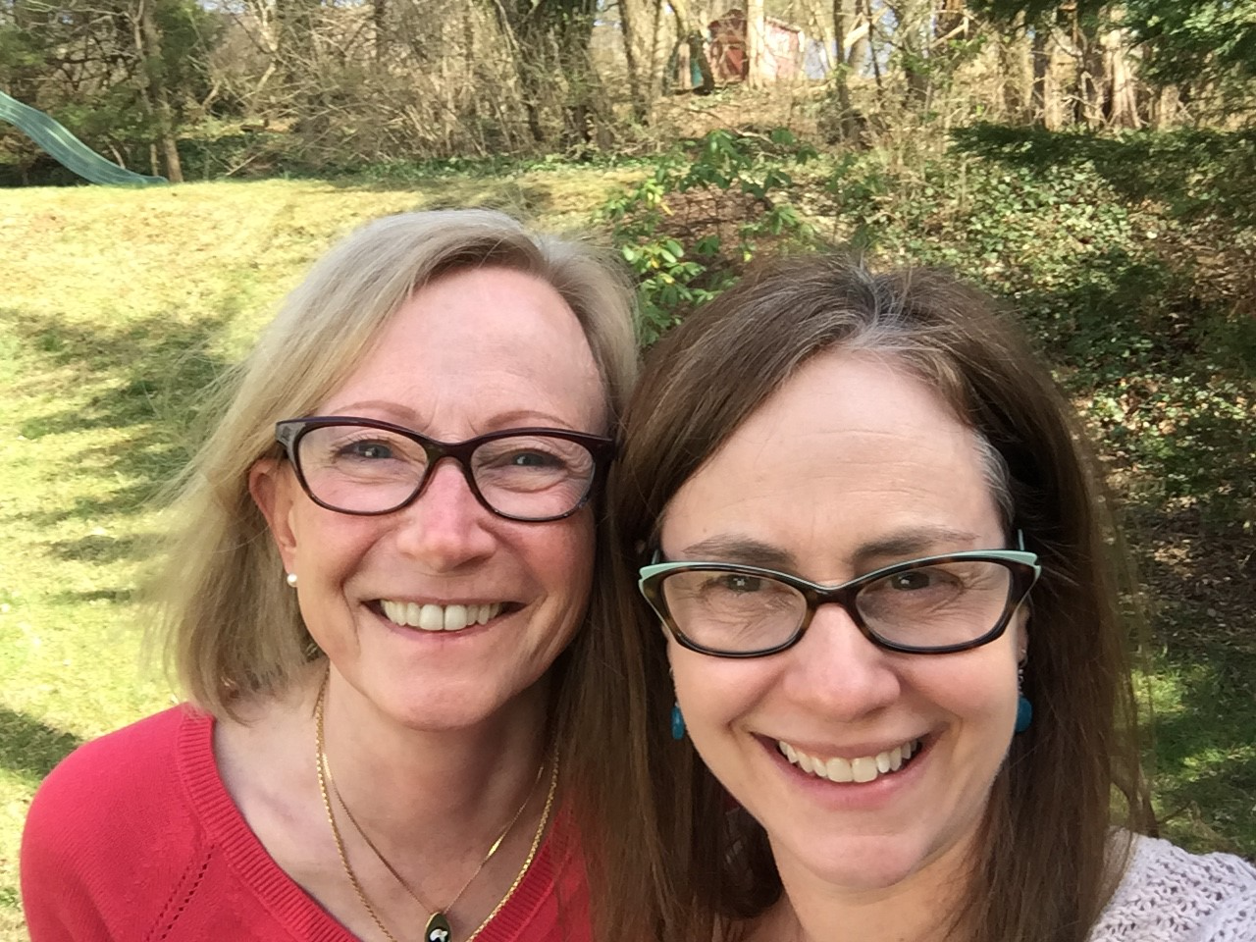
Like begets like…

Slide 10
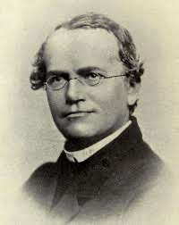
Mendel’s observations led to the basic laws of inheritance
https://www.britannica.com/biography/Gregor-Mendel

Slide 11
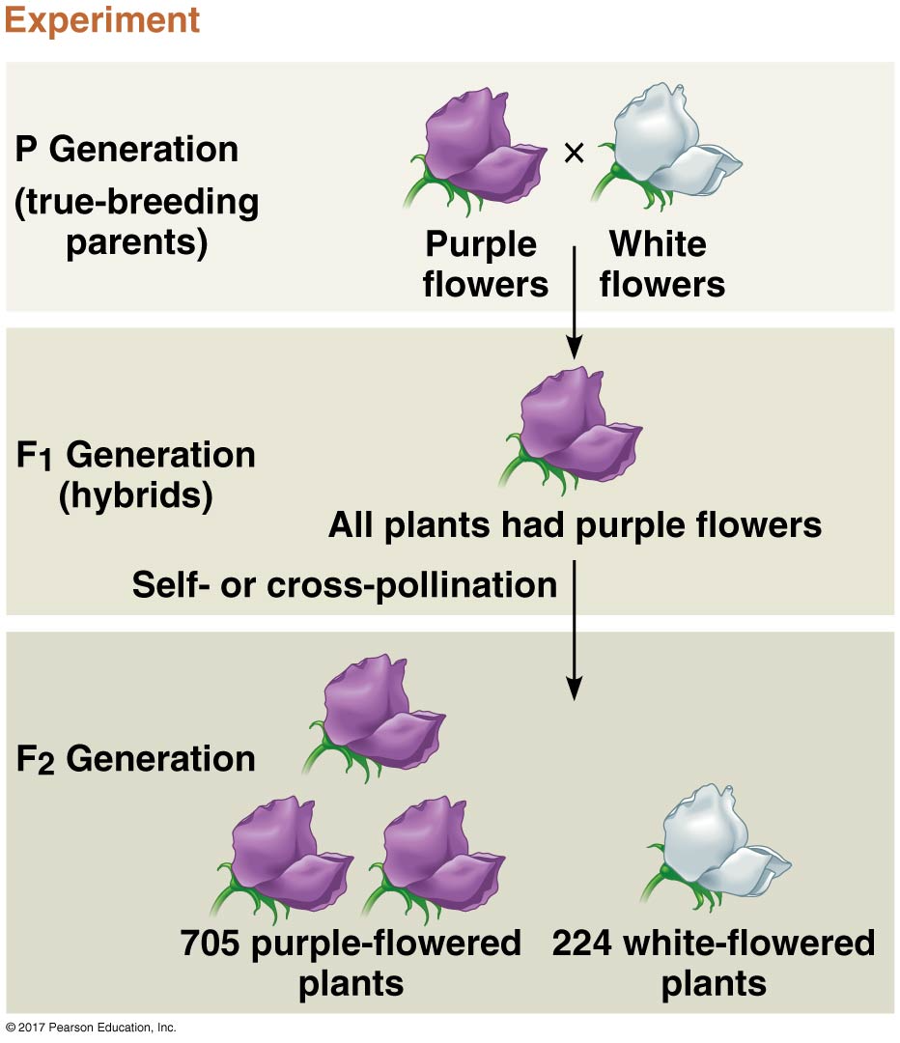
Mendel’s observations led to the basic laws of inheritance
(aka: homozygous)
Campbell, Figure 14-3

Slide 12
Mendel’s observations led to the basic laws of inheritance
(aka: homozygous)
(aka: heterozygous)
Campbell, Figure 14-3

Slide 13
Mendel’s observations led to the basic laws of inheritance
(aka: homozygous)
(aka: heterozygous)
Campbell, Figure 14-3

Slide 14
Dominant and recessive are relative terms
in some cases, two alleles display a clear dominant vs. recessive relationship
  the heterozygote (Aa) has the same phenotype as the dominant homozygote (AA)

Slide 15
Dominant and recessive are relative terms
in some cases, two alleles display a clear dominant vs. recessive relationship
  the heterozygote (Aa) has the same phenotype as the dominant homozygote (AA)
in other cases, the relationship between two alleles isn’t purely dominant vs. recessive
  sometimes, heterozygotes do not display the same phenotype as either homozygote or do not display the expected phenotype 100% of the time

Slide 16
Variations on dominance

Slide 17
Codominance:
When heterozygotes display a phenotype associated with both alleles

Slide 18
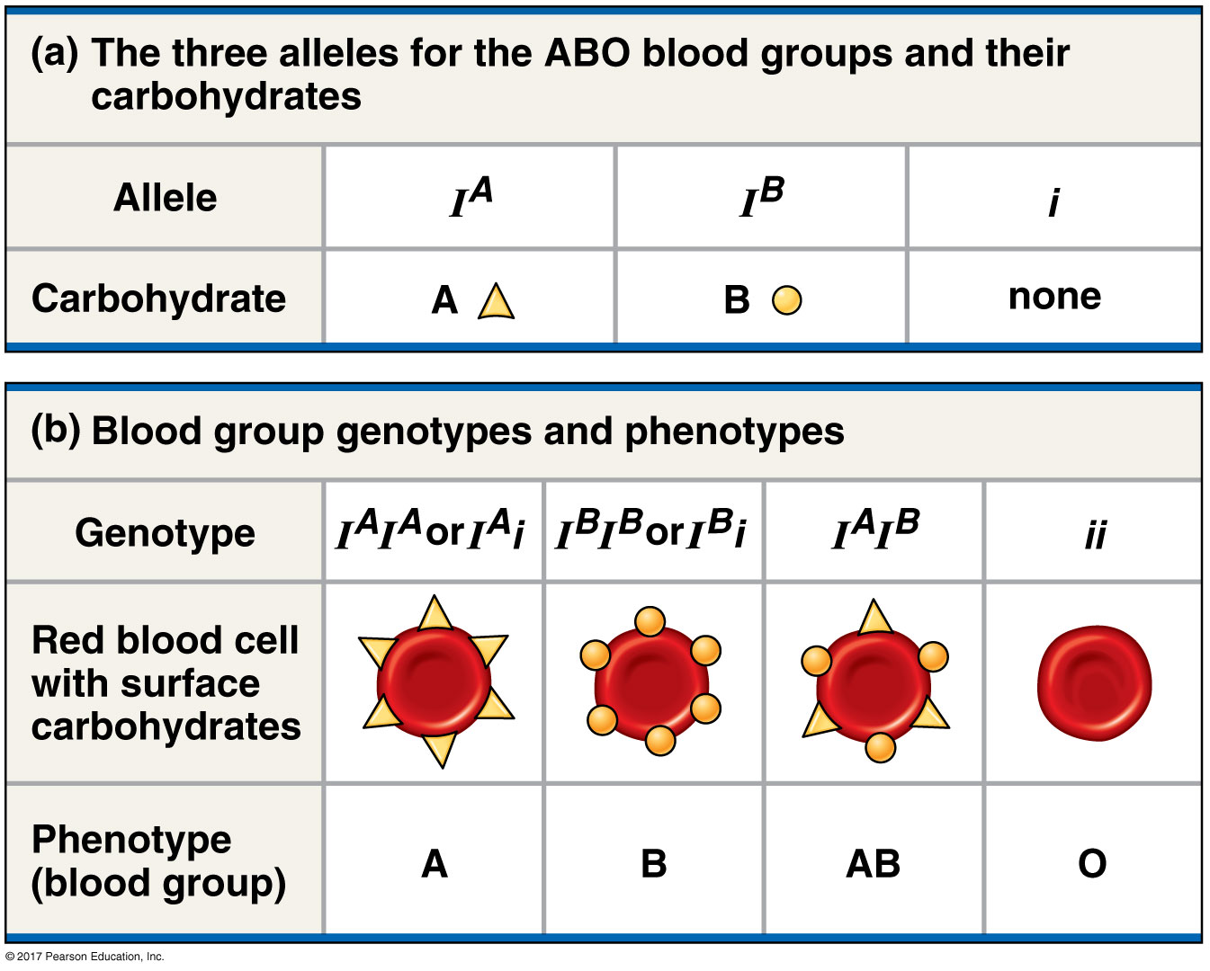
ABO blood group alleles, genotypes & phenotypes
Campbell, Figure 14-11

Slide 19
ABO blood group alleles, genotypes & phenotypes
Campbell, Figure 14-11

Slide 20
ABO blood group alleles, genotypes & phenotypes
Campbell, Figure 14-11

Slide 21
ABO blood group alleles, genotypes & phenotypes
co-dominance: when two distinct phenotypes,
caused by two different alleles,
are both observed
example:
I^{A}I^{B} individuals display both the A & B antigens
Campbell, Figure 14-11

Slide 22
Incomplete dominance: when heterozygotes have a different phenotype than either homozygote
Campbell, Figure 14-10

Slide 23
Incomplete dominance: when heterozygotes have a different phenotype than either homozygote
Campbell, Figure 14-10
Incomplete dominance typically manifests as a phenotype
that is in between the two homozygous phenotypes;
these traits are generally dose sensitive.

Slide 24
Variable expressivity and incomplete penetrance

Slide 25
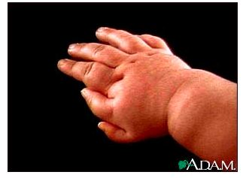
Polydactyly: an example of variable expressivity, when individuals with the same mutant genotype display a range of mutant phenotypes
http://www.nlm.nih.gov/MEDLINEPLUS/ency/imagepages/1719.htm

Slide 26
Same genotype, range of phenotypes: variable expressivity & incomplete penetrance
Variable expressivity: Individuals with the same mutant genotype
display a range of mutant phenotypes.
modified from: Griffiths (2008) An Introduction to Genetic Analysis

Slide 27
Same genotype, range of phenotypes: variable expressivity & incomplete penetrance
Variable expressivity: Individuals with the same mutant genotype
display a range of mutant phenotypes.
Incomplete penetrance: Some individuals with the mutant genotype
fail to express the mutant phenotype.
modified from: Griffiths (2008) An Introduction to Genetic Analysis

Slide 28
Same genotype, range of phenotypes: variable expressivity & incomplete penetrance
Variable expressivity: Individuals with the same mutant genotype
display a range of mutant phenotypes.
Incomplete penetrance: Some individuals with the mutant genotype
fail to express the mutant phenotype.
Incomplete penetrance and variable expressivity
modified from: Griffiths (2008) An Introduction to Genetic Analysis

