Slide 1
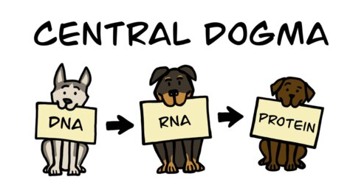
Biology 110: Biological Explorations
Fall 2022
Instructors:
Dr. Tamara Davis Dr. Michelle Kanther
Office: Park 222 Office: Park 210
tdavis@brynmawr.edu mkanther@brynwar.edu

Slide 2


Dr. Kanther
Education:
  Dickinson College
    B.S. Biology
  University of North Carolina at Chapel Hill
    Ph.D. in Genetics and Molecular Biology
Teaching:
  BMC January 2016 – May 2017
  University of the Sciences August 2017 - May 2022

Slide 3
Dr. Davis
B.A. in Molecular Biology, University of California, San Diego
Ph.D. in Molecular & Cell Biology, concentration in Genetics, University of California, Berkeley
Postdoctoral fellow, Developmental Molecular Genetics, University of Pennsylvania

Slide 4
Course Learning Goals
Students will gain foundational knowledge in biology, with an emphasis in the sub-disciplines of cell biology, genetics & molecular biology, by learning basic principles of the field and how these basic principles were derived.
Students will become familiar with various methodological approaches used to investigate biological questions.
Students will develop skills required to synthesize information and apply their knowledge to new situations.
Students will make connections among the different sub-disciplines of biology, as well as to disciplines outside of biology.

Slide 5
How to be successful in this course!
Study for 1-2 hours at least four days a week
  studying regularly will help you learn & retain the information better than cramming
Form a small study group
  when you need to explain something to someone else, it helps you recognize what you understand (or don’t understand)
Practice, practice, practice
  this is especially useful for problem-based content; the more experience you have solving problems & answering questions, the faster you will get and the better prepared you will be for exams
  many resources for additional practice problems are posted on the course Moodle site
Come to office hours
  make it a habit - we are here to help you learn!

Slide 6
Important Info
Dr. Kanther’s Office Hours
  By Appointment – Use Calendly link!
Dr Davis Office Hours
  Tuesday 8-9pm via Zoom
  Additional office hours TBD
TA Office Hours
  Yeipyeng Kwa (ykwa@Brynmawr.edu)
  Emma Unglaub (eunglaub@brynmawr.edu)
Biology Mentoring Program
  See link in syllabus
  Co-coordinators: Siena Martin (Smartin3@brynmawr.edu) and Anne Meyer (ameyer@brynmawr.edu)

Slide 7

Important Info
Recommended Textbook:
  Campbell’s Biology, 11th Edition
  Copies on reserve in Collier Library
Exams and Homework Quizzes
  11 total Quizzes
    Open 5 pm on Friday – 8am Wednesday*
  3 Total Exams
Science Communication Assignment
  Details and due dates posted to Moodle

Slide 8
Schedule Reminder
Week 1 (Aug 29 – Sept 2, 2022)
  Course Introduction
    Chapter 1.3 & 1.4
  Water and Carbon
    Chapters 3 & 4
  Quiz 1
Week 2 (Sept 5-9, 2022)
  Chemistry of live
    Chapter 4
  Macromolecules
    Chapter 5
  Quiz 2

Slide 9
Scientific Inquiry
Science:
  An approach to understanding the natural world.
Inquiry:
  A search for information and explanations of natural phenomena.
Scientific Method
  Method of procedure utilized by scientists for scientific Inquiry
    Exploration and Observation
    Defining your question
    Forming a Hypothesis and making a prediction
    Testing a hypothesis
    Analyzing Data and drawing conclusions

Slide 10
Scientific Method
Observation
Ask a question about your observation
My computer slow
Make a hypothesis and prediction statement
Why is my computer running slow?
Test Hypothesis
I think my computer is slow because I have too many programs running. Prediction: If my computer is slow b/c of all the programs running, then if I close these programs it should run faster.
Analyze data
Measure how long it takes to start open Internet browser before (control) and after closing the files
Does your data support your hypothesis?
Before: took 45 seconds. After: took 3 seconds.
My data supports my hypothesis

Slide 11
Scientific Method
Hypothesis
  Explanation based on observations and assumptions that leads to a testable prediction.
    Logical
    Testable
  Can be supported or refuted but NEVER proven!

Slide 12
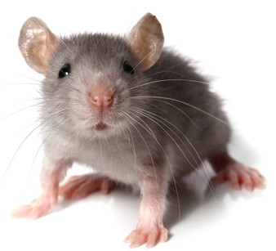
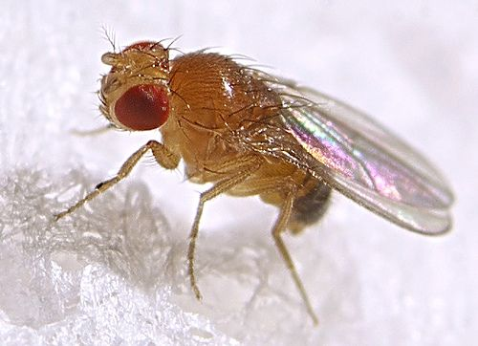
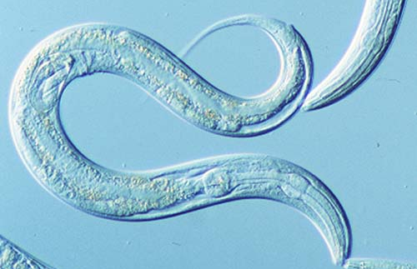
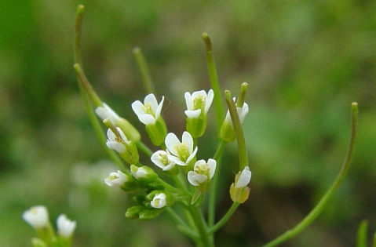
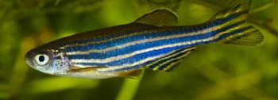
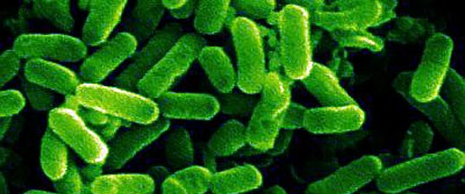
Scientific Method
Experiment:
  Scientific test, carried out under controlled conditions that involve manipulating one factor in a system in order to see the effects of changing that factor.
Model organisms
  Easy to grow/handle
  Systems that can be applied to other organisms

Slide 13
Scientific Method
Components of experimental design
  Experimental Group(s):
    A set of subjects that has the specific factor being tested.
      Independent Variable:
        The factor being manipulated between groups
      Dependent Variable:
        The factor being measured that is predicted to be affected by the independent variable.
      Control Variables
        The factor/s that must stay the same between experimental groups.
  Control Group(s):
    A set of subjects that lacks the specific factor being tested but is identical to the experimental group in all other respects.

Slide 14
Scientific Method
Data:
  Recorded observations
    Qualitative:
      recorded observations and pictures
    Quantitative:
      numerical measurements

Slide 15

Chemistry of Life
Elements of the human body as percentage of body weight.
Oxygen (O): 65%
Carbon (C): 18.5%
Hydrogen (H): 9.5%
Nitrogen (N): 3.3%
Calcium (Ca): 1.5%
Phosphorus (P): 1.0%
Potassium (K): 0.4%
Sulfur (S): 0.3%
Sodium (Na): 0.2%
Chlorine (Cl): 0.2%
Magnesium (Mg): 0.1%
Trace elements: < 0.01%
Pearson Education Inc, 2014

Slide 16
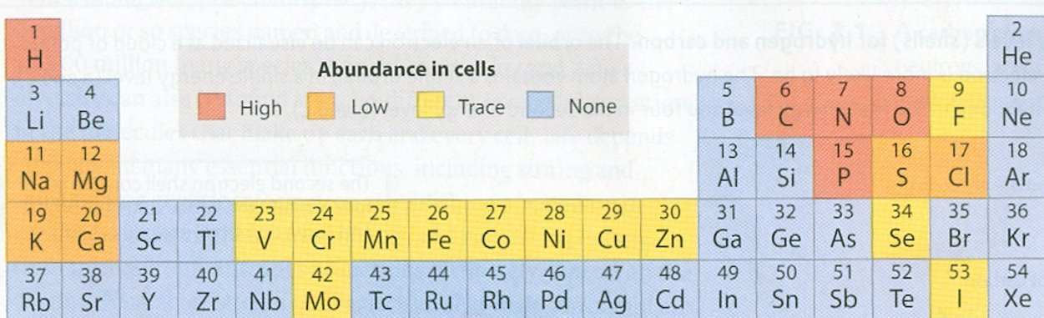
Chemistry of Life
Living organisms are “organic”
Elements interact to form biological molecules

Slide 17
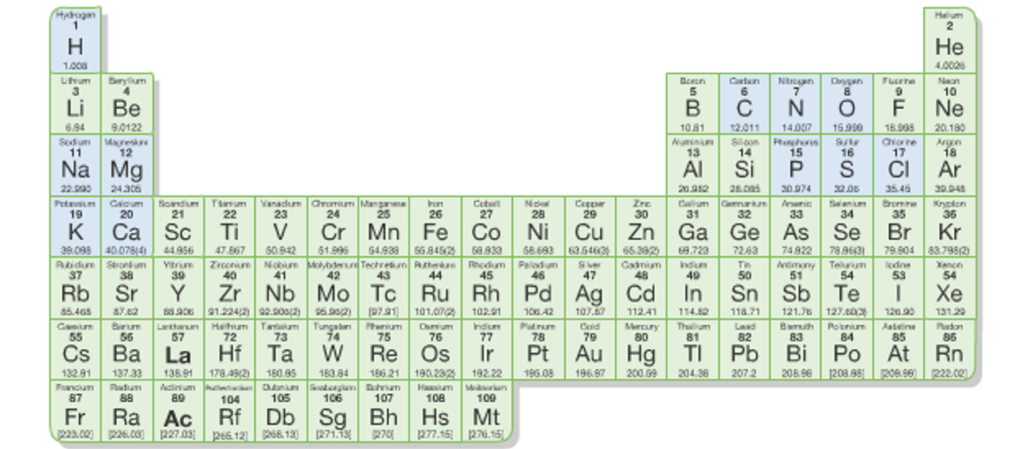
Chemistry of Life
Elements are composed of Atoms
  Smallest unit of an element that has the properties of that element. Composed of subatomic particles.
  Subatomic Particles
    Protons, neutrons and electrons

Slide 18
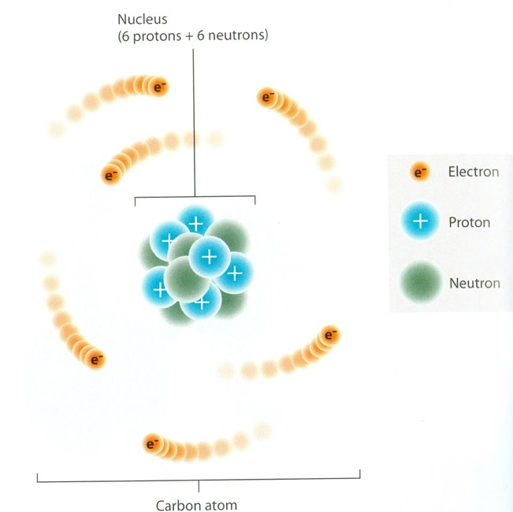
Chemistry of Life
Subatomic Particles and Atomic Structure
  Proton:
    Positively charged particle in the nucleus of the atom
  Electron:
    Negatively charged particle that orbit around the atomic nucleus.
  Neutron:
    Particle in the nucleus of the atom without any electrical charge

Slide 19
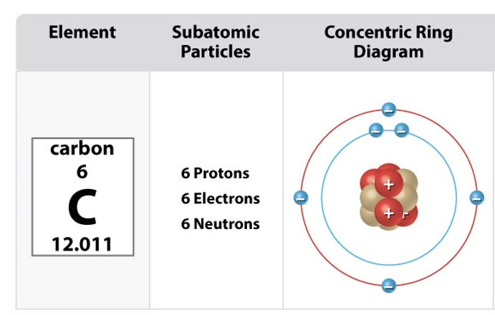
Chemistry of Life
Subatomic Particles and Atomic Structure
  Atomic Number = # of protons
    Atomic Number of C =
  Atomic Mass = # protons + # neutrons
    Atomic Mass of C =
  Number of Neutrons = Atomic Mass – Atomic Number
    Neutrons =
6
12
6

Slide 20
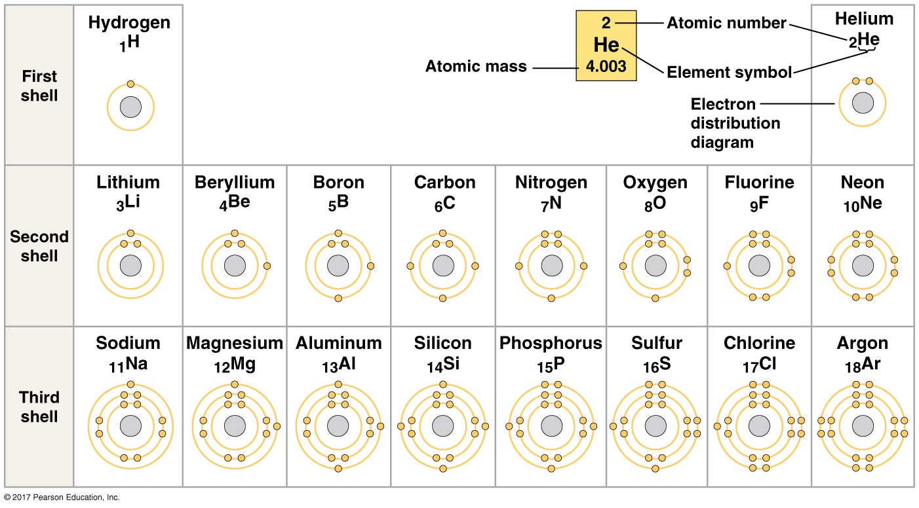
Chemistry of Life
Electron Distribution and Chemical Properties
  Valence Electrons:
    Electrons contained in outermost shell or Valence Shell
  Molecule:
    Consists of two or more atoms held together by a covalent bond.
1st shell can hold maximum 2 electrons
2nd shell can hold maximum 8 electrons
Maximum capacity of additional shells varies but typically 8 electrons

Slide 21
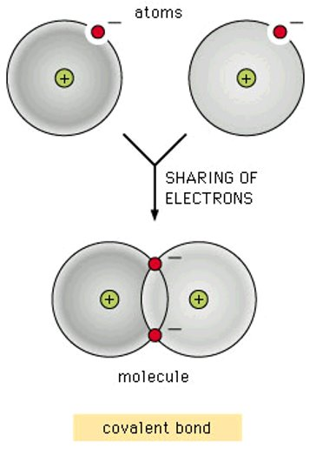
Chemistry of Life: Chemical Bonds
Sharing/exchange of electrons results in the formation of a chemical bond to form molecule
  Covalent bond:
    Consists of the mutual sharing of one or more pairs of electrons between two atoms.
    The shared electrons count as part of each atom’s valence shell

Slide 22
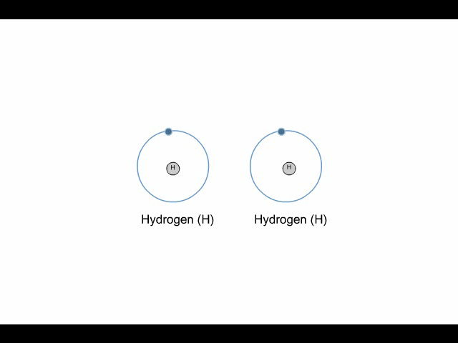
Chemistry of Life
Covalent Bond Animation

Slide 23
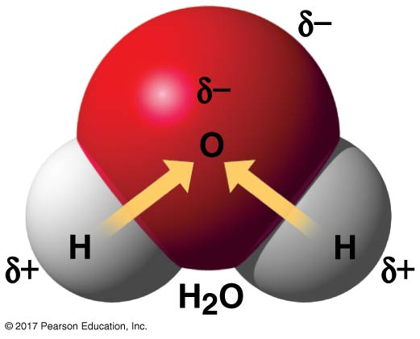
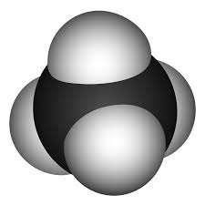
Chemistry of Life: Chemical Bonds
Water (H₂0)
Electronegativity
  An atoms attraction for electrons
  The more electronegative an atom is, the more strongly it pulls shared electrons toward itself.
Polar Covalent Bonds:
  Unequal sharing of electrons cause partial positive and partial negative charge in the molecule.
Non-polar Covalent Bonds
  Equal sharing of electrons and therefore overall charge is evenly distributed
Methane (CH4)
H
H
H
H

Slide 24
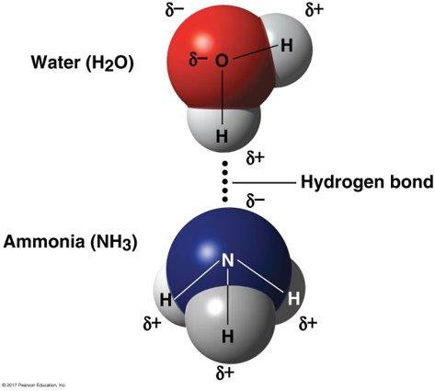
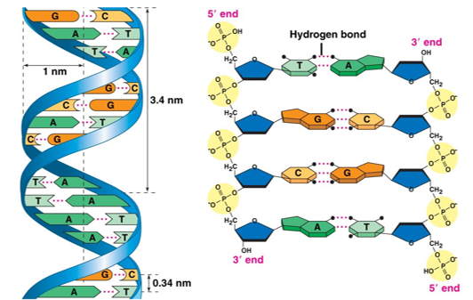
Chemistry of Life: Chemical Bonds
Polar covalent bonds enable Hydrogen bonding.
  Non-covalent bond formed between an electronegative atom and a hydrogen covalently bonded to another electronegative atom

Slide 25
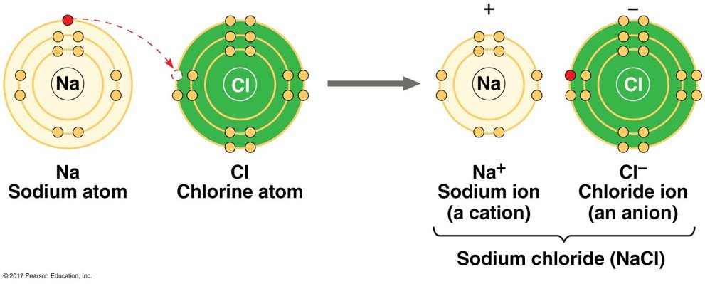
Chemistry of Life: Chemical Bonds
Ionic Bonds
  Consists of the transfer of electrons from one atom to another. Transfer results in a strong non-covalent bond
    Loss of an electron gives a positive charge.
    Gain of an electron gives a negative charge.

Slide 26
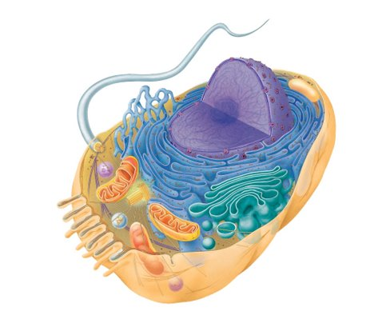
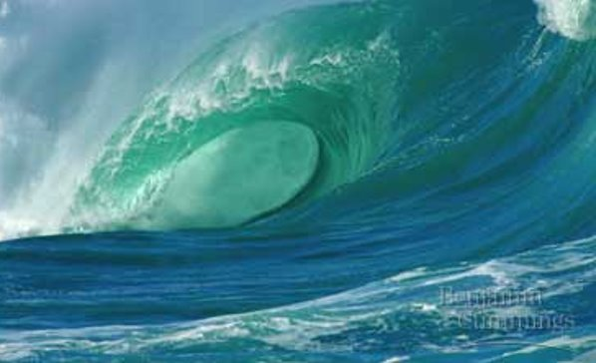
Chemistry of Life: Water
Life Depends on water
  Our external environment is mostly water (75% of Earth)
  Our internal environment is mostly water (70% of the cell)

Slide 27
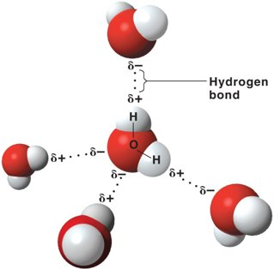
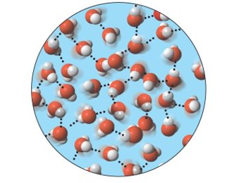
Chemistry of life: Water
Hydrogen bonding in water facilitate four properties for an environment for life
  Cohesion and Adhesion
  Moderation of Temperature
  Versatility as a Solvent
  Expansion upon freezing

Slide 28
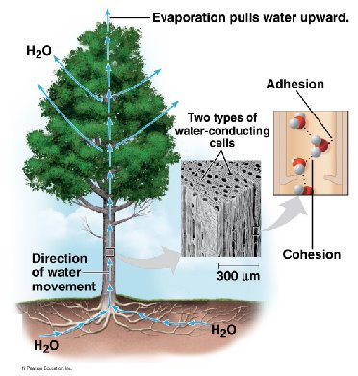
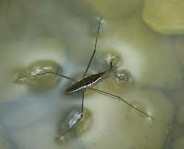
Chemistry of Life: Water
Cohesion
  The linking together of like molecules by hydrogen bonding.
    Surface Tension
      Measure of how difficult is its to break the surface of a liquid.
Adhesion:
    The linking together of unlike molecules by hydrogen bonding.

Slide 29
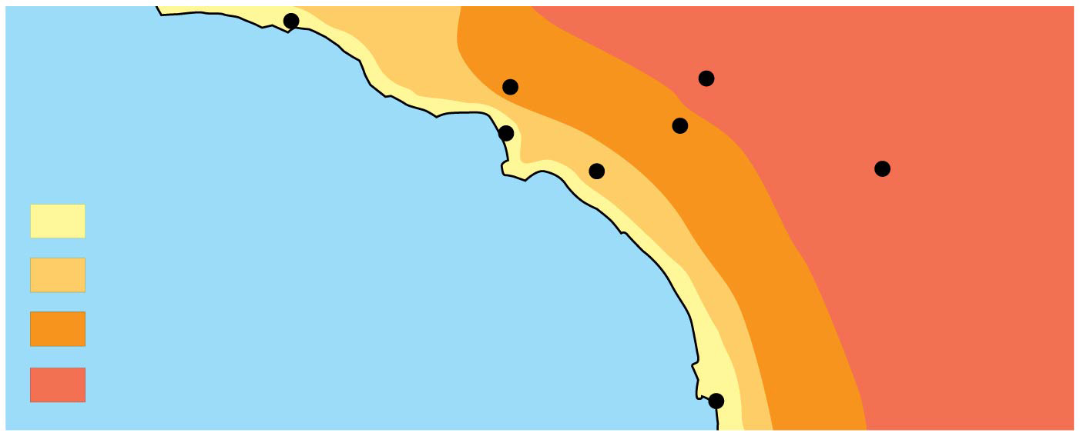
Chemistry of Life: Water
Modulation of air temperature
  Absorbing heat from warmer air
  Releasing stored heat to cooler air
Burbank
90°
San Bernardino
100°
Santa Barbara 73°
Los Angeles
(Airport) 75°
Riverside 96°
Santa Ana
84°
70s (°F)
80s
90s
100s
Palm Springs
106°
Pacific Ocean 68°
San Diego 72°
40 miles

Slide 30
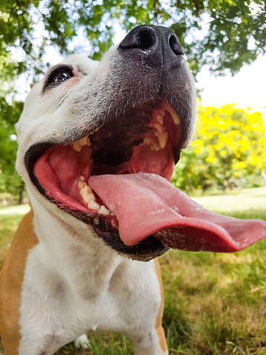
Chemistry of Life: Water
Specific Heat:
  The heat required to raise the temperature of the unit mass of a given substance by a given amount (usually 1 degree).
    Heat is absorbed when hydrogen bond is formed
    Heat is released when hydrogen bonds are broken

Slide 31
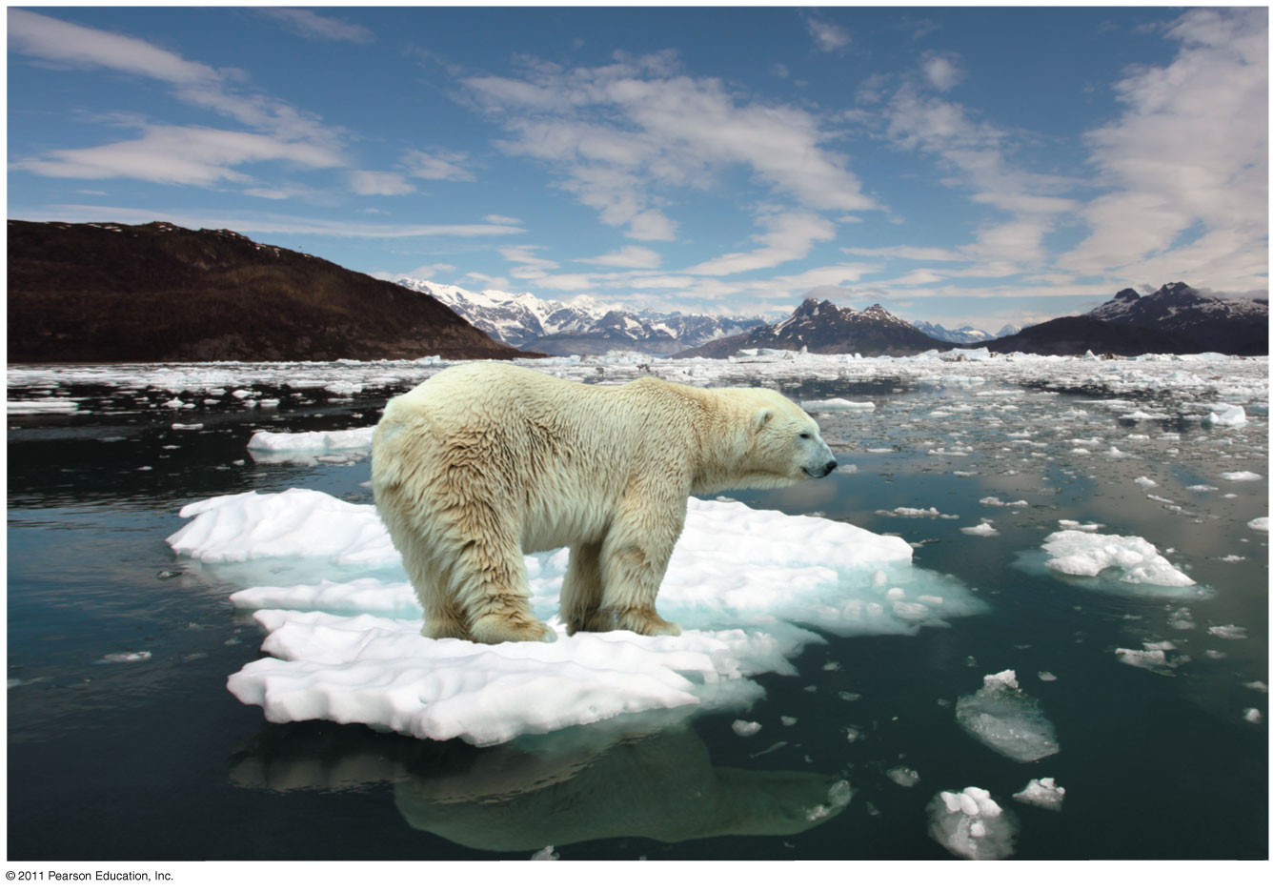
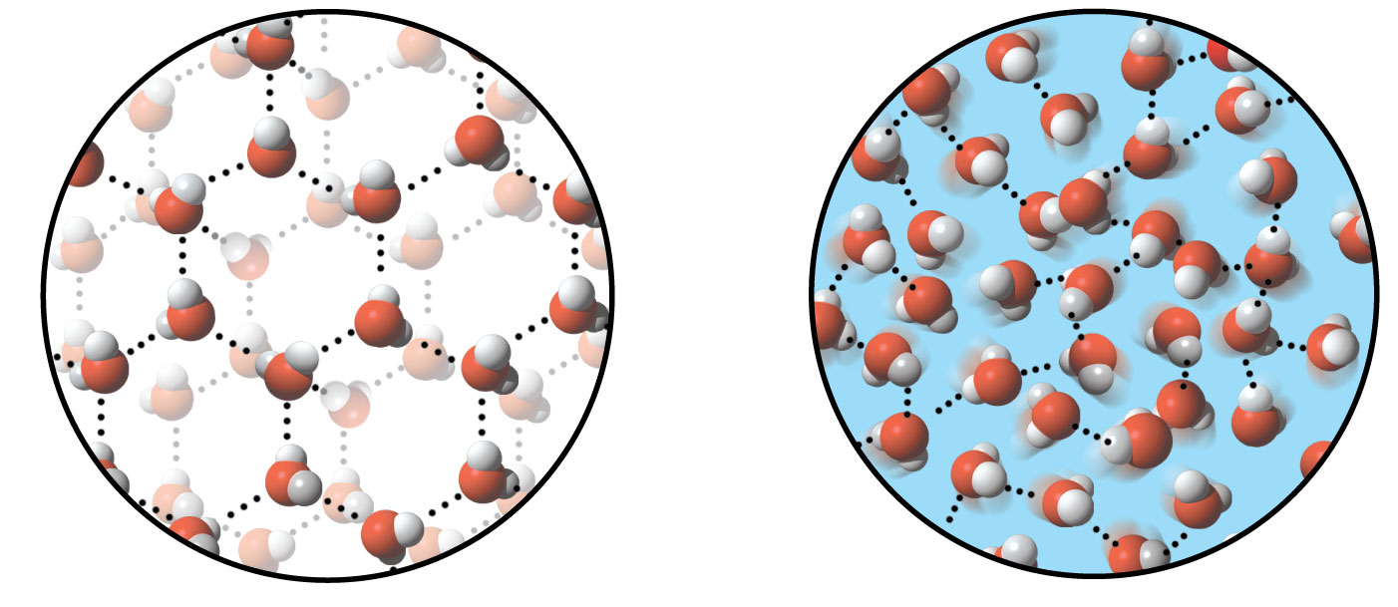
Chemistry of Life: Water
Expands upon Freezing
  Ice floats on liquid water
Ice: stable hydrogen bonds
Liquid water: transient
hydrogen bonds

Slide 32
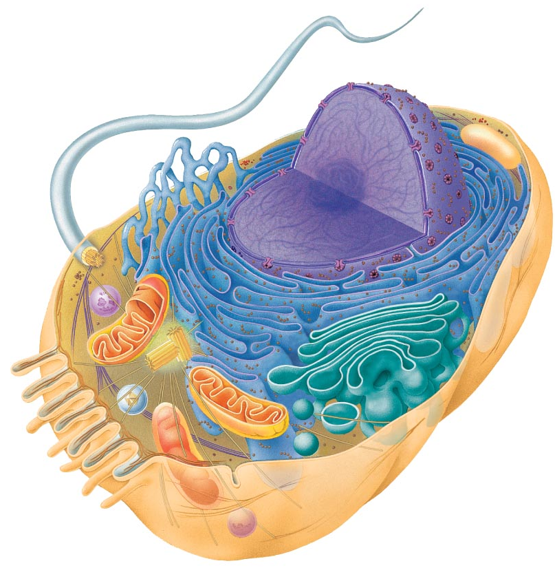
Chemistry of Life: Water
Water: The solvent of live
  The behavior of macromolecules in water enables organization, compartmentalization, and chemistry of a cell/ organism
Solution:
  A liquid that is a completely homogeneous mixture of substances.
Solvent:
  The dissolving agent of a solution.
Solute:
  The substance dissolved in a solution.
Aqueous Solution:
  Solution where water is the solvent

Slide 33
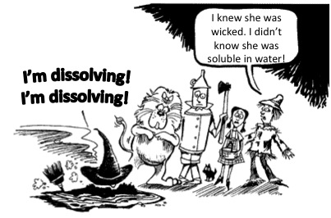
Chemistry of Life: Water
Solute Classification
  Hydrophilic
  Hydrophobic
  Amphipathic

Slide 34
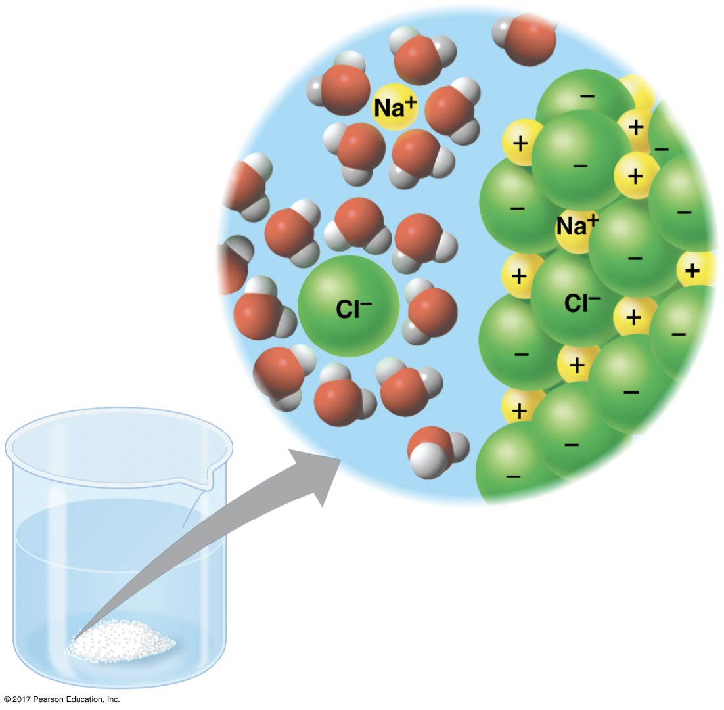
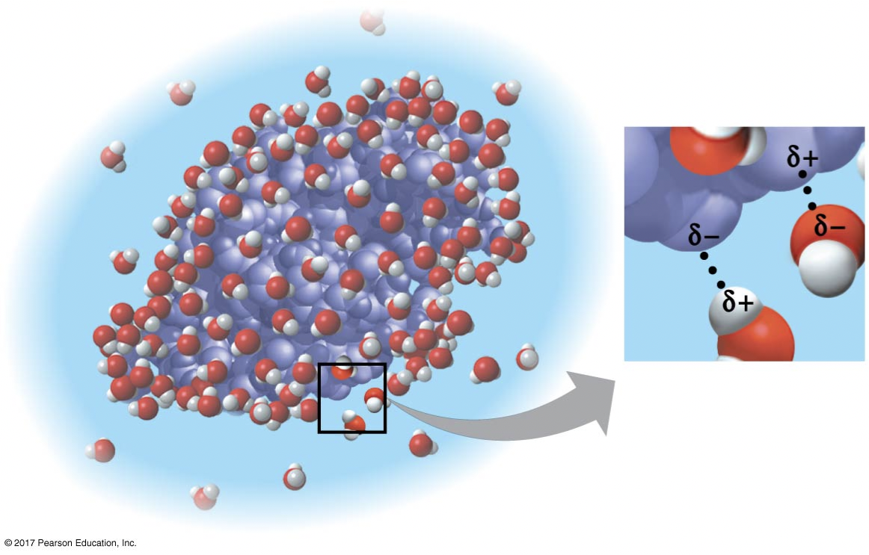
Chemistry of Life: Water
Hydrophilic:
  Polar, substance that has an affinity for water.
Hydrated
  Molecules surrounded by a shell of water
NaCl
Lysozyme (protein)

Slide 35
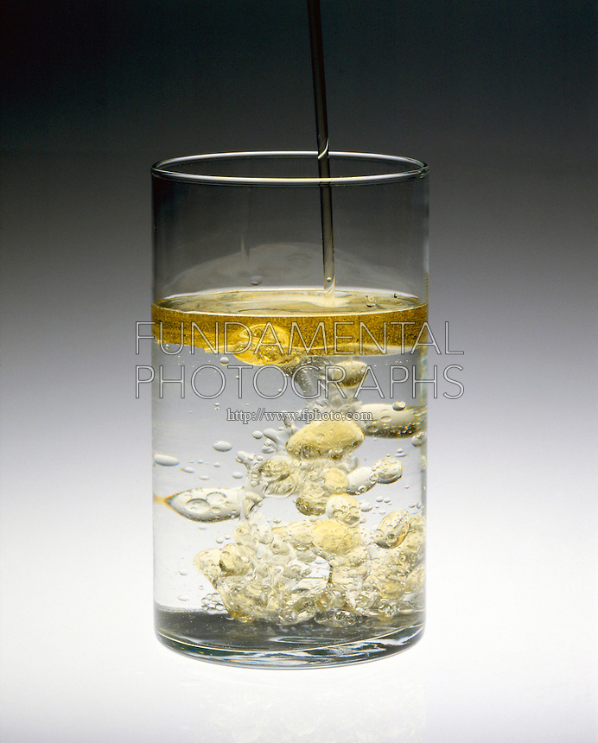
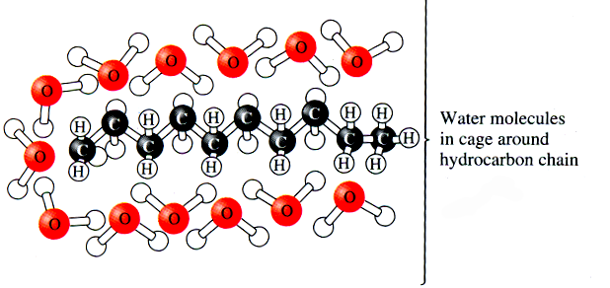
Chemistry of Life: Water
Hydrophobic:
  Non-polar, substance that does NOT have an affinity for water

Slide 36
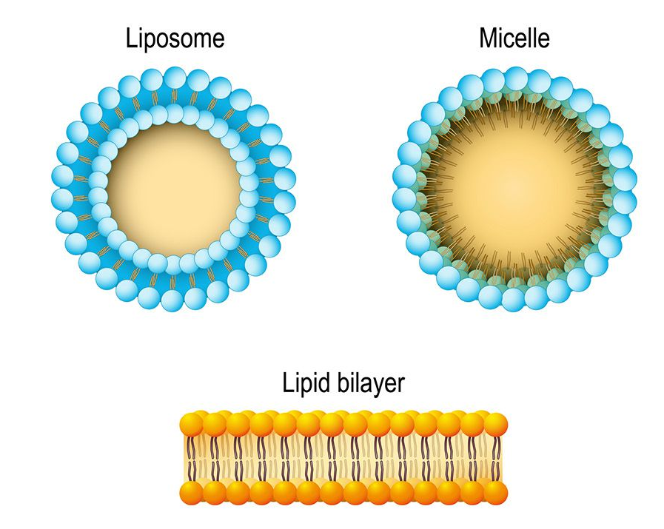
Chemistry of Life: Water
Amphipathic:
  Substances that have both polar (hydrophilic) and non-polar (hydrophobic) regions.

