Slide 1



Active Critical Reading
Pre-reading, Close Reading, post-Reading

Slide 2

Writing is a recursive process & a Conversation
Read, Write, Re-read, Re-write
When you read a text actively you engage in conversation with the author by writing your thoughts and questions in the margins next to theirs.
When you write a paper or an essay you engage in a conversation with the reader.

Slide 3
Why is Effective reading essential?
The reading you do is the basis for the ideas you will have, the ideas that will inform your thesis. Without a strong base any structure will crumble. It is essential to have a firm grasp of your subject so that your ideas grow out of a strong knowledge base.
The reading is also the support for your argument.
In the beginning you read to become informed, as your direction and questions narrow you search for evidence to support your claim.

Slide 4

What is a Good Source?

Slide 5
Primary Sources Firsthand testimonial or Direct evidence “uninterpreted Factual Data” (Harvey 6)
Documents created at the time of the event or subject of interest, documents written by a witness or survivor.
Oral Histories
Novels
Poems
Short Stories
Memoirs
Autobiographies
Diaries
Works of Art
Movies
Artifacts
Recordings (Audio or Visual)
Government Documents

Slide 6
Secondary Sources ~ Interpretations and evaluations of primary Sources
Journal Articles
Biographical works
Commentaries, criticisms
Histories
Periodicals - magazine and newspaper articles

Slide 7

Tertiary Sources
Dictionaries
Encyclopedias
Textbooks
When is it okay to use them?
Often only in the introduction where you are clarifying the general information of the subject. You may define a word using the OED for clarity, so that the reader knows exactly how you approach that word in your paper. There is nothing in-depth about a tertiary source so they do not help you add to the academic conversation. That is why you are sometimes cautioned against or even forbidden to use them.

Slide 8
According to the Purdue OWL:
You can ask the following questions to determine if a source is credible.
Who is the author?
How recent is the source?.
What is the author's purpose?
What type of sources does your audience value?
Be especially careful when evaluating Internet sources!

Slide 9
Librarians will often Affectionately refer students to the CraAp test
C-Currency, Kairos, Timeliness
R-Relevance
A-Authority (credibility of the source)
A-Accuracy (reliability and correctness of the information)
P-Purpose (why was it written)

Slide 10

Once you have a Credible & Relevant Source it’s time to Actively Read it.
This means preparing yourself to paraphrase, summarize and quote from the source in a way that supports your argument.

Slide 11
Ask questions of the text.

Slide 12

Active Reading
Reading that is effective is dynamic.
You must “articulate what you are thinking” as you read by physically interacting with the text!

Slide 13
Active Reading
MARK, ANNOTATE, & ELABORATE
As you read the text the first time:
Highlight or underline
Summarize main points in the margins or a notebook
Ask questions in the margins
Answer the questions if you can
Make note of connections to other texts or relevant theories/schools of thought
Comment – add your own thoughts to the text

Slide 14
Expand & Question the Text
Do you agree or disagree with the text? How or why?
Look for ideas that are implied but not explicitly stated.
Compare with other texts or media
What has been left out, what is missing, from the text?
Are the claims based in fact or opinion? Test them. Do they hold up? (This will help you do this to your own writing as well.)
Does the text have weasel words? Words that negate the claims and make them hollow like: virtually, helps, fights, might, and can be.

Slide 15
How to summarize
Often a thesis statement comes at the end of the first paragraph in short essays. It should express the main argument or idea of the essay. It is not, however, always confined to one sentence.
Often the topic sentence , which states the main claim or point of the paragraph is the first sentence in a paragraph. It makes an essay easier to read if it is the first sentence of the paragraph, but that does not mean it will always be there – it may be in the middle or at the end.
Sometimes the main ideas are never explicitly stated. The author assumes you can put two and two together and see the idea for what it is through an accumulation of the evidence.
If the author wrote the text in a main point at the beginning of the paragraph formula then skimming the text to summarize is easier. Either way, highlight the main points, without examples, and summarize them in the margins or your notebook.
Consider the genre of the argument you are reading (scholarly article, periodical, website), each argument has its own style, format, guidelines, and acceptable tone of voice. A knowledge of these structural characteristicwill help you approach the argument more easily.

Slide 16
Intertextuality
“The practice of relating one’s own text to the texts of other published texts by citing, quoting, paraphrasing, and summarizing”
“A conversation that a text records with other texts”
“The way writers relate the findings of other texts with their own texts”

Slide 17
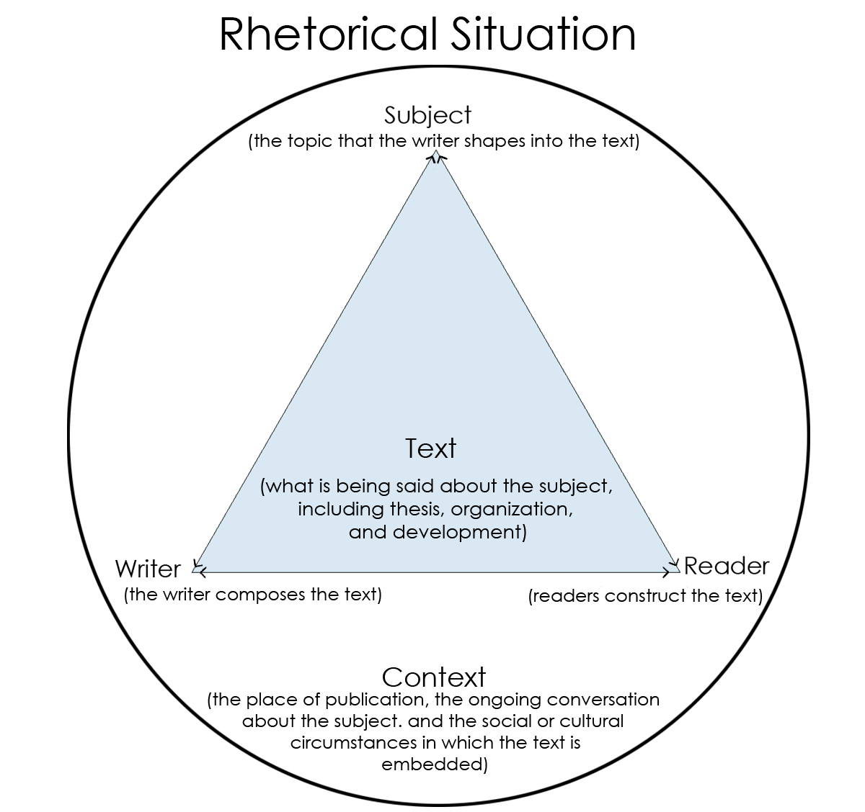
Another part of active reading is asking questions about the rhetorical situation, questions about the writer, reader, subject, and text.
Who is the author?
What makes them credible?
Where and when was the writing published?
Who was the intended audience?
What other circumstances or events were occurring when the document was published that might have influenced it?
How does the author draw on and utilize those events or texts?

