Slide 1
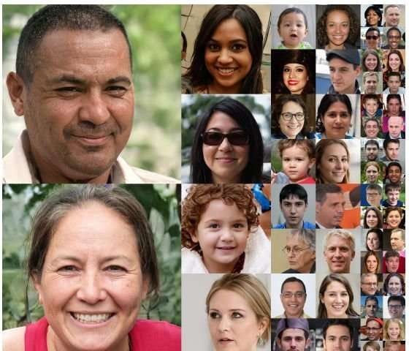
Being Human

Slide 2
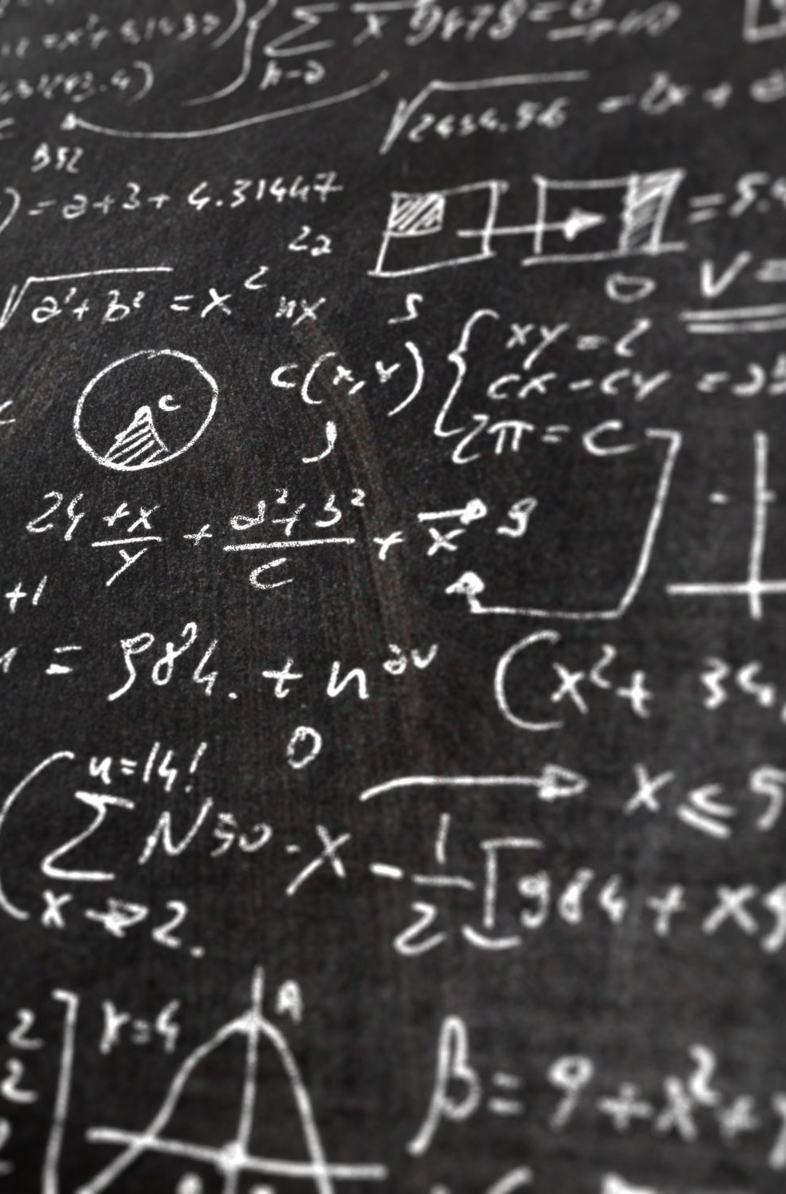
Journal Discussion-Hayles
Write down the quote where Hayles explicitly states how she disagrees and agrees with Hodges’ argument. Have an in-text citation.
What interpretation of Turing by Hodges is Hayles troubling?
Does the “existence of thinking machines” affect (or not affect) “what being human means” (Hayles xiv)?

Slide 3
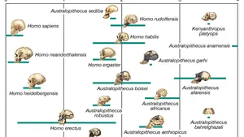
Etymology of “Human”(OED)
Origin: Of multiple origins. Partly a borrowing from French. Partly a borrowing from Latin. Etymons: French humain; Latin hūmānus.
Etymology: < (i) Anglo-Norman humeigne (feminine), humane (feminine), Anglo-Norman and Middle French humain, humayn (French humain ) of or belonging to people (as opposed either to animals or to God) (1119 in Anglo-Norman), having human nature or characteristics (c1170), composed of people (c1174), benevolent (c1175), having people (as opposed to God) as its subject (1552 in letres humaines)

Slide 4
“Human” A. adj. 1.
a. Of the nature of the human race; that is a human, or consists of human beings; belonging to the species Homo sapiens or other (extinct) species of the genus Homo.
1st noted use:
?c1450 tr. Bk. Knight of La Tour Landry (1906) 143 (MED) For the gret compassion and pitee that he hadde upon all humaigne lynage

Slide 5
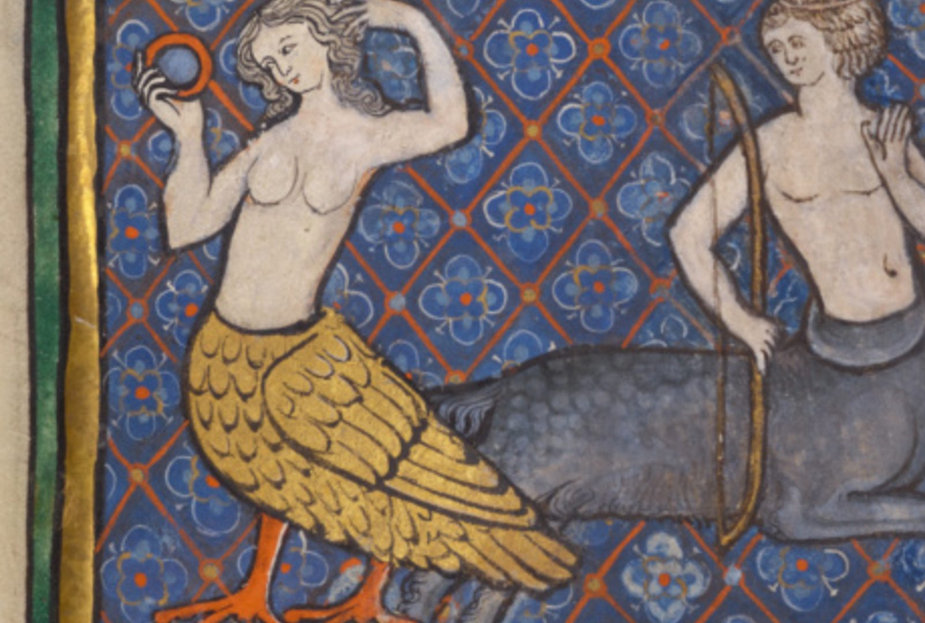
“Human” (cont.)
b. Chiefly figurative. Designating a person who takes on the appearance or form, or who performs the function of a specified (esp. inanimate) thing; (also) designating a person who assumes the appearance, role, or abilities of a specified creature.
Frequently (esp. in the past) in the context of popular entertainment such as a circus or sideshow: Human Cannonball
Notable early usage:
[1746 Brit. Mag. Nov. 344/1 There is, in short, a Person..who calls himself the Man Ostrich; intending to shew himself for a Sight, as he can do like the Ostrich, eat and digest Iron.]

Slide 6

“Human” (cont.)
2. Of, relating to, or characteristic of humans as distinguished from God or gods; secular, not divine; (also) of or relating to the abilities or sphere of activity of human as opposed to supernatural beings; mundane, worldly; imperfect, fallible.
1st use: c1475 Life St. Anne (Trin. Cambr.) (1928) 492 When the moder of good, blessyd mary, That day she sprang in oure nature humayne.

Slide 7
3. Of, relating to, or distinctive of people as distinguished from other animals; of, relating to, or characteristic of the species Homo sapiens or other (extinct) species of the genus Homo.
Notable early use: 1575 E. Hake Commemoration Raigne Lady Elizabeth sig. C We were..brutishe as beastes in the olde age at the first callinge home of our grand Auncestors to human ciuilitye.

Slide 8
Writing Prompt- Starting Point
How would you define “Human”?
What do you think it means to be human?
What do you think Posthuman means at this point?

Slide 9
Works Cited
Hayles, N. Katherine. "How We Became Posthuman: Virtual Bodies in Cybernetics, Literature, and Informatics." (2000): 464.

