Slide 1
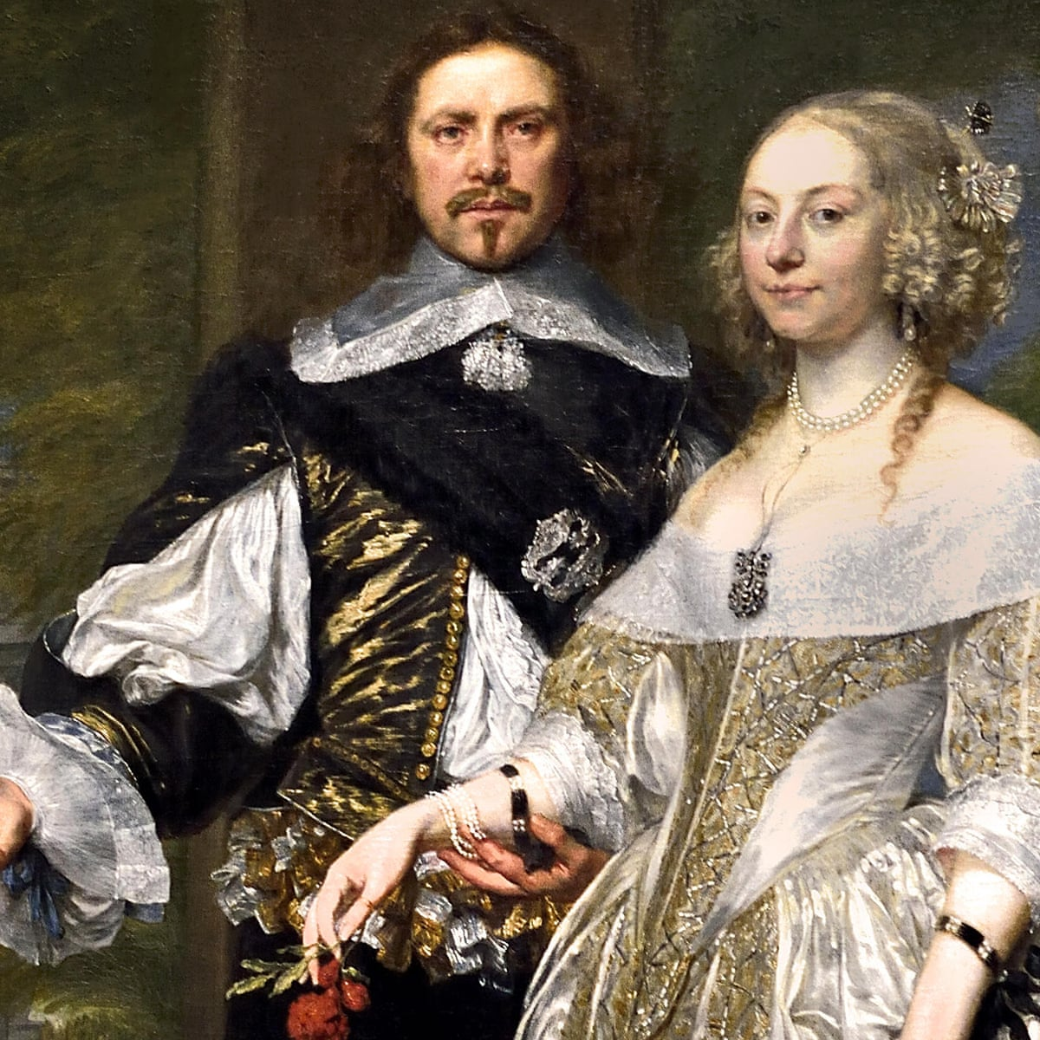
Blazing World
Margaret Lucas Cavendish
1666

Slide 2
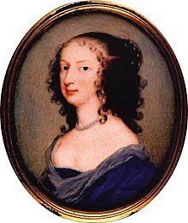
Margaret Cavendish
Philosopher, Poet, Scientist, Fiction-writer, and Playwright
Born in 1623 in Colchester, Essex
Did not receive a formal education
Had access to scholarly libraries
“ It was regarded as unseemly at the time for a woman to be publicly intellectual, she was able to be an intellectual in private in regular conversations with her middle-brother John. This is noteworthy because John was already a well-established scholar: a student of law, philosophy, and natural science, he was fluent in Hebrew, Latin and Greek, and would eventually become a founding member of the Royal Society (Whitaker 2002, 11–12).”

Slide 3
Margaret Cavendish
Philosopher, Poet, Scientist, Fiction-writer, and Playwright
Becomes maid of honor at the court of Queen Henrietta Maria in 1643
Exiled to France in 1644
Meets and marries William Cavendish in 1645
Remain in exile (Paris, Rotterdam, Antwerp) until the restoration of the crown in 1660
Was offered an extremely rare invitation to participate in a meeting of the Royal Society in 1667
Died in December 1673 and was buried at Westminster Abbey

Slide 4
Why Cavendish’s Marriage Matters
Publication
In the mid-seventeenth-century it was unusual for a publisher to print the philosophical and scientific work of a woman
She was able to publish some of her work without assistance
Some of her writings were published with the help of her well-connected husband

Slide 5
Why Cavendish’s Marriage Matters
The “Cavendish Circle”
Interacted with such figures as Thomas Hobbes, Rene Descartes, Marin Mersenne, Pierre Gassendi, and Kenelm Digby
They would not critically correspond with her in print

Slide 6
Margaret Cavendish
Philosopher, Poet, Scientist, Fiction-writer, and Playwright
Materialism
The central tenet of Cavendish's philosophy is that everything in the universe—including human beings and their minds—is completely material. Her commitment to this tenet is reflected throughout her corpus:
  Nature is material, or corporeal, and so are all her Creatures, and whatsoever is not material is no part of Nature, neither doth it belong any ways to Nature….

Slide 7
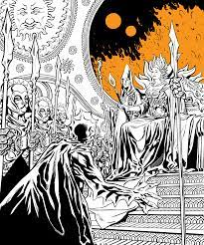
The Title
What expectations did the title set for you as a point of departure?

Slide 8
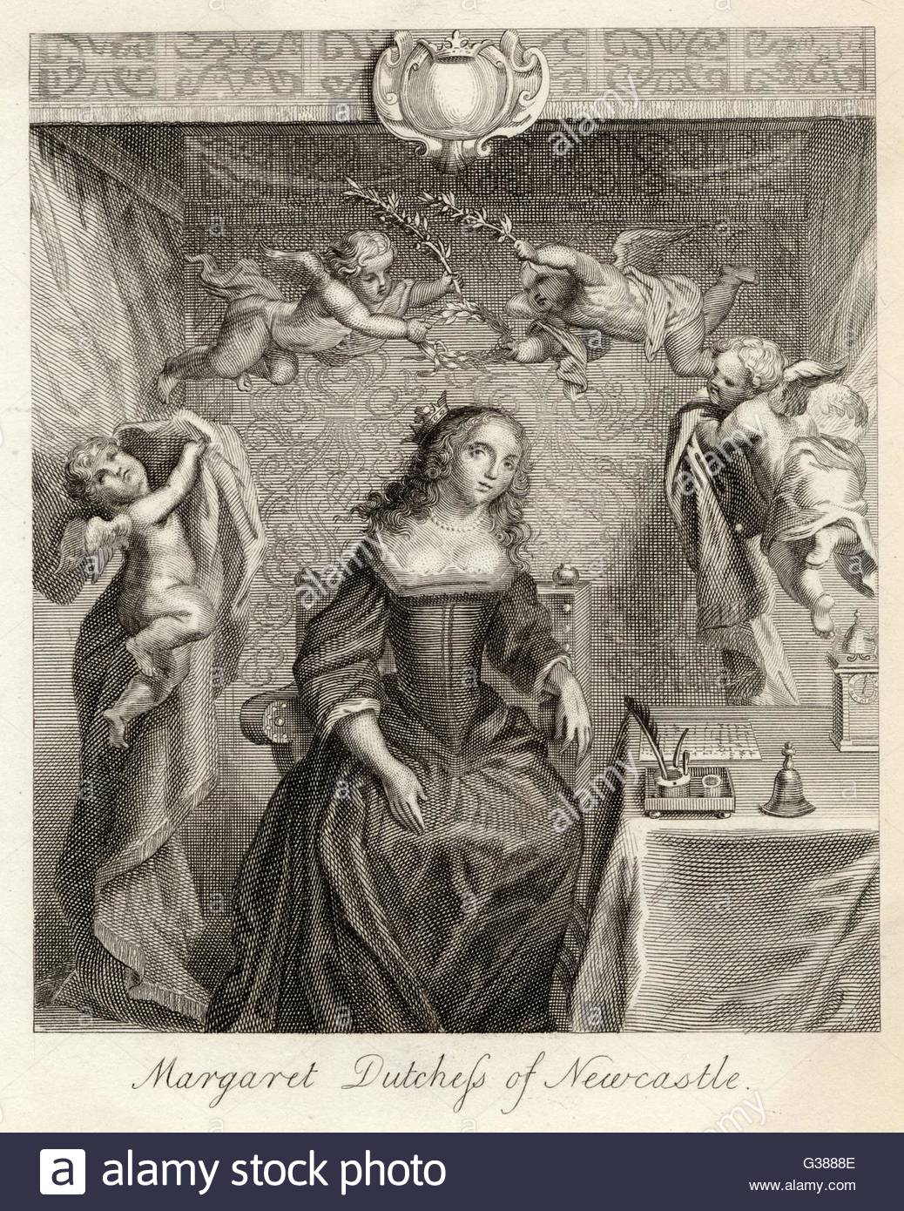
Narratorial Perspective
Consider the position, personality, and values of the narrator:
What tone of voice does the narrator have?
Do they have any specific likes or dislikes?
Does the narrator have an agenda?
What is the agenda if so?
Is the narrator reliable?
If not, in what ways and why not?
Is the exaggeration typical of satire present?

Slide 9
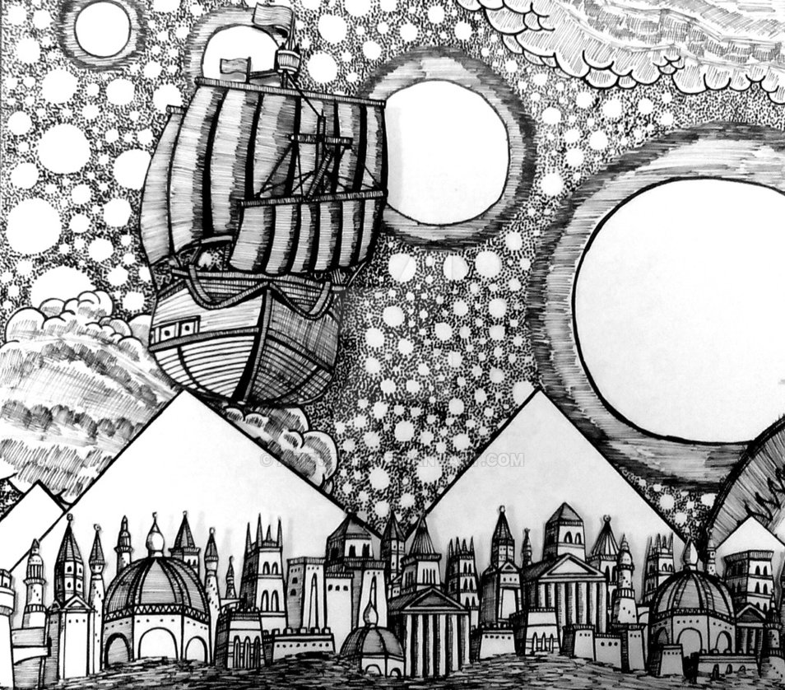
Setting
The location, physical and temporal, where the story takes place
Where does the story take place?
Is there more than one location?
Do any aspects of the setting (landscape, weather, buildings) tie in symbolically to any characters? How so?
During what time period does the story take place?
Does time of day have significance?
Is there cultural or historical significance attached to the time or location?
How does the setting reinforce or inform the reader’s deeper understanding of the text?

Slide 10
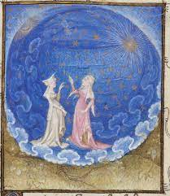
Question
What is the major conflict in the story?
Is there more than one conflict?

Slide 11
Symbolism
The use of symbols to signify ideas and qualities.
Types of symbolism one might encounter:
One object representing another to give a deeper and more significant meaning to something in the text.
A situation being symbolic of a larger idea, which an awareness of deepens the meaning of the text.
A person, place or thing being symbolic of something more abstract that exists outside of the story.

Slide 12
Group Work
Given Le Guin’s premise that science fiction is descriptive not predictive what does “Blazing World” reflect about Cavendish’s world regarding:
Gov’t, Religion, Class Hierarchy, Philosophy, Scientific Thought, Gender Relations, Material Culture
Locate textual evidence and unpack Cavendish’s rendering of her “new world” for 2-3 of the above.
*Note that assumptions can be dangerous ground in literary interpretation as “Her brief preface to the work designates it ‘a work of fancy’” and, unlike Le Guin, Cavendish does not view fancy as needing to refer to anything outside itself (Prakas).

Slide 13
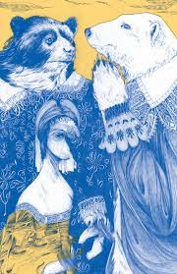
Possibility of Satire
“As several recent critics have proposed, the apparent contradiction between the Empress’s authoritarian mode and Cavendish’s commitment to intellectual liberty might in fact constitute a subtle criticism of the Royal Society.
The structure of the Blazing World debate not only allows for the articulation of scientific opinions corresponding to Cavendish’s own, but also embeds them in discursive mechanisms that make their legitimacy seem irrefutable. While she appears, early in the preface, to champion independent imaginative thought, Cavendish in fact uses her independence as the author to produce a fictive space of intellectual coercion.
This discrepancy might well represent a satire on the experimental processes used by the Royal Society, but it also testifies to Cavendish’s political commitment to absolutist monarchy, one seemingly at odds with the emphasis on individual liberty underpinning both the vitalist schemes in her scientific Opinions and her descriptions in the Blazing World’s preface of what the imagination should be”
~ Prakas 124-5
Who was the Royal Society?
Where is the tension between independent thought and intellectual coercion evident?

Slide 14
Possibility of Satire
“We know from her desire to visit the Royal Society that Cavendish felt curious about this inquisitive atmosphere, and her decision to write scientific texts further evidences a desire to participate in the intellectual exchanges that the Society fostered.15 But it also speaks, perhaps, of the frustration caused by her general exclusion from those exchanges. That exclusion may have seemed, to Cavendish, grounds for complaints that the Society’s openness and commitment to experimentation was something of a fiction, and that it functioned ultimately to legitimize decisions made arbitrarily by a relatively small, elite group of gentlemen scientists.”
~ Prakas 128

Slide 15
Question
How might “The Blazing World” operate symbolically regarding a larger issue outside of the text?
Notes:
As a woman she is excluded from the Academy

Slide 16
Political and Internal Dissonance
“Cavendish’s own politics privilege a Hobbesian conception of sovereign authority. A maid of honor to Queen Henrietta Maria from her youth, her marriage to William Cavendish confirmed and reinforced her devotion to the monarchy and to the notion of the monarch’s absolute control over his subjects. Yet her scientific writing […] conflicts in several regards with that of Hobbes, disputing in particular the terms of his theory of mental function, even while she shares his investment in the political systems of which Hobbes’s theory is a representative part. Cavendish’s writing […] valorizes the autonomy and agency of individual entities to an extent that runs counter to that hierarchical framework”
Prakas 127

Slide 17
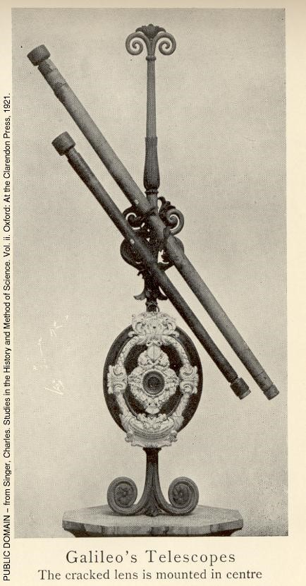
  “The activity of imaginative textual world-building becomes useful and liberating for Cavendish when she uses it to set up—and set herself atop—structures of hierarchical authority. As Maura Smyth suggests, she takes pleasure in “creating alternate worlds in which a woman can rise to be empress” (67).”
  ~ Prakas 125
  Did you note ways this hierarchal structure is problematic?

Slide 18
Conflation
“The degree to which the Empress functions as a mouthpiece for Cavendish’s theories is one of a host of invitations in Blazing World, more and less direct, to conflate the author with her textual protagonist. So how, then, are we to read the frequent occasions on which the text presents that protagonist negatively?”
Prakas 134

Slide 19
Conflation with a purpose
“By implicating herself in the messy pursuit of scientific knowledge that her text mocks, Cavendish may be constructing a sophisticated critique of the claims of “altruistic intent”—claims that the acquisition of knowledge offers universal benefits—often advanced by such proponents of the new science as Hooke and Bacon, and instead highlighting the essential self-interest at the heart of such knowledge acquisition”
Prakas 134

Slide 20
References
https://plato.stanford.edu/entries/margaret-cavendish/
Prakas, Tessie. "" A World of her own Invention": The Realm of Fancy in Margaret Cavendish's The Description of a New World, Called the Blazing World." Journal for Early Modern Cultural Studies 16.1 (2016): 123-145.
Whitaker, Katie. "Mad Madge." The extraordinary life of Margaret Cavendish, Duchess of Newcastle, the First woman to live by her pen 308 (2002).

