Slide 1
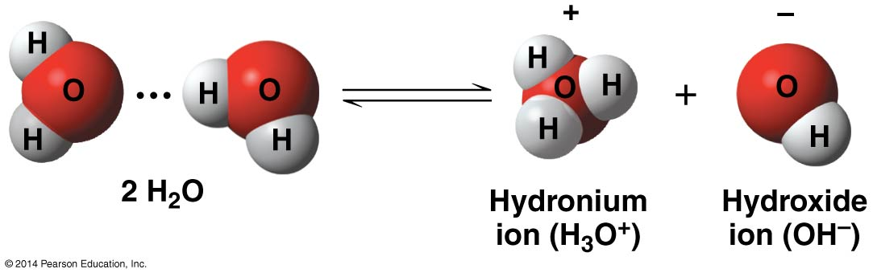
Chemistry of Life: Water
Dissociation of water
A hydrogen atom in a hydrogen bond between two water molecules can shift from one to the other
Also called H+

Slide 2
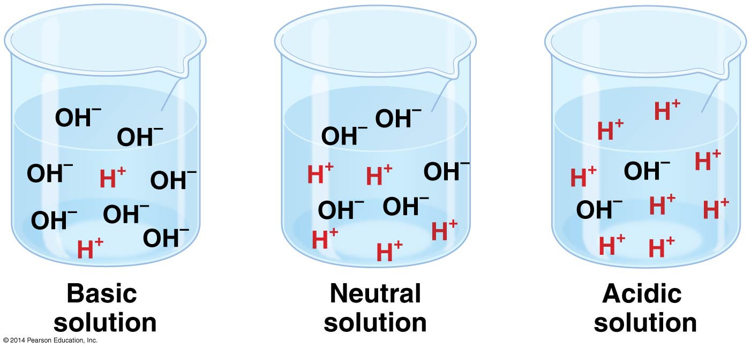
Chemistry of Life: Water
Acids and Bases can disrupt balance of H+ and OH-
Acid:
Any substance that increases the H+ concentration of a solution
HCL H⁺ + CL⁻

Slide 3
Chemistry of Life: Water
Acids and Bases can disrupt balance of H⁺ and OH⁻
Base:
Any substance that reduces the H⁺ concentration of a solution
Addition of OH⁻
NaOH Na + OH⁻
Remove H+ from a solution
NH3 + H+ NH4+

Slide 4
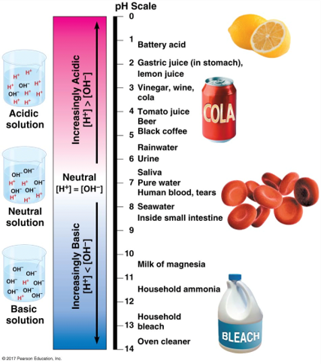
Chemistry of Life: Water
The pH Scale
pH = -Log [H⁺]
0 to 14 Range
Acidic Solutions = pH < 7
Basic Solutions = pH > 7

Slide 5
Chemistry of Life: Water
Buffers:
Substances that minimize changes in concentrations of H⁺ and OH⁻ in a solution.
Can either accept H+ or donate H+ to a solution
​
H₂CO₃ HCO₃- + H+ ​
carbonic acid bicarbonate ion​
(H+ donor) (H+ acceptor)

Slide 6
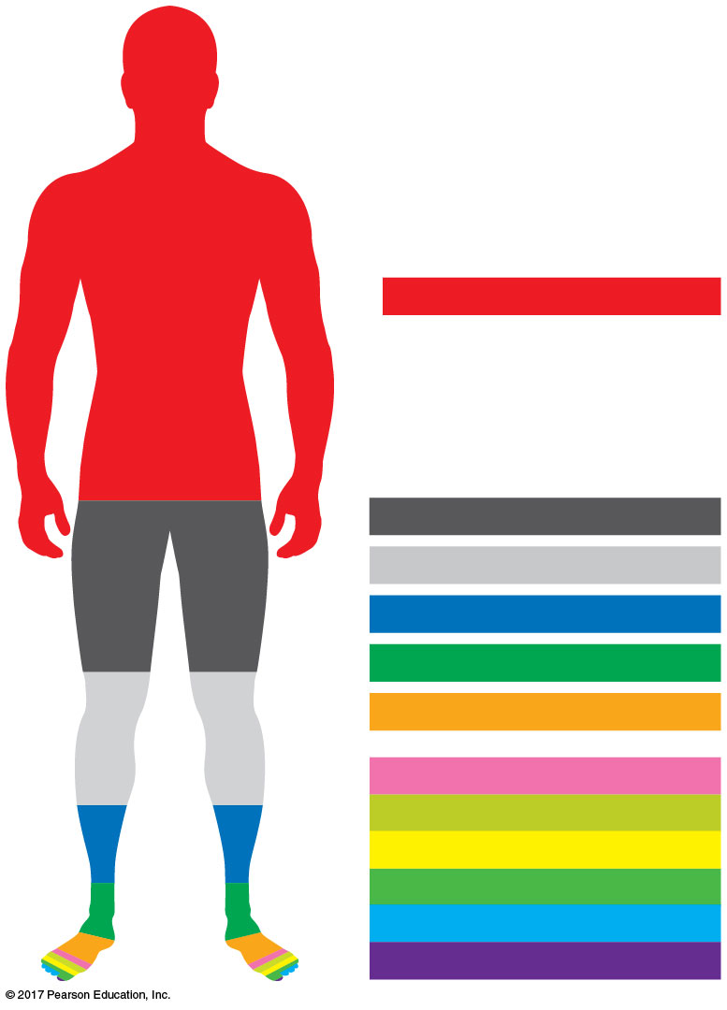
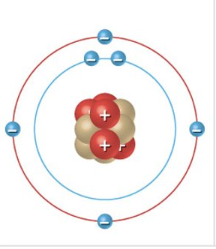
Chemistry of Life: Carbon
Carbon: The backbone of Life
4 Valence
4 Covalent Bonds
Oxygen (O): 65%
Carbon (C): 18.5%
Carbon
Hydrogen (H): 9.5%
Nitrogen (N): 3.3%
Calcium (Ca): 1.5%
Phosphorus (P): 1.0%
Potassium (K): 0.4%
Sulfur (S): 0.3%
Sodium (Na): 0.2%
Chlorine (Cl): 0.2%
Magnesium (Mg): 0.1%
Trace elements: < 0.01%

Slide 7
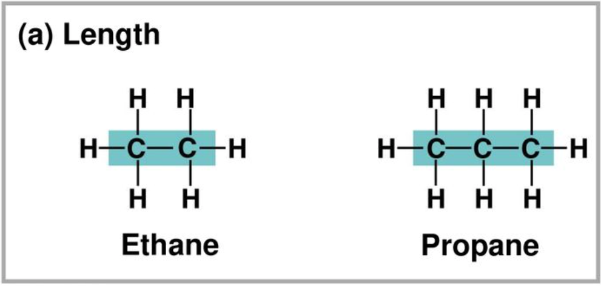
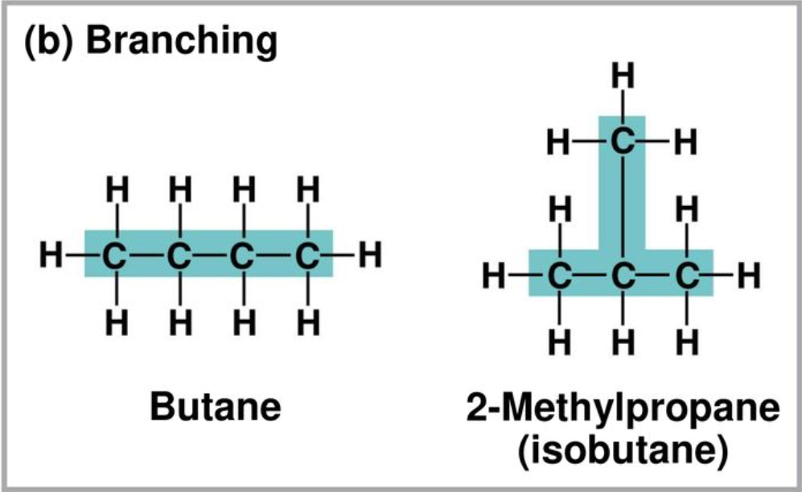
Chemistry of Life: Carbon
Hydrocarbons:
Organic molecules consisting of only carbon and hydrogen.
Limited role in living systems because the do NOT interact with water.

Slide 8
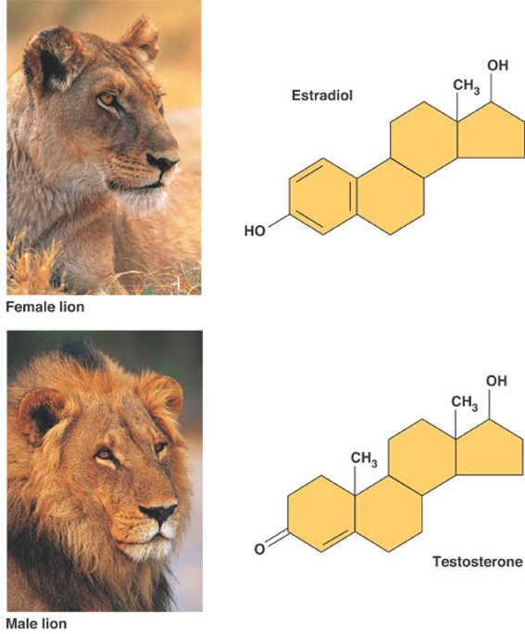
Chemistry of Life: Carbon
Functional Groups:
Components of organic molecules most commonly involved in chemical reactions
Impact shape and allow chemistry
Impart chemical properties to biological molecules

Slide 9
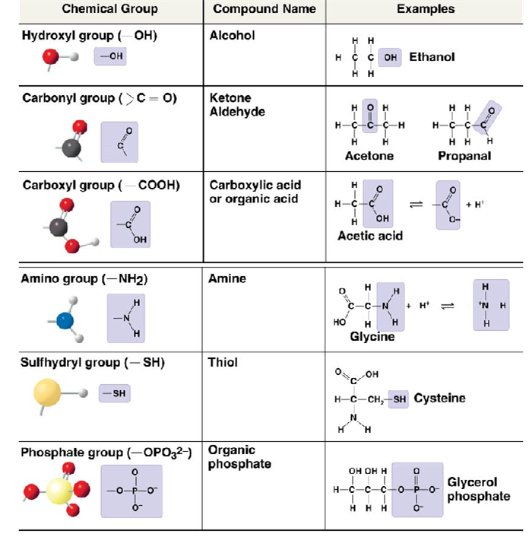
Chemistry of Life: Carbon
Key Functional Groups for biological Molecules

Slide 10
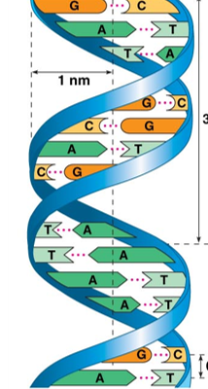
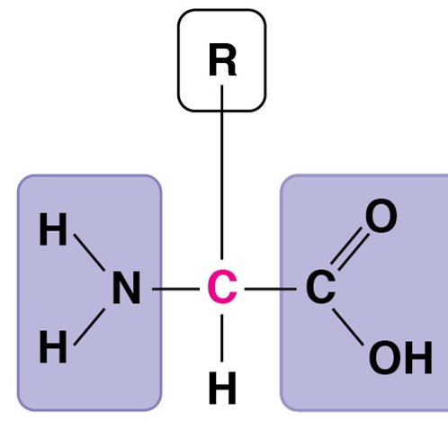
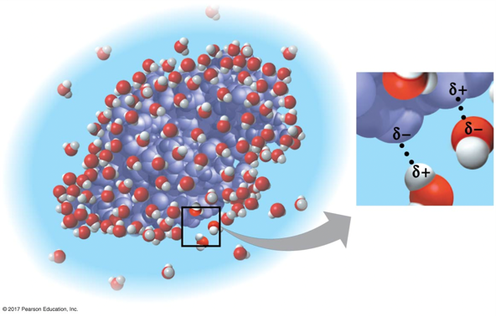
Chemistry of Life: Carbon
Polar functional groups:
Make molecules soluble in aqueous solutions.
Allow inter- and intra molecular interactions.
Are chemically reactive
Proteins
DNA
Amino Acid

Slide 11
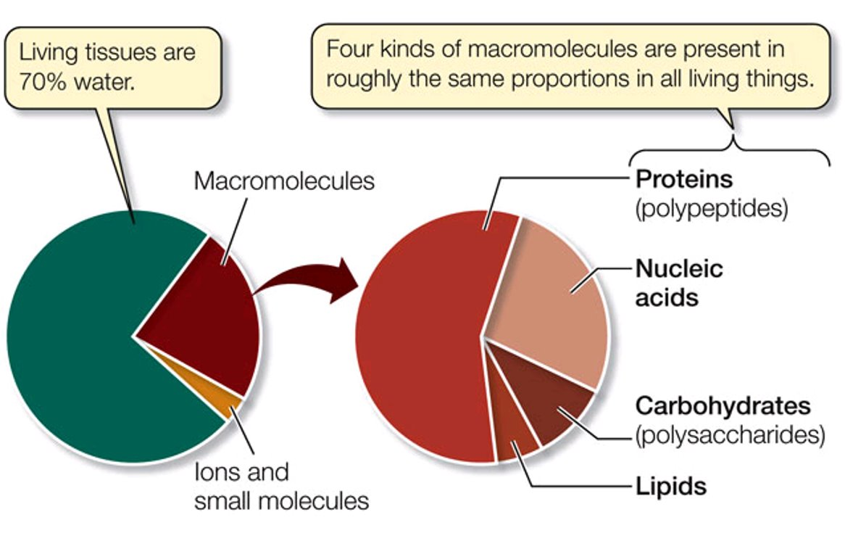
Macromolecules
Macromolecules:
A giant molecule formed by joining smaller molecules.
Carbohydrates
Lipids
Proteins
Nucleic Acids
15%
7%
3%
2%

Slide 12
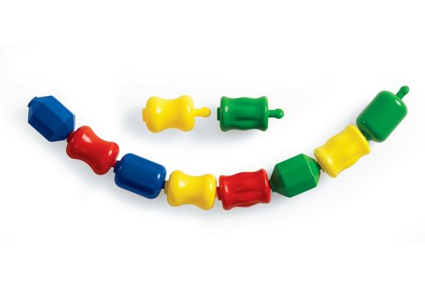
Macromolecules
Polymer:
Long molecule composed of similar or identical building blocks linked by covalent bonds
Monomer:
Building blocks of a polymer
Monomers
Polymer

Slide 13
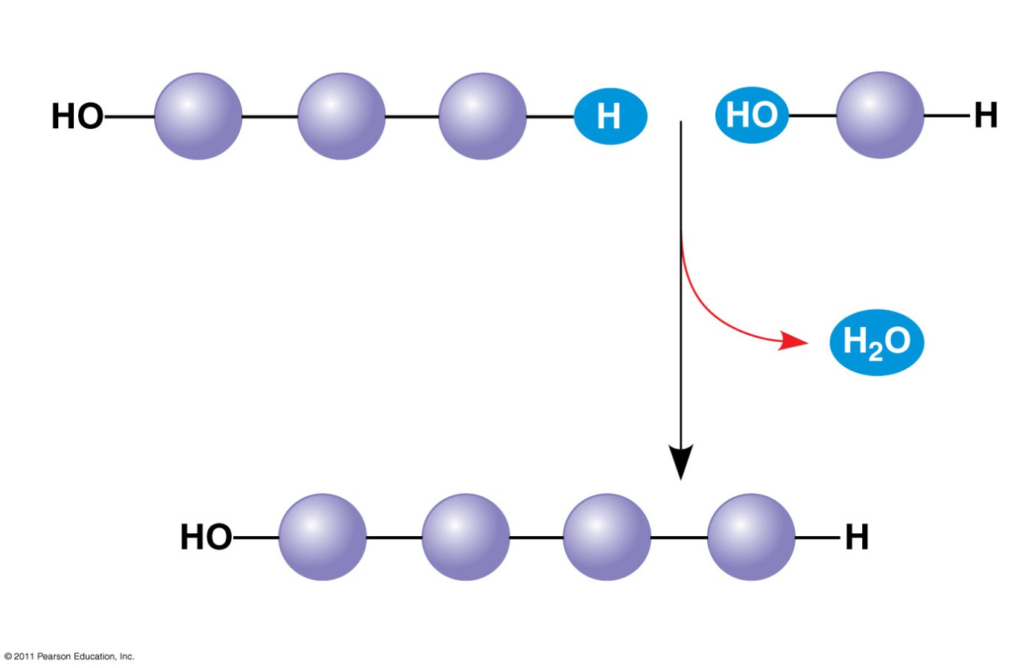
Macromolecules
Dehydration Reaction:
A chemical reaction in which two molecules become covalently bonded to each other with the removal of a water molecule.
(a) Dehydration reaction: synthesizing a polymer
1
2
3
Short polymer
Unlinked monomer
Dehydration removes a water molecule, forming a new bond.
1
2
3
4
Longer polymer

Slide 14
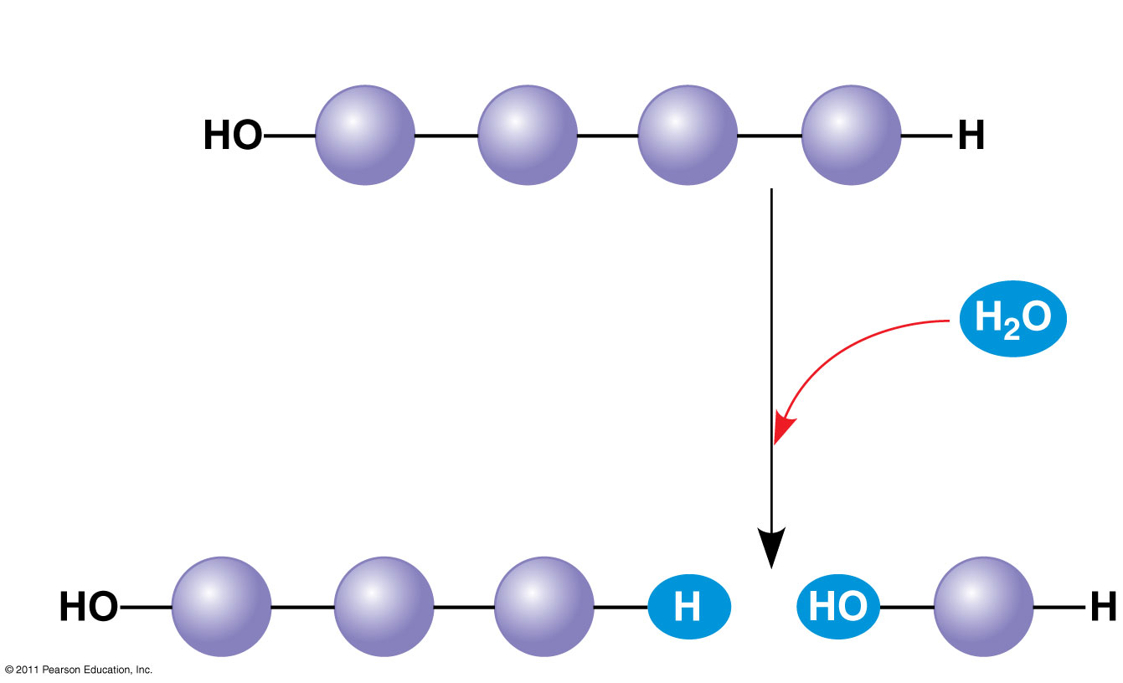
Macromolecules
Hydrolysis Reaction:
A chemical reaction that breaks the bond between two molecules by the addition of water.
Enzymes:
A protein that works to increases the rate of a reaction without being consumed by the reaction.
(b) Hydrolysis: breaking down a polymer
1
2
3
4
Hydrolysis adds a water molecule, breaking a bond.
1
2
3

Slide 15
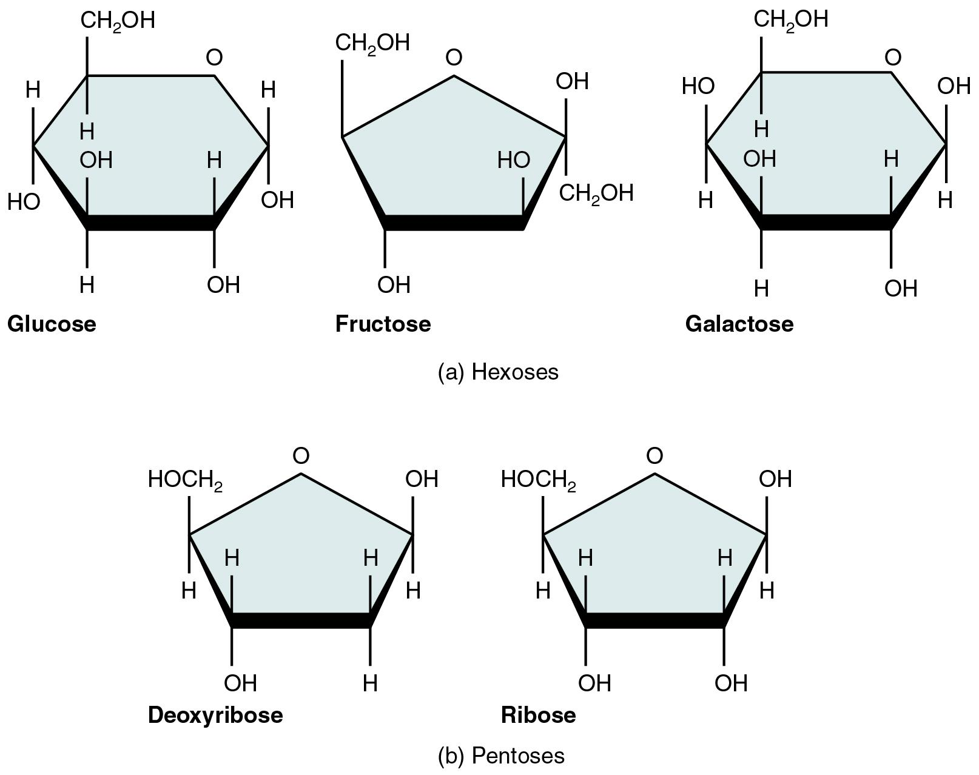
Macromolecules: Carbohydrates
Carbohydrates:
Sugars and polymers of sugars; AKA Saccharides
Monosaccharide:
Monomer of carbohydrates

Slide 16
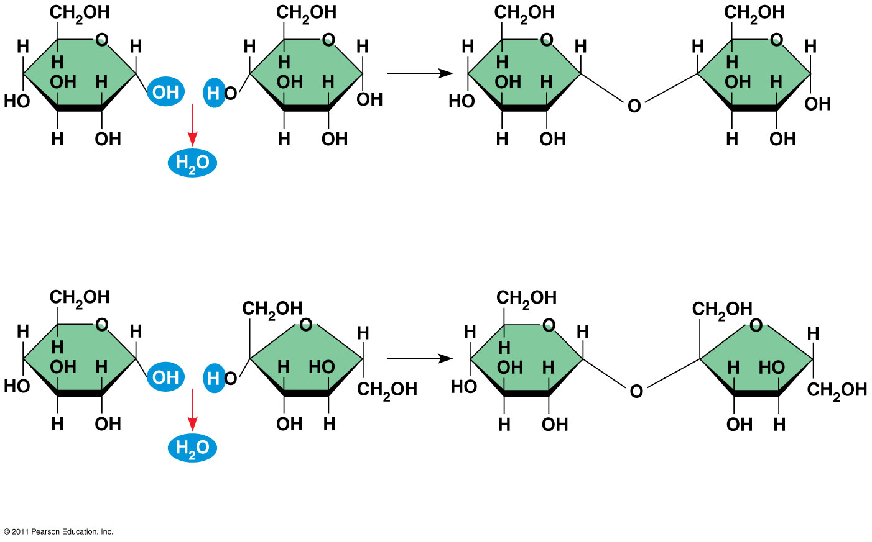
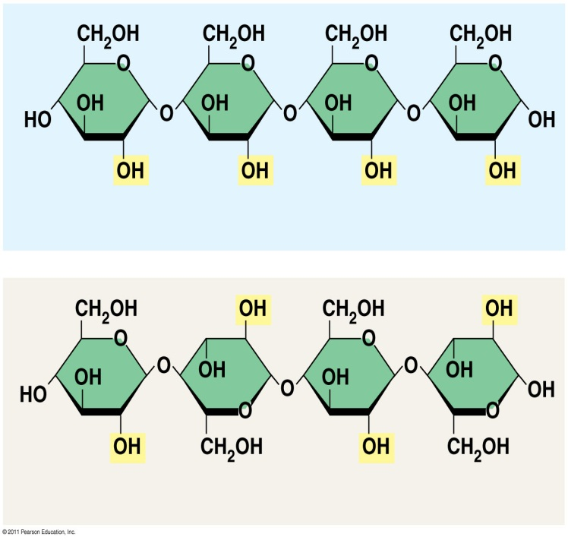
Macromolecules: Carbohydrates
Disaccharide:
Two monosaccharides
Polysaccharide
Sugar Polymer
Important for Energy storage (glycogen and starches) and structure (Cellulose and Chitin)
1–4 glycosidic linkage
1
4
Glucose
Glucose
Maltose
Figure 5.7b
1
4
1
4
(b) Starch: 1–4 linkage of α glucose monomers
(c) Cellulose: 1–4 linkage of β glucose monomers
1
4

Slide 17
Macromolecules: Lipids
Lipids:
Large biological molecules that mix poorly with water..
Not true “polymers”
Not true ”macromolecule”
3 Types
Triglycerides
Phospholipids
Steroids

Slide 18
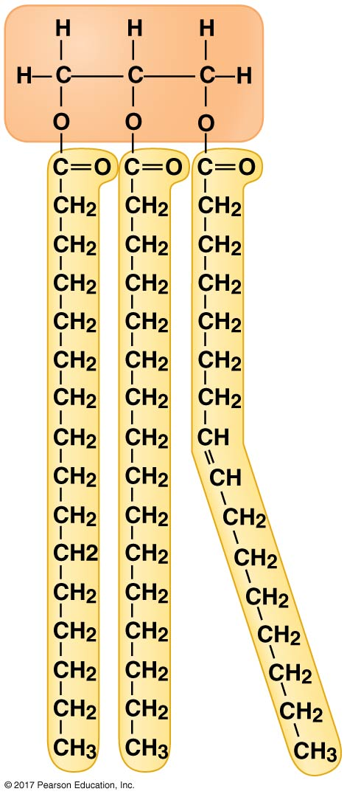
Macromolecules: Lipids
Triglycerides (Fats)
Composed of Glycerol and 3 fatty acid tails
Important for Energy Storage
Glycerol
Fatty Acids

Slide 19
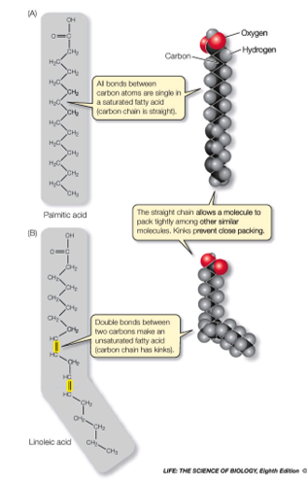


Macromolecules: Lipids
Saturated vs Unsaturated Fats
Saturated – NO double bonds
Unsaturated – One or more double bonds

Slide 20
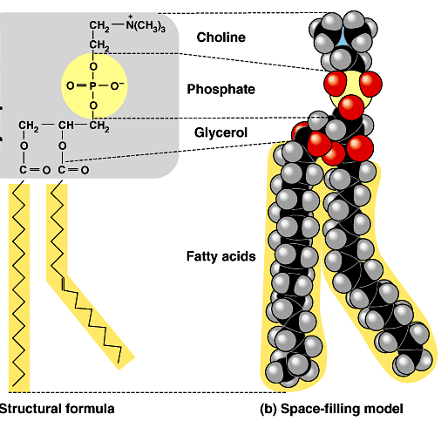
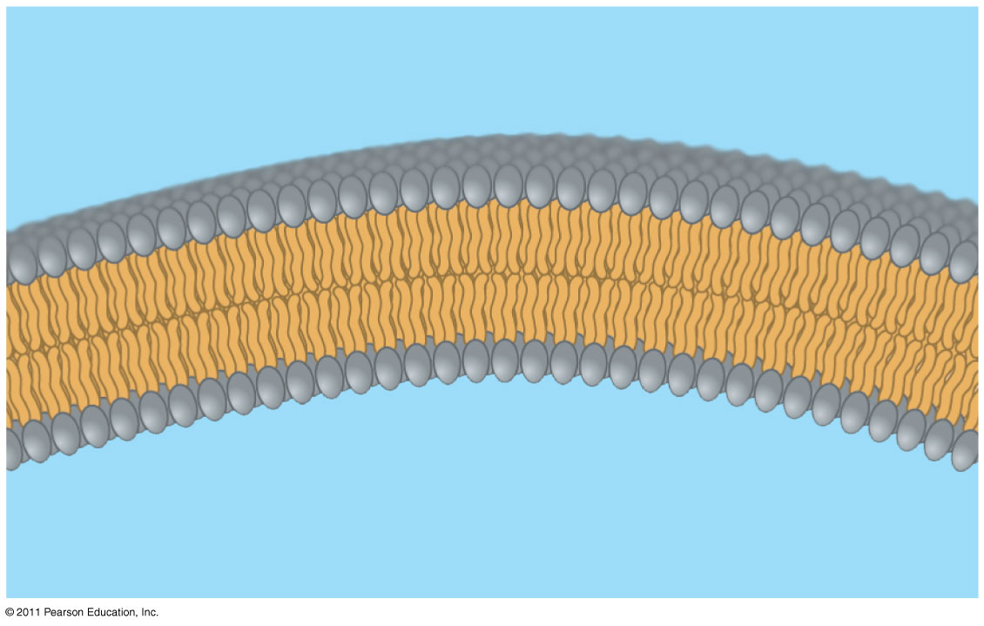
Macromolecules: Lipids
Phospholipids
Composed of Glycerol, 2 fatty acid tails, phosphate group with a polar head group
Important component of cell membranes
WATER
Hydrophilic head
Hydrophobic tail
WATER

Slide 21
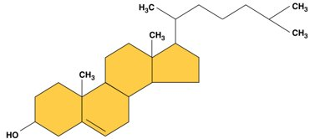

Macromolecules: Lipids
Steroids:
Composed of 4 fused hydrocarbon rings
Important components of membranes and hormone signaling molecules.
Cholesterol
Estradiol
Testosterone

Slide 22
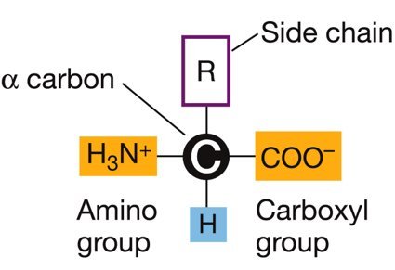
Macromolecules: Proteins
Proteins:
Large biological molecules consisting of one or more polypeptide folded into a specific three-dimensional structure.
Amnio acids:
Monomer of proteins
20 Different amino acids
Polypeptides:
Polymer of proteins

Slide 23
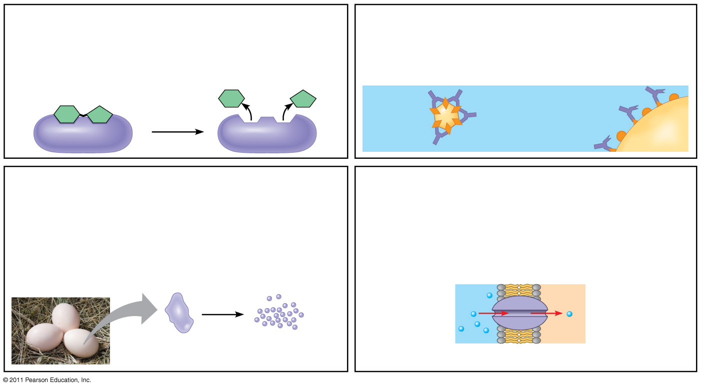
Macromolecules: Proteins
Proteins do all the work!
Enzymatic proteins
Defensive proteins
Function: Selective acceleration of chemical reactions
Function: Protection against disease
Example: Digestive enzymes catalyze the hydrolysis of bonds in food molecules.
Example: Antibodies inactivate and help destroy viruses and bacteria.
Antibodies
Enzyme
Virus
Bacterium
Storage proteins
Transport proteins
Function: Storage of amino acids
Function: Transport of substances
Examples: Casein, the protein of milk, is the major source of amino acids for baby mammals. Plants have storage proteins in their seeds. Ovalbumin is the protein of egg white, used as an amino acid source for the developing embryo.
Examples: Hemoglobin, the iron-containing protein of vertebrate blood, transports oxygen from the lungs to other parts of the body. Other proteins transport molecules across cell membranes.
Transport protein
Ovalbumin
Amino acids for embryo
Cell membrane

Slide 24
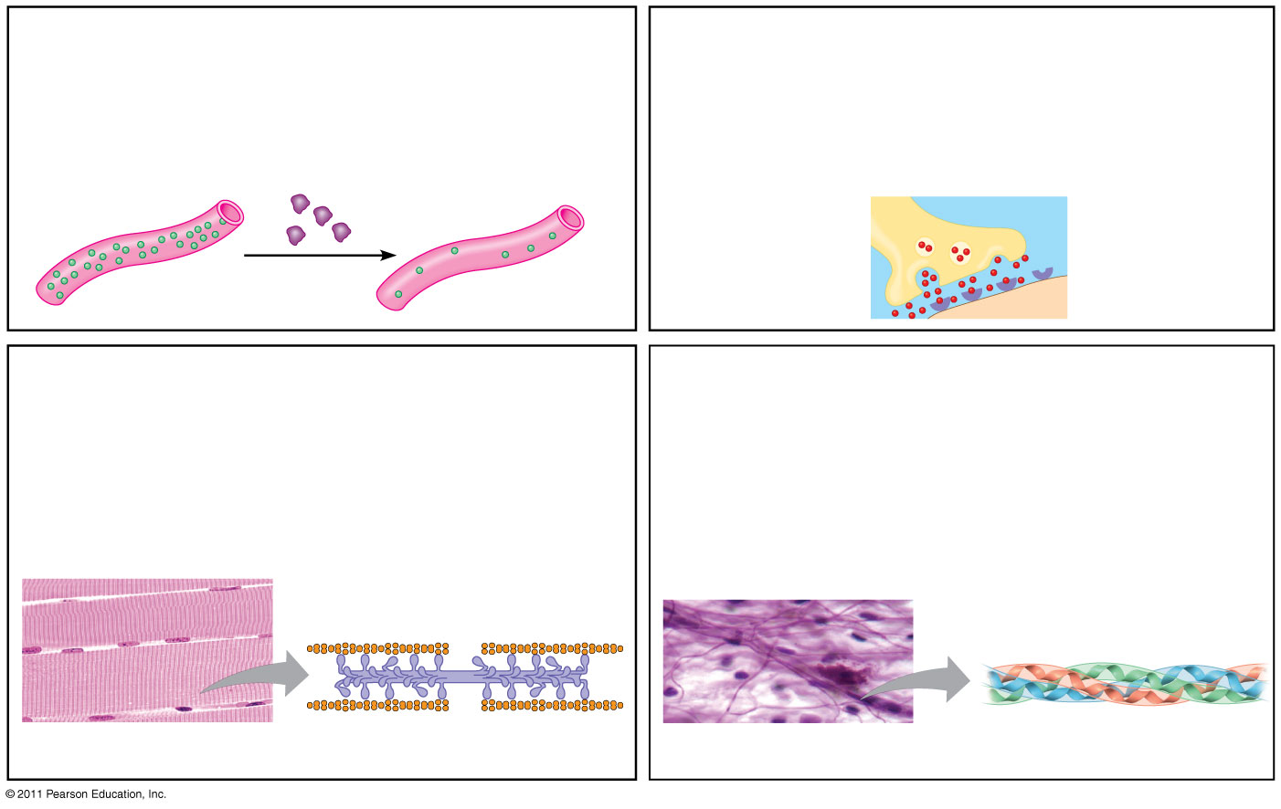
Macromolecules: Proteins
Proteins do all the work!
Hormonal proteins
Receptor proteins
Function: Coordination of an organism’s activities
Function: Response of cell to chemical stimuli
Example: Insulin, a hormone secreted by the pancreas, causes other tissues to take up glucose, thus regulating blood sugar concentration
Example: Receptors built into the membrane of a nerve cell detect signaling molecules released by other nerve cells.
Receptor protein
High blood sugar
Insulin secreted
Normal blood sugar
Signaling molecules
Contractile and motor proteins
Structural proteins
Function: Movement
Function: Support
Examples: Motor proteins are responsible for the undulations of cilia and flagella. Actin and myosin proteins are responsible for the contraction of muscles.
Examples: Keratin is the protein of hair, horns, feathers, and other skin appendages. Insects and spiders use silk fibers to make their cocoons and webs, respectively. Collagen and elastin proteins provide a fibrous framework in animal connective tissues.
Actin
Myosin
Collagen
Muscle tissue
100 μm
Connective tissue
60 μm

Slide 25
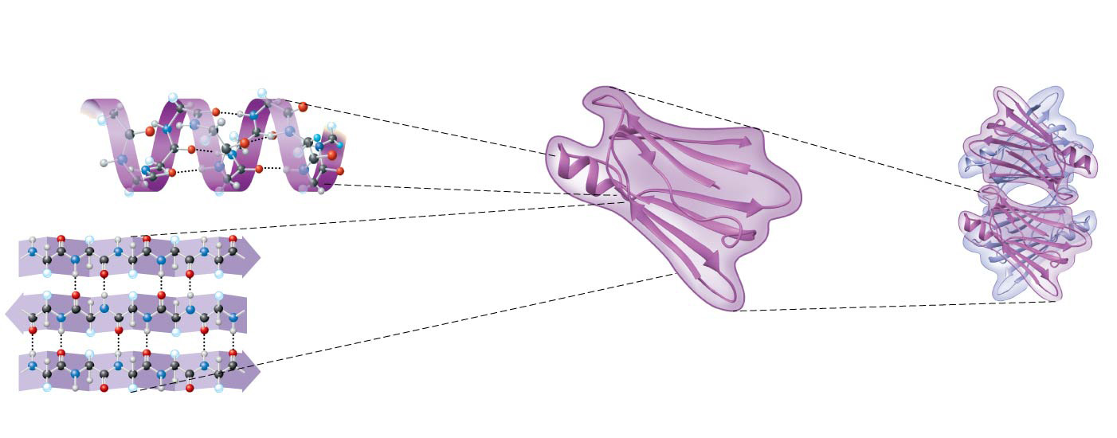
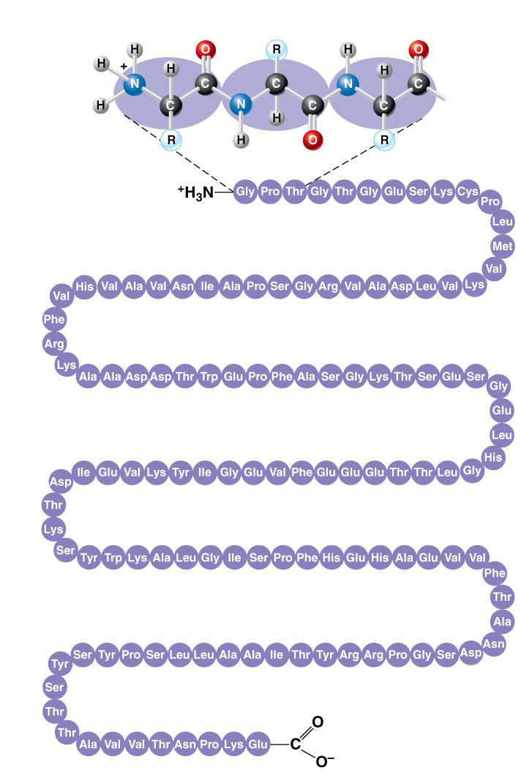
Macromolecules: Proteins
4 levels of Protein structure
Primary Structure
The unique sequence of amino acids
Secondary Structure:
Coils and folds in the polypeptide chain
Amino
acids
Amino
end
𝛂 helix
Carboxyl
end
𝛃 pleated sheet

Slide 26
Macromolecules: Proteins
4 levels of Protein structure
Tertiary Structure:
Interactions among various side chains (R groups)
Quaternary Structure:
Protein consisting of multiple polypeptide chains
Tertiary
Structure
Quaternary
Structure

