Slide 1
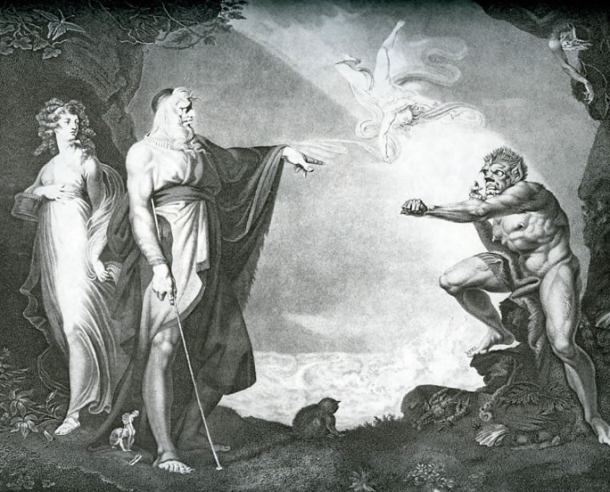
“Caliban Upon Setebos”
Robert Browning
Notes:
NOTE:
To change the image on this slide, select the picture and delete it. Then click the Pictures icon in the placeholder to insert your own image.

Slide 2
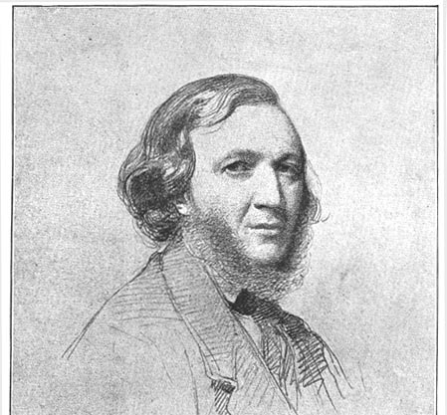
Robert Browning
Biography:
Born on May 7, 1812, in Camberwell, England.
Received only a slight formal education
He lived with his parents in London until 1846
Did a great deal of writing during this time
Failed at writing Drama
Pauline criticized by Joh Stuart Mill
Devoted his main energies for some years to verse drama
Family paid for all his early publications
Meets E.B.B. in 1845 (it all starts with a letter and poetry, of course)
They elope to Italy in 1846 and live there until his death
He writes little during their marriage (she remains prolific however)
She dies in his arms in 1861
He publishes two editions of her most recent verse and then gets back to his own work
Dies in Venice in 1889

Slide 3
Robert Browning
Biography:
https://www.poets.org/poetsorg/poet/robert-browning
Context:
https://www.history.ac.uk/ihr/Focus/Victorians/article.html

Slide 4
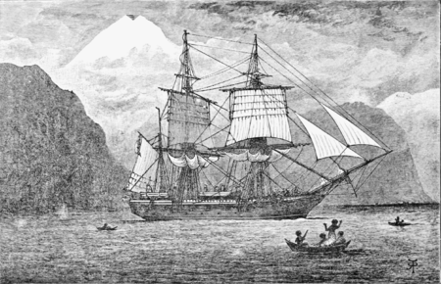
Scientific Context
Darwin’s Origin of Species Comes out in 1859.
“Caliban upon Setebos” is published in 1864 in Dramatis Personae.

Slide 5
Dramatic Monologue
Definition: to be a dramatic monologue a poem must have a speaker and an implied auditor, and […] the reader often perceives a gap between what that speaker says and what he or she actually reveals (victorianweb.org)
Implication:
The theatre
An audience (within the poem & in the way we as the reader/audience must examine the gap)
Characters
Tension
Note that in this poem Browning frustrates structures of the Dramatic Monolgue by having Caliban shift between 1st and 3rd person.

Slide 6
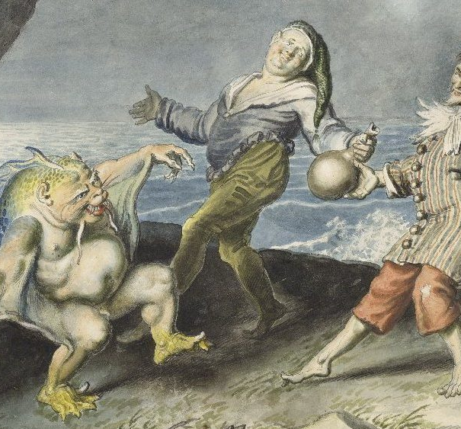
Theatrical Influence- Who is Caliban?
A character from Shakespeare’s The Tempest
Caliban is presented as a savage and deformed
Described as evil by Prospero and Miranda (power relationships and a critique of racism are important in many modern re-visionings of this story and character [Aime Cesaire- Une Tempete -1969].
Enslaved by Prospero
Has a natural and useful knowledge in contrast to Prospero’s book knowledge

Slide 7
Theatrical Influence- Who is Caliban?
In the second act Caliban meets two sailors:
Trinculo asks himself if Caliban is a fish or a man. He thinks that he is a fish because of the smell but then he notices that
Caliban has arms and legs like a human being.
Trinculo says “This is no fish, but an islander that hath lately suffered by a thunderbolt.”
Stefano says that he is a monster of the isle with frog legs and they are surprised
by his talking skills.

Slide 8
Natural Theology
“Natural theology is a program of inquiry into the existence and attributes of God without referring or appealing to any divine revelation. […]
Modern philosophy and modern science was perceived by many to threaten the traditional claims and conclusions of natural theology, for example, that the existence and attributes of God can be known apart from revelation and faith.”
[Rather than search for the divine in sacred writings the natural theologist looks for “God” in the material world, in “the creation,” and in reason.]
[Numerous factions that were proponents of Natural Theology] “suffered a blow from Charles Darwin’s (1809 – 1882) theory of evolution and the subsequent evolutionary theories that have been developed. Given Darwin, the proposition that all life developed by chance alone is widely perceived to have a degree of plausibility that it was not perceived to have [earlier]. Whether and to what extent Darwinian principles eliminate the necessity for positing a divine designer is one of the most hotly contested issues in natural theology today.”
Source: https://iep.utm.edu/theo-nat/

Slide 9
Darwin- Some Key Ideas in the Public Discourse
Evolution- New species come into being through changes in older species rather than divine creation.
How does the notion of chance variation challenge the notion of divine creation?
Natural Selection-There is always variety in the community of a species. These variations are produced by chance, (we know now it is through random genetic mutations, undirected/without purpose, but they did not know this at the time). Based on the changing environment those random mutations allow some variations to thrive while others do not. This can lead to a new species developing.
Contemporaries of Darwin liked the idea of evolution but not of evolution without a purpose, and most rejected natural selection as the cause of evolution. Darwin’s contemporaries wanted a linear narrative with humans at the pinnacle of evolution.
Why is chance unsettling to humans in the conception of evolution?
Notes based on the ideas of Dr. Peter Bowler, Emeritus Professor (Historian of Biology), Queen’s University Belfast.

Slide 10
“Survival of the Fittest”
Coined by Herbert Spencer this statement is still used to explain evolution. However, fittest doesn’t mean best, in the Darwinian sense, it just means best suited to the local environment at the time.
How does this disrupt conceptions of what it is to be human at the time?
Notes based on the ideas of Dr. Peter Bowler, Emeritus Professor (Historian of Biology), Queen’s University Belfast.

Slide 11
Journal- Free Writing
Take 10 minutes to locate and unpack lines that reflect the ideas inherent in Natural Theology and/or Darwin’s Theory of Evolution.
Based on what is in the poem, is Browning encouraging the reader toward a specific view regarding either issue?

