Slide 1
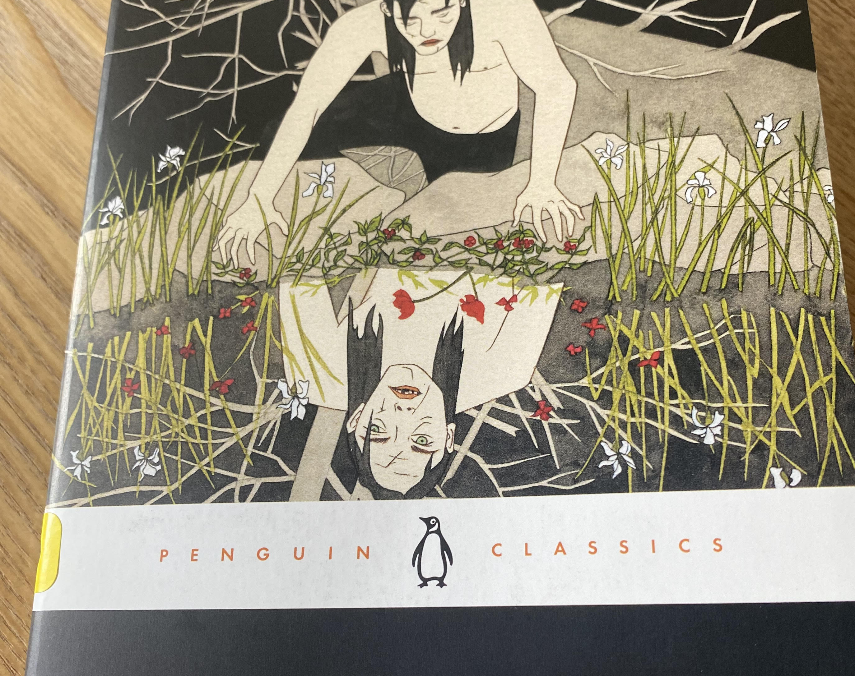
Frankenstein
Letter 1 through Chapter 2

Slide 2
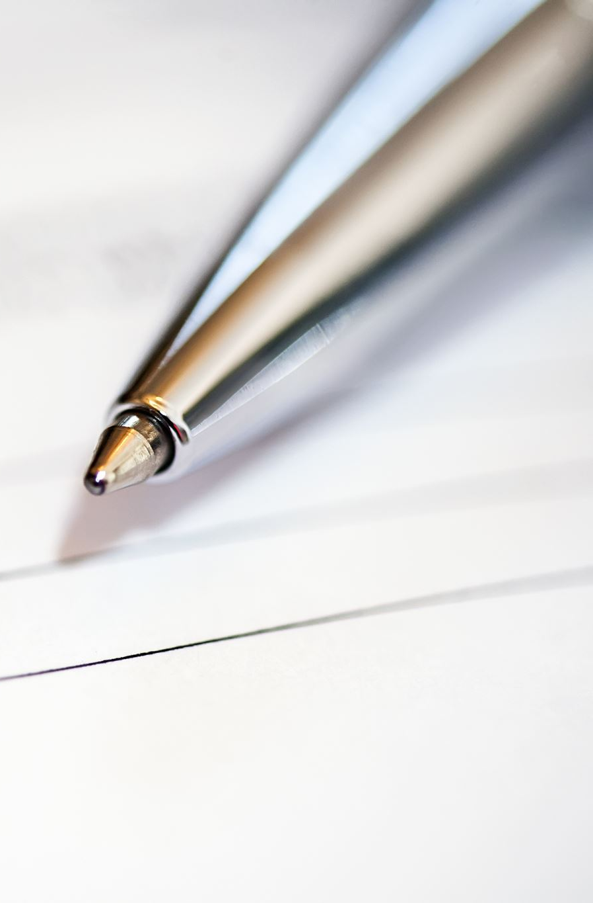
Close Reading
The first paper you are writing is a close reading, as are the initial small 1-2 page informal response papers.
Close reading is a method of literary analysis which focuses on the specific details of a passage or text in order to discern some deeper meaning present in it. The meaning derived from the close reading is the reader’s interpretation of the passage or text.
Close-Reading Handout

Slide 3
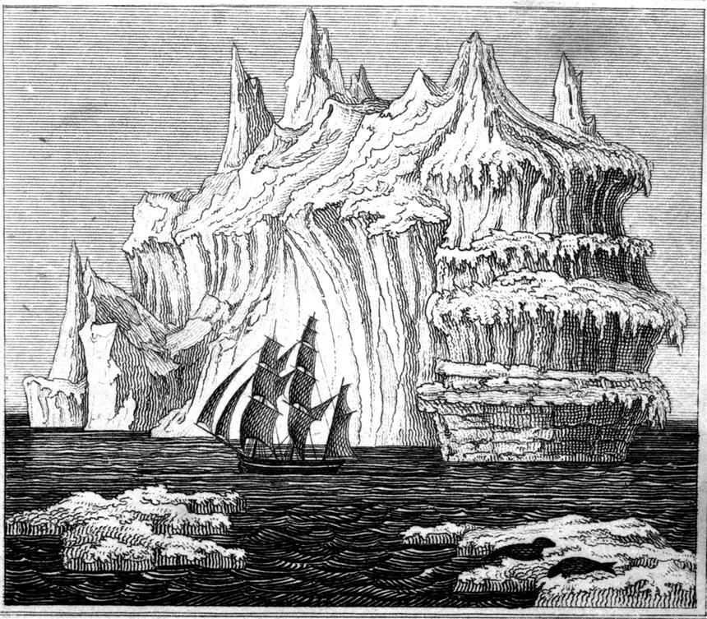
Close Reading Frankenstein
A close reading should never be your first reading of a text. Before focusing on the details of a text or passage, it is important to have an understanding of the text as a whole.
What is Frankenstein's Point of Departure?
Who is writing the letters?
Where are they writing from?
What is the time frame?

Slide 4
Close Reading Frankenstein
How do we first meet Victor?(pp 16 – 17)
How does Robert Walton feel toward Victor Frankenstein?
What aspects of the human condition is Shelley capturing in their relationship?
Unpack the passage on double existence beginning on pp 19
Why do you think Shelley has begun with a Frame Narrative?
How do you know what you know? (pp.20)

Slide 5
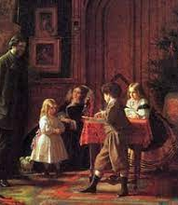
Close Reading Frankenstein
Describe Victor’s childhood.
Find five adjectives in the text used by Shelley in regard to Victor or Victor’s emotional state.
Who are the members of Victor’s inner circle?
How does he describe his feelings towards them?
What is the first traumatic incident of his life?

Slide 6
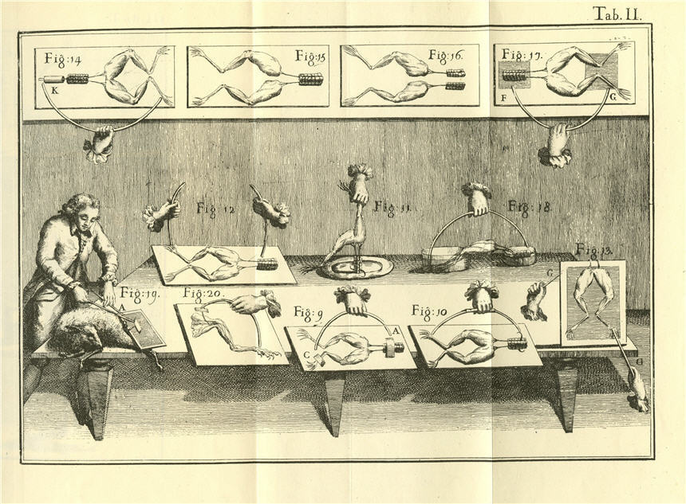
Close Reading Frankenstein
Describe Victor’s relationship with Natural Philosophy and Science.
How does Shelley portray human nature through Victor’s interests and academic pursuits?

Slide 7
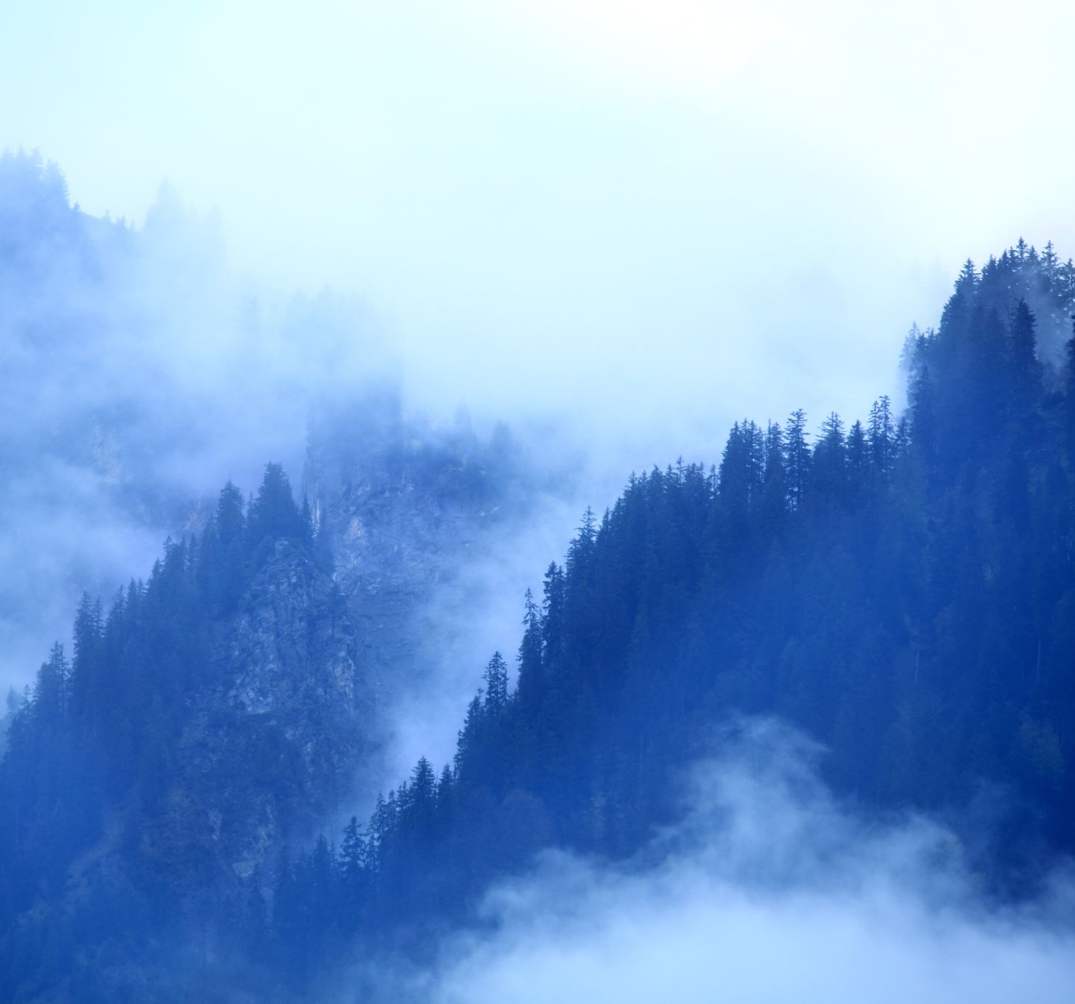
FRANKENSTEIN
Mary Wollstonecraft Shelley,
Romanticism & Characteristics of the Gothic Novel

Slide 8
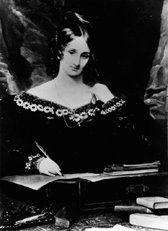
MARY WOLLSTONECRAFT SHELLEY 1797 – 1851 BRITISH NOVELIST HTTPS://WWW.RC.UMD.EDU/EDITIONS/FRANKENSTEIN/MSHELLEY/BIO
Daughter of:
Mary Wollstonecraft: Radical writer, Feminist, A Vindication of the Rights of Woman (1792), Died when Mary was 10 days old
William Godwin: Radical writer, Educated his children equally without bias regarding gender, Friends with Coleridge, Charles Lamb, William Hazlitt (London Writers and Intelligencia) Friends with Scientists like Humphry Davy and William Nicholson (experiments with galvanic electricity)
Parents ideals were influenced by the French Revolution
Published her first poem at 10 in 1808 (some debate about editions/variations and authorship)
Marries Percy Bysshe Shelley in 1816 (Got involved with him in 1814, but they don’t marry until after his wife Harriet commits suicide)
Only one of her children survives
Lives in Italy with Percy Shelley until he drowns in 1822
Returns with her son Percy Florence to London
Writes until her death in 1851

Slide 9
BIBLIOGRAPHY OF SHELLEY’S LARGER WORKS
The Last Man (1826)
Perkins Warbeck (1830)
Lodore (1835)
Falkner (1837)
Edited Collection of P.B. Shelley’s Poetical Works (1839)
Rambles in Germany and Italy (1844)

Slide 10
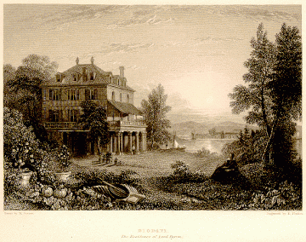
THE BIRTH OF SHELLEY’S NOVEL
Setting: 1816, Summer, The shores of Lake Geneva
“a wet ungenial summer, and incessant rain often confined us for days to the house” (Shelley Introduction to Frankenstein )
Mary, Percy, Claire, Lord Byron, Polidori
Stuck in the house reading German ghost stories translated to French Byron announces, “We will each write a ghost story!”
Morning after rainy morning she is mortified to declare that she has not written anything & then inspired by a conversation between Shelley & Polidori regarding whether or not man is a mere instrument, influenced by talk of Darwin and Galvanism Mary Shelley lays her head on her pillow and has a vision…

Slide 11
BRITISH ROMANTICISM 1798 - 1830
Lineage
German Romanticism
British Romanticism
American Transcendentalism
Early British Romanticism:
William Blake (debate here)
Coleridge & Wordsworth publish Lyrical Ballads (1798)

Slide 12
GOTHIC NOVEL
Initiated in England by Horace Walpole’s Castle of Otranto (1765)
Shelley’s Frankenstein (1818) is a part of this genre
Response to eighteenth century ideals of formal realism as it does not strive to reflect everyday life
Robert D. Hume claims that a Gothic novel “can be seen as one symptom of a widespread shift away from neoclassical ideals of order and reason, toward romantic belief in emotion and imagination.” (https://owlcation.com/humanities/The-Gothic-Novel-What-is-Gothic-Literature )

Slide 13
CHARACTERISTICS OF THE GOTHIC NOVEL
Setting is Gloomy: ruined castles, Decay, hidden chambers, & wild landscapes
Mapping Frankenstein
https://uofmd.maps.arcgis.com/apps/MapJournal/index.html?appid=85b227b2ee964cb9b6279ed0dc3411ac
Supernatural Elements (like raising the dead) or Beings (Ghosts, Vampires)
Curses or Prophecies – the real world impacted by the supernatural
Romance – in the medieval sense of conflict, adventure, & love
Extreme Feeling, Passion
Hero, often a romantic one as opposed to a classical one, think Heathcliff of Wuthering Heights

Slide 14
DEFINING ROMANTICISM
A revolt against the Neoclassicism
“Literature depicting emotional matter in an imaginative form.“ (Shclegel)
Focal Points:
Imagination,
Emotion,
Freedom
Characteristics of Romantic Literature:
Subjectivity
An emphasis on individualism;
Spontaneity;
Freedom from rules;
Solitary life rather than life in society;
The beliefs that imagination is superior to reason
Devotion to beauty;
Love of and worship of nature;
Fascination with the past (*myths and mysticism of the middle ages)
English poets: William Wordsworth, Samuel Taylor Coleridge, Lord Byron, Percy Bysshe Shelley, and John Keats
American poets: Ralph Waldo Emerson, Nathaniel Hawthorne, Edgar Allen Poe, Henry David Thoreau, Herman Melville, Walt Whitman
Source: Morner, Kathleen and Ralph Rausch. NTC's Dictionary of Literary Terms. Chicago: NTC Publishing Group, 1997.
Notes:
“A movement in art and literature in the eighteenth and nineteenth centuries in revolt against the Neoclassicism of the previous centuries...The German poet Friedrich Schlegel, who is given credit for first using the term romantic to describe literature, defined it as "literature depicting emotional matter in an imaginative form." This is as accurate a general definition as can be accomplished, although Victor Hugo's phrase "liberalism in literature" is also apt. Imagination, emotion, and freedom are certainly the focal points of romanticism. Any list of particular characteristics of the literature of romanticism includes subjectivity and an emphasis on individualism; spontaneity; freedom from rules; solitary life rather than life in society; the beliefs that imagination is superior to reason and devotion to beauty; love of and worship of nature; and fascination with the past, especially the myths and mysticism of the middle ages.”

Slide 15
CHARACTERISTICS OF ROMANTICISM
Nature
Sublime Awe & Terror
Medieval Romance According to Samuel Johnson’s Dictionary- “a military fable of the middle ages; a tale of wild adventure in war and love”
Excessive feeling passion – sensibility
Imagination (moving away from the 18th Century view of Imagination as dangerous)
Revolution Politics, Rebellion
The Individual Notions of self-hood
Transcendence
Idealization of Nature in contrast with industry & capitalism

Slide 16
Examples of the Sublime in Art

Slide 17
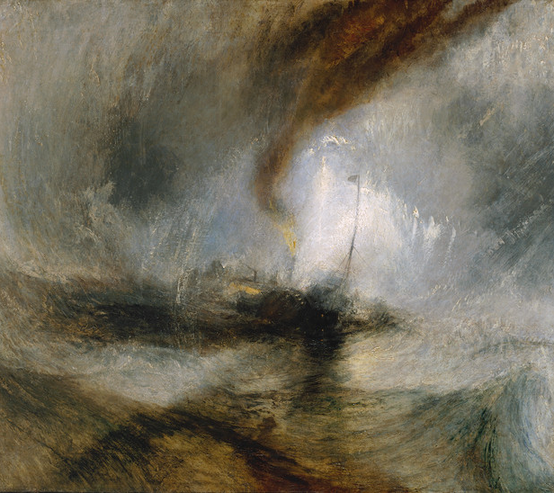
JOSEPH MALLORD WILLIAM TURNER
Snow Storm - Steam-Boat off a Harbour's Mouth exhibited 1842
Tate N00530
https://www.tate.org.uk/art/research-publications/the-sublime/the-romantic-sublime-r1109221

Slide 18
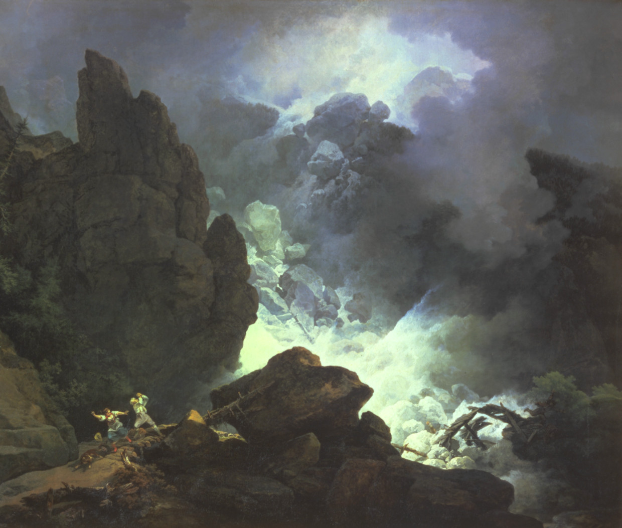
PHILIP JAMES DE LOUTHERBOURG
'An Avalanche in the Alps' 1803

Slide 19
Freewriting Prompt: 1) Pick one characteristic of Romanticism 2) Locate 2-3 examples of it in the text 3) Explain how these examples exemplify this characteristic of Romanticism 4) Connect this to the experience of being human
Nature
Sublime Awe & Terror
Medieval Romance According to Samuel Johnson’s Dictionary- “a military fable of the middle ages; a tale of wild adventure in war and love”
Excessive feeling passion – sensibility
Imagination (moving away from the 18th Century view of Imagination as dangerous)
Revolution Politics, Rebellion
The Individual Notions of self-hood
Transcendence
Idealization of Nature in contrast with industry & capitalism

Slide 20
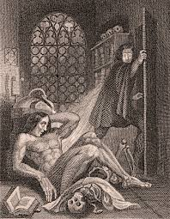
Questions How is the frame narrative important to reading the novel and how does it impact interpretation of the novel? Consider that the title is Frankenstein, but much of the story is told from the perspective of the creature- who is the main protagonist, and why do you think so? What does the novel suggest about identity formation? Do you think that Shelley is arguing that people’s personalities are innate or socially constructed? Appearance is a theme within the text- Explain what you think the novel is saying about appearance and British Society.

Slide 21
Questions Consider the religious implications in the text- and Shelley’s reference to Milton’s “Paradise Lost”- what connections can be made regarding Victor and the creature to God and Satan? What might this novel be saying about religion? Atheism? What responsibilities, if any, does Victor have toward the creature? When does Victor fail to act and how does this impact the way Victor and the monster are read? Unpack and explain how Victor and the creature both exhibit monstrousness and humanness. This tale is a warning. What is Shelley’s position on technology? Society? Religion? Duty? Social Class? Gender issues? How do you know what you know?

Slide 22
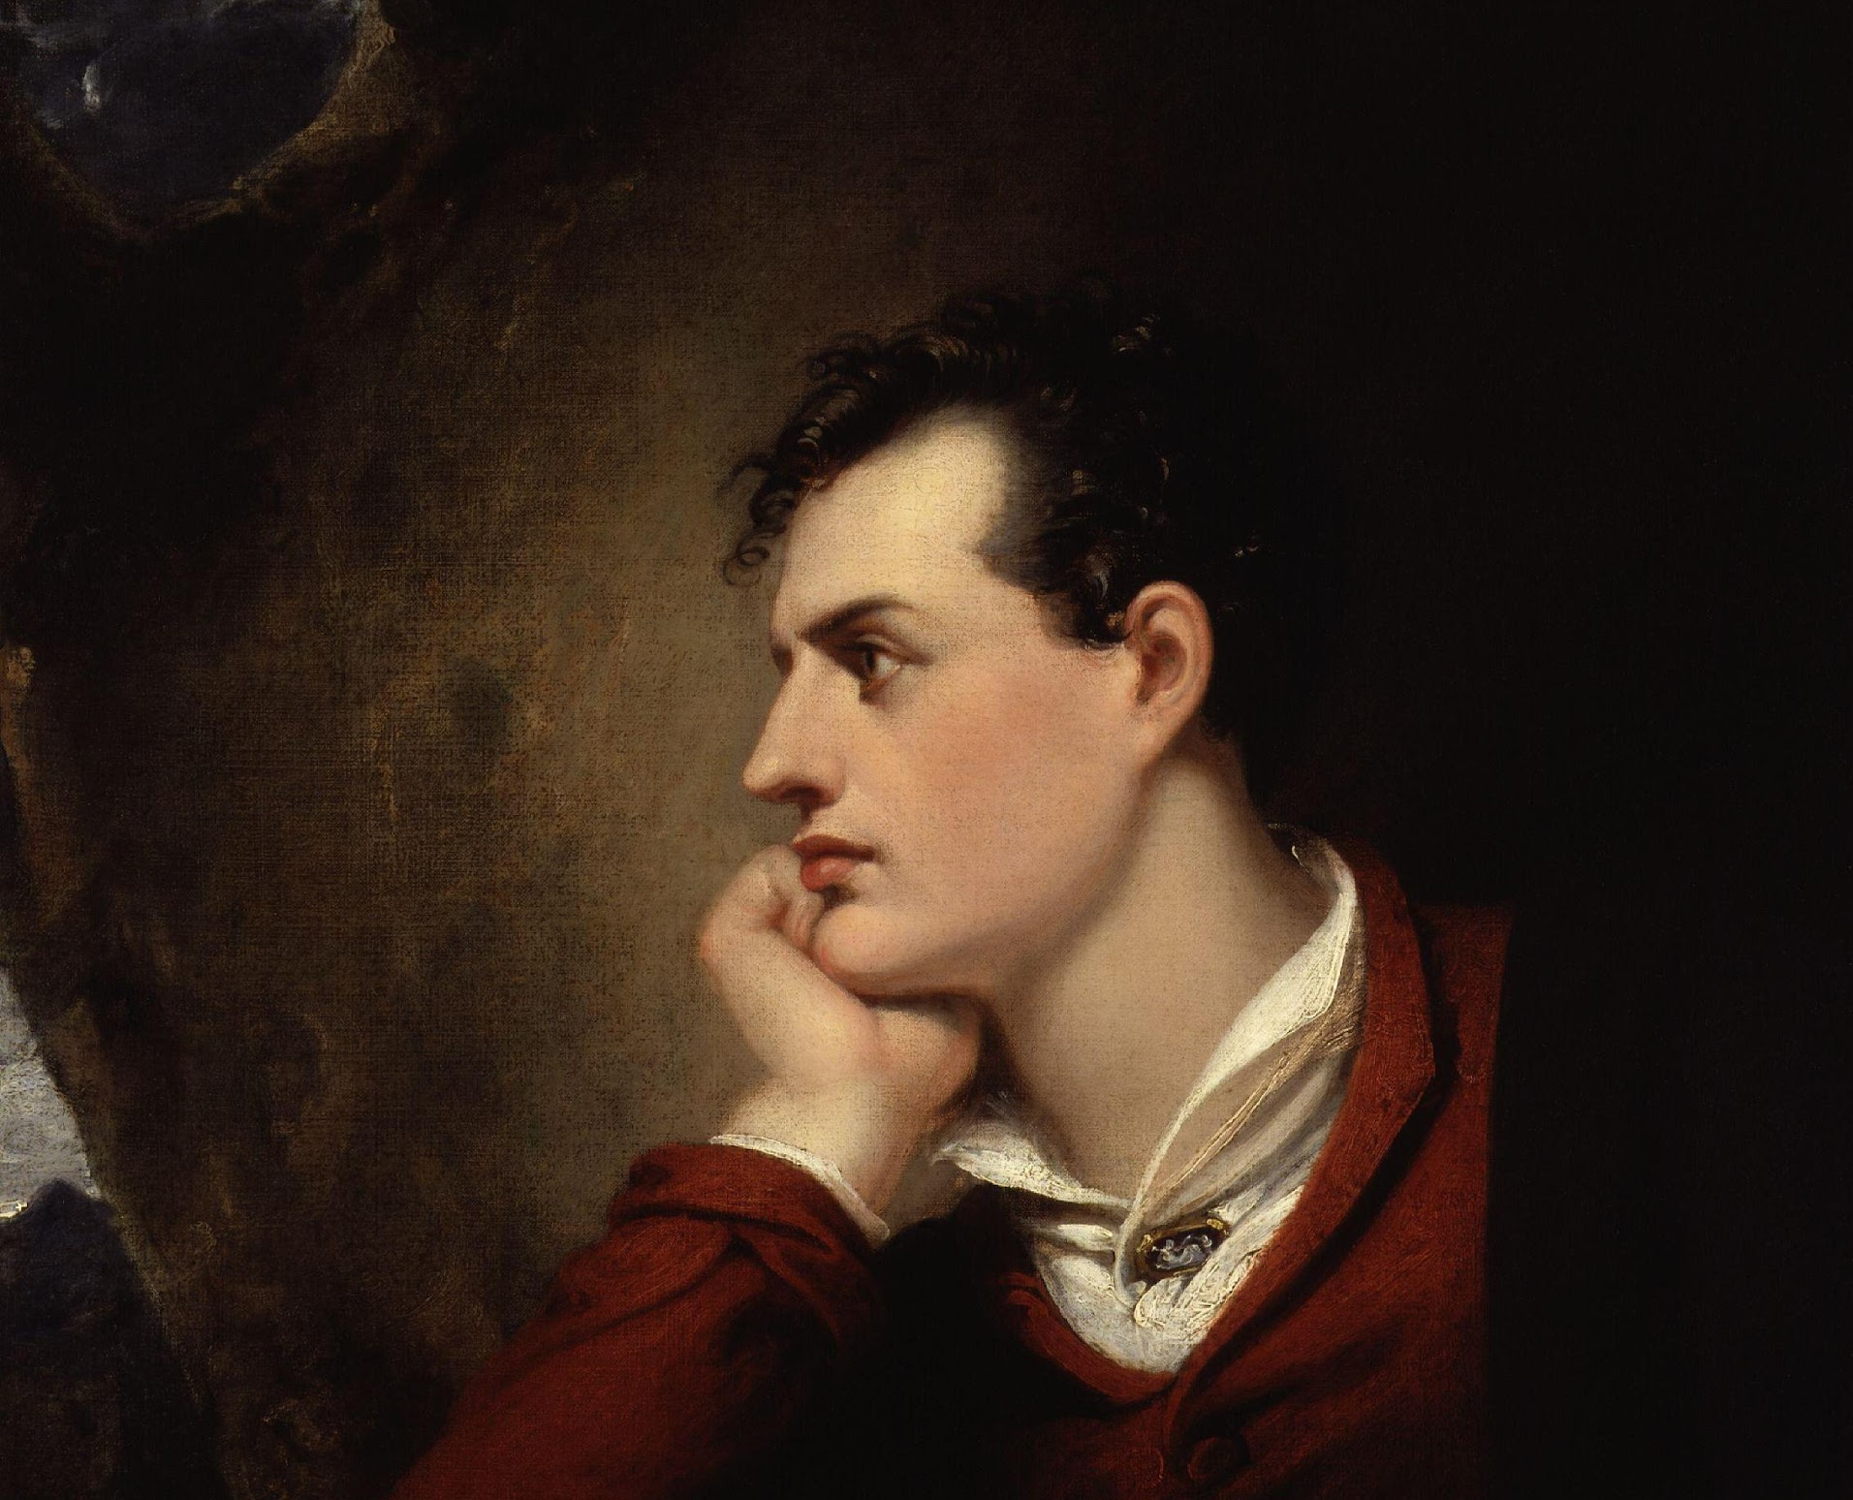
ROMANTIC HERO (LITERARY ARCHETYPE)
Rejects established norms and conventions
Rejected by society
Individualism or Self-hood- is the center of his/her own existence
(See also Byronic Hero, Lord Byron, “Childe Harold’s Pilgrimage” (1812) )

