Slide 1
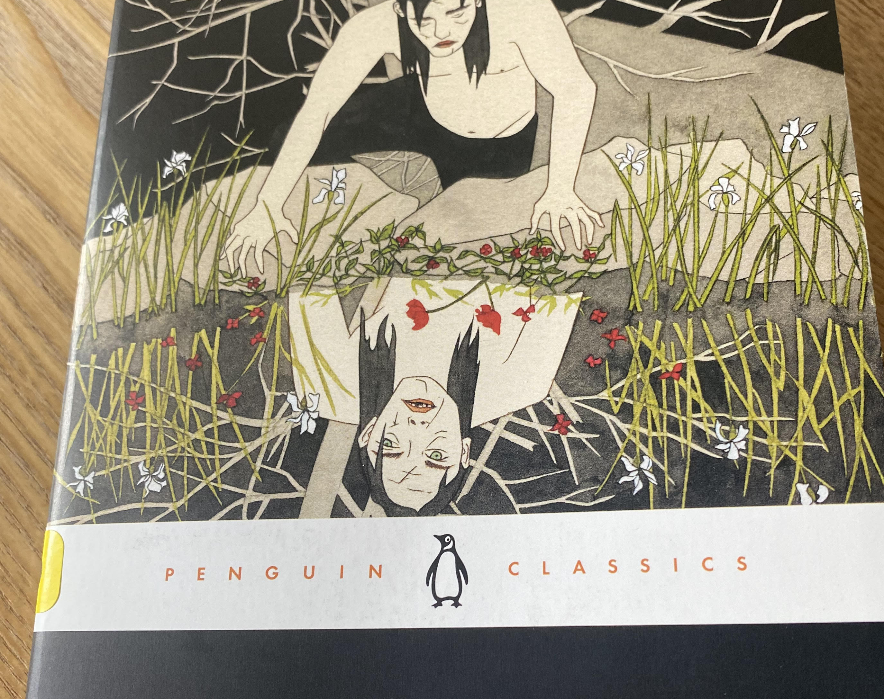
Frankenstein
Letter 1 through Chapter 2

Slide 2
Frankenstein
Describe Victor’s application to his studies during the first two years?
What impact does this have on his wider life?
What question and interest drives Victor’s independent research after he surpasses his professors in the field of Science? Pp. 39
On pp. 41 he pauses and speaks directly to Robert Walton. He does this numerous times throughout this chapter. What purpose does this choice be Shelley, to remind us of the implied auditor, serve?
What is the end goal Victor aspires to? (also pp. 41)

Slide 3
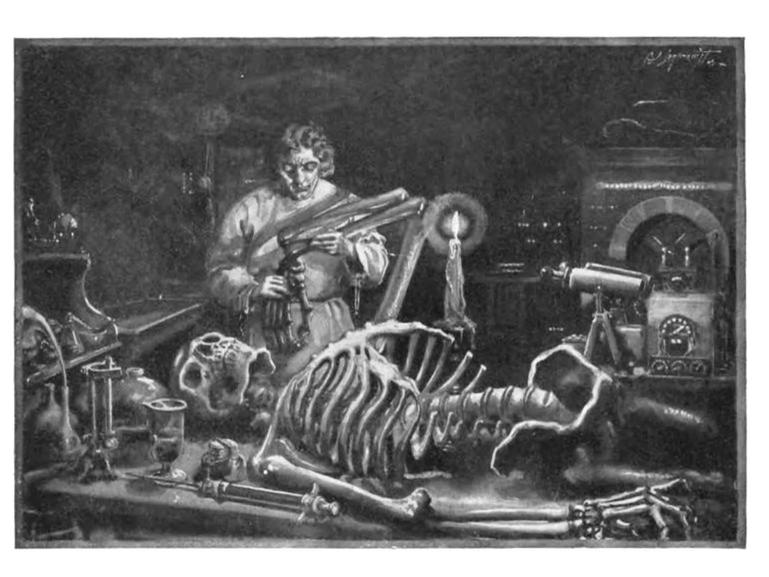
Frankenstein
Unpack your conception of Superhuman. Do you think this is what Victor aspires to?
What about life and death as a binary to be broken?

Slide 4
Frankenstein
How does Victor expect his creation to respond to him? (pp. 42) How might Shelley’s inclusion of this impact her reader, specifically her contemporaries?
What advance does he hope to make after creating a whole new race of humans?

Slide 5
Frankenstein
Describe how Victor changes after his mother’s death. Think of the adjectives used and the progression we see (pulling it through into today’s reading). Could we argue that his behavior is indicative of a severe traumatic response? What evidence would you use?

Slide 6
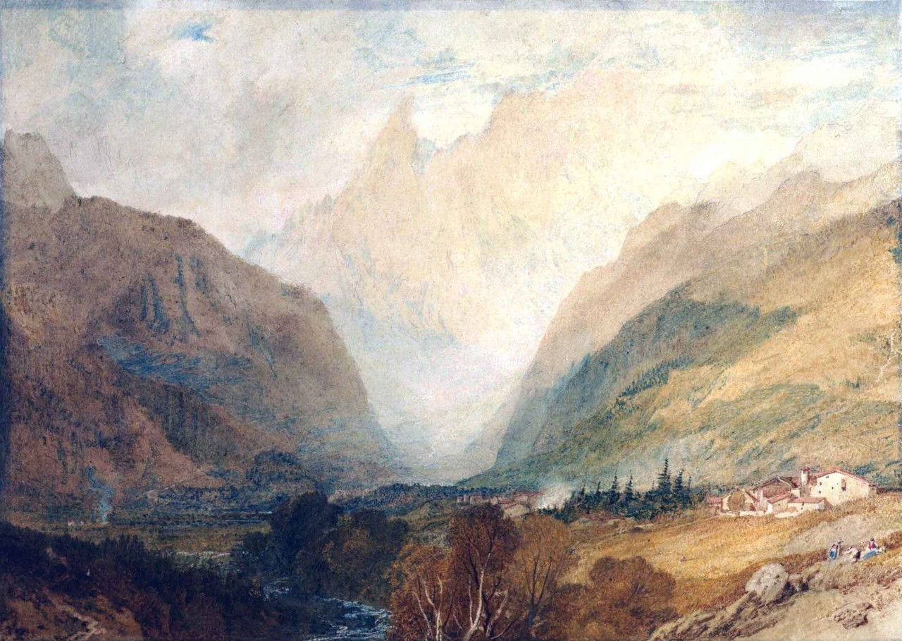
Frankenstein
Why do you think it is important that Shelley has Victor lose sight of nature?
Mont Blanc, From Above Courmayeur, J W Turner, 1810

Slide 7
Frankenstein
Elizabeth waxes a bit didactic in her letter about Ernest’s future Career: Farmer Vs. Judge. How does this bit of moralizing reinforce a bias in the book or indicate how Shelley wants the reader to perceive Victor’s actions?
What characters does the reader become more familiar with in the letter? Why does Shelley introduce the reader to them more fully here? Is it exposition?

Slide 8
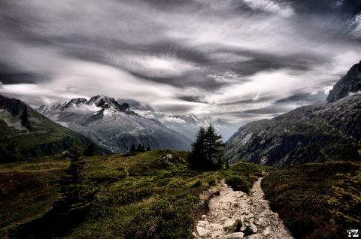
Frankenstein
In the portion of the text where Victor sees his creation at the foot of Mont Blanc how do the weather and the scenery reinforce the mood?
(pp. 64)

Slide 9
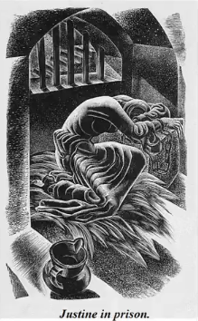
Frankenstein
Why doesn’t Victor tell everyone who the murder is?
Unpack Victor’s not speaking up regarding Justine’s innocence. (pp. 69

Slide 10
BRITISH ROMANTICISM 1798 - 1830
Lineage
German Romanticism
British Romanticism
American Transcendentalism
Early British Romanticism:
William Blake (debate here)
Coleridge & Wordsworth publish Lyrical Ballads (1798)

Slide 11
CHARACTERISTICS OF THE GOTHIC NOVEL
Setting is Gloomy: ruined castles, Decay, hidden chambers, & wild landscapes
Mapping Frankenstein
https://uofmd.maps.arcgis.com/apps/MapJournal/index.html?appid=85b227b2ee964cb9b6279ed0dc3411ac
Supernatural Elements (like raising the dead) or Beings (Ghosts, Vampires)
Curses or Prophecies – the real world impacted by the supernatural
Romance – in the medieval sense of conflict, adventure, & love
Extreme Feeling, Passion
Hero, often a romantic one as opposed to a classical one, think Heathcliff of Wuthering Heights

Slide 12
DEFINING ROMANTICISM
A revolt against the Neoclassicism
“Literature depicting emotional matter in an imaginative form.“ (Schlegel)
Focal Points:
Imagination,
Emotion,
Freedom
Characteristics of Romantic Literature:
Subjectivity
An emphasis on individualism;
Spontaneity;
Freedom from rules;
Solitary life rather than life in society;
The beliefs that imagination is superior to reason
Devotion to beauty;
Love of and worship of nature;
Fascination with the past (*myths and mysticism of the middle ages)
British: William Wordsworth, Samuel Taylor Coleridge, Lord Byron, Percy Bysshe Shelley, and John Keats
American: Ralph Waldo Emerson, Nathaniel Hawthorne, Edgar Allen Poe, Henry David Thoreau, Herman Melville, Walt Whitman
Source: Morner, Kathleen and Ralph Rausch. NTC's Dictionary of Literary Terms. Chicago: NTC Publishing Group, 1997.
Notes:
“A movement in art and literature in the eighteenth and nineteenth centuries in revolt against the Neoclassicism of the previous centuries...The German poet Friedrich Schlegel, who is given credit for first using the term romantic to describe literature, defined it as "literature depicting emotional matter in an imaginative form." This is as accurate a general definition as can be accomplished, although Victor Hugo's phrase "liberalism in literature" is also apt. Imagination, emotion, and freedom are certainly the focal points of romanticism. Any list of particular characteristics of the literature of romanticism includes subjectivity and an emphasis on individualism; spontaneity; freedom from rules; solitary life rather than life in society; the beliefs that imagination is superior to reason and devotion to beauty; love of and worship of nature; and fascination with the past, especially the myths and mysticism of the middle ages.”

Slide 13
British Romanticism _____________Context
Revolutions :
United States (1776)
France (1789),
Social transformations:
The Industrial Revolution
The rise of liberal movements because of the destruction of the cottage industry
The state’s counterrevolutionary measures
(Punishment of the Luddites, Peterloo)
The voicing of radical ideas:
Parliamentary reform,
Expanded suffrage,
Abolitionism,
Atheism

Slide 14
CHARACTERISTICS OF ROMANTICISM
Nature
Sublime Awe & Terror
Medieval Romance According to Samuel Johnson’s Dictionary- “a military fable of the middle ages; a tale of wild adventure in war and love”
Excessive feeling passion – sensibility
Imagination (moving away from the 18th Century view of Imagination as dangerous)
Revolution Politics, Rebellion
The Individual Notions of self-hood
Transcendence
Idealization of Nature in contrast with industry & capitalism

Slide 15
Romanticism
Poetry and Art

Slide 16
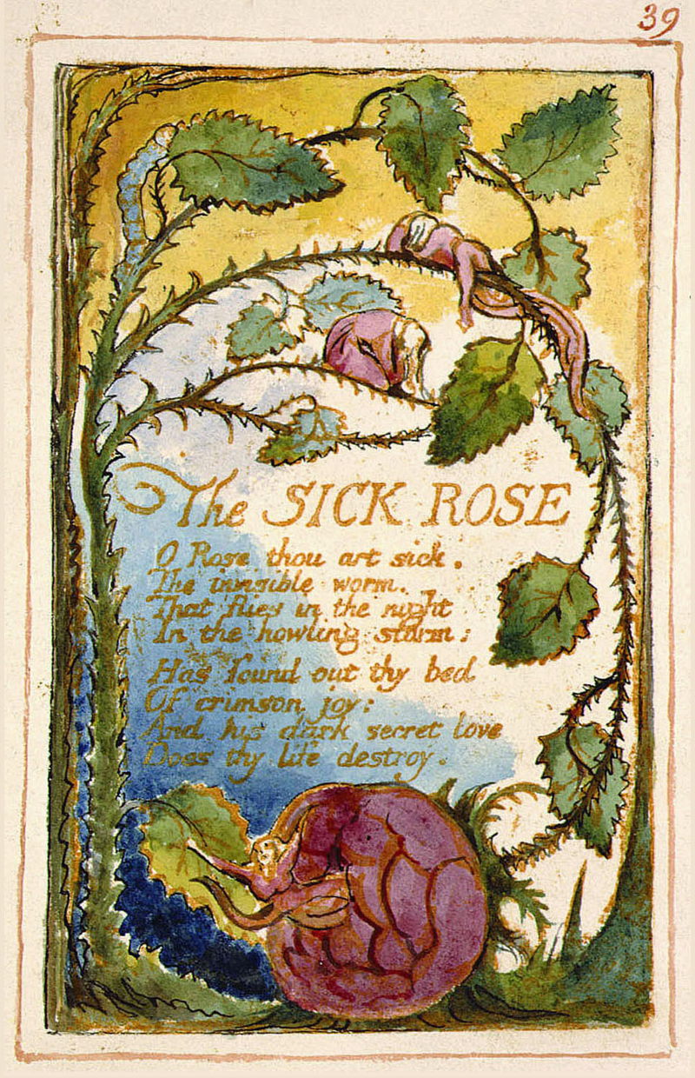
William Blake From Songs of Innocence

Slide 17
Preface to Lyrical Ballads Wordsworth
“The principal object, then, proposed in these Poems was to choose incidents and situations from common life, and to relate or describe them, throughout, as far as was possible in a selection of language really used by men, and, at the same time, to throw over them a certain colouring of imagination, whereby ordinary things should be presented to the mind in an unusual aspect; and, further, and above all, to make these incidents and situations interesting by tracing in them, truly though not ostentatiously, the primary laws of our nature”
.pdf of Preface

Slide 18
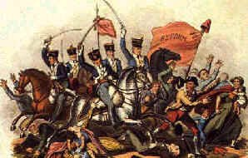
“England in 1819” P.B. Shelley in response to Peterloo
An old, mad, blind, despised, and dying King;
Princes, the dregs of their dull race, who flow
Through public scorn,—mud from a muddy spring;
Rulers who neither see nor feel nor know,
But leechlike to their fainting country cling
Till they drop, blind in blood, without a blow.
A people starved and stabbed in th' untilled field;
An army, whom liberticide and prey
Makes as a two-edged sword to all who wield;
Golden and sanguine laws which tempt and slay;
Religion Christless, Godless—a book sealed;
A senate, Time’s worst statute, unrepealed—
Are graves from which a glorious Phantom may
Burst, to illumine our tempestuous day.

Slide 19
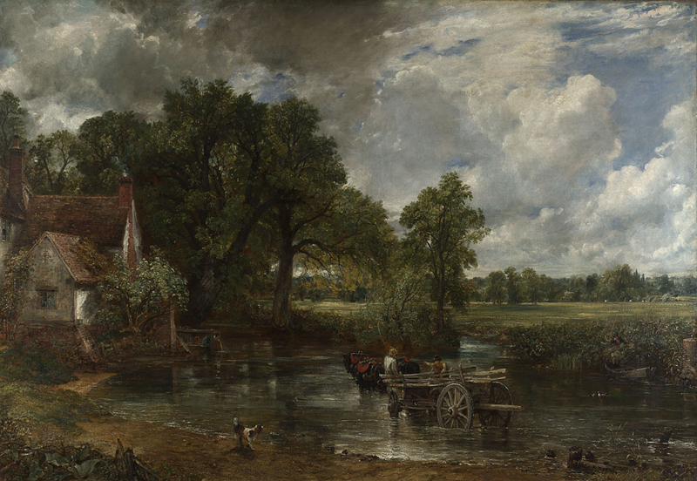
John Constable “The Hay Wain” 1821

Slide 20
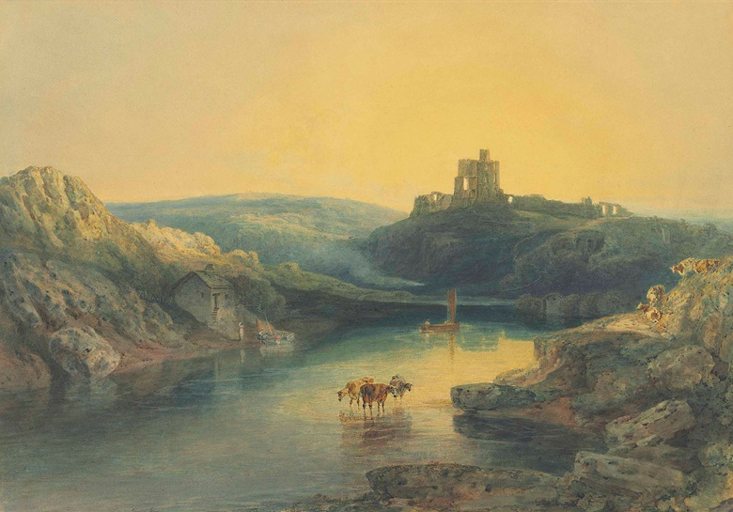
J.W. Turner “Norham Castle” 1845

Slide 21
Examples of the Sublime in Art

Slide 22
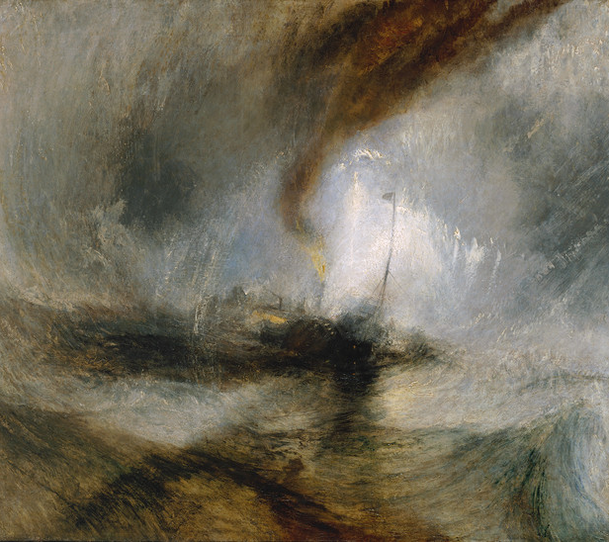
JOSEPH MALLORD WILLIAM TURNER
Snow Storm - Steam-Boat off a Harbour's Mouth exhibited 1842
Tate N00530
https://www.tate.org.uk/art/research-publications/the-sublime/the-romantic-sublime-r1109221

Slide 23
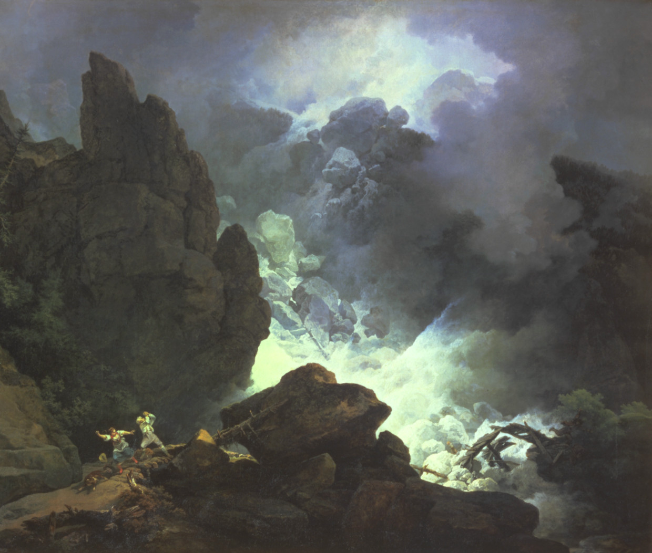
PHILIP JAMES DE LOUTHERBOURG
'An Avalanche in the Alps' 1803

Slide 24
Freewriting Prompt: 1) Pick one characteristic of Romanticism 2) Locate 2-3 examples of it in the text 3) Explain how these examples exemplify this characteristic of Romanticism 4) Connect this to the experience of being human
Nature
Sublime Awe & Terror
Medieval Romance According to Samuel Johnson’s Dictionary- “a military fable of the middle ages; a tale of wild adventure in war and love”
Excessive feeling passion – sensibility
Imagination (moving away from the 18th Century view of Imagination as dangerous)
Revolution Politics, Rebellion
The Individual Notions of self-hood
Transcendence
Idealization of Nature in contrast with industry & capitalism

Slide 25
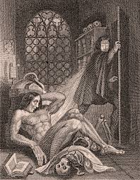
Questions How is the frame narrative important to reading the novel and how does it impact interpretation of the novel? Consider that the title is Frankenstein, but much of the story is told from the perspective of the creature- who is the main protagonist, and why do you think so? What does the novel suggest about identity formation? Do you think that Shelley is arguing that people’s personalities are innate or socially constructed? Appearance is a theme within the text- Explain what you think the novel is saying about appearance and British Society.

Slide 26
Questions Consider the religious implications in the text- and Shelley’s reference to Milton’s “Paradise Lost”- what connections can be made regarding Victor and the creature to God and Satan? What might this novel be saying about religion? Atheism? What responsibilities, if any, does Victor have toward the creature? When does Victor fail to act and how does this impact the way Victor and the monster are read? Unpack and explain how Victor and the creature both exhibit monstrousness and humanness. This tale is a warning. What is Shelley’s position on technology? Society? Religion? Duty? Social Class? Gender issues? How do you know what you know?

Slide 27
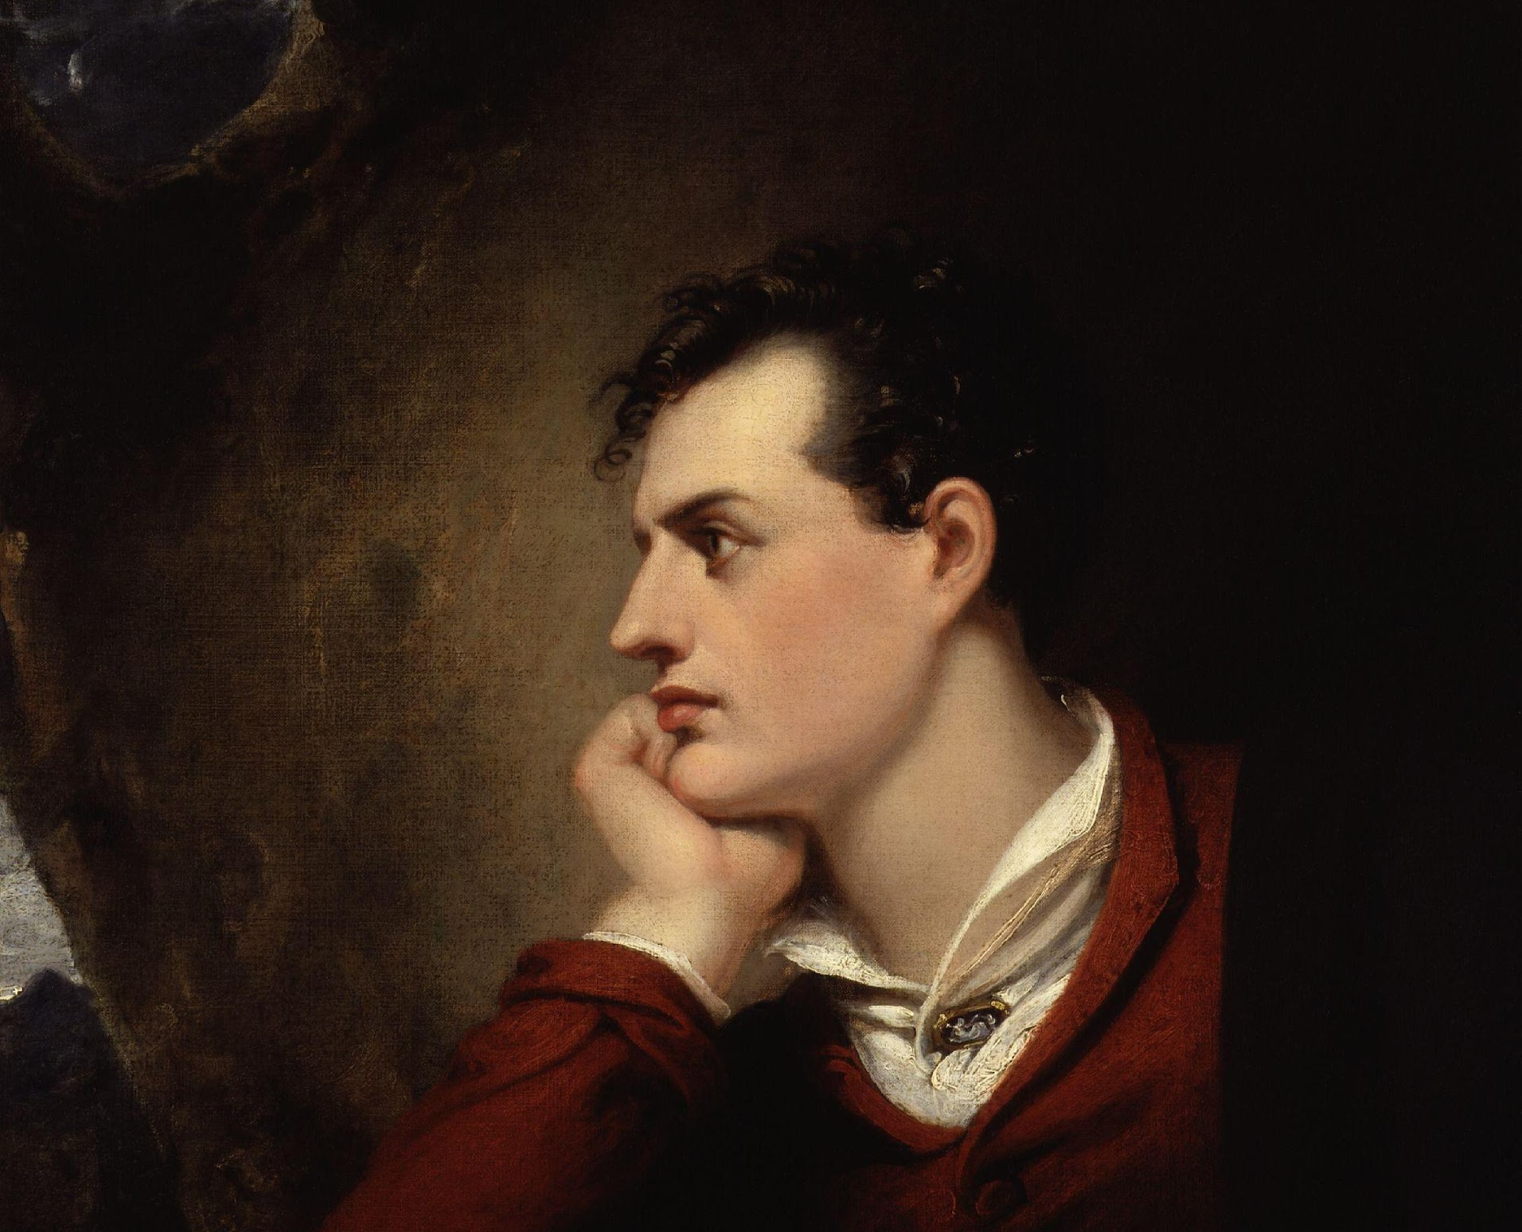
ROMANTIC HERO (LITERARY ARCHETYPE)
Rejects established norms and conventions
Rejected by society
Individualism or Self-hood- is the center of his/her own existence
(See also Byronic Hero, Lord Byron, “Childe Harold’s Pilgrimage” (1812) )

