Slide 1
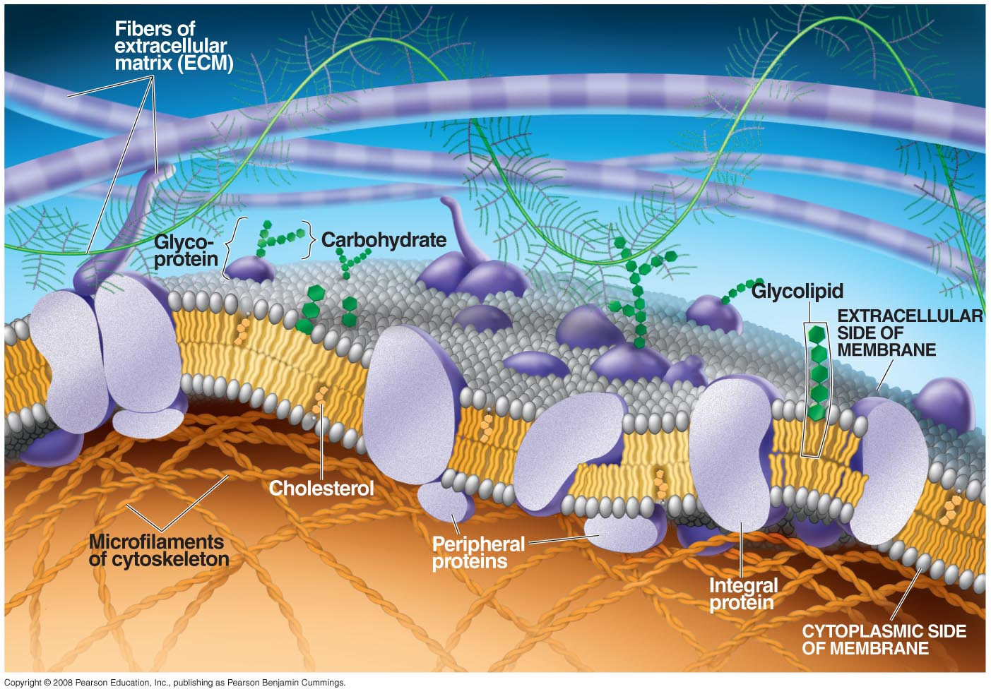
Cell Membranes
Membrane Composition
  Lipids
  Proteins
  Carbohydrates

Slide 2
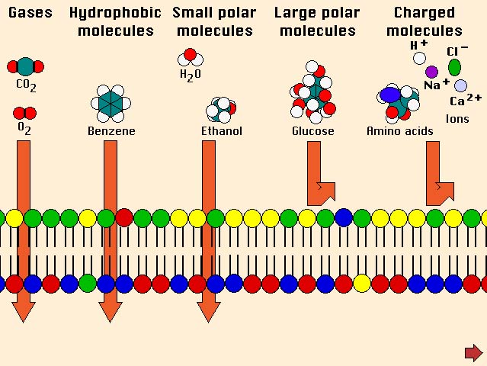
Cell Membranes
Semi-permeable:
  Allow certain substances to pass through but not others.
Two types of Transport
  Passive Transport
  Active Transport

Slide 3
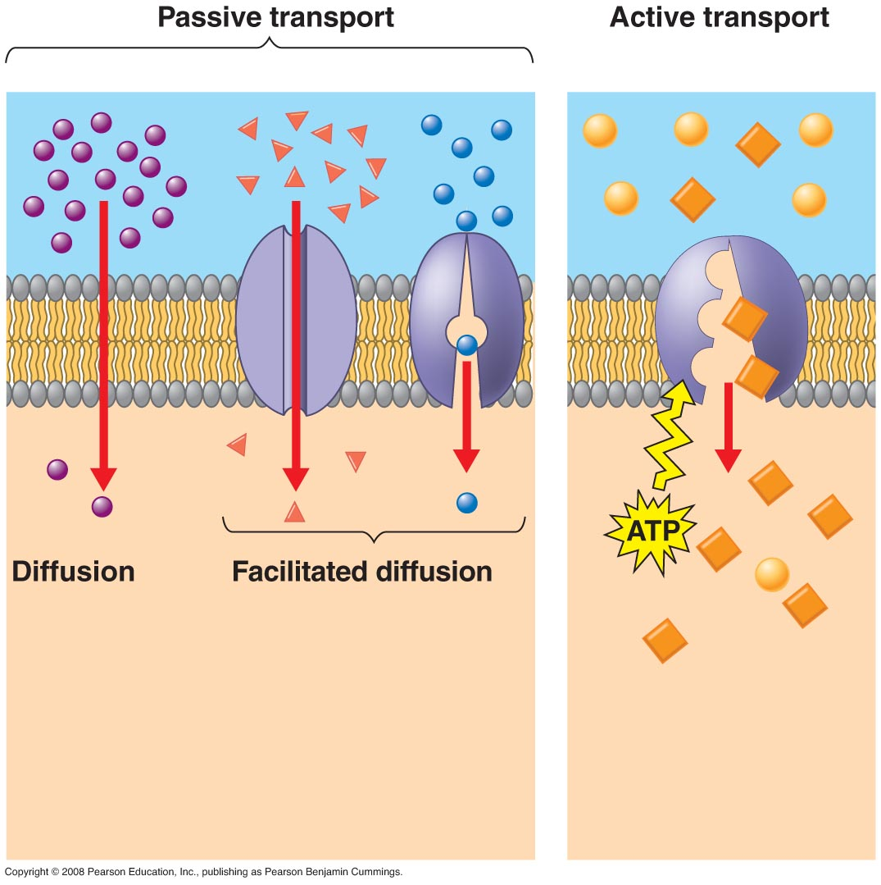
Cell Membranes
Types of Transport
  Passive Transport:
    Movement of molecules down a concentration gradient (high to low)
      Simple Diffusion
      Facilitated diffusion
    No energy required

Slide 4
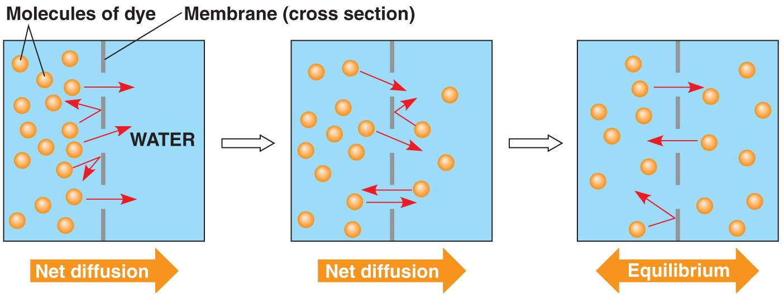
Cell Membranes
Passive Transport
  Diffusion:
    Random thermal motion of molecules results in their movement down their concentration gradient.
    No proteins required

Slide 5
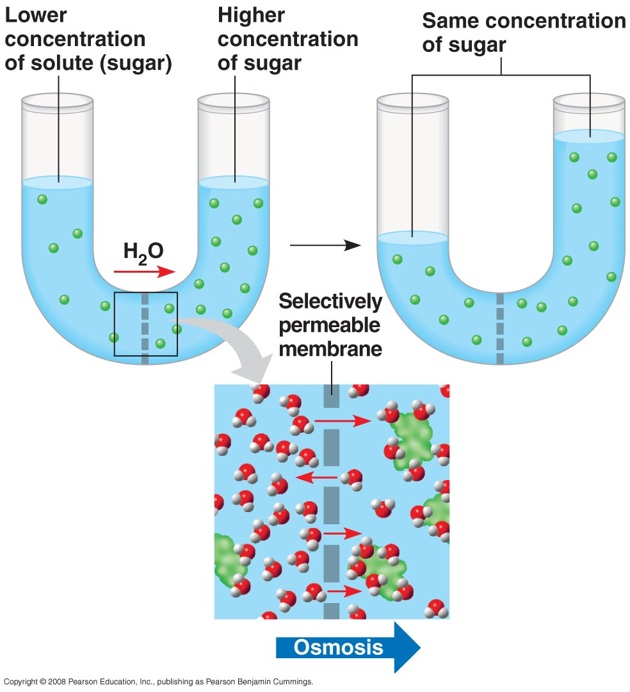
Cell Membranes
Osmosis
  Diffusion of water
  Water moves down its concentration gradient to reach equilibrium

Slide 6
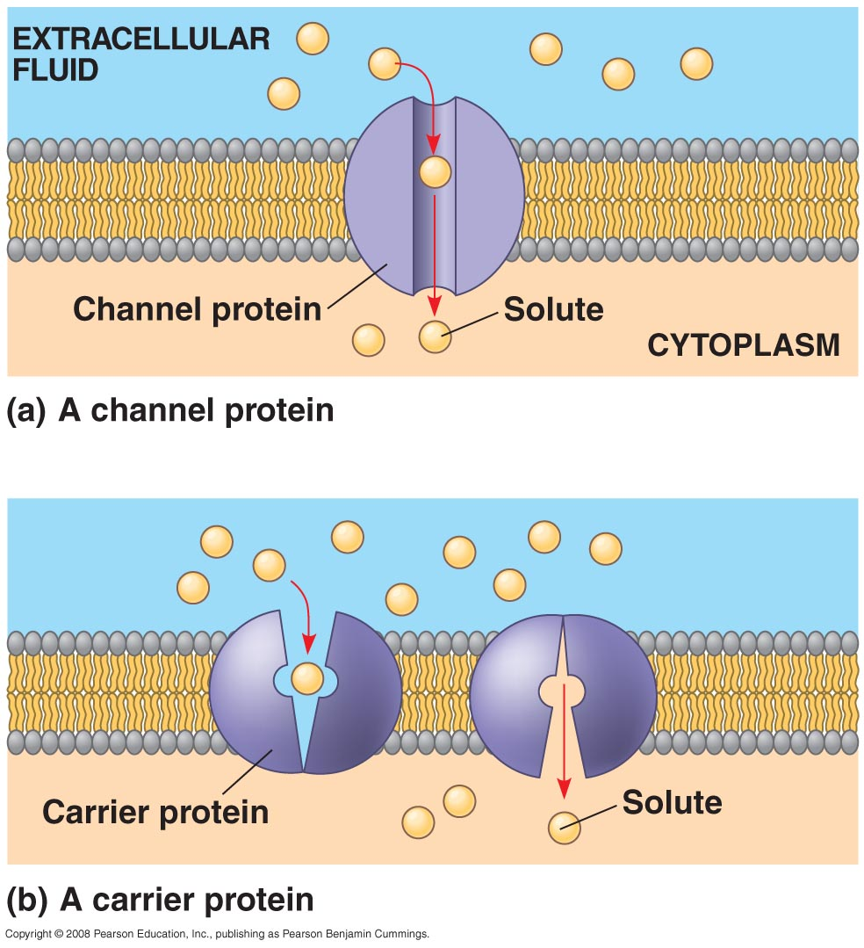
Cell Membranes
Passive Transport
  Facilitate diffusion:
    Passage of molecules down a gradient across a membrane with the assistance of transport proteins.
      Transmembrane proteins that help substances cross a membrane
      Specific for certain types or classes of related proteins.
      Two types
        Channel Proteins
        Carrier Proteins

Slide 7
Cell Membranes
Types of Transport
  Active Transport:
    Movement of molecules against a concentration gradient (low to high)
    Requires energy (ATP)
    Involves transport proteins

