Slide 1


Undocu-Career 101

Slide 2
Icebreaker & Intros
Name
Class Year
Major
What is something that not many people know about you?

Slide 3
purpose
MISSION: To prepare and support Bryn Mawr Undocumented students as they navigate their post-graduation and/or career pathways.
**Disclaimer: This information is gathered through a combination public resources and work conducted by former/current students not put together by a lawyer. This is not official legal advice.
Acknowledgements: Special Thank You
Higinia Flores-Rosas’23
Yesenia Mendez Pacheco’21
Kathryn Gonzales’20

Slide 4
Federal legislation
Where the U.S. stands right now

Slide 5
Immigration reform & control Act (irca) 1986
Required employers to attest to their employees’ immigration status. It made it illegal to knowingly hire or recruit undocumented immigrants.
It legalized certain seasonal agricultural workers who were undocumented and legalized undocumented immigrants who entered the U.S. before 1982, had resided there continuously with the penalty of a fine, back taxes due, and admission of guilt. Approximately 3 million undocumented immigrants were granted legal status as a result.

Slide 6
Immigration & nationality act (INA) 1952
Reorganized the structure of immigration law and consists a collection of provisions related to immigration law.
Section 274A of INA requires employers to verify that all employees are authorized to work and have established their identities using Form I-9
U.S. Dept. of Homeland Security & Dept. of Labor created E-Verify a free voluntary, web-based system that allows employers to electronically verify the legal status & SSN of newly hired employees.

Slide 7
E-verify system
Employers are not required to use this system unless they are located or doing business in certain states.
Illinois does not allow employers to use E-Verify
These states require ALL employers to use E-Verify: Arizona, Mississippi, and South Carolina
These states require public employers and/or any person or entity doing business within the state to use E-Verify:
Rhode Island
Missouri
Oklahoma
Arizona
Colorado
Georgia
Utah
Minnesota
Mississippi
North Carolina
South Carolina

Slide 8
The i-9 system

Slide 9
The i-9 system
A two-part Federal Employment Verification system:
Complete the Employment Eligibility Verification I-9 Form – used to verify whether someone is “authorized” to work in the U.S.
Submit original documentation that is listed under the “Acceptable Documents” list (ex. U.S. passport, Permanent Resident Card, Employment Authorization Document, etc.)
There are exceptions to the I-9 System:
An individual or entity is NOT required to obtain Form I-9 from independent contractors or sporadic domestic workers

Slide 10
Working for yourself terminology

Slide 11
Working for yourself terminology
Entrepreneur – one who organizes, manages, and assumes the risks of a business or enterprise
Self-Employed – Earning income directly from one’s own business, trade, or profession rather than as a specified salary or wages from an employer
IRS Definition: You are self-employed if you carry on a trade or business as a sole proprietor or an independent contractor; you are a member of a partnership that carries on a trade or business and/or; you are otherwise in business for yourself (including a part-time business or a gig worker)
Independent Contractor – A person hired to do work who controls how the work is done
IRS Definition: You are considered an independent Contractor if the payer has the right to control or direct only the result of the work and not what will be done and how it will be done

Slide 12
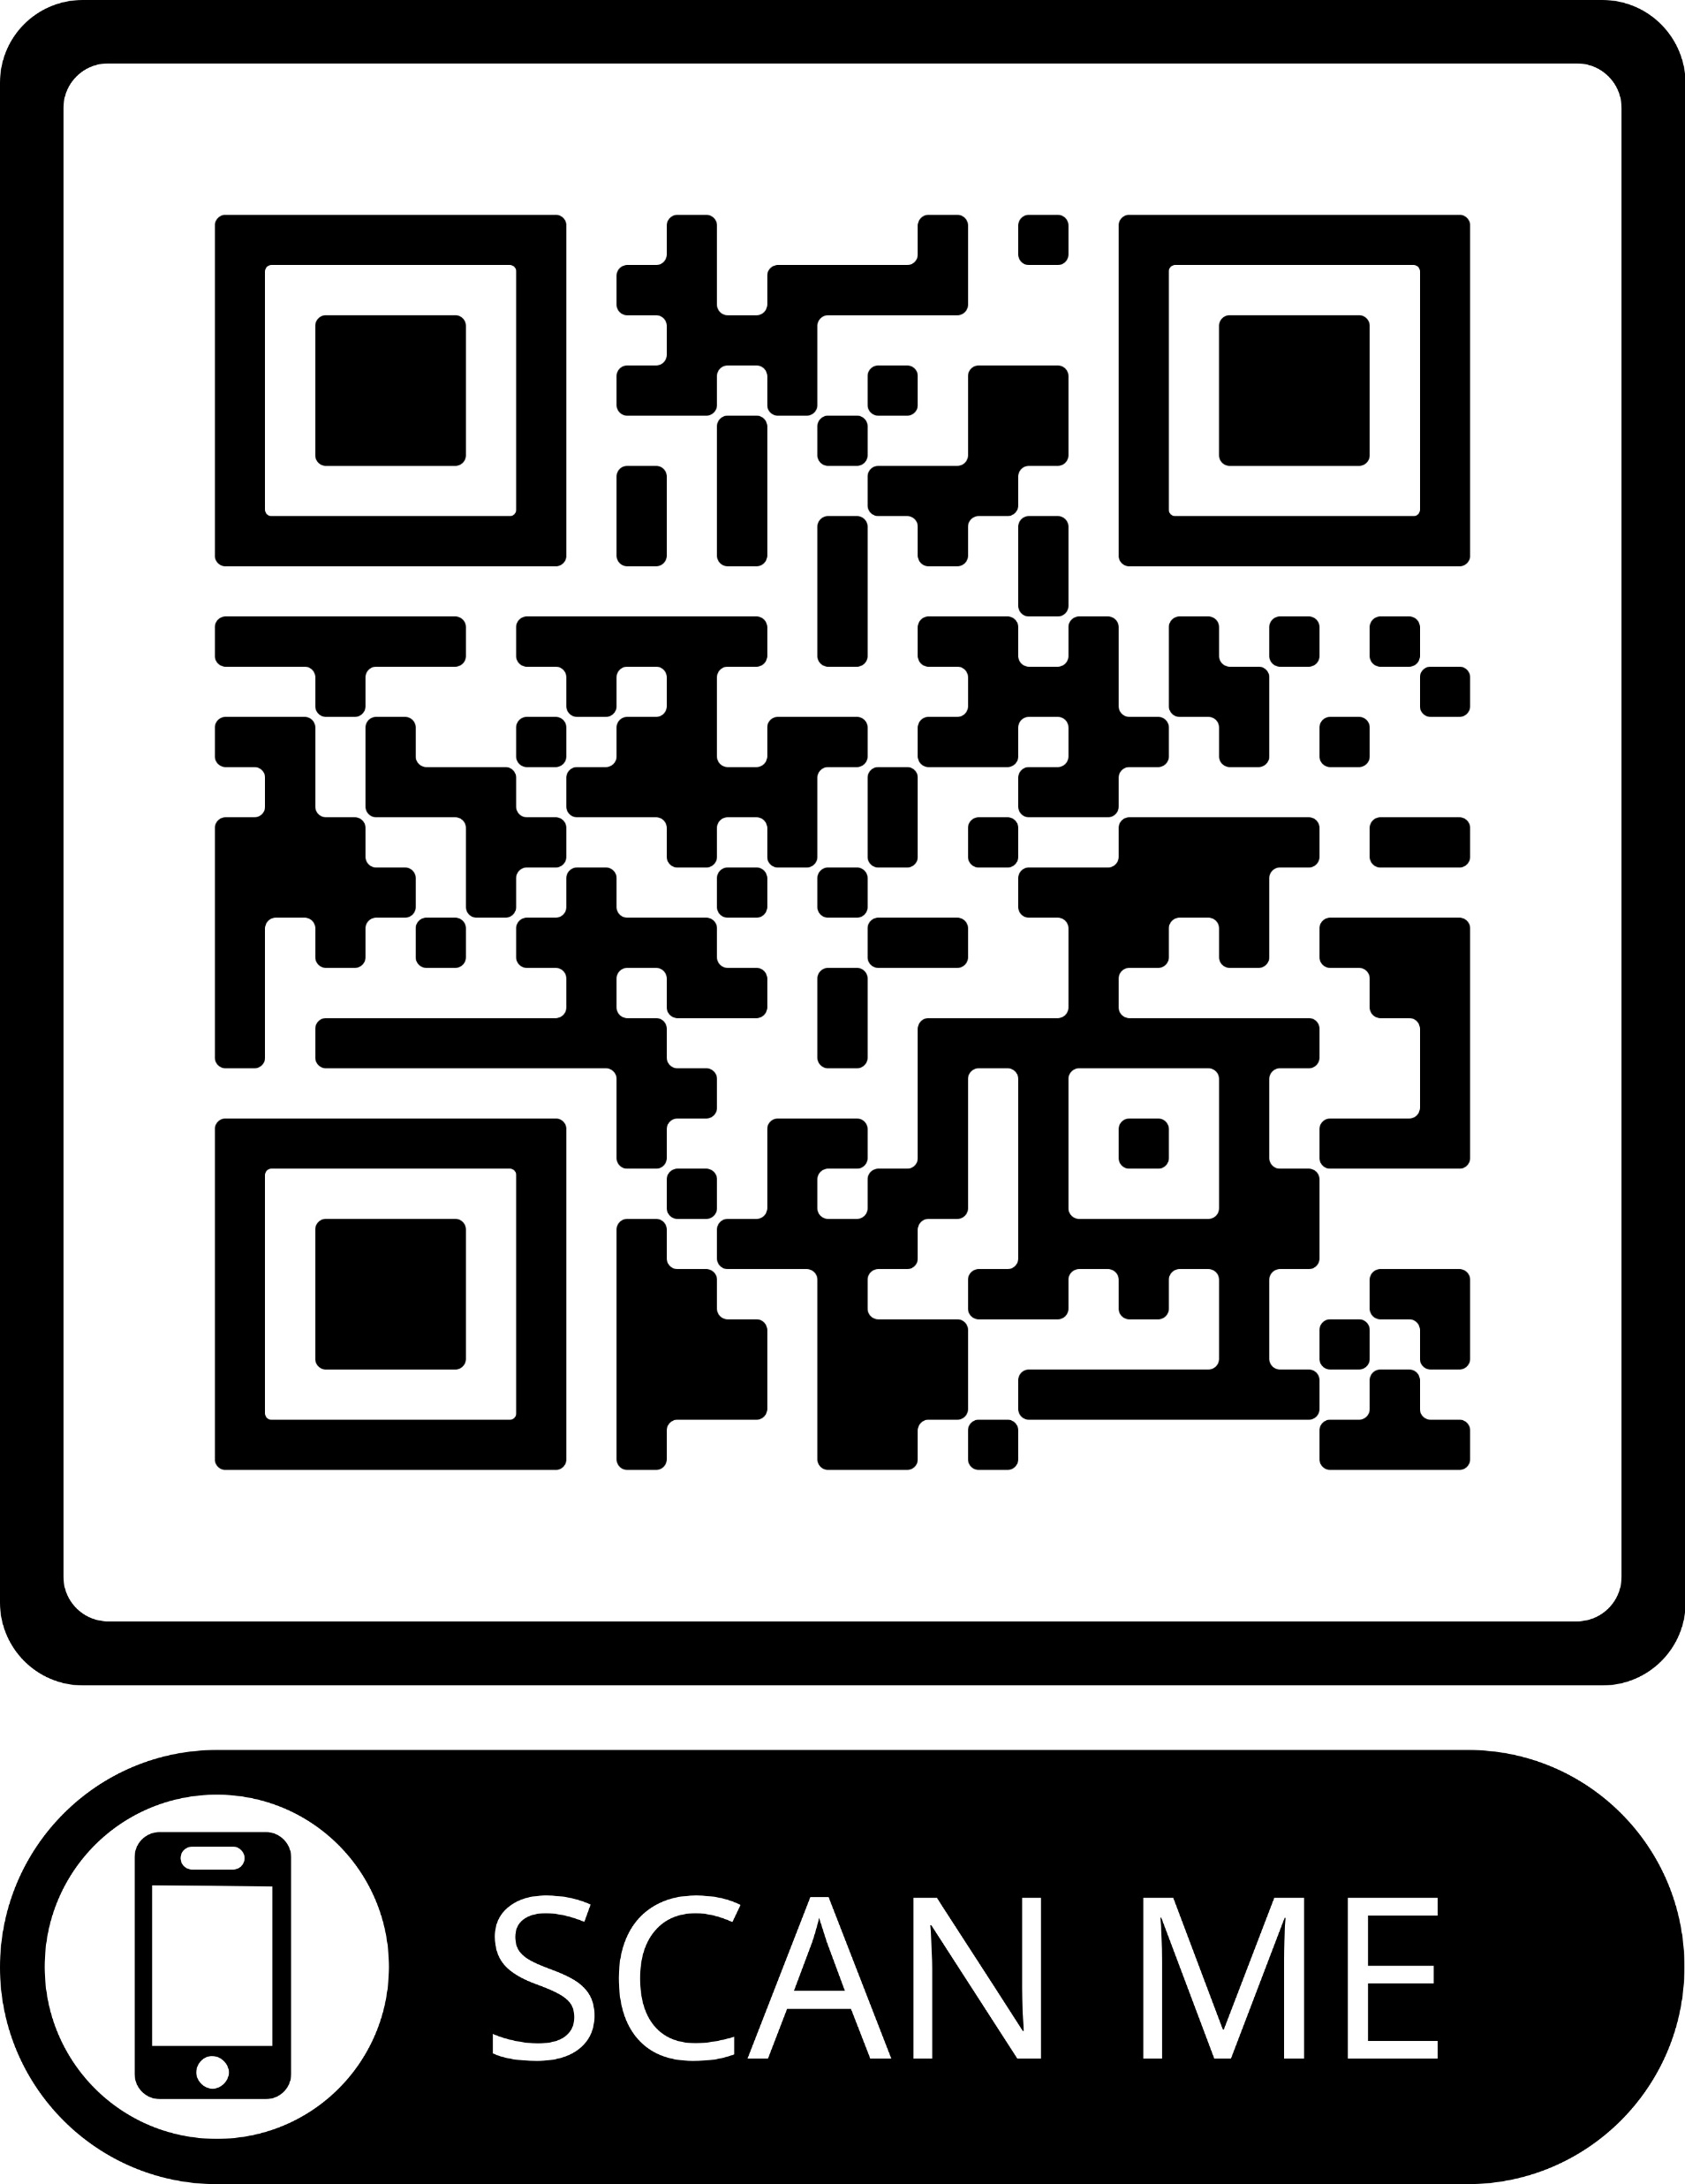
Aesop academy entrepreneurship 101 event
Sunday October 2nd 10:30AM – 3:00PM
Session Topics –
A Look into the Entrepreneurial Career Track, Common Characteristics, and Pitfalls to Avoid
The Stages and Segments of Business Planning – from Idea to Market Sizing to Activity Planning to Launch
Evaluating Market Sizes and Various Channels for Performing Customer Market Research
Review of Funding Stages and Experience a Real-World Funding Planning Exercise

Slide 13
Aesop academy – 2 more programs!
Data Analytics Specialist Intensive
Session Topics – All 5 days:
10/8/22, 10AM – 5PM US EST: SQL Extractions, Custom Queries, Excel Fundamentals
10/9/22, 10AM – 5PM US EST: Excel Empowerment - Advance Techniques and Functions
10/11/22, 6:00 – 9PM US EST: Tableau Basics 10/13/22, 6:00 – 9PM US EST: Tableau Advancement
10/14/22, 6:00 – 7PM US EST: Office Hours
Real World Group Project Case
November 6th – Time TBD
Session Topics –
Group Analysis & Problem-Solving
Group Presentations
For students who complete all 5 days of the Data Analytics Specialist Intensive

Slide 14
Entrepreneurship & Innovation career & Civic Engagement Center Intensive
3-Days in January 2023 (see Handshake mid-fall to register)
Alumna Leslie Mitts + Guest speakers
Multi-day program, meals included
Develop knowledge and skills in entrepreneurship
Mark Your Calendars!
1/20: 5:00 PM-9:00 PM
1/21: 10:00 AM-2:00 PM
1/22: 10:00 AM-2:00 PM
For students who are just beginning to think about entrepreneurship and innovation, and how it might fit into their next steps. At the end of the 3 days, each student will have a better grasp of what entrepreneurship looks like, how to think about it practically as well as conceptually and, if they so desire, a roadmap to bring their idea into reality. There will be time for 1:1 feedback and questions meant to deliver an iterative, fun, and engaging time to begin the year and look ahead.

Slide 15

foundation WWW.FORTEFOUNDATION.ORG
Career Ready Certificate Program
Work through a self-guided roadmap of activities at your own pace. Start your Career Ready Journey today.
Leadership Conferences
Campus to Business Leadership Conf.
College Fast Track to Finance Conf.
Women of Color Leadership Symposium
Undergraduate Leadership Summit
Forte Ambassadors
Minolta Ndlovu '23 mndlovu@brynmawr.edu
Dylan Su '24 ysu@brynmawr.edu

Slide 16
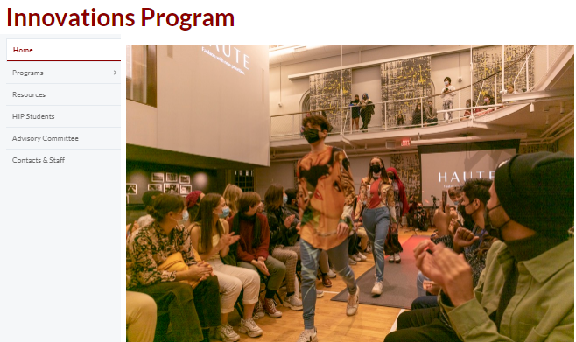
Haverford college innovation program https://www.haverford.edu/innovations-program
BMC works with the program to support our students to participate.

Slide 17
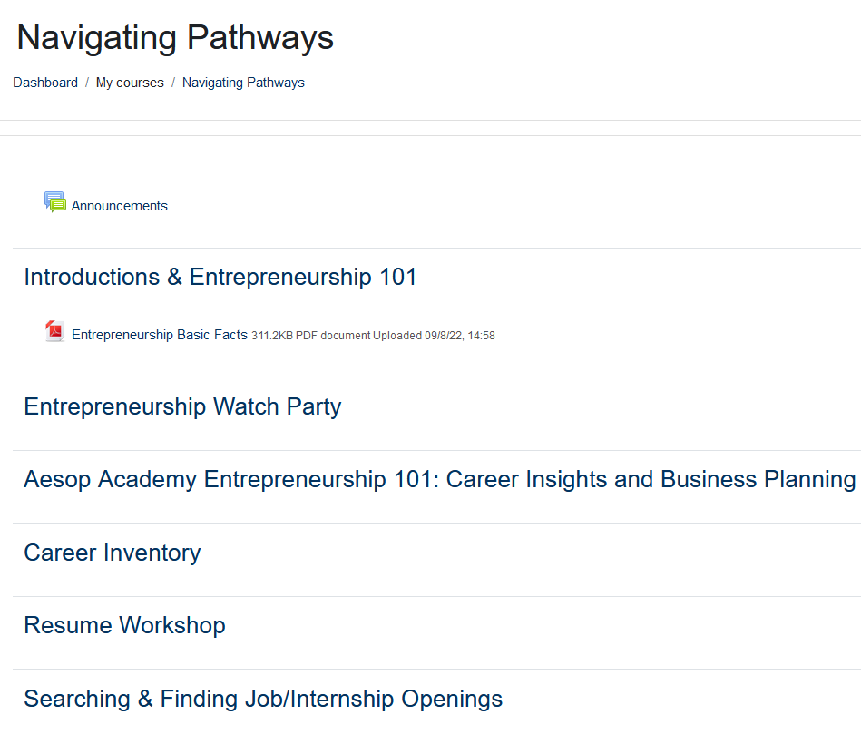
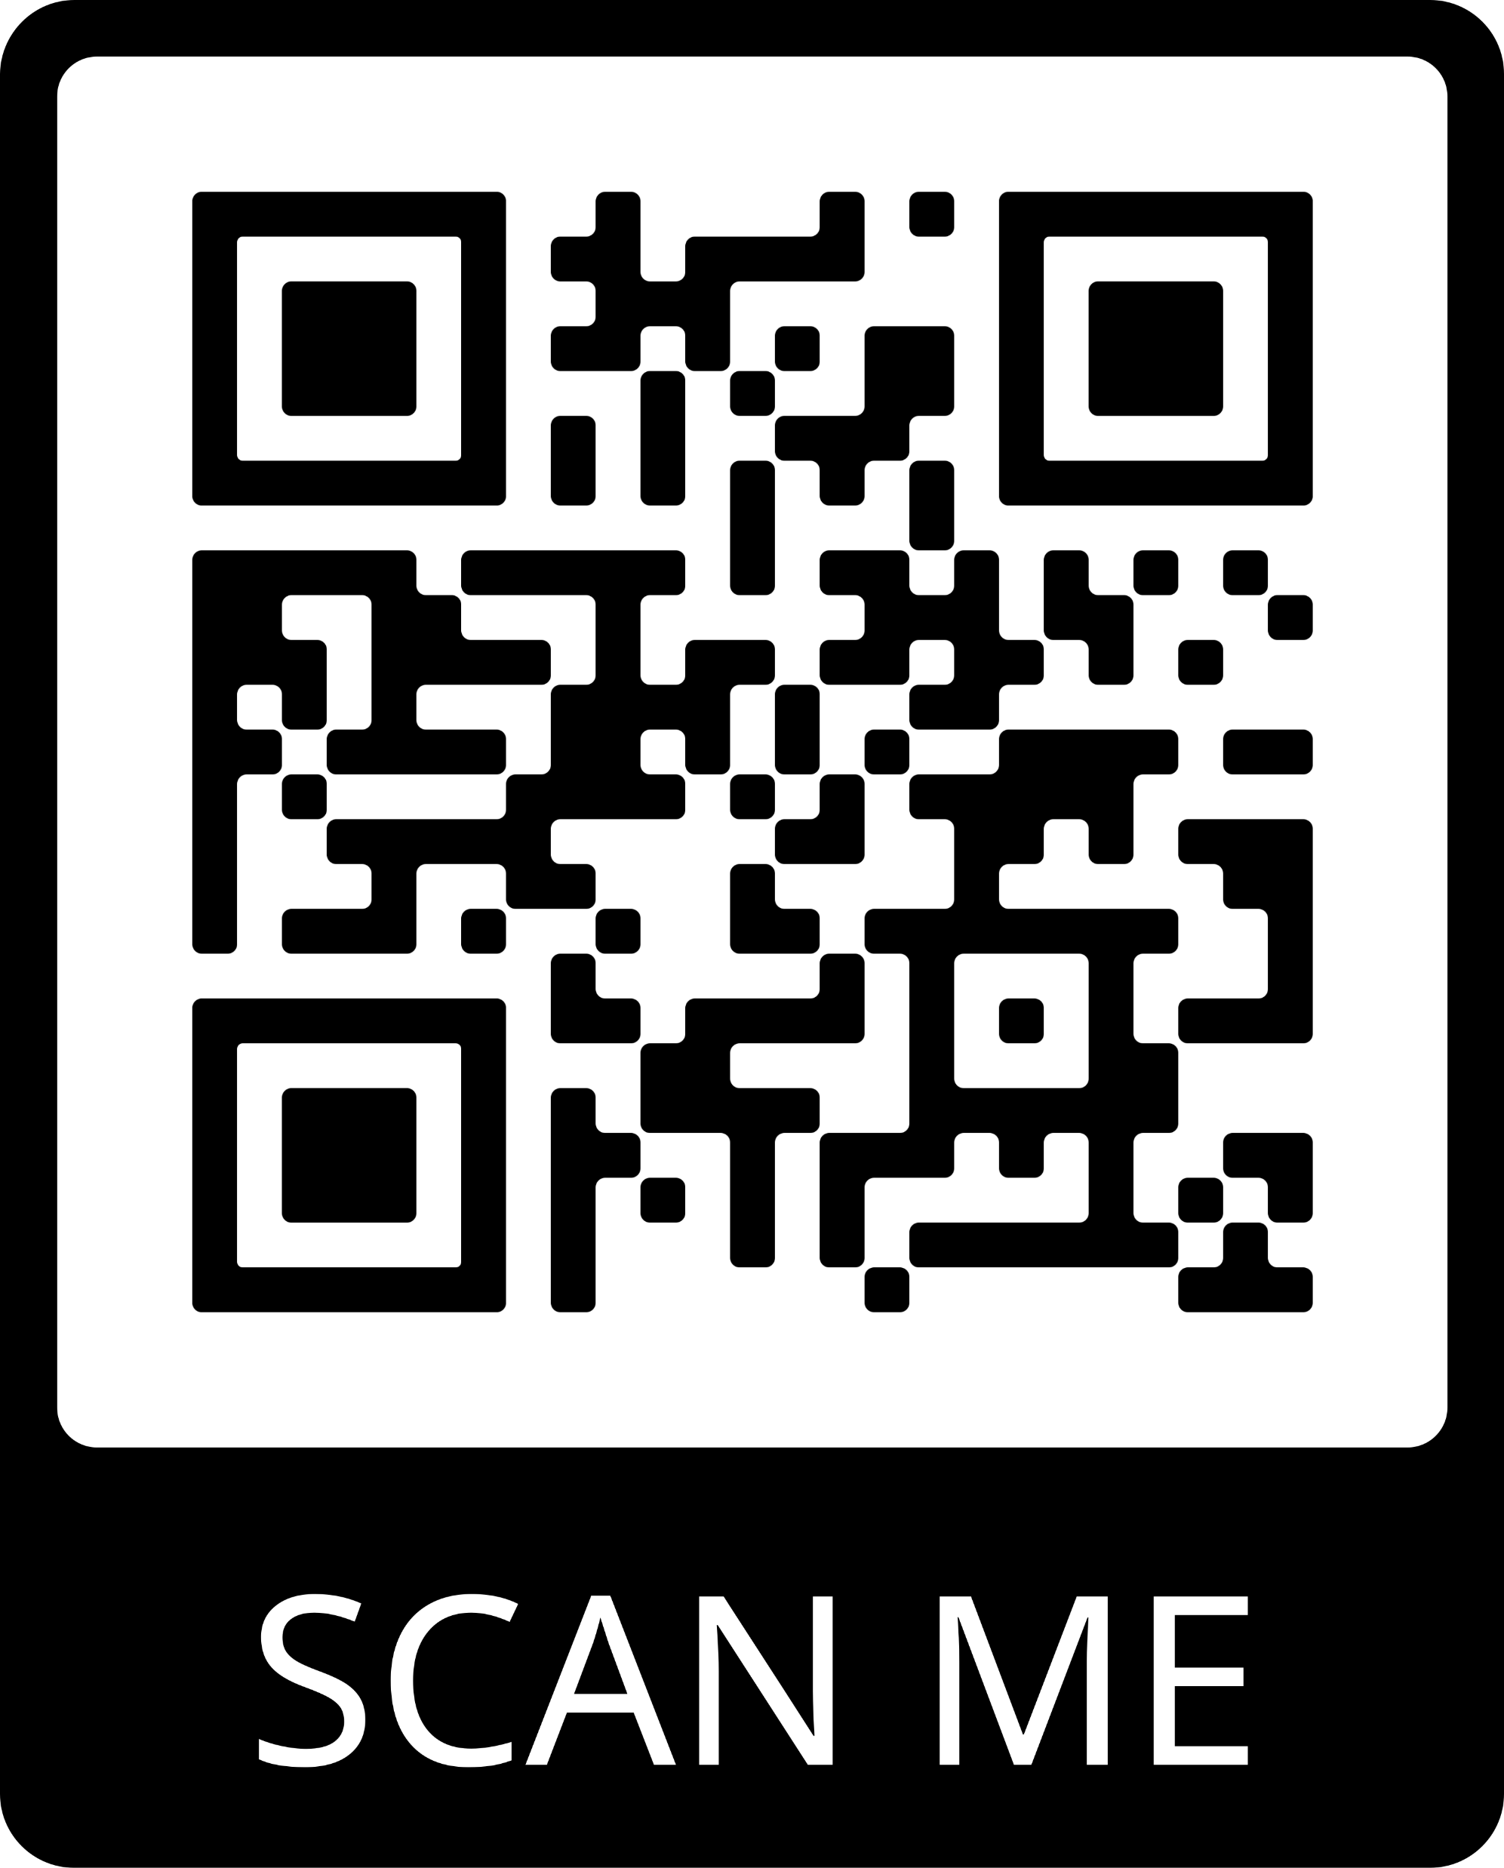
Navigating pathways moodle
Presentations & materials will be available every week
Guest Access – MUST login using guest access
Password – Rising5!
Link – https://moodle.brynmawr.edu/enrol/index.php?id=4484

Slide 18


Immigrants Rising Resources
Scholarships
Fellowships
Tips on Entrepreneurship
Storytelling
https://immigrantsrising.org/resources/
**Disclaimer: this is information gathered through public resources not put together by a lawyer. This is not official legal advice**
Notes:
Formerly Known as Educators for Fair Consideration (E4FC).

Slide 19
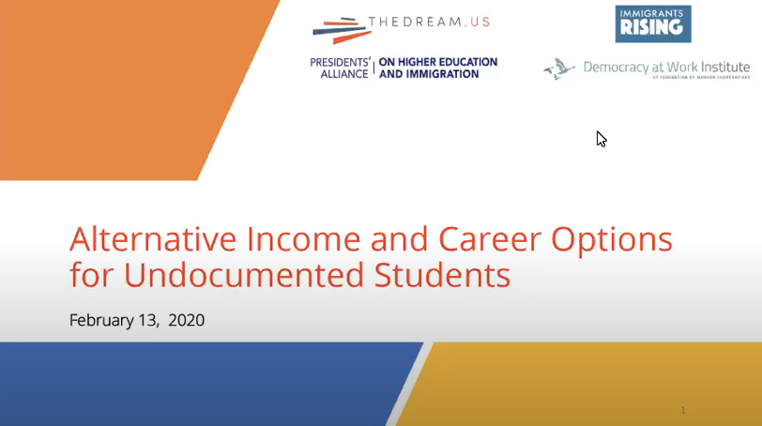
Immigrants Rising Resources
Webinar: “Alternative Income and Career Options for Undocumented Students”
2/13/20
Video: https://www.youtube.com/watch?v=wY6ycbZIEmY&feature=youtu.be
**Disclaimer: this is information gathered through public resources not put together by a lawyer. This is not official legal advice**

Slide 20
Immigrants Rising Resources
Tips on Entrepreneurship
• Immigrants Rising Entrepreneurship newsletter: https://d2ag3jdu89hmr4.cloudfront.net/browser_preview/awMst5yr84_9ycJA
• Choosing a Business Structure
https://immigrantsrising.org/resource/choosing-a-business-structure-guide/
**Disclaimer: this is information gathered through public resources not put together by a lawyer. This is not official legal advice**

Slide 21

Democracy at work institute Resources
Tips on Worker Cooperatives
• What is a Worker Cooperative?
https://institute.coop/what-worker-cooperative-1
• Worker Cooperative Resource Guide
https://institute.coop/resource-guide
**Disclaimer: this is information gathered through public resources not put together by a lawyer. This is not official legal advice**

Slide 22



Immigrants Rising & Other Resources
**Disclaimer: this is information gathered through public resources not put together by a lawyer. This is not official legal advice**

Slide 23


GoinGlobal Resources
.
Visa & Work Permit Overview
Application process
Students
Business
Work Environment
Visa Resources
Legal Considerations
**Disclaimer: this is information gathered through public resources not put together by a lawyer. This is not official legal advice**

Slide 24

ADDITIONAL Resources
UPENN list of Employers Interested in Hiring DACA Students https://careerservices.upenn.edu/employers-interested-in-hiring-daca-students/
Life After College: A Guide for Undocumented Students https://www.msjc.edu/counseling/documents/Life_After_College-A_guide_for_undocumented_students_by_Educators_for_Fair_Consideration.pdf
My Undocumented Life: List of College Scholarships https://mydocumentedlife.org/category/college-scholarships/
Check these out!
**Disclaimer: this is information gathered through public resources not put together by a lawyer. This is not official legal advice**

Slide 25
Contact us!
Leslie Castrejon
Pensby Center
Lcastrejon@brynmawr.edu
610-526-6588
Room 167, Student Life & Wellness Bldg.
Dayna Levy
Career & Civic Engagement Center
Dlevy1@brynmawr.edu
610-526-5174
Room 153, Student Life & Wellness Bldg.
**Disclaimer: this is information gathered through public resources not put together by a lawyer. This is not official legal advice**

