Slide 1
Schedule Reminder
Week 4 (Sept 19 – 23)
  Cell Respiration & Fermentation
    Chapter 9
  Quiz 4
Week 5 (Sept 26-30)
  Monday Review
  Mendelian genetics and concepts of dominance
    Chapter 14, see syllabus for exact pages
  Pedigrees, transmission patters and probabilities
    Chapter 15, see syllabus for exact pages
  Exam 1
    Available Friday September 30 – Wednesday October 5th
    Material through Friday September 26th.

Slide 2
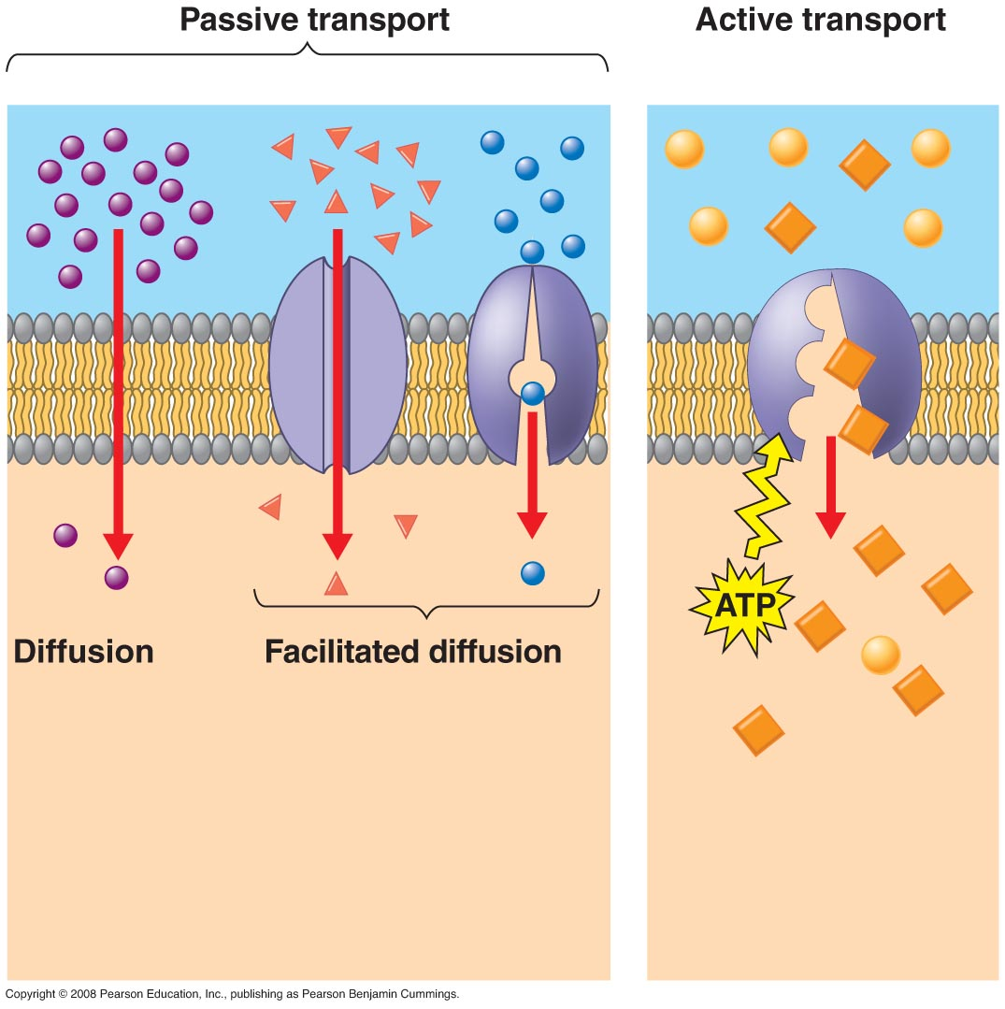
Cell Membranes
Types of Transport
  Active Transport:
    Movement of molecules against a concentration gradient (low to high)
    Requires energy (ATP)
    Involves transport proteins
      Carrier Proteins

Slide 3
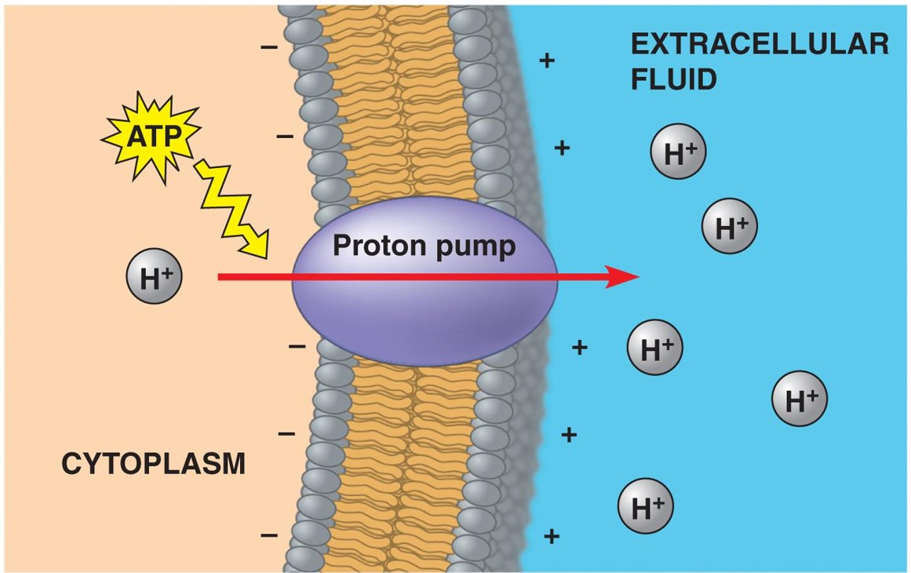
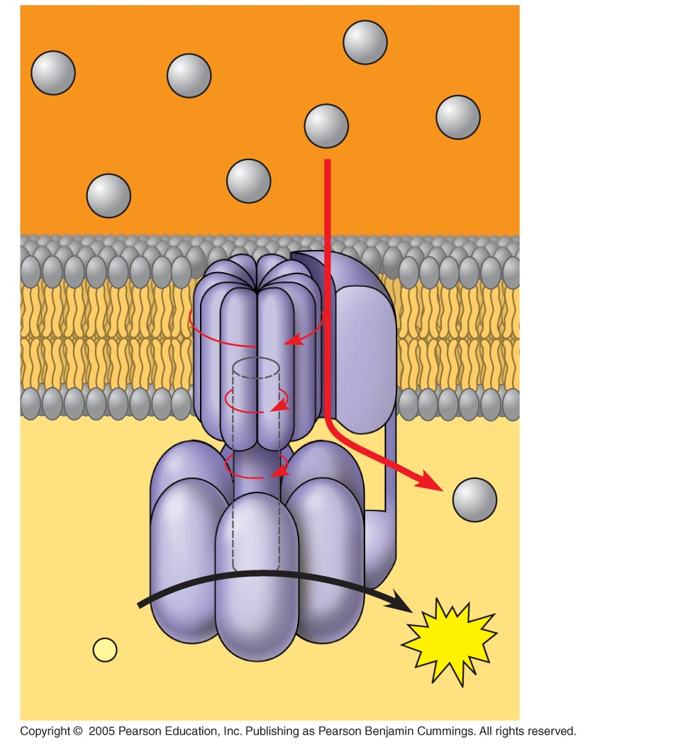
Cell Membranes
Active Transport
  Establish gradients across a membrane
INTERMEMBRANE SPACE
H⁺
H⁺
H⁺
H⁺
H⁺
H⁺
H⁺
H⁺
ADP
+
ATP
P
i
MITOCHONDRAL MATRIX

Slide 4
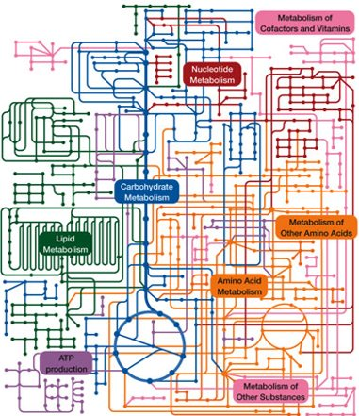
Cell Metabolism
Metabolism:
  The totality of an organism’s chemical reactions.
Metabolic Pathway:
  Series of steps, catalyzed by an enzyme, that converts a molecule into a product.

Slide 5
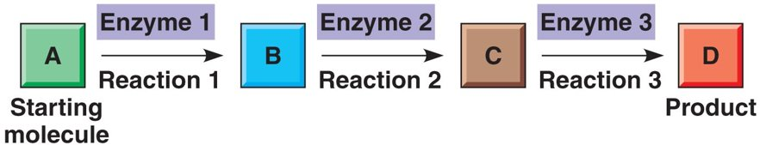
Cell Metabolism
Parts of a metabolic Pathway:
  Substrate(s):
    The reactant on which an enzyme works.
  Enzyme:
    A chemical agent that increases the rate of a reaction without being consumed by the reaction
  Products:
    Material resulting from a chemical reaction.

Slide 6
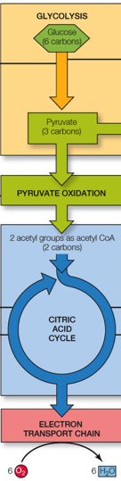
Cell Metabolism
C₆H₁₂O₆ + 6O₂
6CO₂ + 6H₂O + Energy
24 steps in a Cell
1 step in a beaker
ATP
Heat & Light

Slide 7
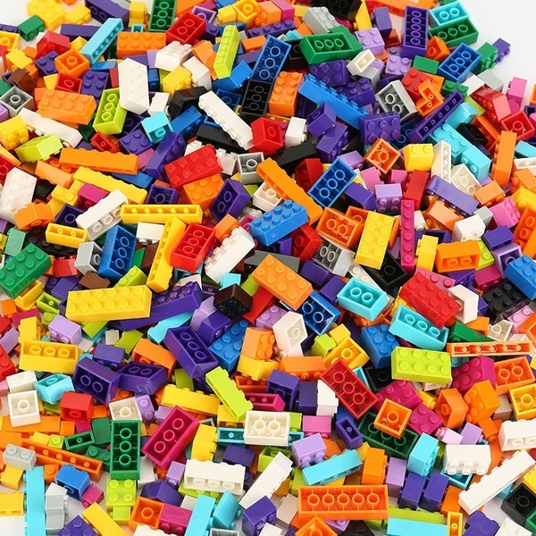
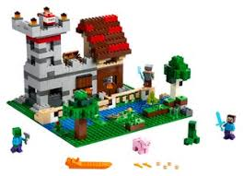
Cell Metabolism
Catabolic vs Anabolic Reactions
  Catabolic:
    A metabolic pathway that releases energy by breaking down complex molecules into simpler molecules
  Anabolic:
    A metabolic pathway that consumes energy to synthesize complex molecules from simpler molecules
Catabolic
Anabolic

Slide 8
Cell Metabolism
Energy:
  Capacity to cause change.
ATP:
  Adenosine triphosphate, energy source in cells

Slide 9
Cell Metabolism
Thermodynamics:
  Study of energy transformations.

Slide 10
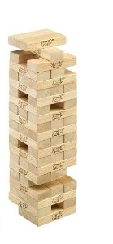
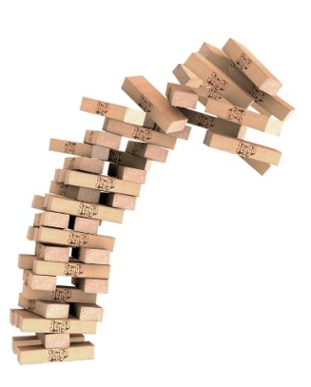
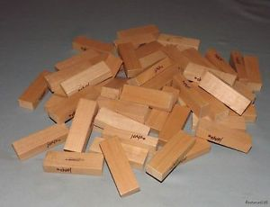
Cell Metabolism
Which is more complex: the tiles on the table or the tower?
Which of these is less stable?
Which requires energy to occur: building or topling the tower?

Slide 11
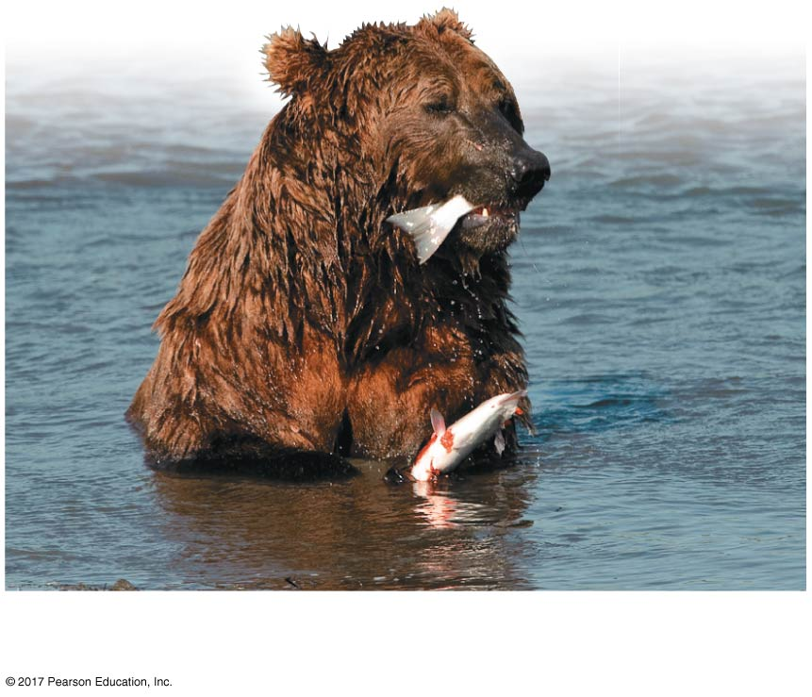
Cell Metabolism
First Law of thermodynamics:
  Energy can be transferred and transformed but it cannot be created or destroyed.
Chemical
energy
in food

Slide 12
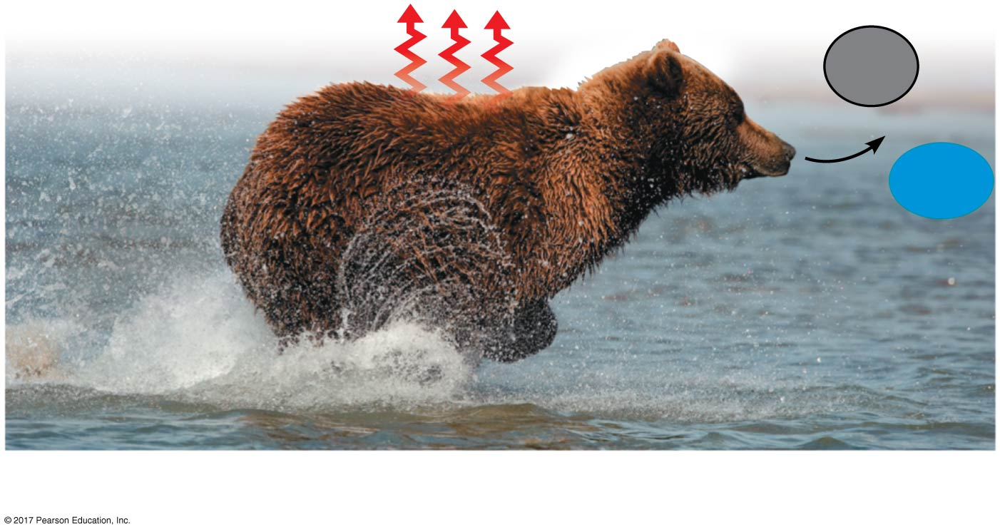
Cell Metabolism
Second law of thermodynamics:
  Every energy transfer or transformation increases the entropy of the universe.
    A measure of molecular disorder, or randomness
Heat
CO₂
+
H₂O
Kinetic
energy

Slide 13
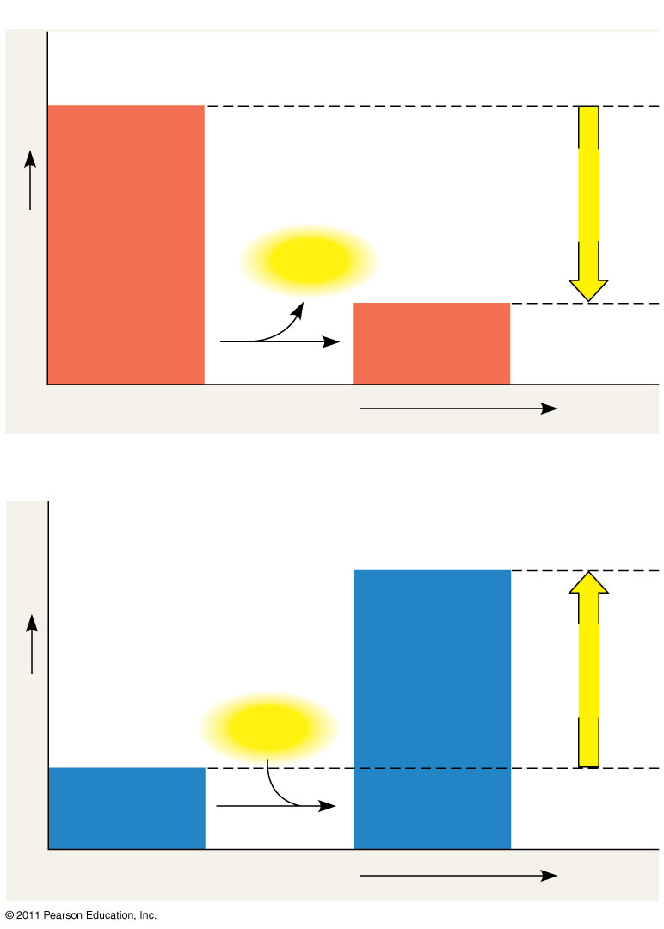
Cell Metabolism
Free Energy (∆G):
  The portion of a systems energy that can perform work when temperature and pressure are uniform throughout the system.
    Gibbs Free Energy: ∆G= G _{final} – G _{initial}
Exergonic reaction: energy released, spontaneous
Endergonic reaction: energy required, nonspontaneous
Reactants
Products
Amount of
energy
released
(ΔG < 0)
Amount of
energy
required
(ΔG > 0)
Free energy
Energy
Free energy
Energy
Products
Reactants
Progress of the reaction
Progress of the reaction

Slide 14
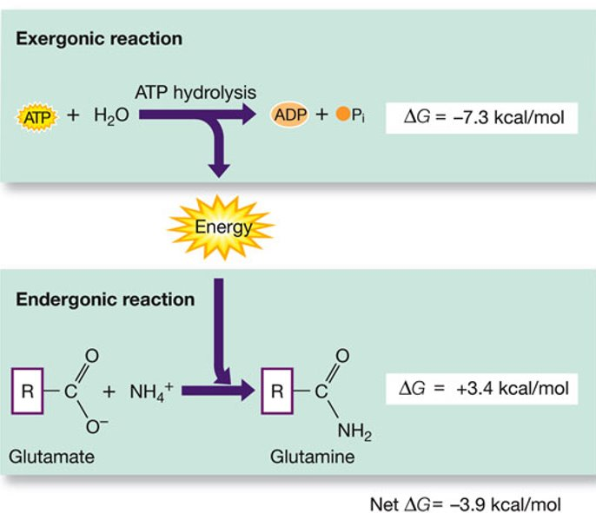
Cell Metabolism
Energy Coupling:
  The use of energy released from an exergonic reaction to drive an endergonic reaction.

Slide 15
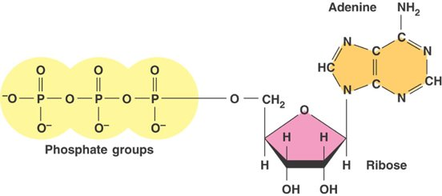
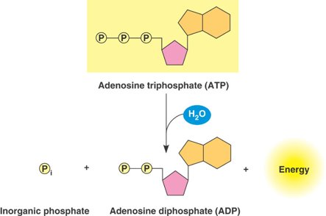
Cell Metabolism
ATP Structure
  Ribose
  Adenine
  3 phosphate groups
Hydrolysis reaction
  ADP
  Pi
  Energy

Slide 16
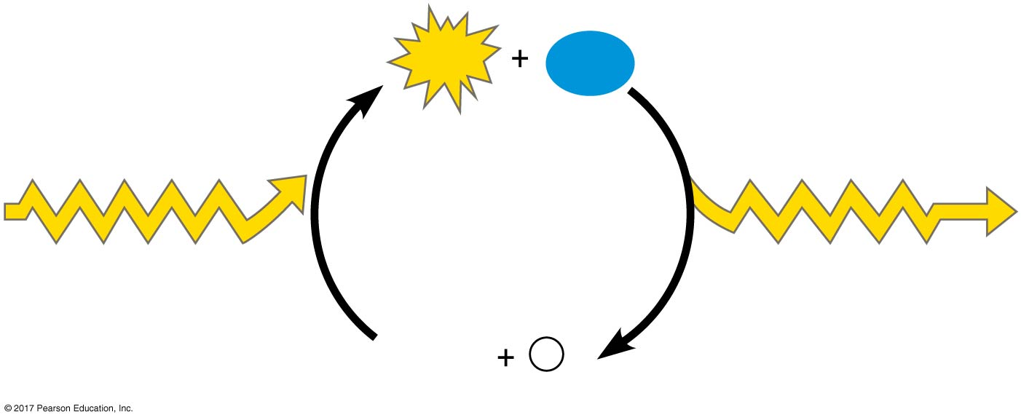
Cell Metabolism
ATP Cycle:
  Process by which energy released by catabolism is used to phosphorylate ADP, regenerating ATP.
ATP
H₂O
Energy from
catabolism (exergonic,
energy-releasing
processes)
Energy for cellular
work (endergonic,
energy-consuming
processes)
ADP
P

Slide 17
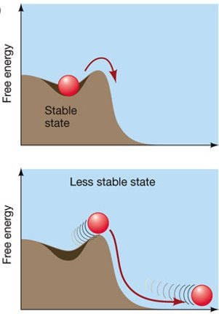
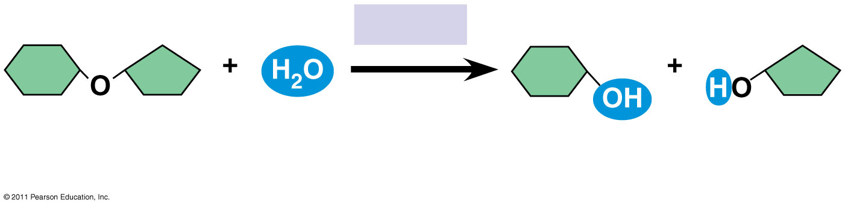
Cell Metabolism
Activation energy (E_{A})
  Energy required to begin a reaction.
Sucrase
Sucrose
(C₁₂H₂₂O₁₁)
Glucose
(C₆H₁₂O₆)
Fructose
(C₆H₁₂O₆)

Slide 18
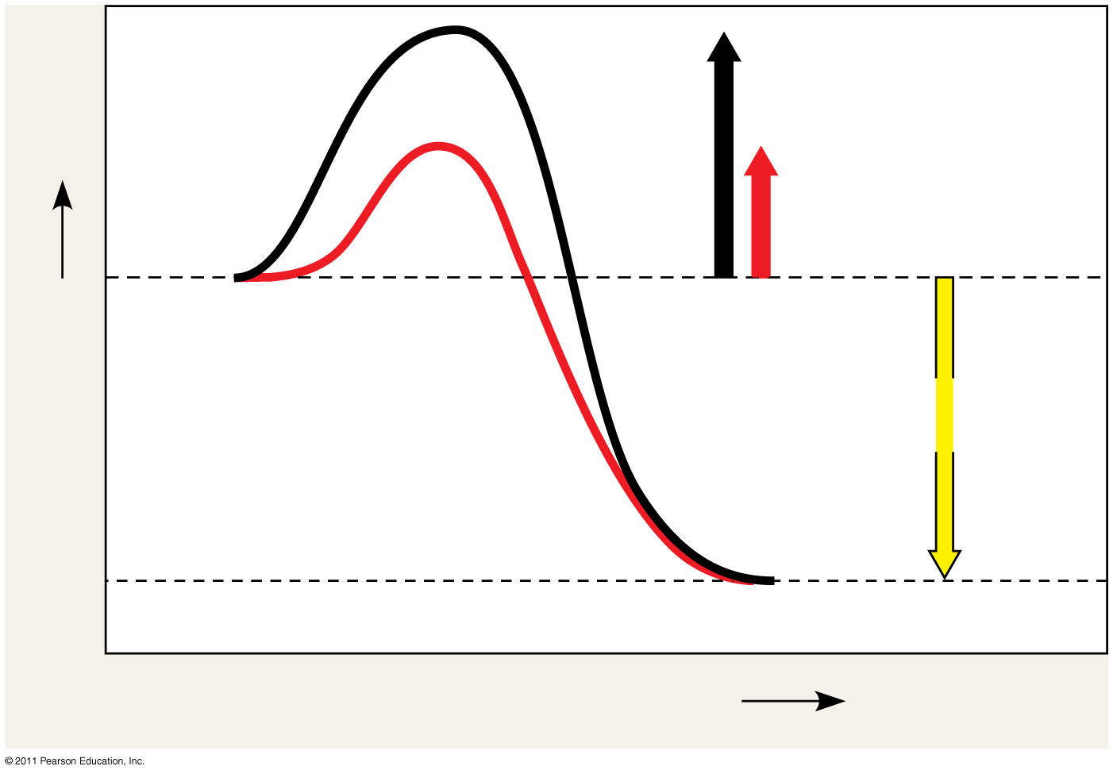
Cell Metabolism
Enzymes lower E_{A} and allow the reaction to move forward.
Course of
reaction
without
enzyme
E_{A}
without
enzyme
E_{A} with
enzyme
is lower
Reactants
Free energy
Course of
reaction
with enzyme
ΔG is unaffected
by enzyme
Products
Progress of the reaction

Slide 19
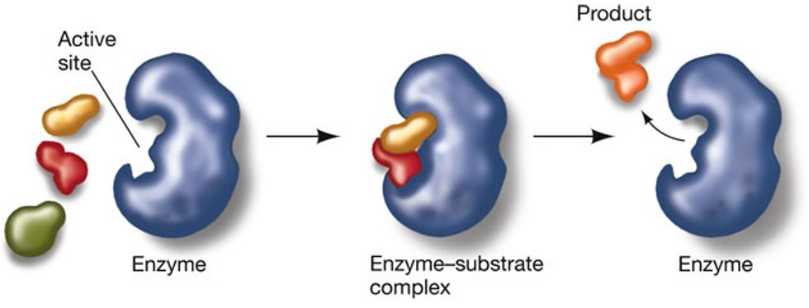
Cell Metabolism
Active Site:
  Site where enzyme binds specific substrates
Induce fit:
  Enzyme changes confirmation

Slide 20
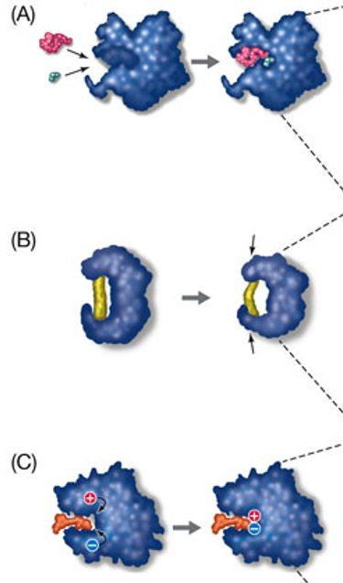
Cell Metabolism
How do enzymes lower activation energy
  Bring substrates together in close proximity and properly oriented.
  Strain the substrate to get it to transition state.
  Chemistry of active site encourages reaction.

Slide 21
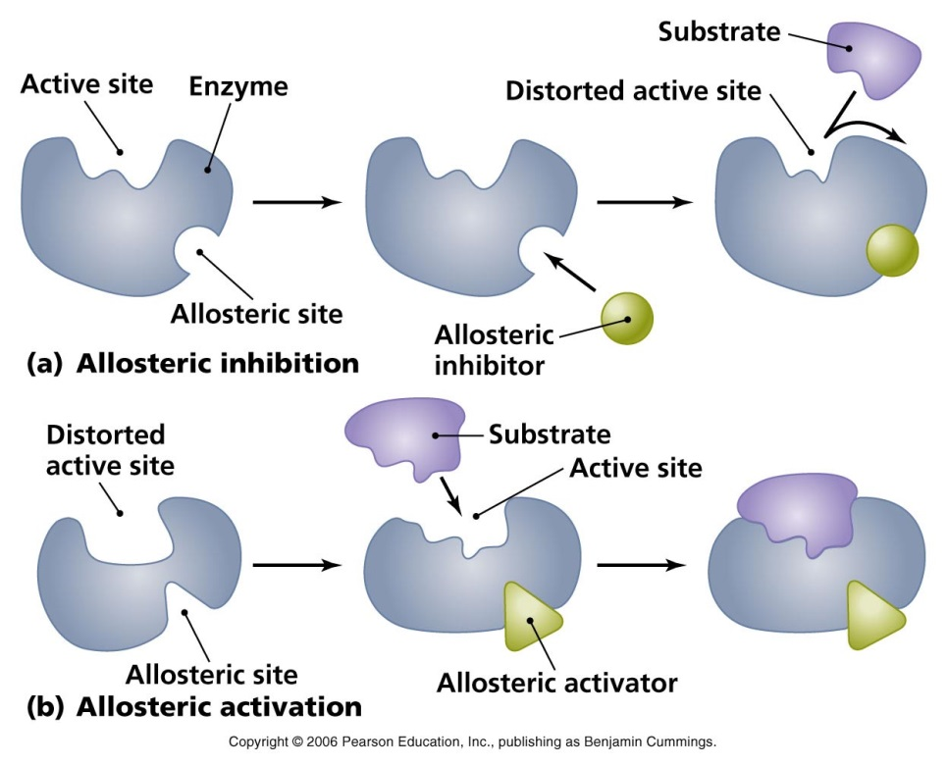
Cell Metabolism
Enzyme Regulation
  Allosteric Site:
    Region of enzyme separate from the active site where regulatory molecules can bind

Slide 22
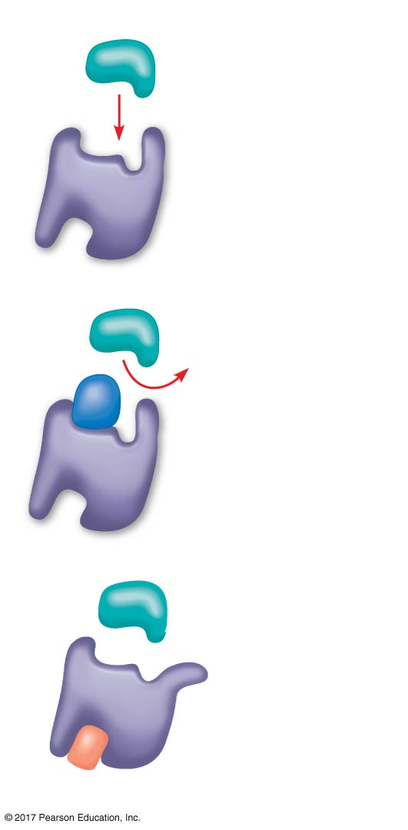
Cell Metabolism
Enzyme Regulation
  Competitive Inhibitors
    Bind active site
  Non-competitive Inhibitors
    Bind allosteric site to inhibit enzyme activity.
(a) Normal binding
Substrate
Active site
Enzyme
(b) Competitive inhibition
Competitive
inhibitor
(c) Noncompetitive inhibition
Noncompetitive inhibitor

Slide 23
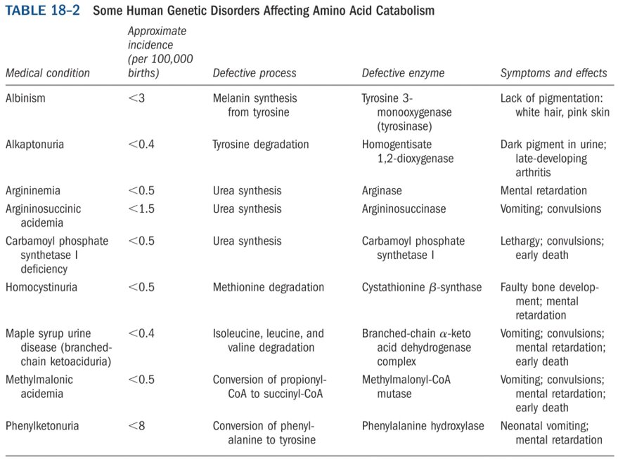
Cell Metabolism

