Slide 1
Frankenstein Day 3
Reverse Outline of Rough Draft

Slide 2
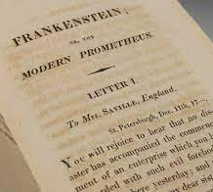
Free Writing & Discussion
Locate a passage from the reading for today that stood out to you.
Unpack in your writing why you think this passage matters.
How is this passage relevant to the wider human experience?

Slide 3

Reverse Outline
Read through the paper and summarize the main idea of each paragraph on a separate piece of paper. # each idea based on the paragraph it is in(leave space after the summaries)
Note if any paragraphs support more than one idea- label them #A,B,C etc…
Under each summary/idea briefly indicate what evidence you have supporting it & the citation with bullet points
After each bullet point explicitly state (can be a fragment) how that evidence supports the idea
What does this help you see about your current draft?

