Slide 1
Schedule Reminder
Week 4 (Sept 19 – 23)
  Cell Respiration & Fermentation
    Chapter 9
  Quiz 4
Week 5 (Sept 26-30)
  Monday Review
  Mendelian genetics and concepts of dominance
    Chapter 14, see syllabus for exact pages
  Pedigrees, transmission patters and probabilities
    Chapter 15, see syllabus for exact pages
  Exam 1
    Available Friday September 30 – Wednesday October 5th
    Material through Friday September 26th.

Slide 2
Cell Respiration & Fermentation
Cell Respiration:
  A catabolic pathways where the cell transfers and transforms chemical energy molecules to create ATP.
Does the organism have available oxygen?
Aerobic Respiration Anaerobic respiration or Fermentation
More efficient Less efficient
High ATP yield Lower ATP yield
Yes
No

Slide 3
Cell Respiration & Fermentation
Aerobic Respiration:
  A catabolic pathways which break down organic molecules in the presence of oxygyn for the production of ATP.
    More efficient
    High ATP Yield

Slide 4
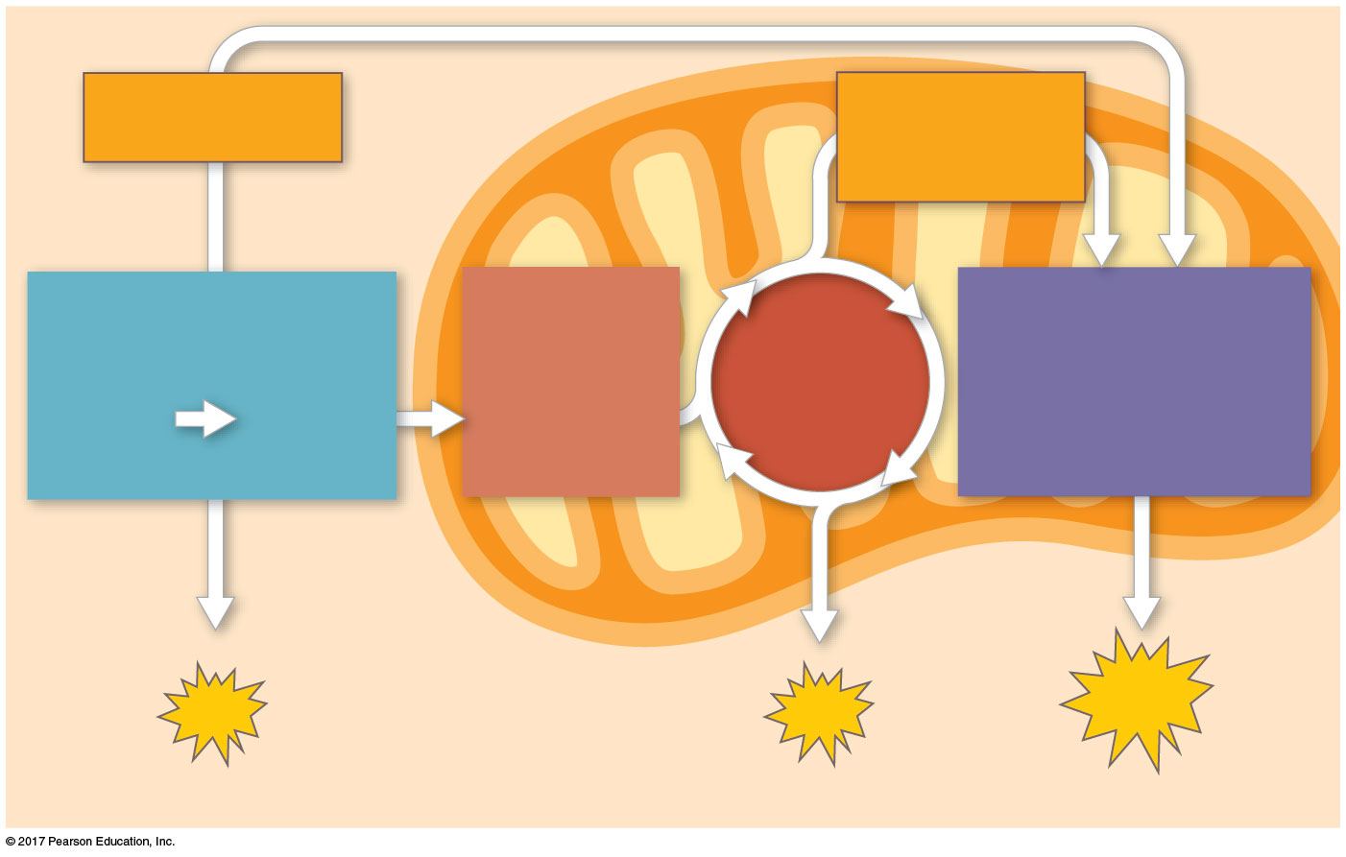
Aerobic Respiration
3 Stages
  Glycolysis
  Citric Acid Cycle (TCA)
  Electron Transport
Electrons
via NADH
Electrons
via NADH
and FADH₂
GLYCOLYSIS
PYRUVATE
OXIDATION
CITRIC
ACID
CYCLE
OXIDATIVE
PHOSPHORYLATION
Glucose
Pyruvate
Acetyl CoA
(Electron transport
and chemiosmosis)
CYTOSOL
ATP
ATP
ATP
Substrate-level Phosphorylation
Substrate-level Phosphorylation
Oxidative

Slide 5
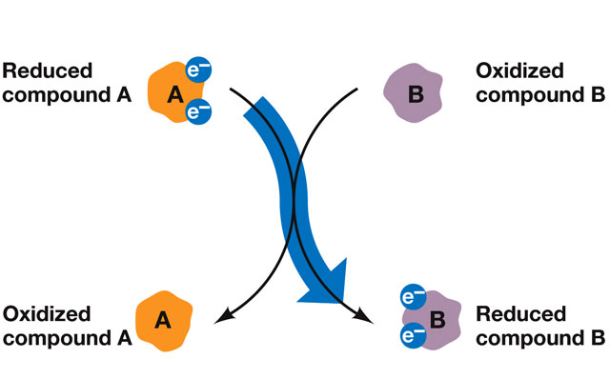
Aerobic Respiration
Redox (Oxidation-Reduction) Reactions:
  Reactions where energy is transferred in the form of electrons.
    Oxidation = loss of an electron
    Reduction = Gain of an electron
LEO the lion says GER

Slide 6
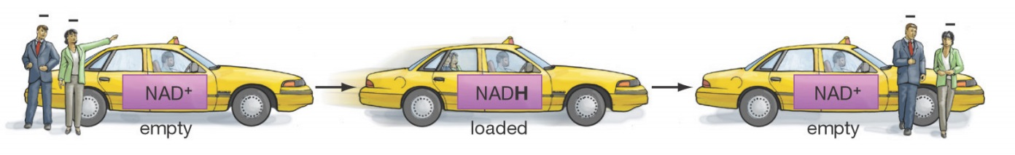
Aerobic Respiration
Electron Carriers:
  Small organic molecules that pick-up electrons from molecule and deliver them to another.
    NAD+
    FAD
NADH
FADH₂

Slide 7
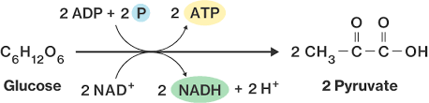
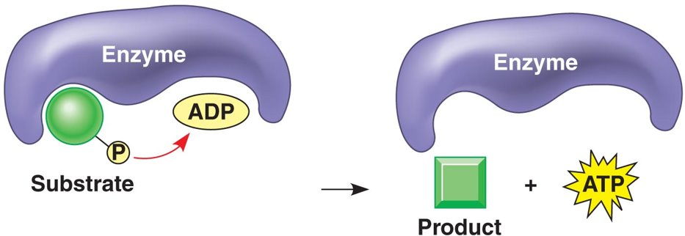
Aerobic Respiration
Glycolysis:
  Breaks glucose
  Produces : 2 molecules pyruvate and 2 ATP
  Transfer energy to 2 NAD⁺ NADH
Substrate Level Phosphorylation (SLP)
  The enzyme-catalyzed formation of ATP by direct transfer of a phosphate group to ADP

Slide 8
Aerobic Respiration
Glycolysis Benefits
  Small energy yield
  Rapid Process
  Does not require oxygen

Slide 9
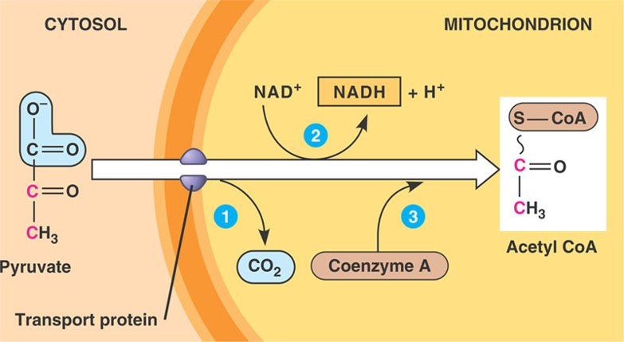
Aerobic Respiration
Glycolysis / TCA junction:
  Pyruvate transported via active transport to matrix
    Oxidized and release of CO
    NAD+ is reduce to NADH
    Remaining two-carbon fragment and Coenzyme A are combined to form Acetyl CoA (acetyl coenzyme A)
      High energy molecule, substrate in TCA.
Pyruvate dehydrogenase

Slide 10
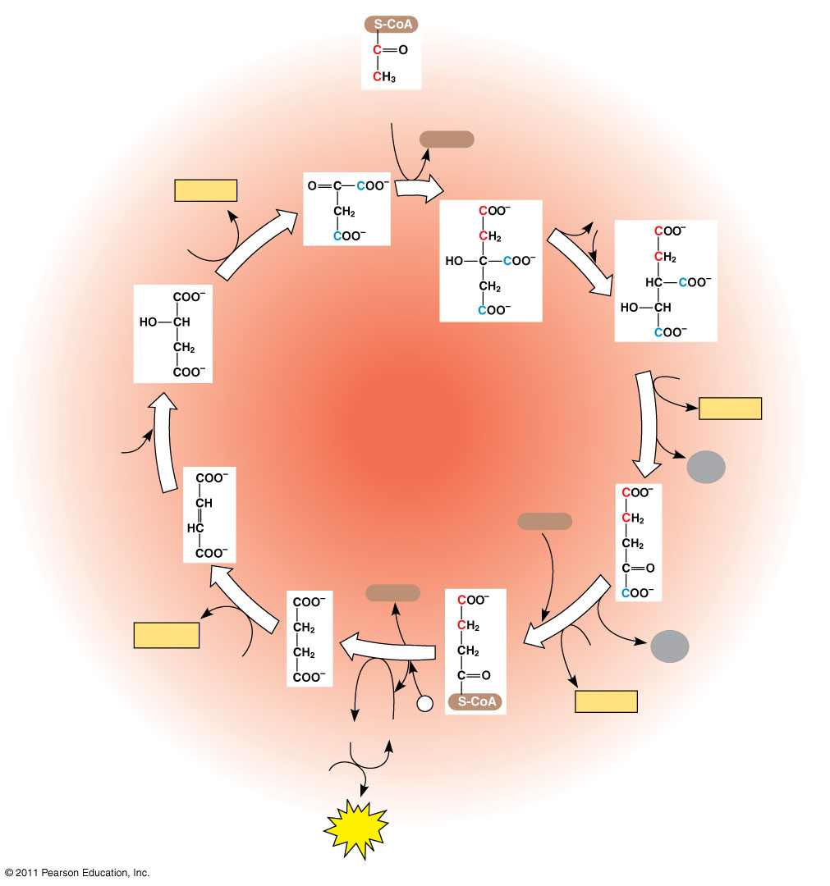
Aerobic Respiration
Citric Acid Cycle (TCA)
  Breaks down Acetyl-CoA
  Produces : 4CO₂ and 2 ATP by SLP
  Transfer energy to 6 NADH and 2 FADH₂
Acetyl CoA
CoA-SH
NADH
+ H⁺
1
H₂O
NAD⁺
Oxaloacetate
8
2
Malate
Citrate
Isocitrate
NAD⁺
Citric
acid
cycle
3
NADH
H₂O
7
+ H⁺
CO₂
Fumarate
CoA-SH
α-Ketoglutarate
6
CoA-SH
4
FADH₂
5
CO₂
FAD
NAD⁺
Succinate
P _{i}
NADH
GTP
GDP
Succinyl
CoA
+ H⁺
ADP
ATP

Slide 11
Aerobic Respiration
Oxidative Phosphorylation:
  ETC + Chemiosmosis
  The production of ATP using energy derived from redox reactions of an Electron Transport Chain.
    A sequence of electron carrier molecules (Complexes I- IV) that shuttle electrons down a series of redox reactions that release energy used to make ATP.
    ATP will be produced during Chemiosmosis.
      ATP synthesis powered by the flow of H⁺ back across the membrane.

Slide 12
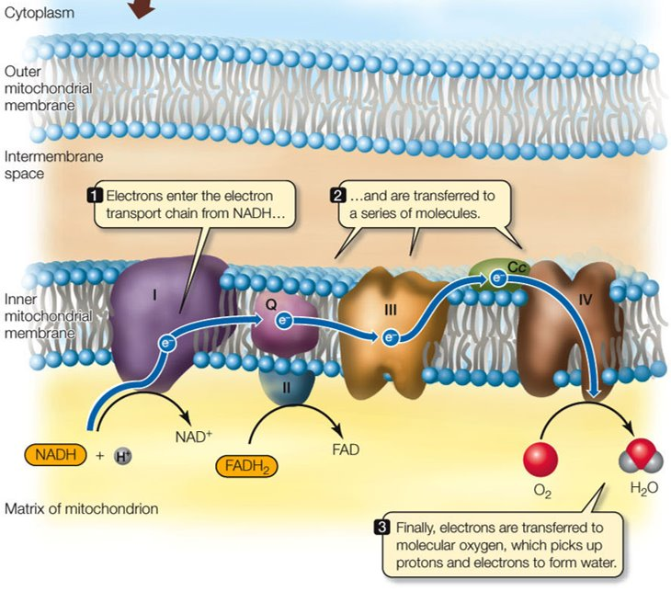
Aerobic Respiration
Electron Transport Chain:
  Activity of ETC carried about by set of complexes (mostly proteins) in cristae.
  Located in the inner membrane (cristae) of the mitochondria.
  Does NOT directly generate ATP.

Slide 13
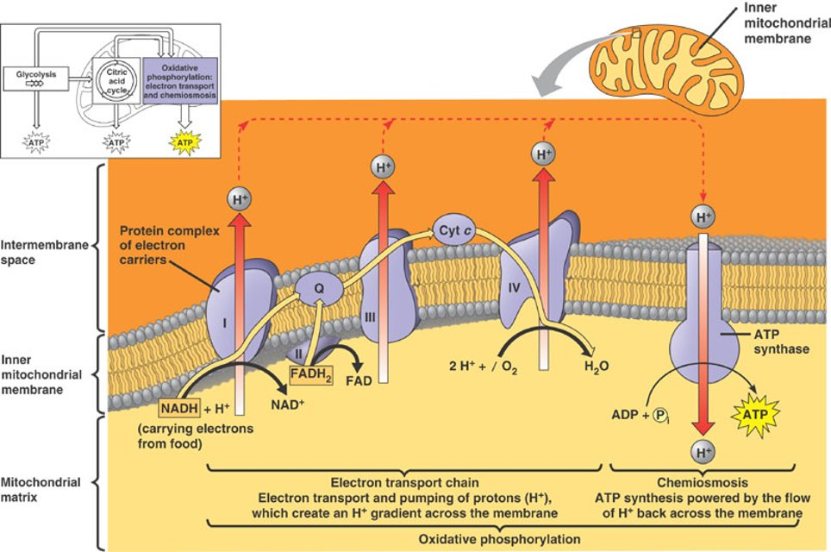
Aerobic Respiration
Oxidative Phosphorylation:
  H⁺’s pump into intramembrane space.

Slide 14
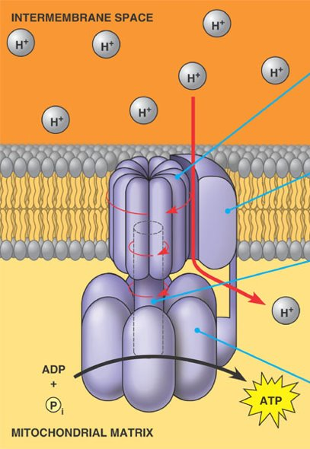
Aerobic Respiration
Chemiosmosis:
  ATP synthesis powered by the flow of H⁺ back across the membrane through ATP Synthase.
    Protein complex utilized to generate ATP from energy stored in electrochemical gradient.

Slide 15
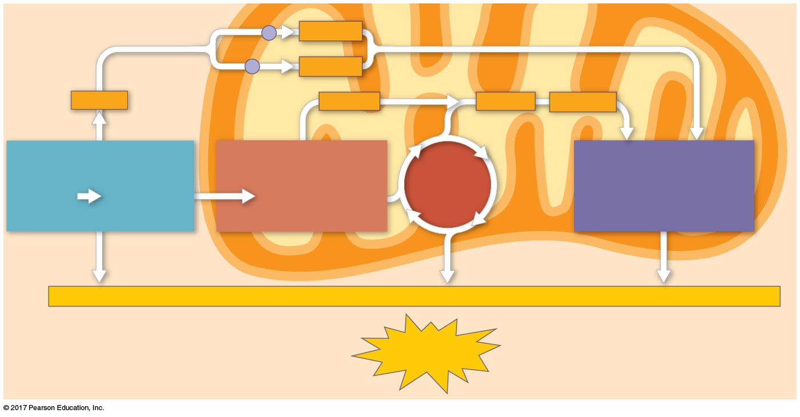
Aerobic Respiration
Accounting of ATP Produced
  2 ATP from Glycolysis
  2 ATP from Citric Acid Cycle
  ~26 – 28 ATP from Oxidative Phosphorylation
  30 – 32 ATP total
Electron shuttles
span membrane
MITOCHONDRION
2 NADH
CYTOSOL
or
2 FADH₂
2 NADH
2 NADH
6 NADH
2 FADH₂
GLYCOLYSIS
PYRUVATE
OXIDATION
CITRIC
ACID
CYCLE
OXIDATIVE
PHOSPHORYLATION
Glucose
2 Pyruvate
2 Acetyl CoA
(Electron transport
and chemiosmosis)
+ 2 ATP
+ 2 ATP
+ about 26 or 28 ATP
Maximum per glucose:
About
30 or 32 ATP

Slide 16
Aerobic Respiration
Other Products
  H20
  CO₂
  Heat

