Slide 1

Frankenstein Day 4
Thesis Workshop

Slide 2
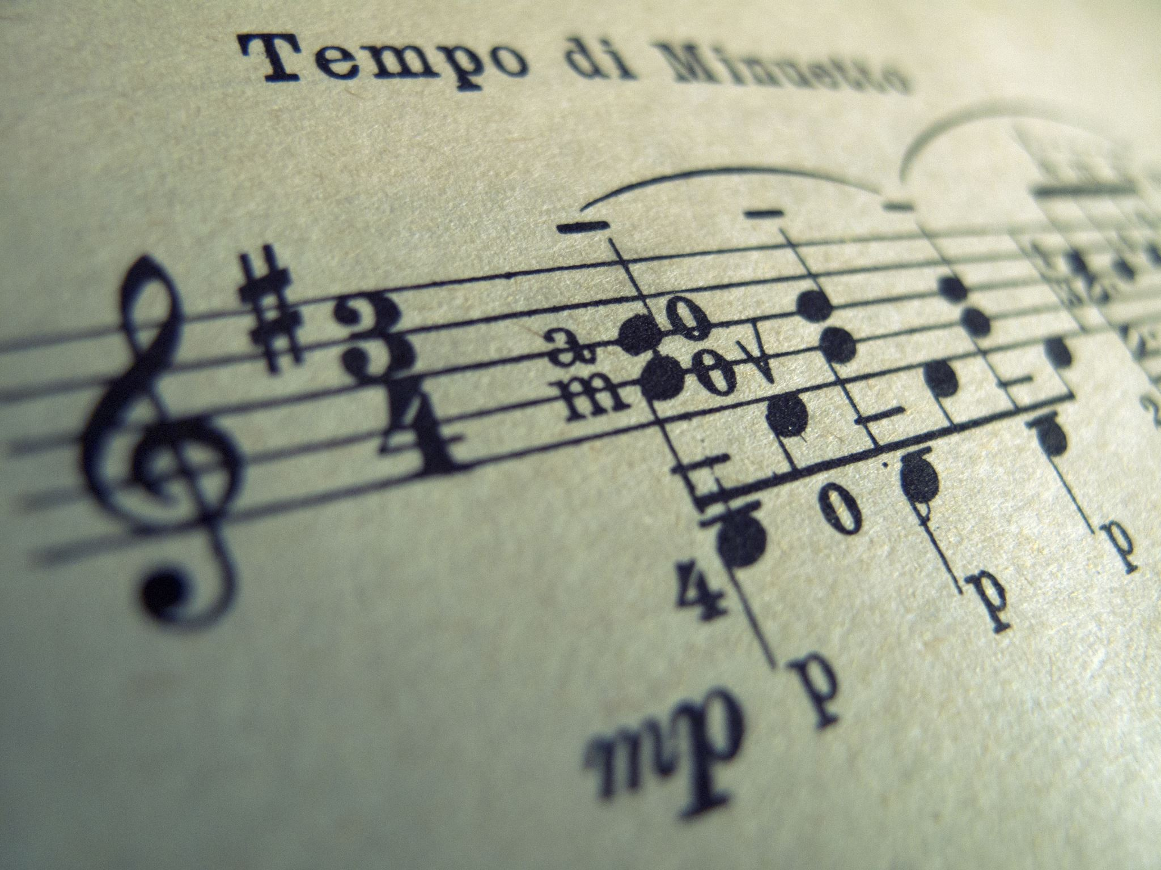
Free Writing
Take 10 minutes to locate and consider different things Shelley aligns the Creature within today’s section (pp 92-127). Examples would be music, deep emotion….
Unpack the impact of Shelley’s choices on interpretations of the Creature.

Slide 3
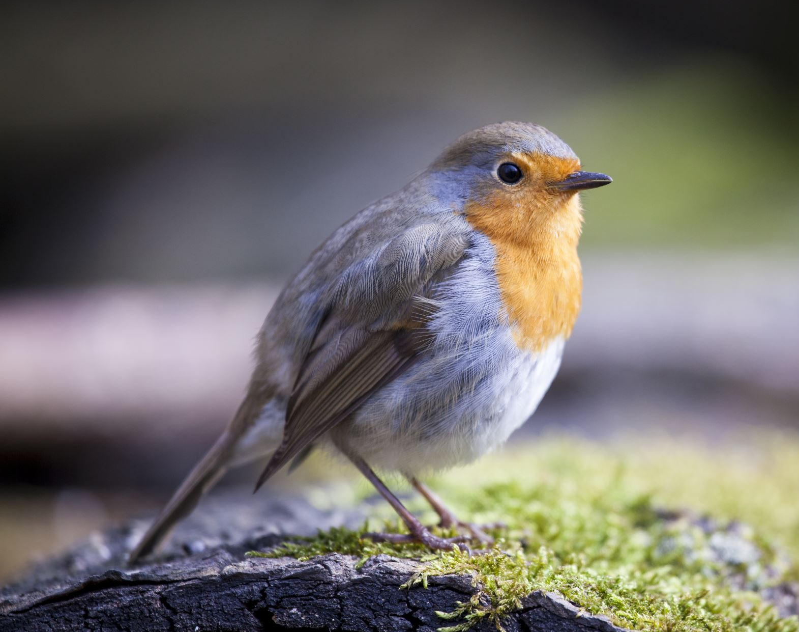
Discussion
Describe the creatures first sensations. How do they align with Romantic ideals?
The creature, like Caliban, fixates on birds (pp.94). How do birds operate as a poignant symbol in this context?
What are the first things the creature learns in his lonely journey through the woods? Why might Shelley have chosen to include this?

Slide 4
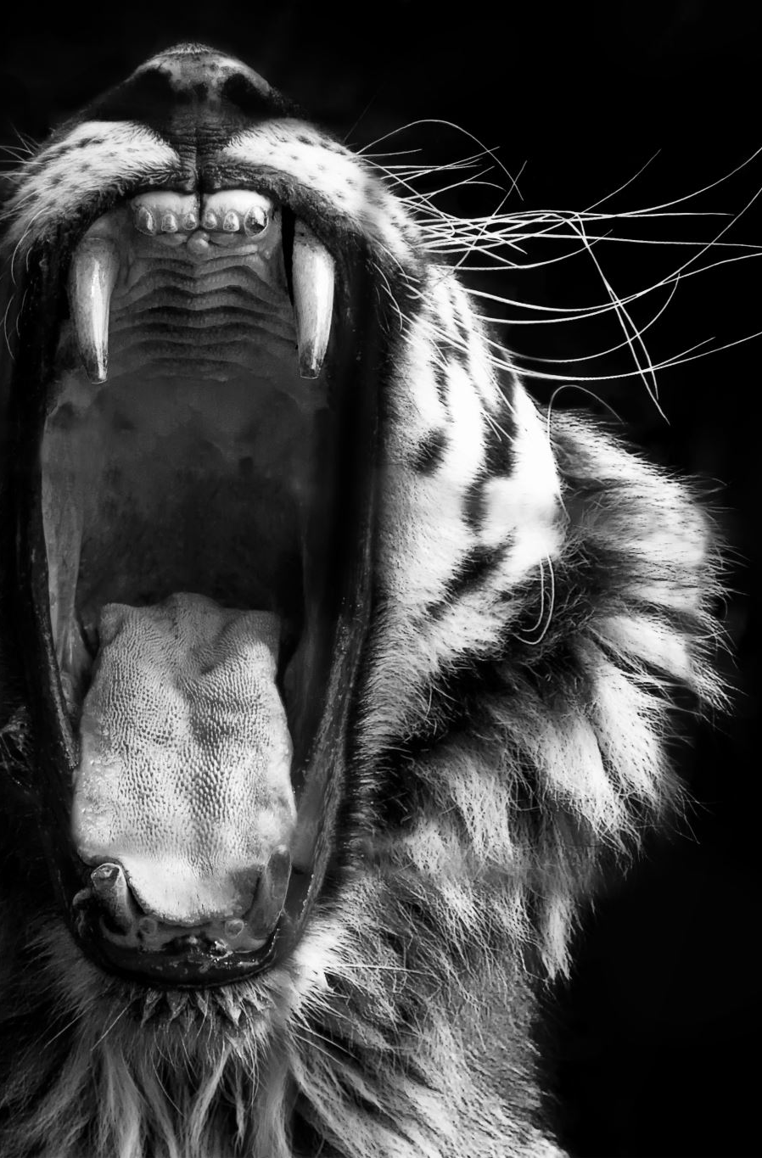
Discussion
What impact does the reception the creature receives from the people he meets have on the reader (96-97)?
What does the first moment the creature hears De Lacey play an instrument tell the reader about the creature (98)?

Slide 5
Discussion
The creature sees the cottagers suffering (102). How does he react? Is he active or passive? Consider the creature’s character in contrast to Victor. (What is Shelley up to?)
What makes the creature think the De Lacey’s might accept him (106)?
Unpack the creature’s journey to language?
Passages on 110-111, 120. Unpack

Slide 6

Thesis Workshop
A Close Reading is an argumentative essay in that it argues for a specific interpretation of the text.
Argumentative Papers are the most common paper in academia.
“The goal of the argumentative paper is to convince the audience that the claim is true based on the evidence provided.” (Purdue owl)

Slide 7
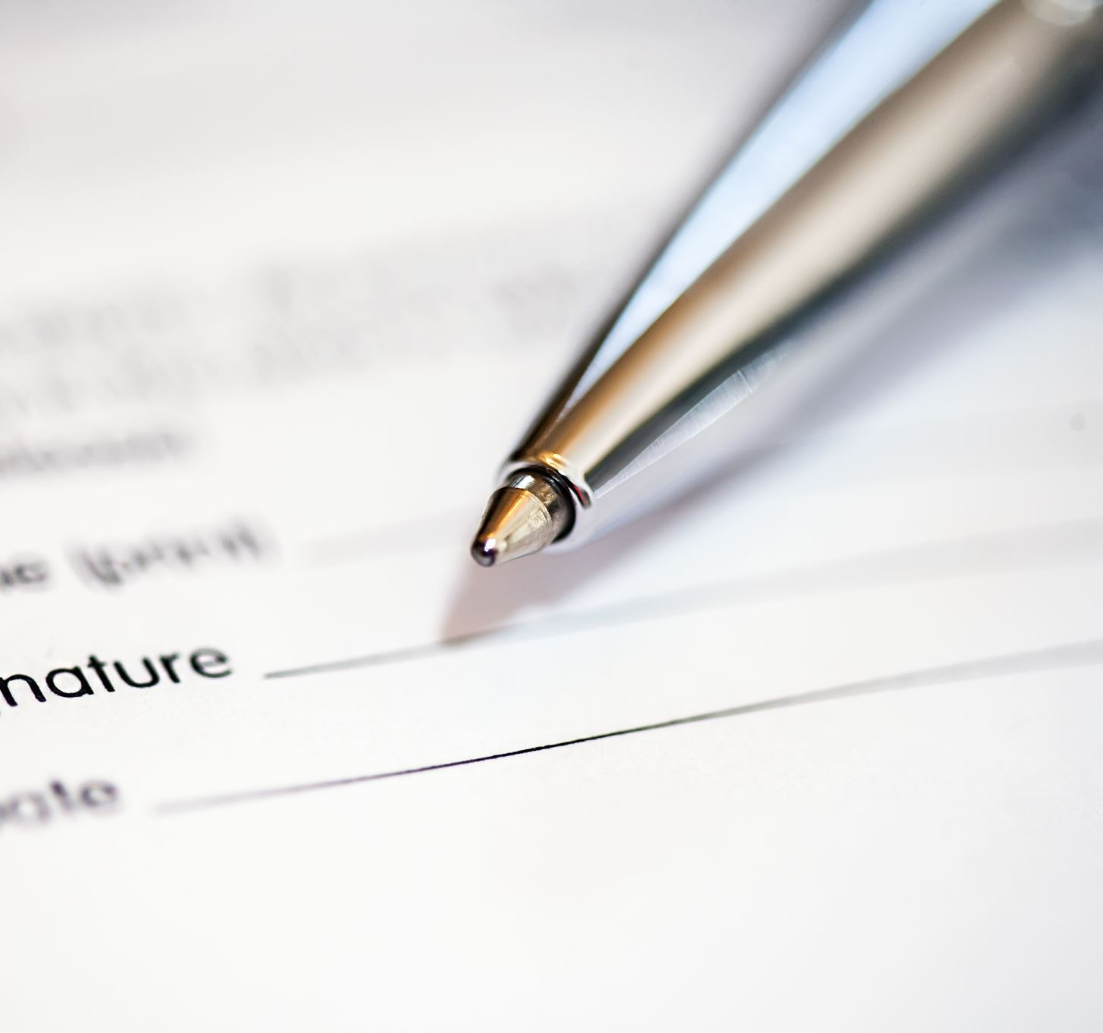
Be specific & relevant
Subject + Claim + why it matters.
Include only what you will discuss in your paper.

Slide 8
Where does the thesis statement go?
The thesis statement usually appears at the end of the first paragraph of a paper.
The introduction, which is the first paragraph, should walk the reader into your argument (relevant definitions and plot summary).

Slide 9

Group Work
Groups of 3 (may be one group of 4)
1st explain your paper to your peers. A very quick pitch.
2nd read the thesis statement as written.
3rd As a group work to strengthen the thesis statement.
Is it clear what the subject it?
Is it clear what the claim is?
Is it clear why it matters, making it easier to deepen the analysis throughout?
Is it specific enough?

Slide 10
Works Cited
Purdue Owl. https://owl.purdue.edu/owl/general_writing/the_writing_process/thesis_statement_tips.html

