Slide 1
Schedule Reminder
Week 4 (Sept 19 – 23)
  Cell Respiration & Fermentation
    Chapter 9
  Quiz 4
Week 5 (Sept 26-30)
  Monday Review
  Mendelian genetics and concepts of dominance
    Chapter 14, see syllabus for exact pages
  Pedigrees, transmission patters and probabilities
    Chapter 15, see syllabus for exact pages
  Exam 1
    Available Friday September 30 – Wednesday October 5th
    Material through Monday September 26th.

Slide 2
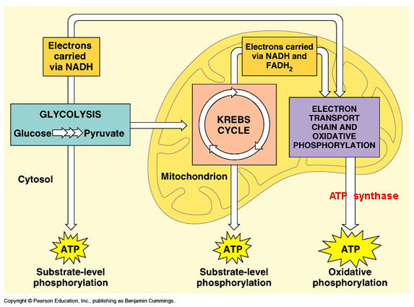
Anerobic Respiration
Anaerobic Respiration
  A catabolic pathway in which inorganic molecules other than oxygen accept electrons at the end of electron transport chains.
Not O₂ acceptor

Slide 3
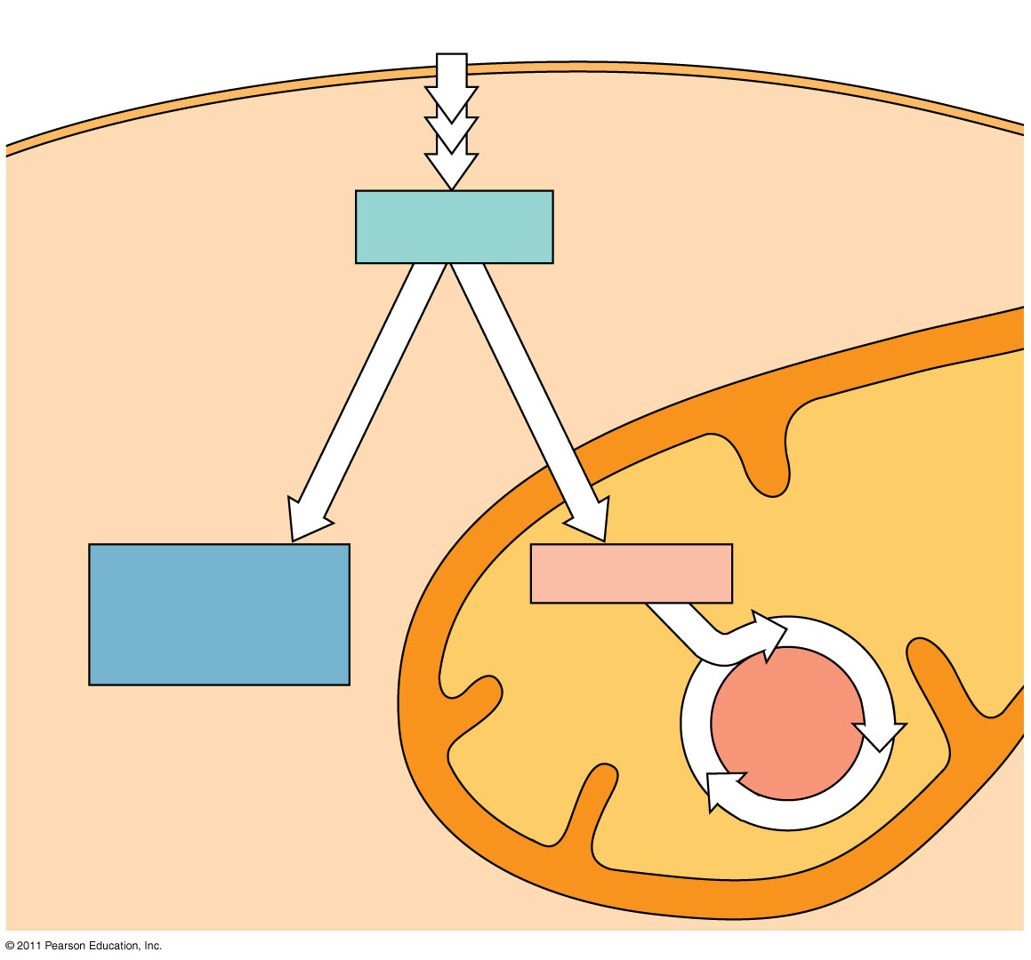
Fermentation
Fermentation:
  A catabolic process that makes a limited amount of ATP from organic molecules with out an electron transport chain
Glucose
CYTOSOL
Glycolysis
Pyruvate
O₂ present:
Aerobic cellular
respiration
No O₂ present:
Fermentation
MITOCHONDRION
Ethanol,
lactate, or
other products
Acetyl CoA
Citric
acid
cycle

Slide 4
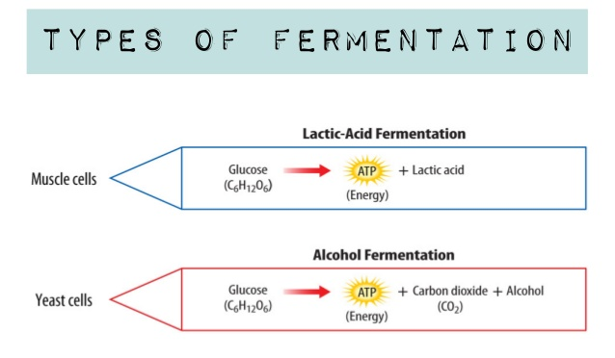
Fermentation
Two types of Fermentation
  Alcohol Fermentation
  Lactic Acid Fermentation

Slide 5
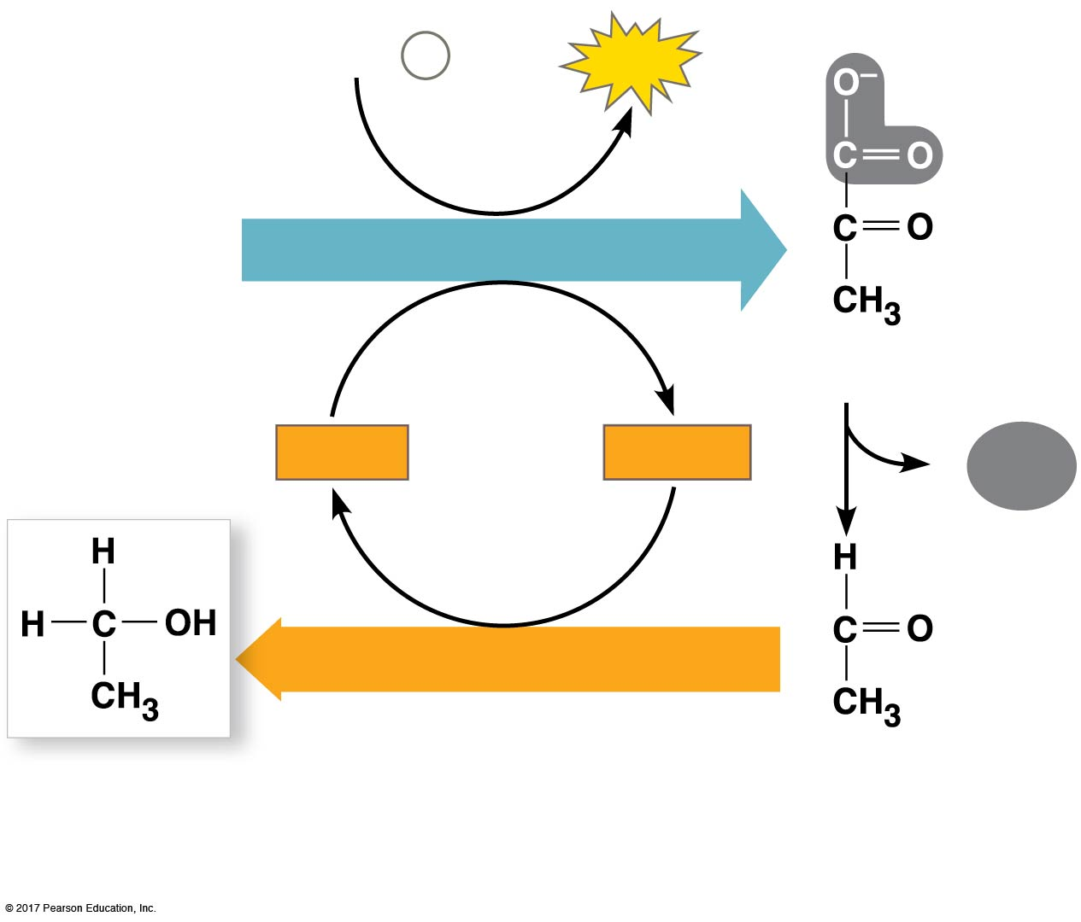
Fermentation
Alcohol fermentation:
  Breaks down: Pyruvic Acid and NADH
  Produces: Alcohol, CO₂, and NAD⁺
2 ADP
+
2
P _{i}
2
ATP
Glucose
GLYCOLYSIS
2 Pyruvate
2
NAD⁺
2
NADH
2
CO₂
+ 2 H⁺
NAD⁺
REGENERATION
2 Ethanol
2 Acetaldehyde
(a) Alcohol fermentation

Slide 6
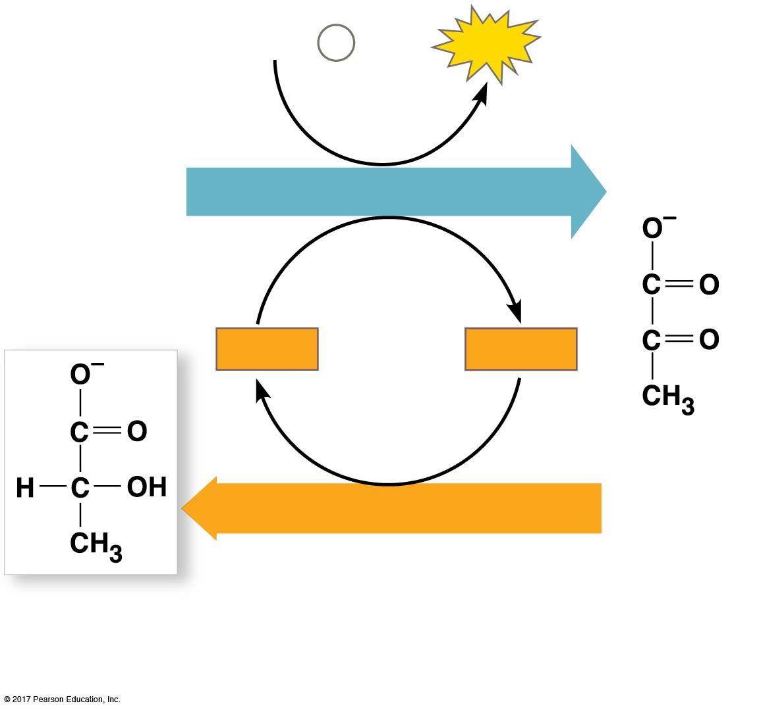
Fermentation
Latic Acid Fermentation:
  Breaks down: Pyruvate
  Produces: Lactate and NAD⁺
2 ADP
+
2
P _{i}
2
ATP
Glucose
GLYCOLYSIS
2
NAD⁺
2
NADH
+ 2 H⁺
2 Pyruvate
NAD⁺
REGENERATION
2 Lactate
(b) Lactic acid fermentation

Slide 7
Anerobic Respiration and Fermentation
Obligate anaerobes:
  An organism that carries out only fermentation or anerobic respiration.
    Cannot survive in the presence of oxygen
  Facultative anaerobes:
    An organism that makes ATP by aerobic respiration if oxygen is present but switches to anaerobic respiration and fermentation of oxygen is not present.
Glucose
CYTOSOL
Glycolysis
Pyruvate
O₂ present:
Aerobic cellular
respiration
No O₂ present:
Fermentation
MITOCHONDRION
Ethanol,
lactate, or
other products
Acetyl CoA
Citric
acid
cycle

Slide 8
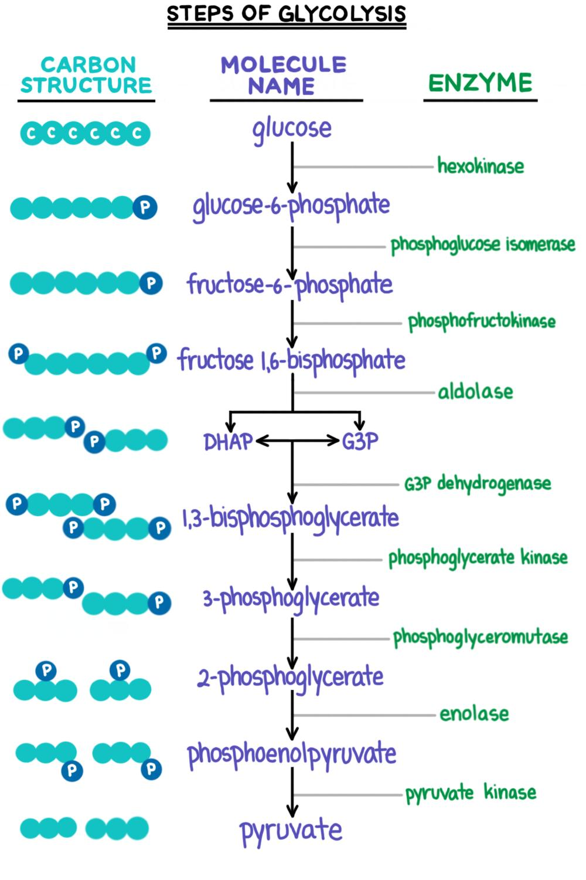
Evolutionary Significance of Glycolysis
Utilized by all three pathways for producing ATP
Occurs in the cytosol
Evolutionarily Ancient Process
Low ATP Yield
Rapid Process
Does not require oxygen

