Slide 1
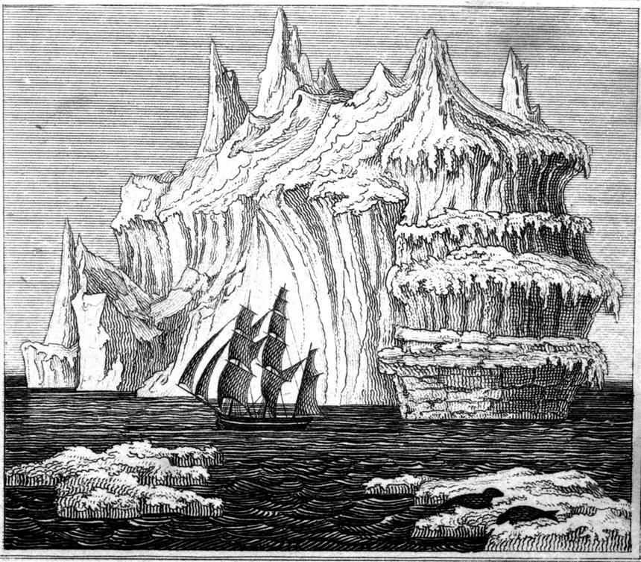
Frankenstein
Wrapping up the Novel

Slide 2
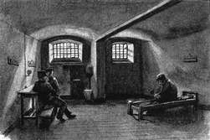
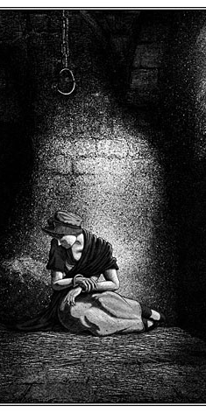
Final Plot Points
What does Victor do after the creature visits him?
Unpack “choice” in Victor’s decision. (Victor’s, The creature’s, The potential choices of the creature’s potential “mate”)
Whose murder is Victor accused of?
And how does Victor react to this most recent trauma?
How does Victor’s experience with the justice system differ from Justine’s?

Slide 3
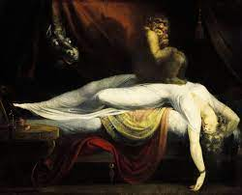
Plot Points (cont.)
Who is the monster’s final victim?
Should Victor have seen this coming?(Does the reader? How? What does Shelley do to warn the reader?) Does this play into choice again?
Victor goes home and tells his father. His father dies of grief. And Victor vows to follow or hunt the creature. Exeunt one of the frame narratives…
Why end Victor’s life on a ship trapped in ice?

Slide 4
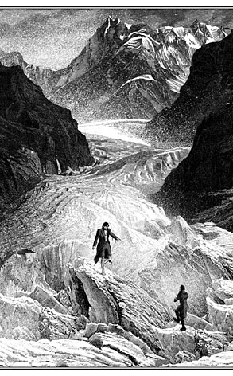
Plot Points (Cont.)
Unpack the final interaction between Walton and the creature.
What characters in the novel showed compassion?
What characters does the reader tend to sympathize with?
Why might Shelley’s choices in her portrayal of compassion matter?
What sacrifices does Victor make? In the end, is Victor a hero?
Final thoughts on who the main protagonist is?

Slide 5
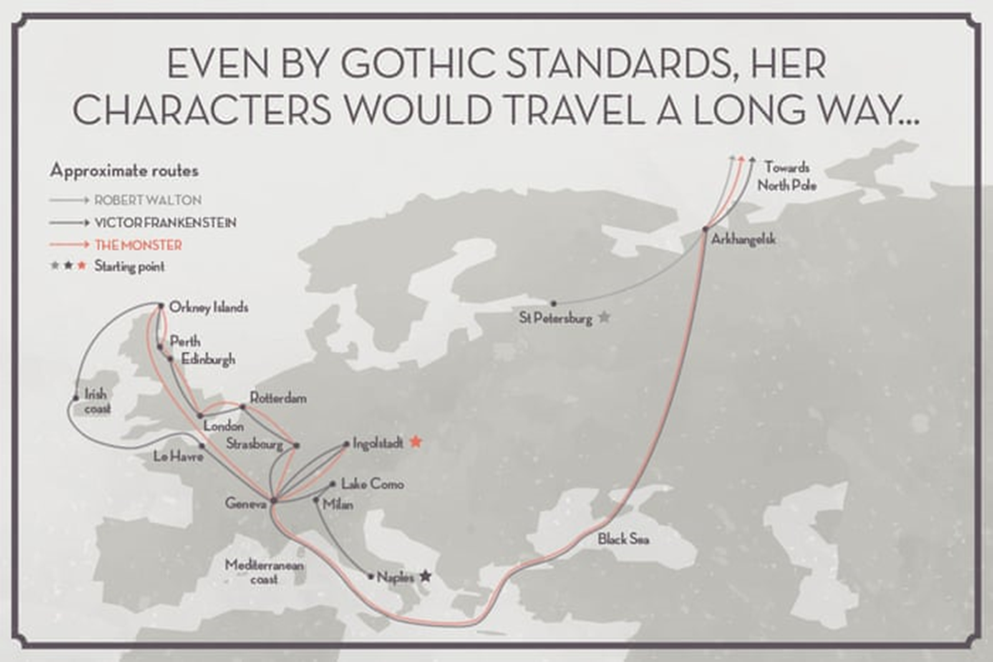
Travel Literature:
Mapping Time and Space
Map Project

Slide 6
Freewriting: Porous Boundaries
Consider the external and internal explorations Shelley presents in the novel, the way the pushing of boundaries (scientific, familial, geographical) resonates with human nature. The creature is made of animal and human parts. Victor aspires to be godlike but is unfailingly imperfect and human in his flaws. Both characters, in their hybridity, challenge the boundaries of
Animal-Human-Divine
New developments in science and technology can blur the lines between human and machine, natural and artificial, and can even shift humankind’s place in the universe.
How does Shelley navigate these boundaries?
How should we navigate these changing, increasingly porous boundaries?

Slide 7
References
The Guardian 200 Years (Map Image):
https://www.theguardian.com/books/gallery/2018/jan/13/mary-shelleys-frankenstein-in-charts
Map Project:
https://uploads.knightlab.com/storymapjs/b2925168b9a3deca018d1b1dfc90467b/frankenstein-map/draft.html

