Slide 1
The relationship between genes & chromosomes
Independent assortment & linkage

Slide 2
Transmission patterns associated with multiple genes can vary
independent assortment
  transmission of multiple genes is independent because the genes are not physically connected
  frequency of specific outcomes can be predicted based on Mendelian genetics
genetic linkage
  tendency for multiple genes to be transmitted together
  frequency of specific outcomes is determined by the physical distance between the genes

Slide 3
Independent assortment

Slide 4
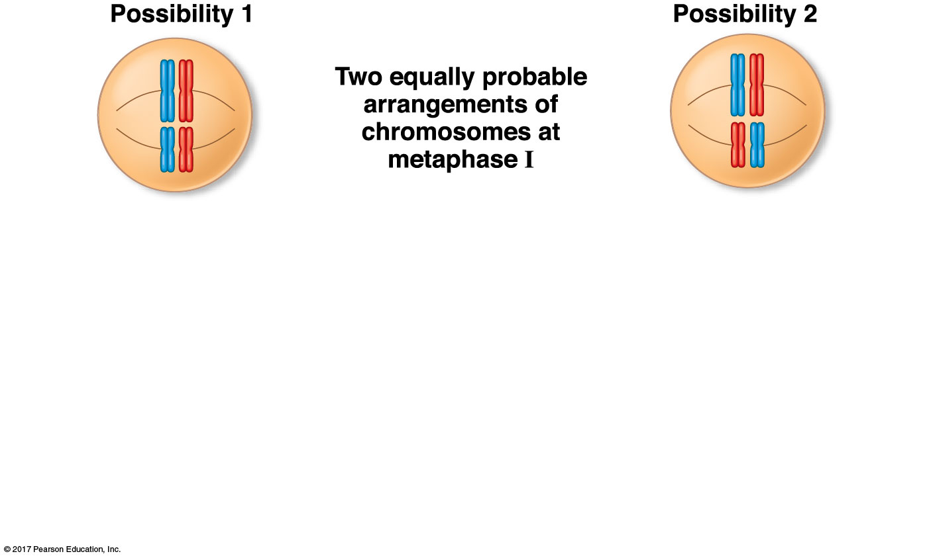
Genes that are located on different chromosomes assort independently
Campbell, Figure 13-11
Notes:
4

Slide 5
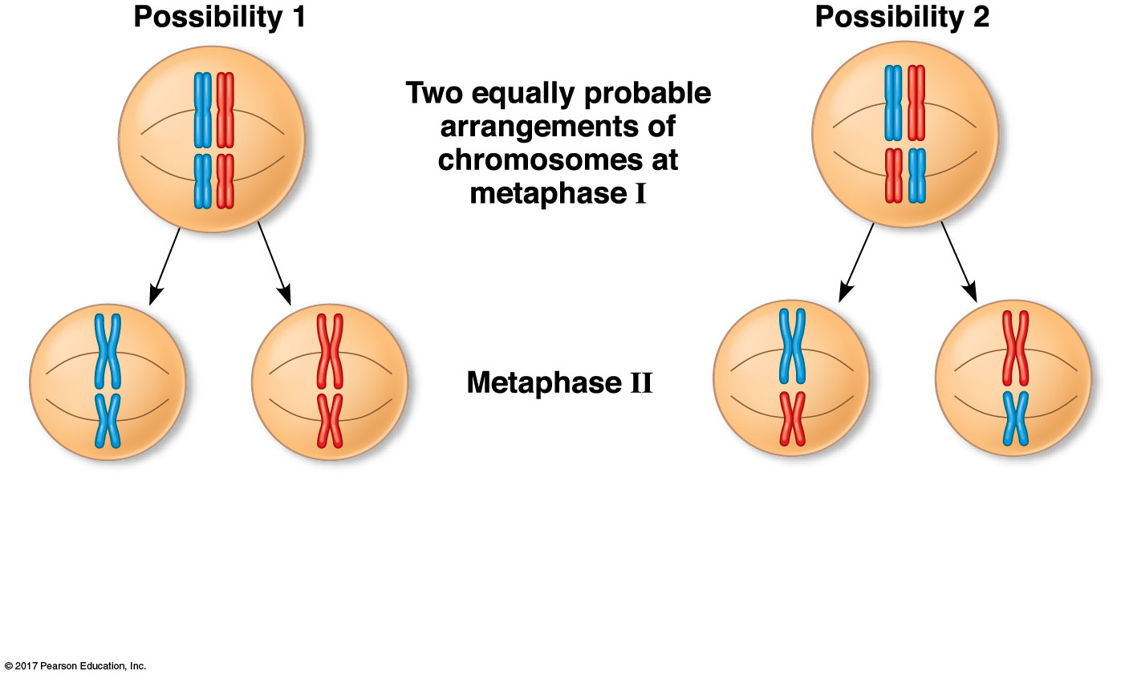
Genes that are located on different chromosomes assort independently
Campbell, Figure 13-11

Slide 6
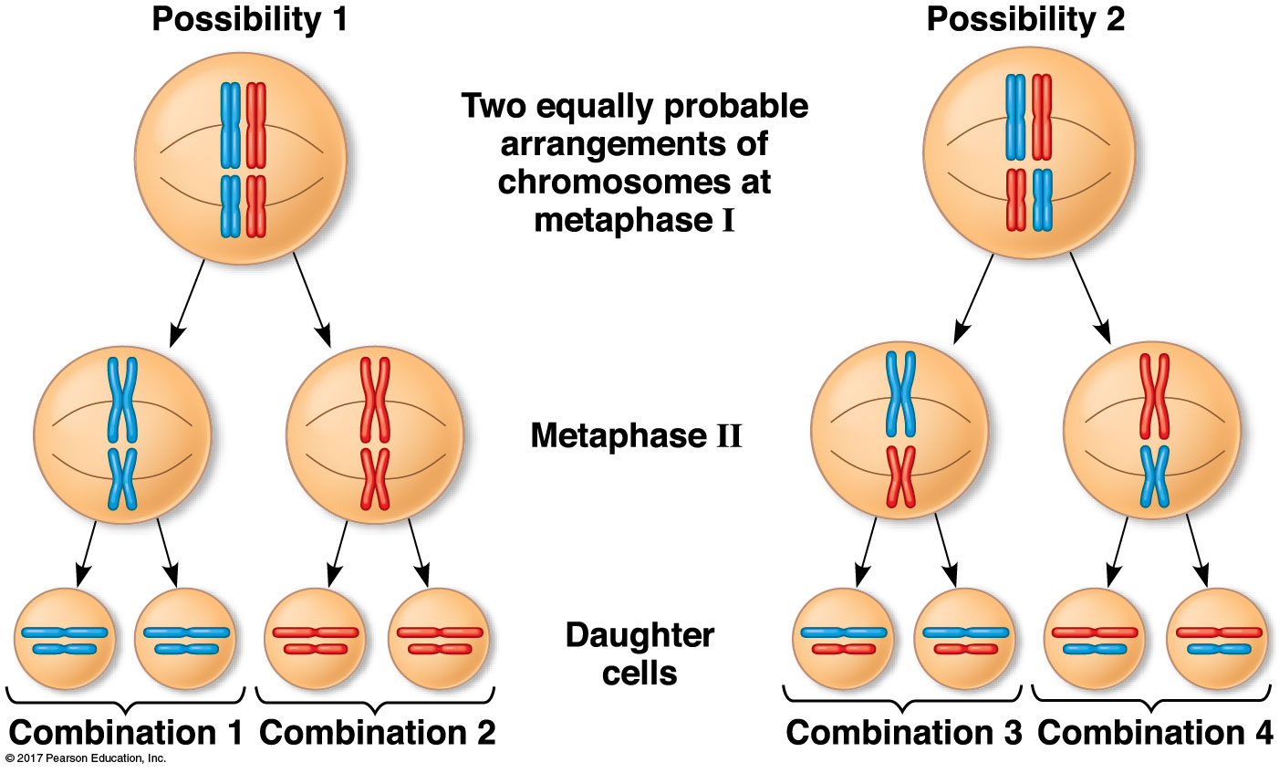
Genes that are located on different chromosomes assort independently
Campbell, Figure 13-11

Slide 7
Analyzing the segregation of body color & wing alleles into Drosophila gametes
true-breeding parents:
F₁ hybrid offspring:
x
e⁺e⁺; ap⁺ap⁺ x
e e; ap ap
e⁺ e; ap⁺ ap

Slide 8
Using the forked-line method to determine genotype frequencies with multiple genes
a dihybrid cross: e⁺ e; ap⁺ ap x e⁺ e; ap⁺ ap

Slide 9
Using the forked-line method to determine phenotype frequencies with multiple genes
a dihybrid cross: e⁺ e; ap⁺ ap x e⁺ e; ap⁺ ap

Slide 10
Using the forked-line method to determine phenotype frequencies with multiple genes
notice… this is a somewhat different cross: e⁺ e; ap⁺ ap x e e; ap ap

Slide 11
Using probability to predict outcomes for unlinked genes
If two plants with the genotype Pp Yy Rr are crossed to each other, what is the frequency of offspring with the genotype PP Yy rr?
Notes:
11

Slide 12
Using probability to predict outcomes for unlinked genes
If two plants with the genotype Pp Yy Rr are crossed to each other, what is the frequency of offspring with the genotype PP Yy rr?
If two plants with the genotype Pp Yy Rr are crossed to each other, what is the frequency of offspring with purple flowers and yellow, wrinkled seeds?
Notes:
12

Slide 13
Genetic linkage

Slide 14
A different example of the transmission of two traits in Drosophila
b⁺ = yellow body (dominant); b = black body (recessive)
vg⁺ = normal wings (dominant); vg = shriveled wings (recessive)
if these genes are independently assorting…
b⁺ b; vg⁺ vg x b b; vg vg ➔

Slide 15
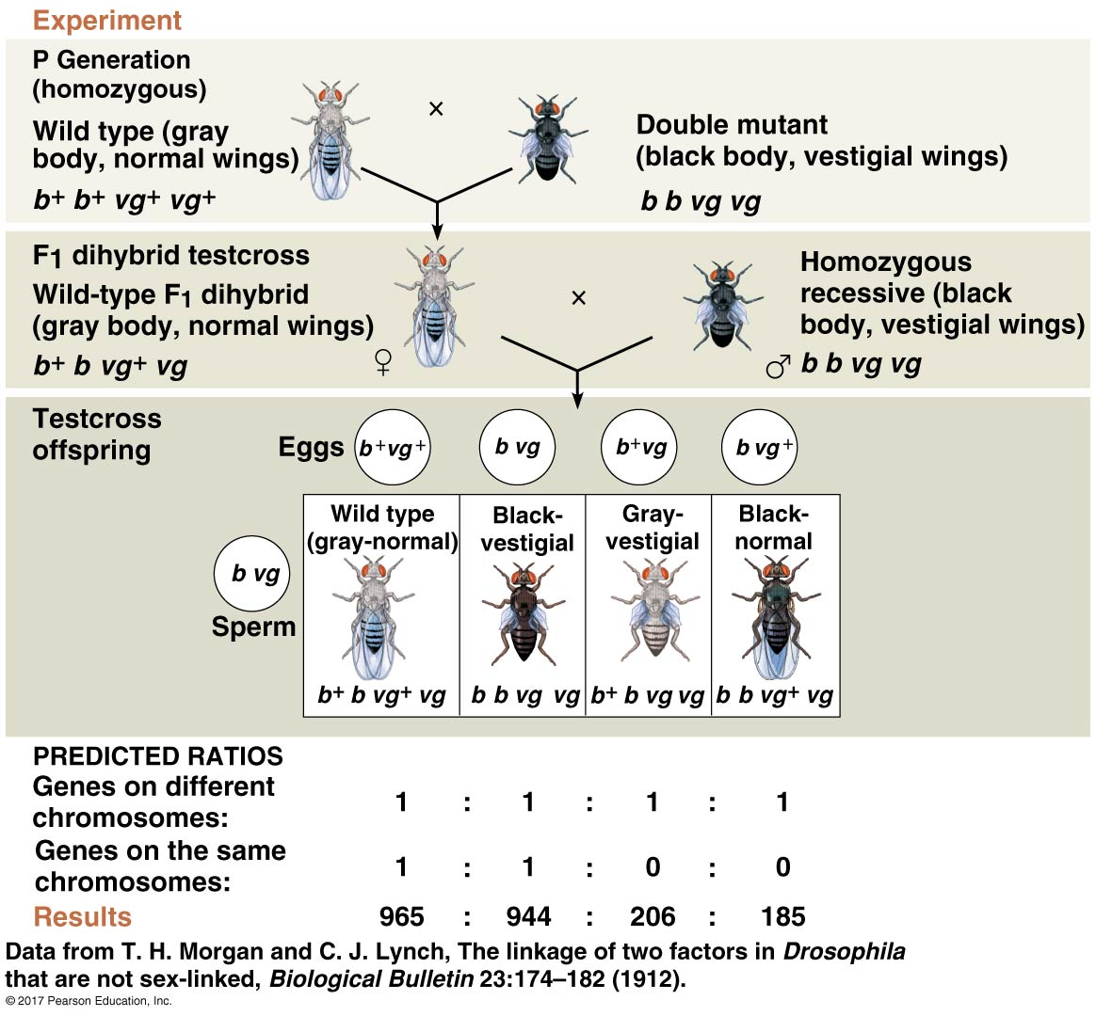
The observed distribution of flies resulting from the black, vestigial testcross was different from the prediction for independently assorting traits
# out of 2300:
575
575
575
575
Campbell, Figure 15-9

Slide 16
The observed distribution of flies resulting from the black, vestigial testcross was different from the prediction for independently assorting traits
# out of 2300:
575
575
575
575
actual results:
Campbell, Figure 15-9

Slide 17
Linked genes fail to assort independently
Campbell, Figure 13-11
Notes:
17

Slide 18
Independent assortment vs.
gene linkage during meiosis
if genes are located on separate chromosomes, they will assort independently during meiosis
if genes are located on the same chromosome, they will segregate together during meiosis…
Notes:
18

Slide 19
Independent assortment vs.
gene linkage during meiosis
if genes are located on separate chromosomes, they will assort independently during meiosis
if genes are located on the same chromosome, they will segregate together during meiosis…
SOMETIMES…
Notes:
19

Slide 20
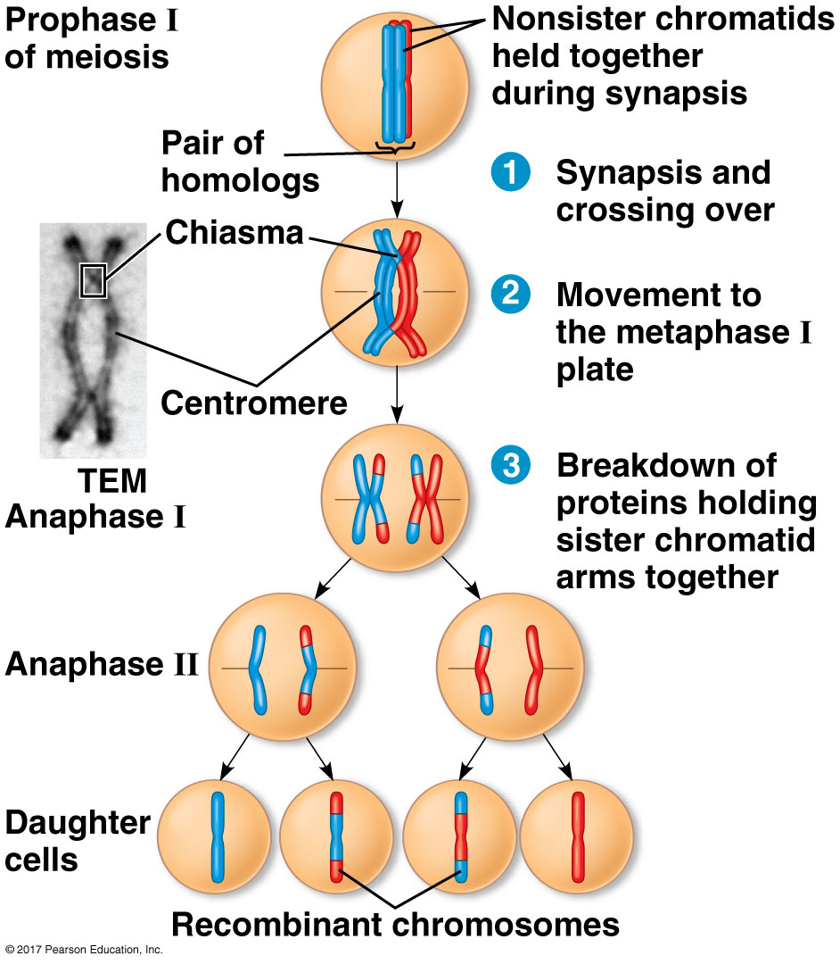
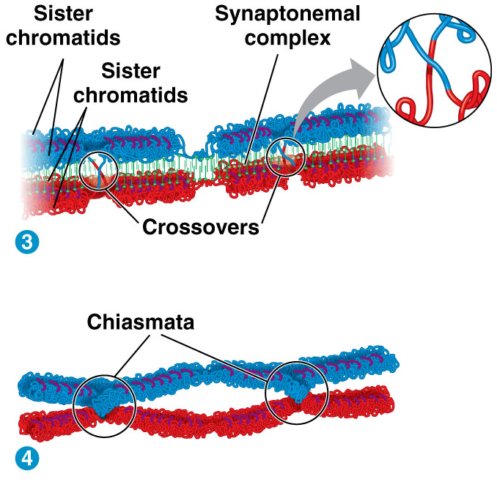
Recombination generates genetic diversity during prophase of meiosis I
Campbell, Figure 13-12
Campbell, Figure 13-9
Notes:
20

Slide 21
Crossing over only occurs in between two specific genes some of the time

Slide 22
Assessing linkage using testcrosses and recombination frequencies
if genes are unlinked, non-recombinant (NR) and recombinant (R) types of offspring will be produced at similar frequencies
  # NR ≈ # R ≈ 50%
if genes are linked, non-recombinant (NR) types of offspring will appear more frequently than recombinant (R) types of offspring
  # NR > # R

Slide 23
The observed distribution of flies resulting from the black, vestigial testcross was different from the prediction for independently assorting traits
# out of 2300:
575
575
575
575
actual results:
Campbell, Figure 15-9

Slide 24
Using statistical analyses to determine if data fit a model
offspring from testcross | wild type | vestigial | black | vestigial, black
expected ratio if the genes are unlinked | 1 | 1 | 1 | 1
expected number of offspring (out of 2300) | 575 | 575 | 575 | 575
observed number of offspring (out of 2300) | 965 | 206 | 185 | 944

Slide 25
Using statistical analyses to determine if data fit a model
offspring | expected # (e) | observed # (o) | deviation (o – e) | (o – e)² | (o – e)² e
wild type | 575 | 965
vestigial | 575 | 206
black | 575 | 185
vestigial, black | 575 | 944
𝑥² = sum:

Slide 26
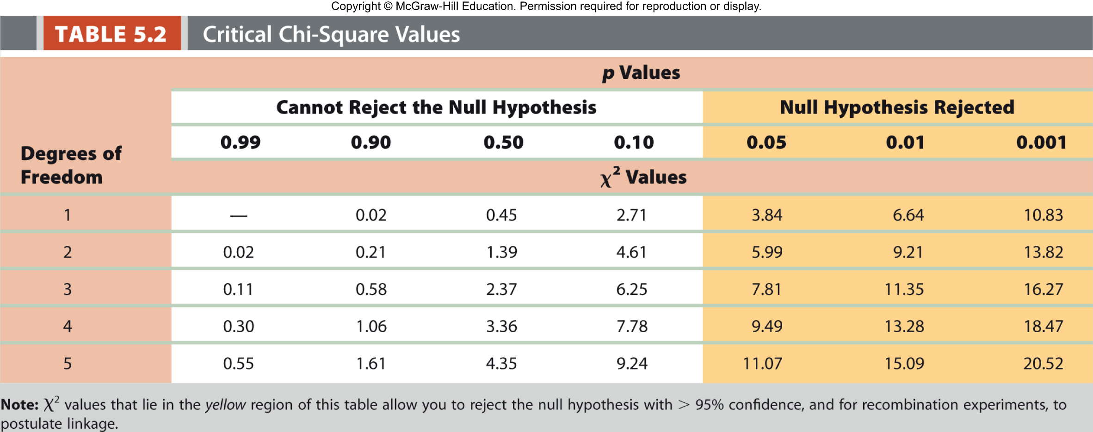
Using statistical analyses to determine if data fit a model
offspring | expected # (e) | observed # (o) | deviation (o – e) | (o – e)² | (o – e)² e
wild type | 575 | 965 | 390 | 152,100 | 265
vestigial | 575 | 206 | 369 | 136,161 | 237
black | 575 | 185 | 390 | 152,100 | 265
vestigial, black | 575 | 944 | 369 | 136,161 | 237
𝑥² = sum: |  |  |  |  | 1004
Hartwell, Genetics: from Genes to Genomes

Slide 27
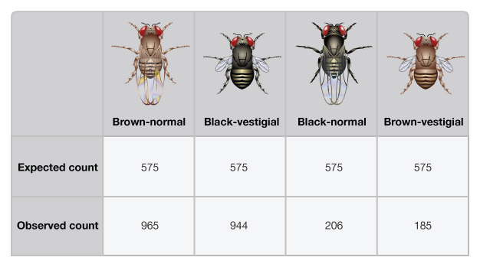
Recombination frequencies reflect both genetic and physical distance between genes
wild-type
black, vestigial
black
vestigial

Slide 28
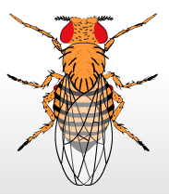
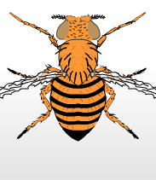

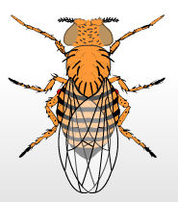
Different gene pairs recombine with different frequencies
wild-type
brown eyes,
vestigial wings
vestigial wings
brown eyes
632
618
367
383

Slide 29
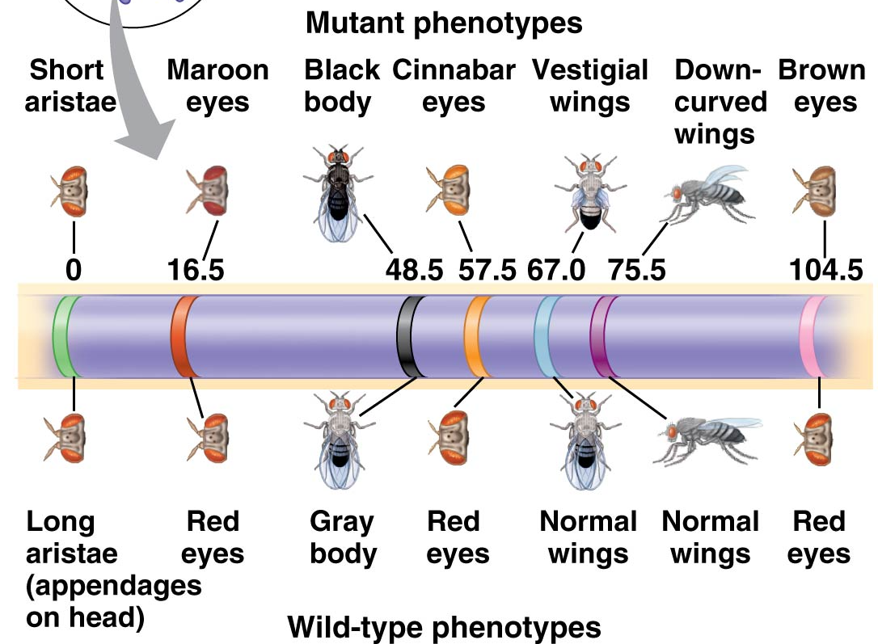
Genetic distances reflect physical distances between genes
Drosophila chromosome 2
Campbell, Figure 15.12
Notes:
29

