Slide 1
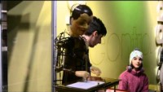
Goss & Riquelme
Superhuman to Posthuman in Shelley’s Frankenstein & Butler’s Xenogenesis
Henri Maillardet’s Automaton c. 1800

Slide 2
Annotation Exercise
Locate what you think is the thesis of the essay.
Note 3 of the main ideas you think are really important. Consider why you think they matter.
Locate a word you don’t know the definition of and look it up.
Jot down 3 questions you have regarding the article.
The questions can be:
Clarification
Analytical
Challenging the ideas in the article

Slide 3

Freewriting Prompt
What idea of Goss & Riquelme from this article most impacted your interpretation of Frankenstein?
How? In other words, what is one interpretation you have and did this article enhance or shift it? How are your ideas in conversation with the ideas in the article?
Use evidence—note a passage in the article and a passage in the novel.

Slide 4
Hierarchical Power Structures
Goss argues that “in its hierarchical tendencies, the technological ambition central to Frankenstein is related to the social hierarchies that characterize earlier gothic writing. […] Frankenstein, an intellectual aristocrat expects to exercise power over his creature and other people” (435).
What different social hierarchies do we encounter?
Familial
Gendered
Class
Captain and crew
Juridical
Creator/Creation
Human and non-human

Slide 5
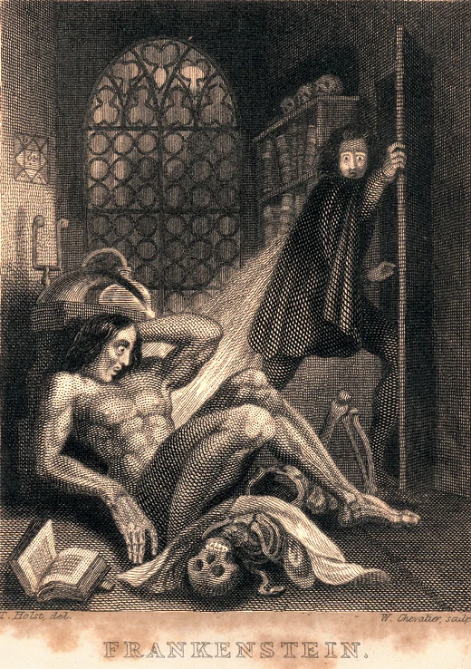
Levels of Awakening
Goss contends that, “because awake is both transitive and intransitive, when we encounter the word “awakening,” we are not sure whether the character is waking up on her own or whether someone is causing her to wake up” (437). Goss further notes that in Butler’s series the being experiencing “awakening” is human and the scientist is alien, or Other and argues that because of this that there is a reversal that does not occur in Frankenstein.
What levels of awakening are there in Frankenstein?
Many of you argued that the creature is also human, but others would disagree as he was not born or even cloned. Given that we are arguing “Adam” is human, with his humanity in his conscious awakening (Emotion, Self Reflection, Rational Choices), is Victor de-humanized, or less awake?

Slide 6
Human/Non-Human
Does Shelley address the danger of de-humanizing?

Slide 7
Binary Oppositional Structures
Goss notes that binary structures exists in both Frankenstein and Xenogenesis, but argues that “Butler’s narrative goes further […] in its transvaluation of values through the undoing of binary oppositional structures”(438).
What binary structures do we encounter in Frankenstein?
How are they reinforced in the novel?
How are they challenged or even undone?
How would you state your disagreement with Goss in a thesis?

