Slide 1


Resume & Cover Letter: Highlighting Skills & Experiences
Pensby Center for Community Development & Inclusion
Career & Civic Engagement Center

Slide 2
Agenda
Resume Highlights:
Effective Descriptions
"Unrelated" positions
College Life & Leadership
Cover Letter Highlights:
Purpose
Identify skills
Writing tips

Slide 3
Descriptions
Action verbs first
(google ‘Resume Action Verb’)
http://www.quintcareers.com/action_skills.html
Duties, accomplishments
Quantify when you can
Industry language
Context (what does the organization do)

Slide 4
Effective Descriptions
2 examples for describing the same experience:
Showed freshmen and their parents around campus and answered questions (less effective)
OR
Developed relationships with first-year students and parents while advising them on academic and personal questions and concerns (more effective)
Notes:
Share Resume Makeover Handout. (Moodle)

Slide 5
‘Unrelated’ Positions
Wait staff, Clam Shack, Martha’s Vineyard, MA, Summer 2013
Developed strong customer service skills in high volume tourist restaurant. Worked long hours in pressured environment.
Make them related… think skills/attributes/enthusiasm
These skills are transferable to any field you choose to go into.
Notes:
People often downplay these experiences
BUT, employers as well as your future clients really value these!
Consider what you learned, developed, gained in terms of knowledge, skill, experience, confidence

Slide 6
College Life & Leadership
Translate & make it transferable
(what is traditions??)
Skills you’ve gained
Think Transferrable
It is in the description and connect the dots
Common Mistakes
Downplaying
Including every detail (balance)
Co-Head, Bryn Mawr College Traditions, 2021
Organized and publicized the college’s four annual campus-wide events that builds community and camaraderie. Oversaw the planning and publicizing of events, managed over 20 volunteers and administered a $75,000 budget.

Slide 7
Activities/Interests/Volunteer
Participant, Leadership Empowerment Advancement Program, BMC, PA 2019 Selected for 45 hours of intensive experiential instruction in group development, interpersonal communication, group facilitation, and team building.
Summer Science Research, Bryn Mawr College, Bryn Mawr, PA 2022
Assisted faculty member in Biology department to examine specimens. Develop skills in critical analysis. Trained in PCR and Spectrometry.
President, Mawrters for Immigrant Justice, BMC, PA 2021 Selected for 45 hours of intensive experiential instruction in group development, interpersonal communication, group facilitation, and team building.

Slide 8
Cover Letter purpose
Matching: your skills to their needs
Answers ‘why' - how do your interests connect with what they're about (mission/purpose)?
Demonstrates your
abilities
credibility
understanding of employers needs
writing ability
What it is/what it is not

Slide 9
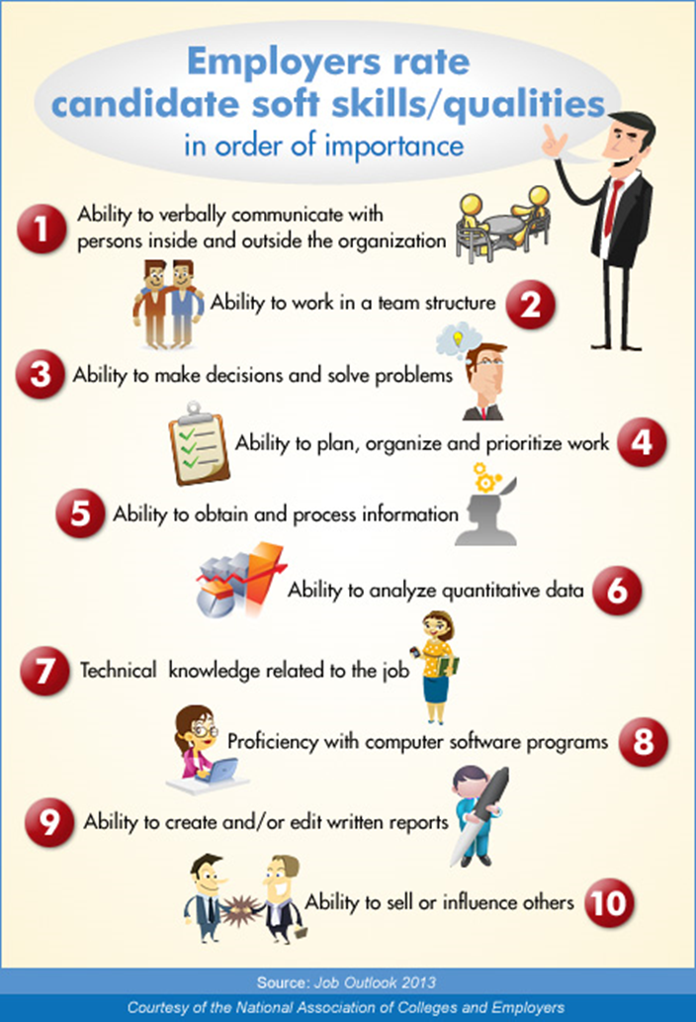
Identify skills
Liberal arts skills
Extracurricular
Time/self management
Integrity
Creativity
(NACE)

Slide 10
Writing tips
Write it – a fresh start each time
Focus on what you have to offer them
Read it out loud
Double check spelling grammar and format

Slide 11
Career & Civic Engagement Center Resume & CL Services
Handouts/website samples
www.brynmawr.edu/cpd
15 min Drop-ins Daily: Monday-Friday
30 minute appointments
Find us on Handshake!
https://brynmawr.joinhandshake.com

