Slide 1
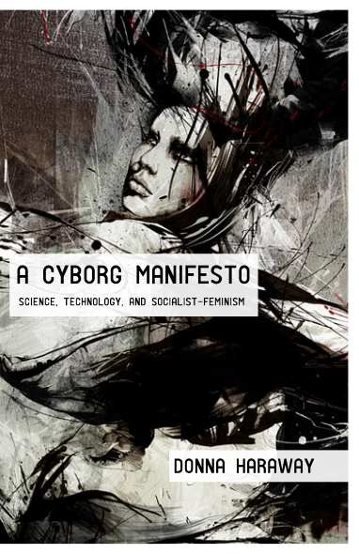
Donna Haraway
A Cyborg Manifesto

Slide 2
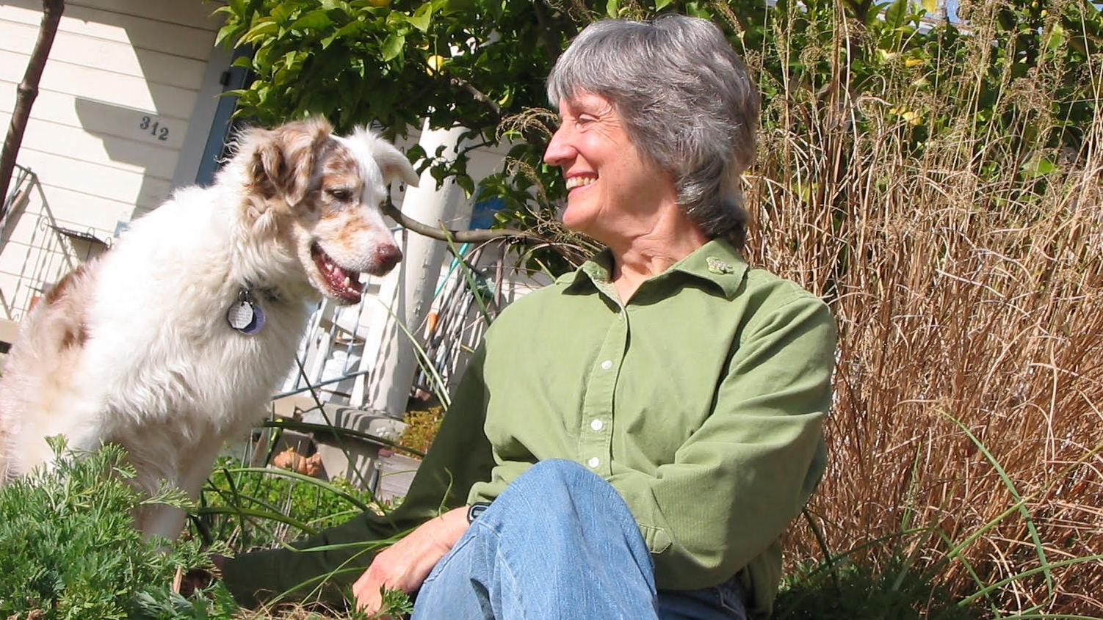
Donna Haraway
a biologist and philosopher

Slide 3
“A Cyborg Manifesto”
Published 1985
A seminal essay of the 20th century regarding the relationship between power, gender, and technology
Social Context
  1984 Strategic Defense Initiative Organization (SDIO) “Star Wars” program
  Internet use starts mid 80s (it won’t fully enter homes until the mid 90s)
Genealogy of Influence: 1960’s “Radical Feminism,” Marxist Anti-Capitalism, Psychoanalytical Criticism, Poststructuralism
  Focus on patriarchal gender relations, Labor force, and power relationships
  Influences later movements:
    Cultural Feminism
    Socialist Feminism

Slide 4
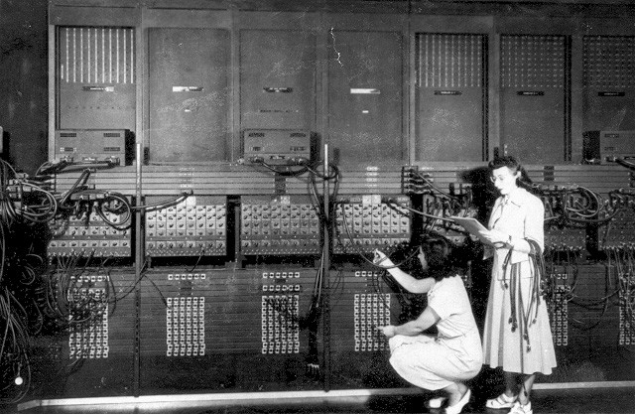
An Ironic Dream of a Common Language for Women in the Integrated Circuit

Slide 5
Finding Irony
Aristotelian logic tells us that because the world contains categories (individual, separate things) binaries exist:
Animal/Human
Human/Divine
Nature/Culture
Living/Non-Living
Organism/Machine
Male/Female

Slide 6
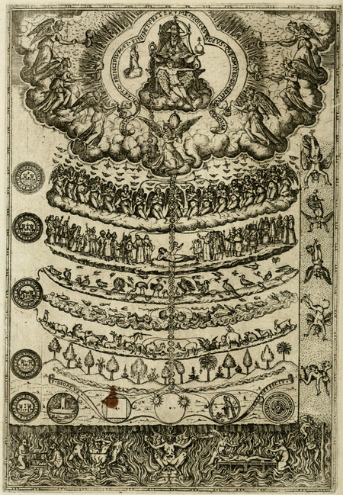
The Great Chain of Being
This categorized logic led to the medieval, Christian hierarchical perception of all things having a place that western thinking is so deeply rooted in:
God
Angels
Human
Animals
Plants
Minerals

Slide 7
The “Age of Reason”
Enlightenment thinkers (17th-18th Century) continued this hierarchical structure with an ever-narrowing definition of what is “rational”
A definition and power structure that is both racist and sexist in its perception of the Other.
Women were seen as biologically less rational, less capable of reason, than men and thus inferior.
Non-European colonized cultures were seen as less “civilized” (i.e. lacking scientific and philosophical reason) and thus inferior.

Slide 8
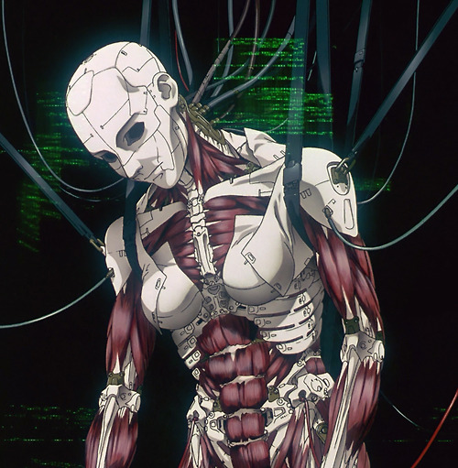
Domination and Power
Haraway thus uses the cyborg as a vehicle to destabilize and challenge this longstanding, European, patriarchal social hierarchy.
Because the cyborg is a hybrid.
The cyborg holds two (plus) categories at the same time.
How does this disrupt conceptions of human identity as static and stable?

Slide 9

Cyborg
“A Cyborg is a cybernetic organism, a hybrid of machine and organism, a creature of social reality as well as a creature of fiction.” (149)
An Integrated Circuit is, “ a set of electronic circuits on one small flat piece (or "chip") of semiconductor material, usually silicon. Large numbers of tiny MOSFETs (metal–oxide–semiconductor field-effect transistors) integrate into a small chip” (Wikipedia).
In other words, hundred, thousands, millions… of electronic circuits integrated together on a tiny chip.

Slide 10
2nd Wave Feminism
Feminists, (like Adrienne Rich) advocated for a “goddess” model of feminism & wanted to find a common language that women could speak
A language allowing women to speak in one voice, to understand one another perfectly.
Haraway, also a feminist, is criticizing this, why might that be?

Slide 11
An Ironic Dream of a Common Language for Women in the Integrated Circuit
For Haraway, “Irony is about contradictions that do not resolve into larger wholes, even dialectically, about the tension od holding incompatible things together because both or all are necessary and true” (149).
So, what do you think the title tells us about what Haraway is trying to do?

Slide 12
Purpose
“This chapter is an effort to build an ironic political myth faithful to feminism, socialism, and materialism. Perhaps more faithful as blasphemy is faithful, than as reverent worship and identification.”
(149)
Unpack the use of contradictions here.
Why might Haraway create a “blasphemous” “ironic” myth and call it more faithful than “reverent worship and identification”?

Slide 13

Cybernetics
With singular agreement. The field of study concerned with communication and control systems in living organisms and machines.
First Use:
1948 N. Wiener Cybernetics 19 We have decided to call the entire field of control and communication theory, whether in the machine or in the animal, by the name Cybernetics.
2. In extended use: the field of study concerned with the integration of living organisms and electronic or other technological devices; robotics. Cf. bionics n.
Most Relevant Use:
1993 M. Benjamin Question Identity 18 Using cyborg fiction, she deals with the posthuman...that results when the human body is plugged into machinery or when mechanical appendages or prostheses are welded to the human body. Cybernetics offers numerous metaphors for boundary violation.
(OED)

Slide 14
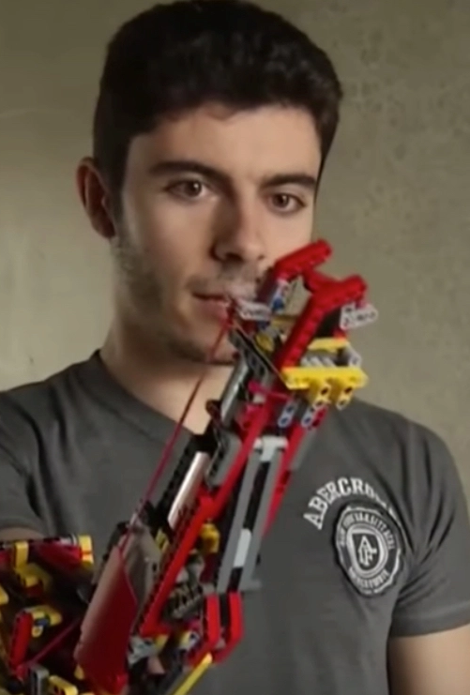
Augmentation
In what ways does science allow us to augment, add onto, our bodies in ways that are beneficial?
What about purely superficial augmentations?
In what ways do you cross the boundary of human/machine in your everyday life?

Slide 15

Replication rather than Reproduction
“Cyborg replication is uncoupled from organic reproduction” (150)
Why is this important to Haraway’s disruption of hierarchy?

Slide 16
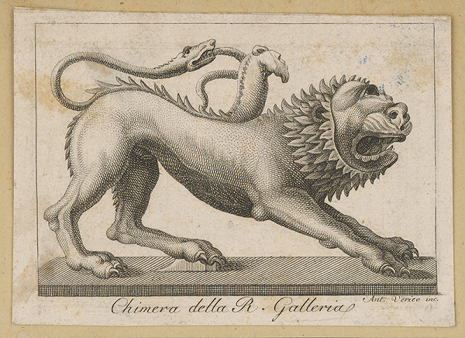
We are Cyborgs.
“By the late twentieth century, our time, a mythic time, we are all chimeras, theorize and fabricated hybrids of machine and organism; in short, we are cyborgs” (150).
Are we?
In what ways?
How does hybridity and commonality contribute to Haraway’s ideal world?

Slide 17
“The cyborg is a creature in a post gender world” (150)
“This Chapter is an argument for pleasure in the confusion of boundaries and for responsibility in their construction. It is also an effort to contribute to socialist-feminist culture and theory in a postmodernist, non-naturalist mode and in the utopian traditions of imagining a world without gender […]” (150)
How does Haraway’s cyborg break away from the traditional roles imposed on women?

Slide 18
Liberation from the Father (and the Mother)
“Unlike the hopes of Frankenstein’s monster, the cyborg does not expect its father to save it through a restoration of the garden; that is through the fabrication of a heterosexual mate, through its completion in a finished whole” (151)
How is Haraway’s cyborg a symbol of human liberation?

Slide 19
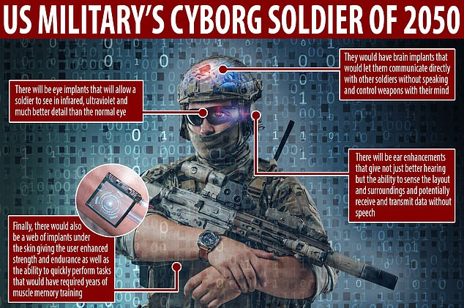
Military Offspring
“The main trouble with cyborgs, of course, is that they are the illegitimate offspring of militarism and patriarchal capitalism, not to mention state socialism. But illegitimate offspring are often exceedingly unfaithful to their origins. Their fathers, after all, are inessential”
How is Haraway’s cyborg both a symbol of white male power and a symbol against it?

Slide 20
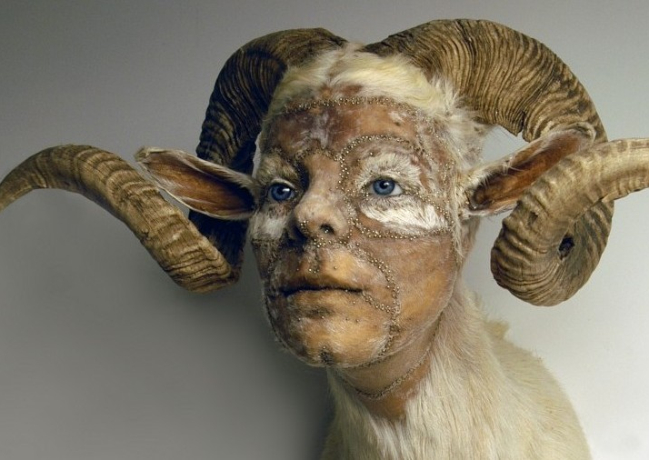
Breached Boundaries: Animal/Human
Haraway asserts that “the boundary between humans and animals is thoroughly breached […] nothing really convincingly settles the separation of human and animal.” (151).
She further contends that, “movements for animal rights[…] are a clear-sighted recognition of connection across the discredited breach of nature and culture”
Unpack your own response the anthropocentric vs. ecocentric worldviews.

Slide 21
Leaky Boundaries: Organism/Machine
“Our machines are disturbingly lively, and we ourselves frighteningly inert” (151)
What do you think she meant writing in the 1980s with technology mostly in the hands of the government?
How does this sentence track differently now that technology has completely infiltrated our daily lives?

Slide 22
Women & Labor
How has women’s labor changed?
What is women’s work?
How do women in labor change social boundaries?
How does society describe women who transgress those boundaries?
Is the conversation about the devaluation of “women’s work” and the power dynamic of the objectification of women still relevant 40 years later?
“The consequence of the wage relationship is systematic alienation, as the worker is dissociated from his product” (158)
How is a cyborg a symbol of oppression or exploitation? How is it a symbol of change?

Slide 23
The Lack
Haraway responds to Catherine Mackinnon’s assertion that women across the world lack an identity because their identity is socially determined through Othering, in opposition to men, a unity based solely in lack, in sexual objectification and a lack of autonomy. (159)
Haraway contends this form of radical feminism more effectively damages women than the patriarchy.
Unpack how you agree, disagree, or both?
Haraway believes identity exists and that we are more than one singular structure, that we are all interconnecting through networks (social and technological). That our affinity is our ability to cross boundaries like the cyborg (And that we are all Cyborgs).
How might science be complicit is the creation of social hierarchy?

Slide 24
A Matter of Size
“Writing, power, and technology are old partners in Western stories of the origin of civilization, but miniaturization has changed our experience of mechanism.
Miniaturization has turned out to be about power; small is not so much beautiful as pre-eminently dangerous, as in cruise missiles. Contrast the TV sets of the 1950s or the news cameras of the 1970s with the TV wrist bands or hand-sized video cameras now advertised.
Our best machines are made of sunshine; they are all light and clean because they are nothing but signals, electromagnetic waves, a section of a spectrum, and these machines are eminently portable, mobile -- a matter of immense human pain in Detroit and Singapore.” (153)
In what ways is “miniaturization” about power’?
Whose power?
What are the ambivalences in the power relationships when thinking about, for instance, cell phone cameras and CCTV surveillance?

Slide 25
Decolonial Discourse
“Ironically, it might be the unnatural cyborg women making chips in Asia and spiral dancing in Santa Rita jail whose constructed unities will guide effective oppositional strategies.” (154)
Haraway's use of “Third World Women” could be read as problematic, however critics such as Chela Sandoval [Professor of Chicana Studies at UC Santa Barbara] find Haraway inspiring.
How do you read Haraway's strategy of networking in 'Third World' women workers?
In what ways might Haraway’s intersection with race be problematic?
In what ways is it useful for conceptualizing progressive radical change?

Slide 26
References
Excerpt from Haraway, Donna. "A Cyborg Manifesto: Science, Technology, and Socialist-Feminism in the Late Twentieth Century," in Simians, Cyborgs and Women: The Reinvention of Nature (New York; Routledge, 1991), pp.149-181.
https://www.york.ac.uk/teaching/cws/wws/cyborgweek789.html

