Slide 1

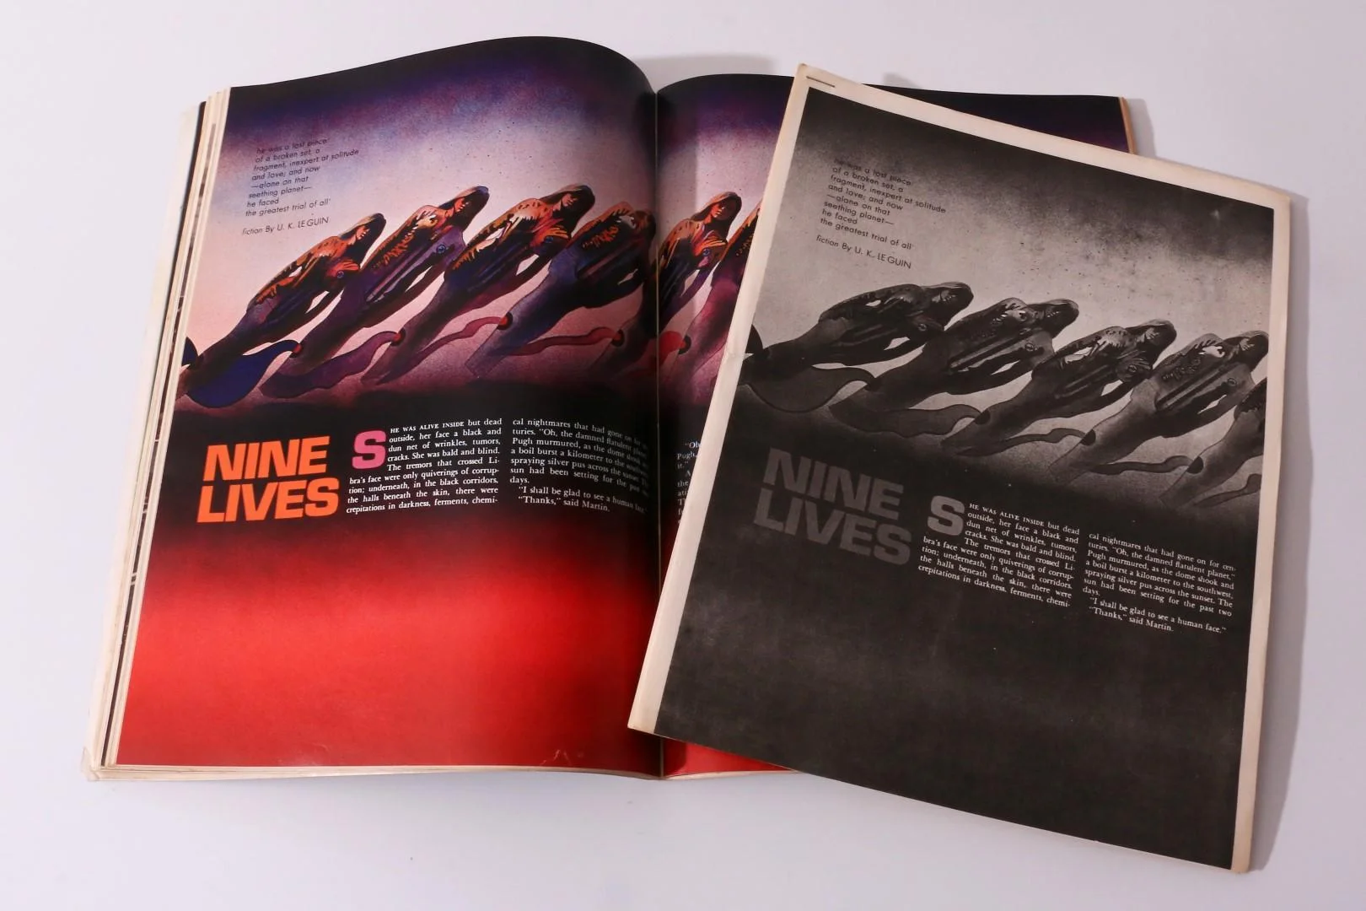
“Nine Lives”
Ursula K. LeGuin
1969

Slide 2
Biography

Slide 3
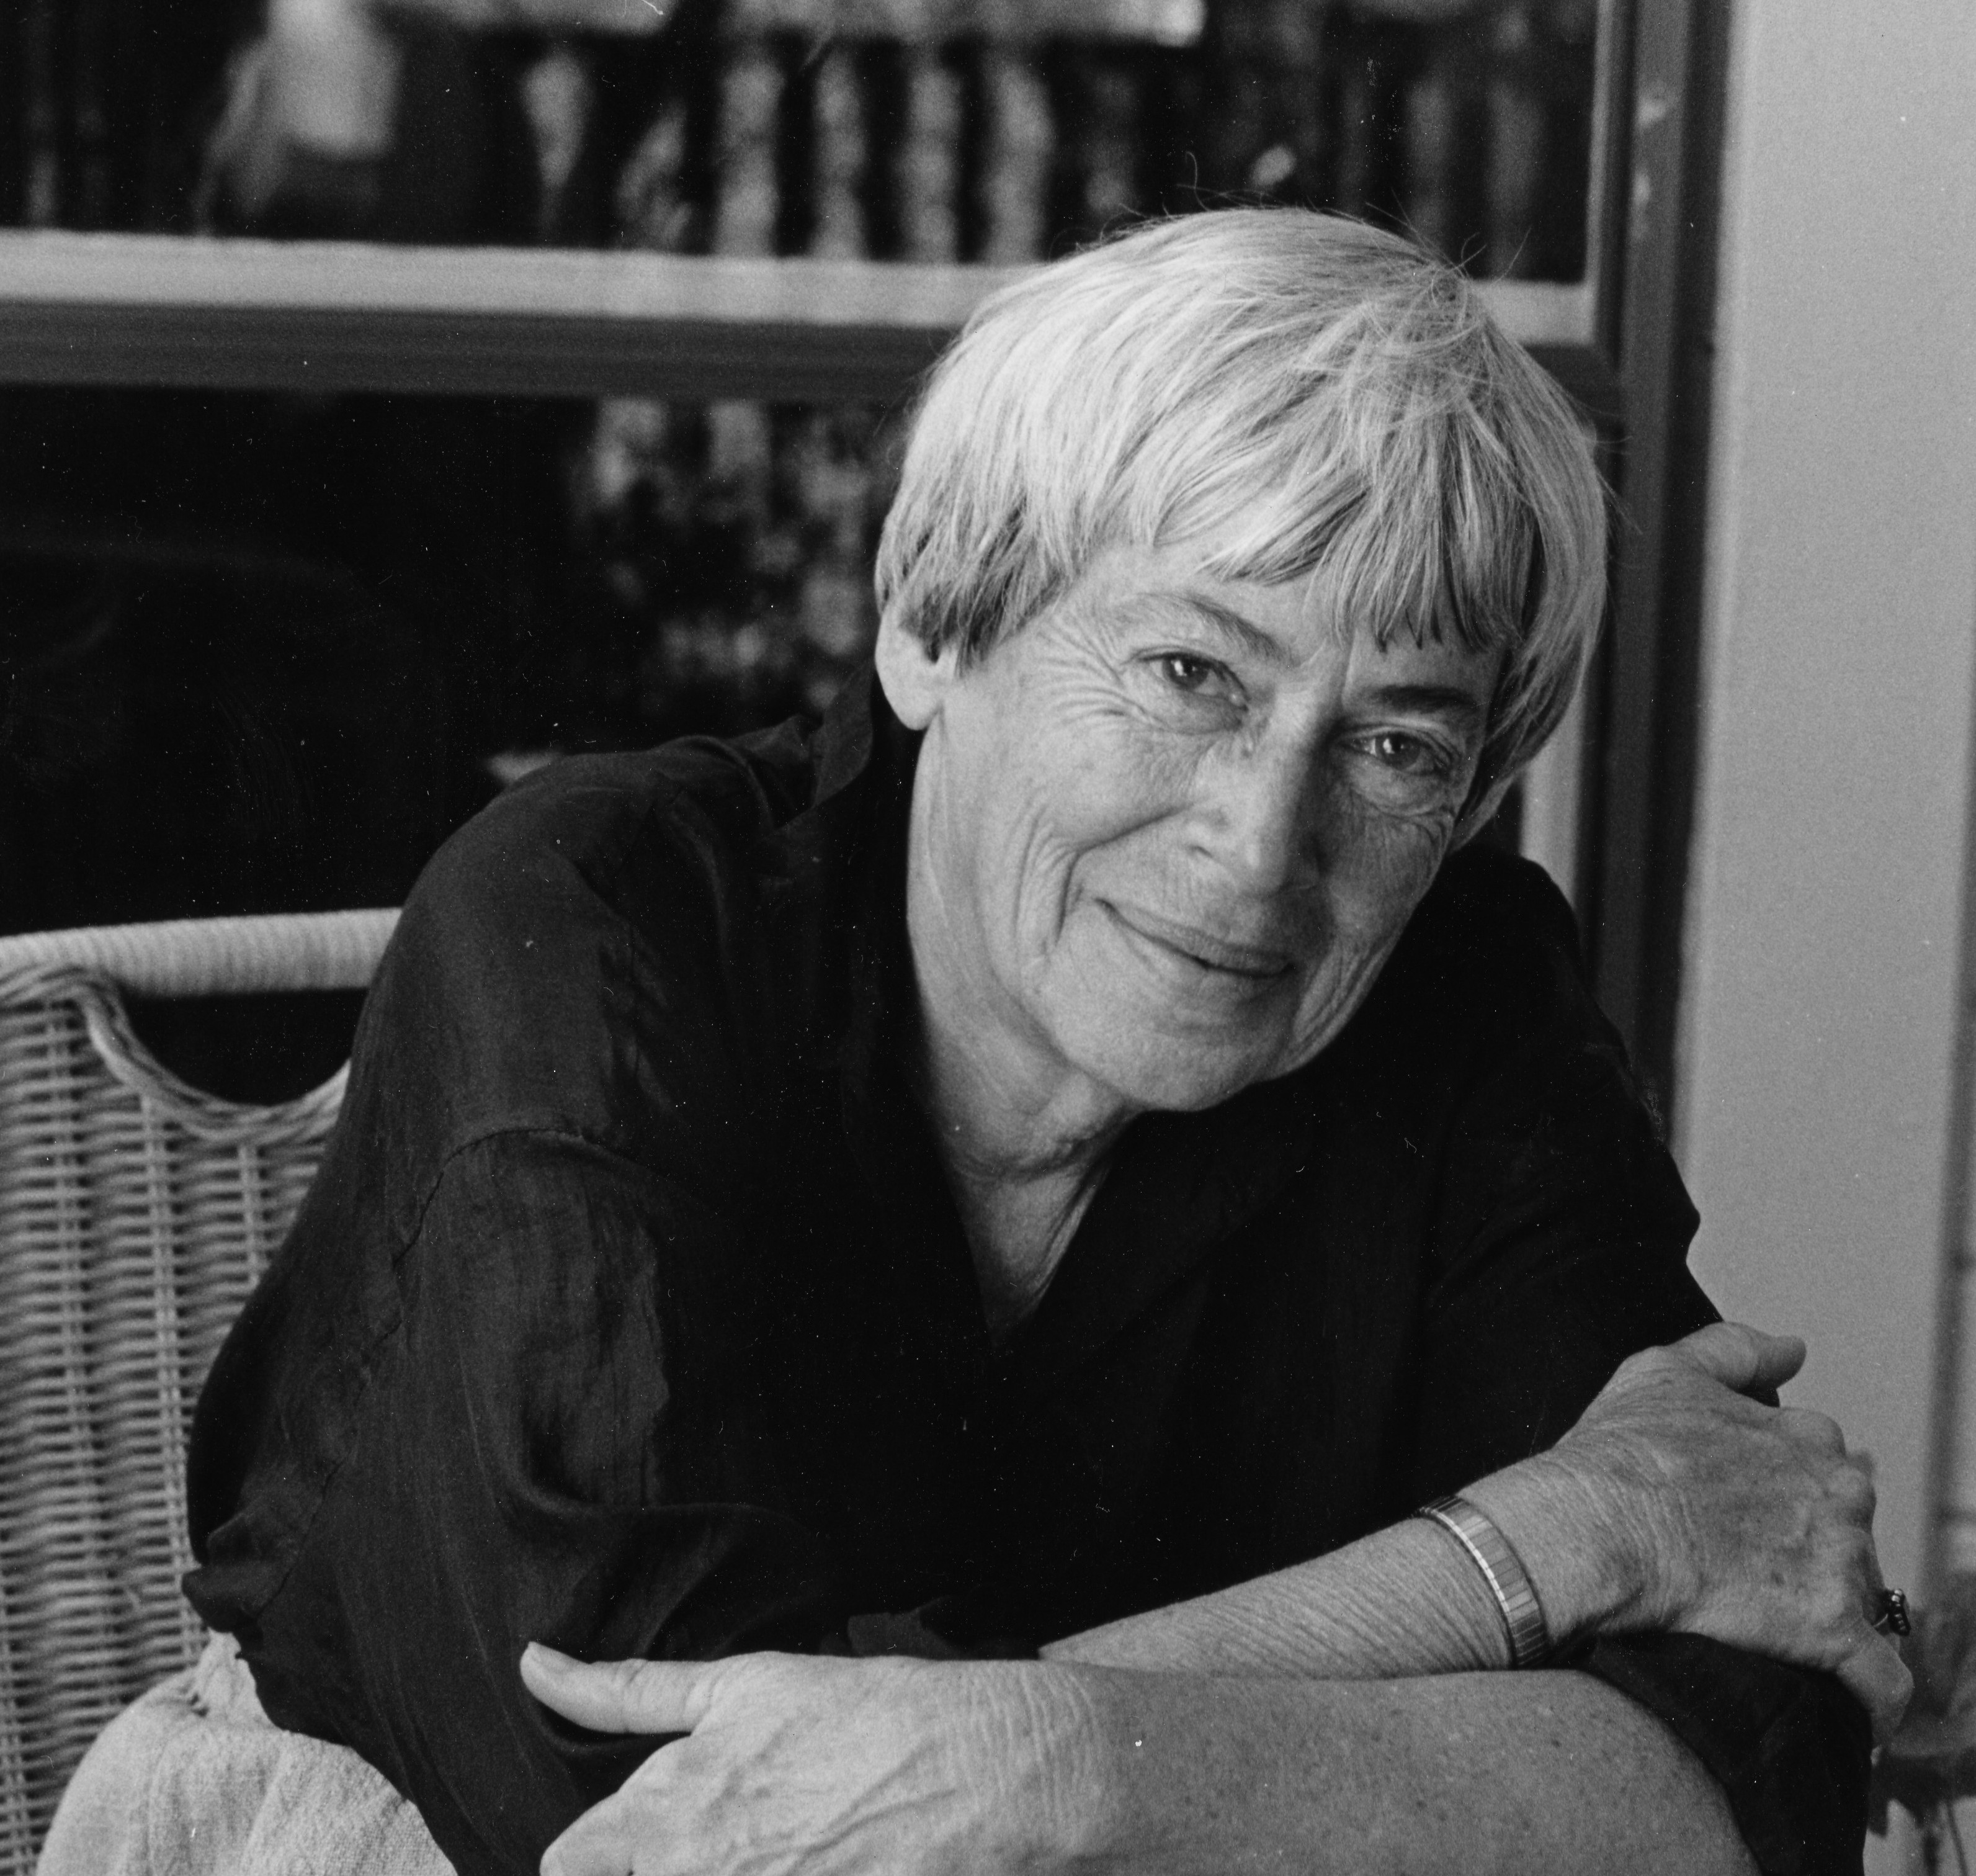
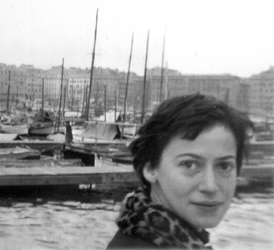
Ursula Le Guin
Born Ursula Kroeber on October 21, 1929, in Berkeley, California to
Mother, Theodora, anthropologist who chronicled the life of the last Yahi tribe member, Ishi
Father, Alfred, was a celebrated anthropologist
Attended Radcliffe College for her BA -Renaissance Literature (French and Italian)
Attended Columbia University for her MA- French
Got married (a historian), had 3 children, lived in Portland, OR for ages
Know for her worldbuilding
Died January 22, 2018

Slide 4
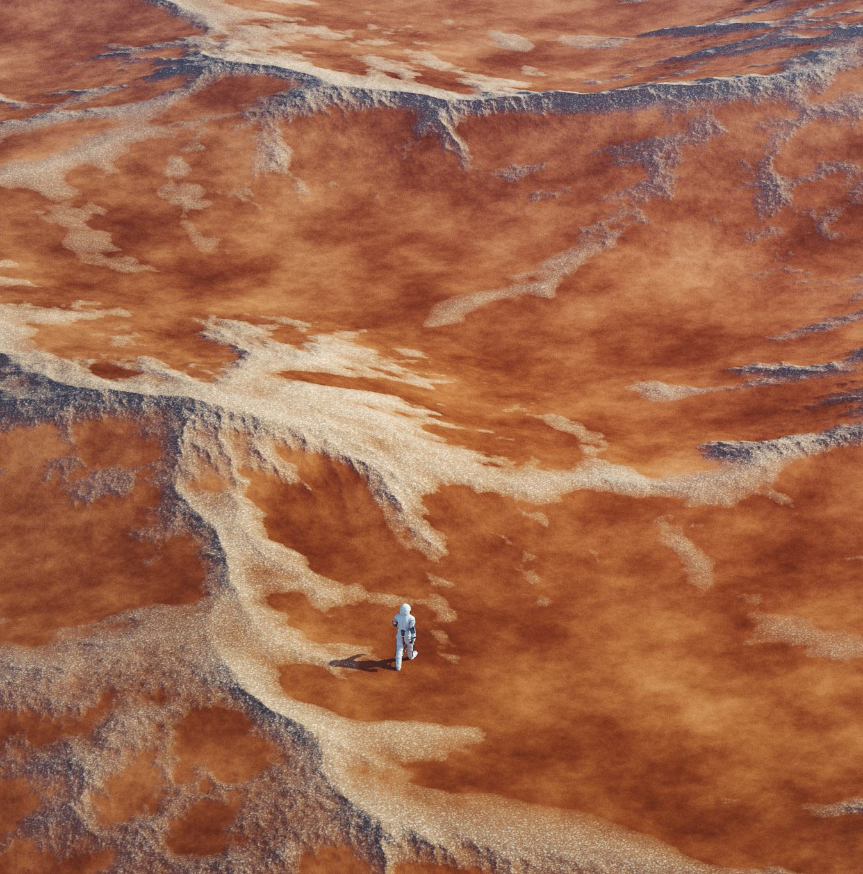
Setting
Libra: Uranium Mining Planet

Slide 5
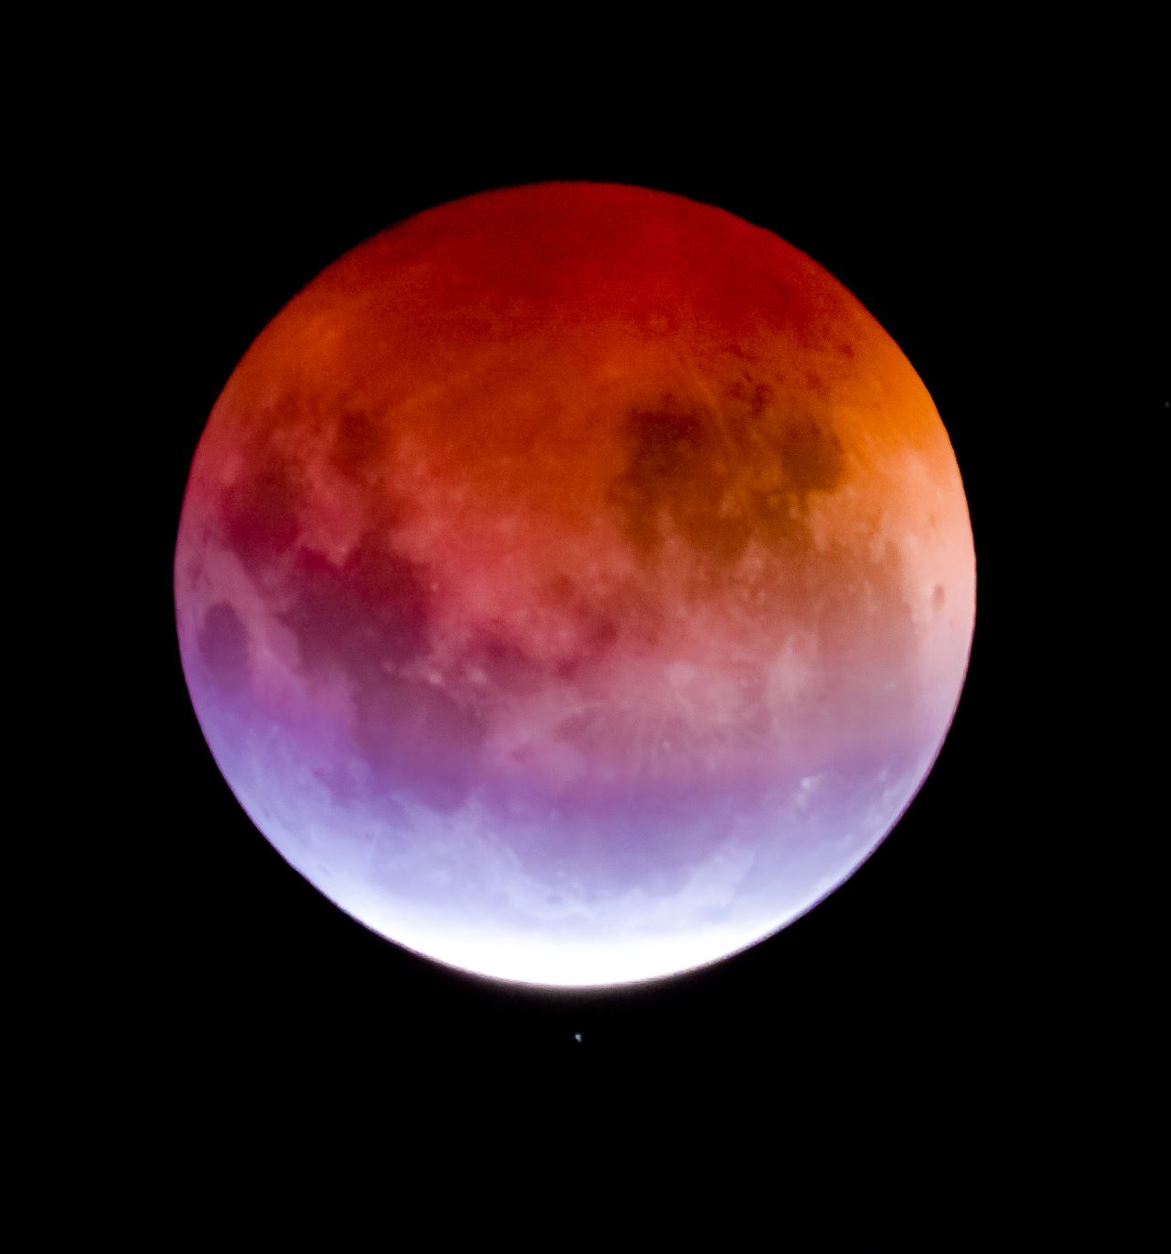
Libra
Locate a passage describing the planet in the “Nine Lives”.
How does the planet mirror or reinforce ideas withing the story?

Slide 6

Characters

Slide 7

Owen Pugh & Martin Bach
Describe Pugh & Martin.
What do you know?
How do you know it?
Locate a passage for each in the short story that as a group you agree captures the essence of each character.

Slide 8
Exploitation
Locate the use of this word in “Nine Lives”
What different connotations does it have?
Why does this matter to conceptions of Le Guin’s personified planet?
Why does this matter to conceptions of and use of cloning?

Slide 9
John Chow
Describe the tendone as a whole.
How can they be distinguished?
The clones, like the androids in Dick’s novel, are “consistently confronted with social conventions which assert their artificiality” (Olsen 107).
Why do Martin and Pugh find them uncanny?
How does the tendone treat the humans?

Slide 10
John Kaph Chow
“After all every boy has got to break free of his family” (Le Guin)
What was your affective (emotional) response to John Kaph Chow’s separation from his siblings through there death?

Slide 11

Trauma Theory

Slide 12

Anthropocene
Olsen claims that, “we tend to think of the mind, the unconscious and emotional intelligence as something uniquely and definingly human” (101) but that stories like “Nine Lives” suggest that manufactured posthuman subjects are indeed able to experience trauma in different manners, and that this contributes to a blurring of boundaries between machines and human” (102).
How does the changing relationship between human and clone in “Nine Lives” challenge human exceptionalism?
How does the initial relationship promote human exceptionalism?

Slide 13
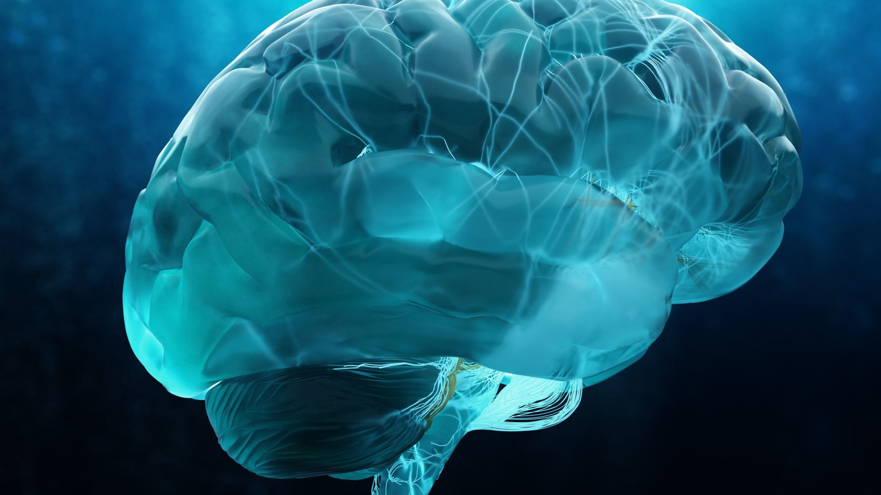
A Romanticized Understanding of the Human Mind
Can the Human Brain be replicated?
What is it to romanticize the notion of a “Human” mind?
How does Memory play a role?
Unpack- natural/unnatural & Human/Artificial

Slide 14
Can technology experience trauma
Consider both Frankenstein’s creature (human/animal) and the clone John Kaph Chow (Manufacture human).
Is trauma a uniquely human experience?

Slide 15
The Childs Dream (Le Guin)
The pivot in “Nine Lives” occurs when John Kaph Chow finally “sees” Martin and Pugh.
Locate this section of the story.
What is it to see the Othered subject?
What does human exceptionalism do to the Other in the case of humanoids like the Creature and John Chow?

Slide 16
The main point?
Olsen argues throughout that it is crucial that the posthuman subject’s capacity to experience trauma be “acknowledged and dealt with by humans” (109).
Why does Olsen think this is so important?
Do you agree or disagree?

