Slide 1
Epistasis
Expression of one trait can influence the expression of another trait, altering Mendelian ratios

Slide 2
Dihybrid crosses yield four genotypes in predictable ratios
Bb Ee x Bb Ee
9/16 B- E- dominant at both traits
3/16 B- ee dominant at one trait,
3/16 bb E- recessive at the other
1/16 bb ee recessive at both traits

Slide 3
An example of epistasis
example: Labradors can be black, brown or yellow
dominant allele B is required for black pigment
  bb = brown coat color
dominant allele E is required to deposit pigment in hair
  ee = yellow coat color
if genotype is ee, dogs will be yellow regardless of genotype at the B gene, because neither pigment (black nor brown) can be deposited in hair

Slide 4
Epistasis
Bb Ee x Bb Ee
9/16 B- E- black pigment, in fur black
3/16 B- ee black pigment, not in fur yellow
3/16 bb E- brown pigment, in fur brown
1/16 bb ee brown pigment, not in fur yellow

Slide 5
Epistasis
Bb Ee x Bb Ee
9/16 B- E- black pigment, in fur black
3/16 B- ee black pigment, not in fur yellow
3/16 bb E- brown pigment, in fur brown
1/16 bb ee brown pigment, not in fur yellow
the genotype at one gene affects our ability to observe the phenotypic outcome at a second gene
if the ee genotype is present, the dog will be yellow regardless of the BB or Bb genotype
in this case, although the genotype ratio is 9:3:3:1, the phenotype ratio is 9:3:4

Slide 6
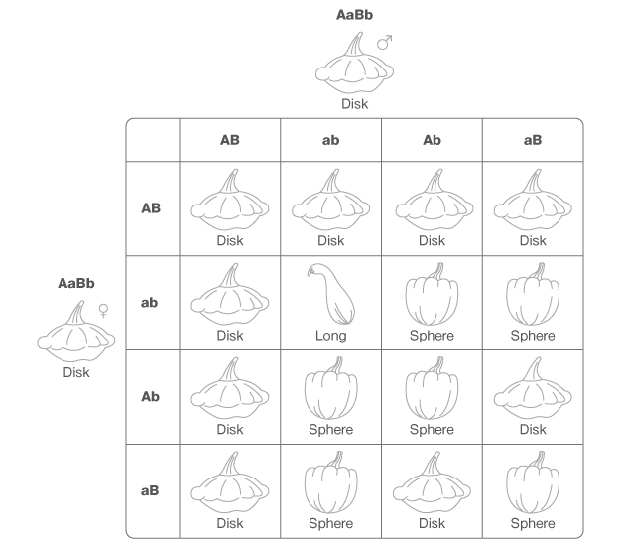
Epistatic gene interactions influence squash shape
two genes, A and B, function together to influence the shape of squash
--dominant alleles A and B increase width
--recessive alleles a and b do not increase width
widest
narrowest

Slide 7
Epistatic gene interactions influence squash shape
two genes, A and B, function together to influence the shape of squash
--dominant alleles A and B increase width
--recessive alleles a and b do not increase width
widest
narrowest
Aa Bb x Aa Bb
9/16 A- B-
3/16 A- bb
3/16 aa B-
1/16 aa bb

Slide 8
Polygenic traits have multiple genes that function together to influence phenotype

Slide 9
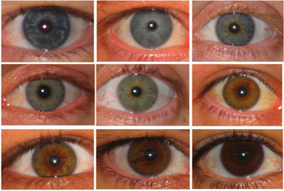
Genetic variation in eye color
http://discovermagazine.com/2007/mar/eye-color-explained/eyes-400.jpg

Slide 10
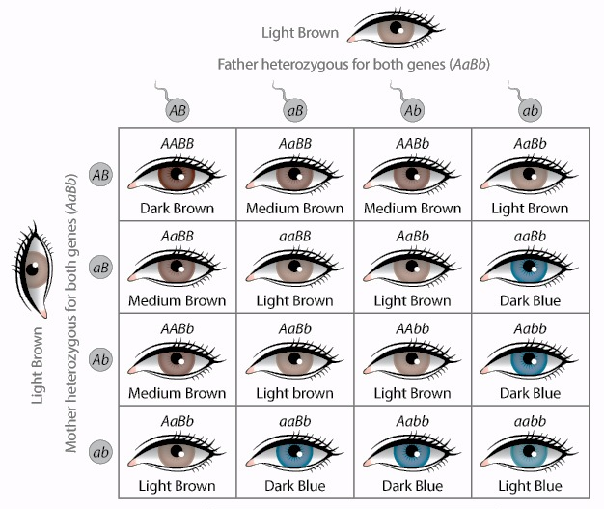
Genetic determination of eye color involves multiple genes
Principles of Biology unit 39, Figure 9

Slide 11
Continuous variation of a trait suggests the involvement of multiple genes
continuous variation: a range of phenotypes that cross clearly distinct categories

Slide 12
Continuous variation of a trait suggests the involvement of multiple genes
continuous variation: a range of phenotypes that cross clearly distinct categories
phenotypic outcome is influenced by the activity of multiple genes
for many continuously varying traits, phenotype is also influenced by the environment
continuously varying traits are often quantifiable

Slide 13
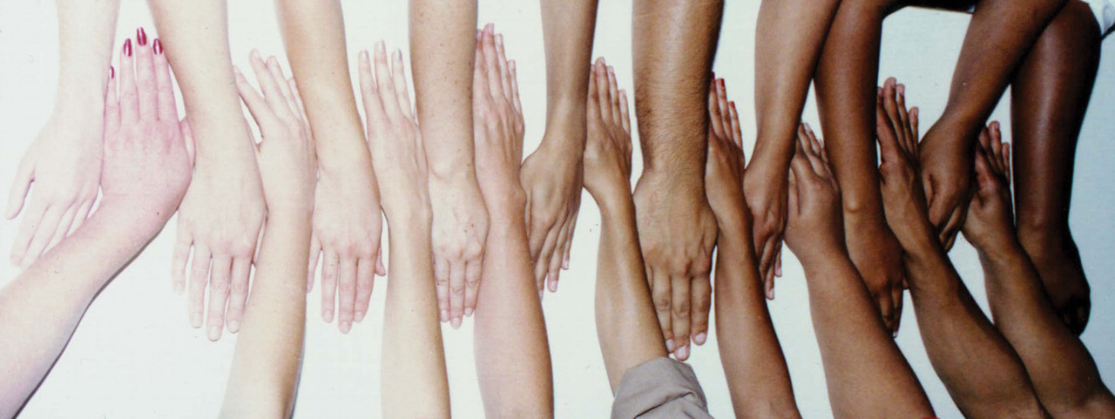
Genetic explanation for skin tone distribution
Sturm (2009) Human Molecular Genetics 18:R9-R17

Slide 14
Genetic explanation for skin tone distribution
Sturm (2009) Human Molecular Genetics 18:R9-R17
in this example, three genes control skin tone: A, B and C
alleles A, B, C = pigment
alleles a, b, c = no pigment

Slide 15
Genetic explanation for skin tone distribution
Sturm (2009) Human Molecular Genetics 18:R9-R17
in this example, three genes control skin tone: A, B and C
alleles A, B, C = pigment
alleles a, b, c = no pigment
Campbell, Figure 14-13

Slide 16
Environment can influence phenotype

Slide 17
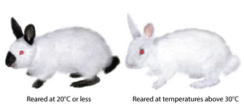
Environmental influences on phenotype
http://www.nature.com/scitable/

Slide 18
Environmental influences on phenotype
http://www.nature.com/scitable/
Campbell, Figure 14-14

