Slide 1

Nalo Hopkinson
“Message in a Bottle”

Slide 2

Biography
Born 20 December 1960 in Kingston, Jamaica
Moved to Toronto, Canada at 16
Mother was a Library tech, Father was a writer
Has an MFA in Fiction from Seton Hill University
Teaches Creative Writing at UC Riverside in CA

Slide 3
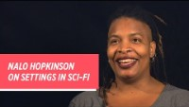
Hopkinson on Setting

Slide 4

Setting
Where is the story set?
When is the story set?
Why might the familiarity of this futuristic setting matter?
How is dislocation present in the setting of “Message in a Bottle”?

Slide 5

Perspective and Adaptations

Slide 6
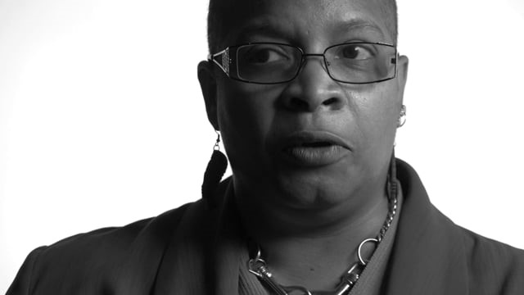
Culture and Connection

Slide 7
Characters
Greg
Babette & Sunil
Kamla
Ceclia
How are concerns about the future reflected by the characters in the story?
How are concerns about the present reflected in these characters?
What important connections are made between these characters?
Describe Greg’s narratorial voice and tone.
What cultures meet? What growth or motion forward is made?
What characters grow and change? How?
How do Greg’s feelings about children impact the overall tone of the story? Do they impact the readers perception of Kamla?
What acts of generosity encourage human connection?

Slide 8

Clones
Unpack how the lived experience of the clones is different in “Message” than it was in “Nine Lives.”

Slide 9

Locating a Lens
When you were reading “Message” did any of the ideas from the critical theory you have read (Goss, Haraway, Olsen, Hayles) come to mind?

Slide 10

Hayles
Toward Embodied Virtuality

Slide 11
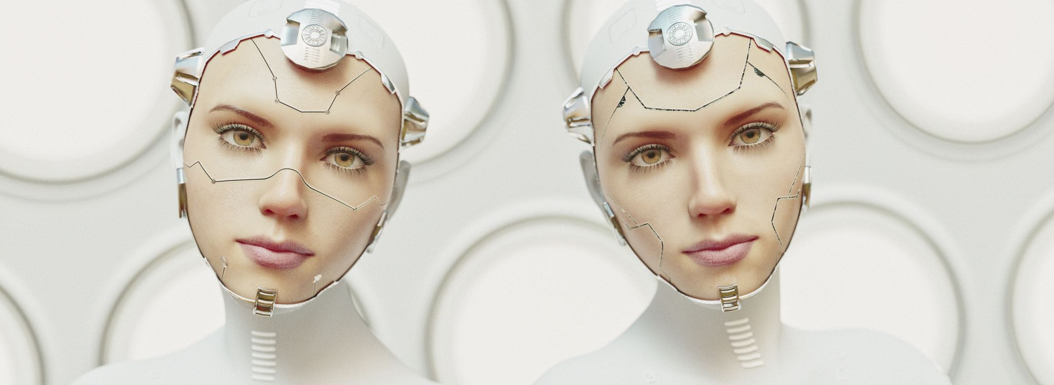
Hayles focuses on what she calls 3 stories (2):
Information has lost its body
The cyborg as a technological artifact and cultural icon
The shift from a social construction of human to a social construction of posthuman

Slide 12

Hayles conceptualizes the cyborg as a composite of organic being and electronic systems with a flow of information passing between them and contends that the posthuman view “privileges informational patter over material instantiation” (2).
In what ways are we already articulated with machines, already seamlessly inputting and outputting information?

Slide 13
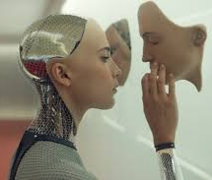
Are we Posthuman Subjects?
What do you make of Hayle’s assertion that the posthuman views the body as “the original prothesis” (3)?
Are our boundaries, as material-informational entities, “undergoing continuous construction and reconstruction”(3)?
Hayles is arguing that there is actually no firm boundary between human and posthuman, that both the definitions and borders are constantly in flux. Do you agree that “‘human’ and ‘posthuman’ coexist in shifting configurations that vary with historically specific contexts” (6)?

Slide 14

Consciousness
Hayles contends that consciousness in a different medium will change, that there is a connection between consciousness and whatever container that consciousness is in (1). In other words, embodiment matters because even if the container is in flux the consciousness is impacted by any container it inhabits.
In “Message” Kamla tells Greg, “They sent small people instead. Clones of the originals, with their personalities superimposed onto our own. They sent children back who weren’t children” (20).We also know that Kamla has her original’s memories.
Considering this:
How does Hopkinson frustrate our more traditional conception of a clone?
How do we see embodied consciousness in a modified human form impact consciousness in “Message”?

