Slide 1
Francesca Ferrando
“A feminist genealogy of posthuman aesthetics in the Visual Arts”
(2015)

Slide 2
Context
Art, like literature, represents the present it was created in
Ferrando traces the philosophical & artistic movements that intersect posthumanism & Feminism
We can read a work of art through a critical lens just like we read a fictional story
You can write informal responses and/or your last two papers on works of art

Slide 3
What is a posthuman aesthetic?
“Thinkers like Donna Haraway, N. Katherine Hayles, Karen Barad and many more have changed the general focus of attention towards postanthropocentric political and aesthetic practices, in which humans and nonhumans co-exist, co-experience, and co-produce in distributed cognitive environments, assemblages and networks of humans, animals, machines, software, environments…”
Stefan Herbrechter “Posthumanism and Aesthetics”

Slide 4
Most Western art as Anthropocentric
Human centered
Direct depiction of human subjects
Representation of the human gaze on nature
Representation of human impact on their spaces

Slide 5
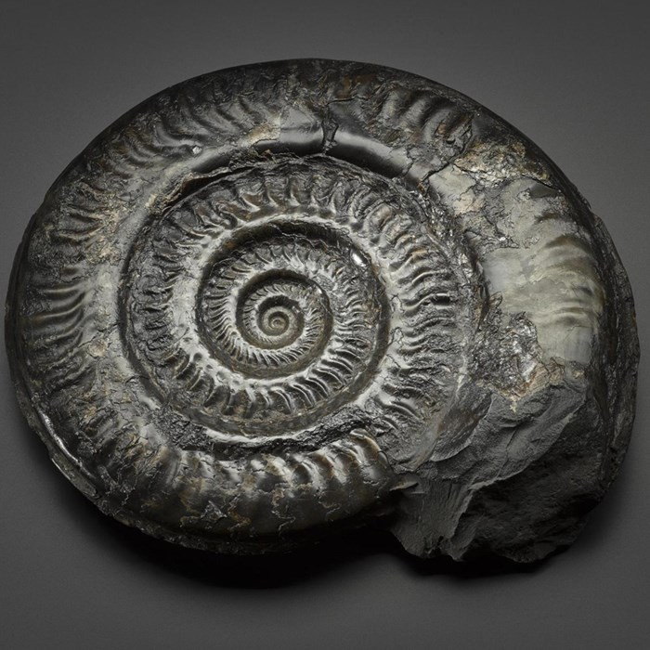
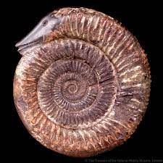
Ammonite/Snake Stone
Natural History Museum, Scotland/Natural History Museum, London

Slide 6
Posthuman Aesthetic = Decentering the “Human”
Hybridity
  Divine/Human/Animal/Plant/Machine
Boundary Crossing or Boundary Altering
  Real/Imaginary/Dream/Virtuality
  Material Embodiment/ Disembodied
  Cultural
  Nature/Culture
  Time/Space
Structurally Hybrid in Medium
  Collage
  Assemblage
  Digital Generation
    Augmented reality
    Virtual reality
    Digital manipulation

Slide 7
Futurist
“Futurism was an Italian art movement of the early twentieth century that aimed to capture in art the dynamism and energy of the modern world” (Tate Museum)

Slide 8
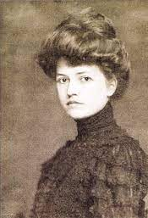
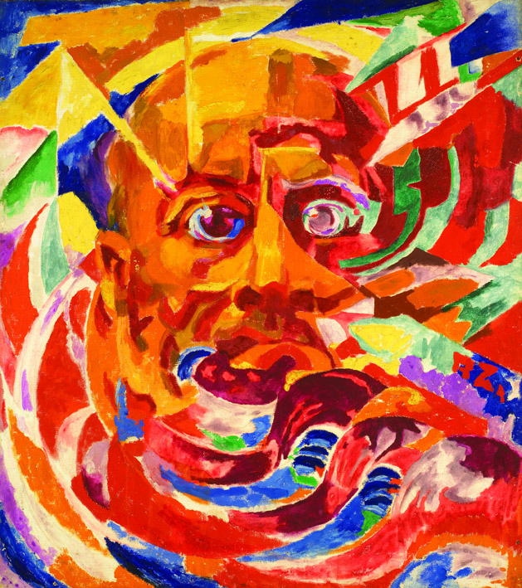
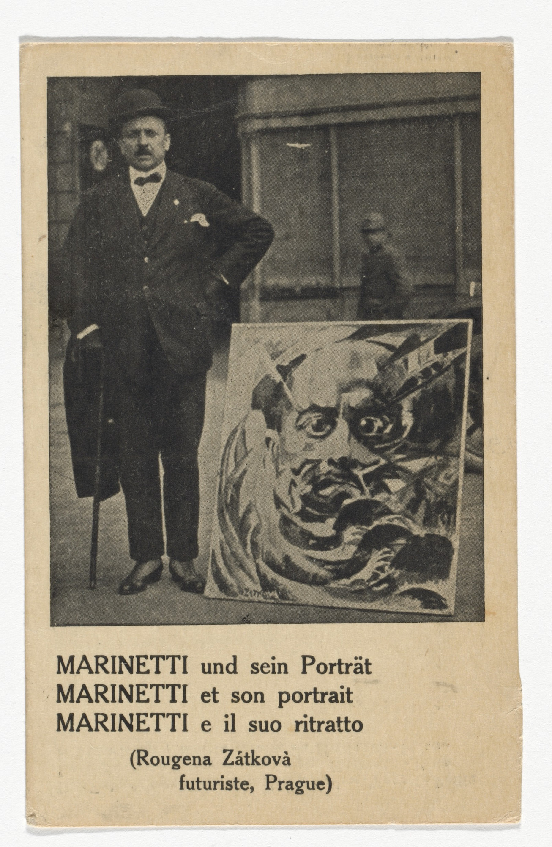
Růžena Zátková – Marinetti (1922)

Slide 9
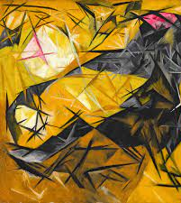
Natalia Goncharova
(1881–1962)
Cats in Rose, Black, and Yellow (1913)
Guggenheim, New York
“Rayonism focused on representing the rays of light reflected from objects, rather than objects themselves, in a pre-intuition of the central role of light in virtual reality and the consequent electrical infrastructure of cyberspace.”
(Ferrando pp. 3)
Notes:
“Rayonism focussed on representing the rays of light reflected
from objects, rather than objects themselves, in a pre-intuition of
the central role of light in virtual reality and the consequent
electrical infrastructure of cyberspace.”
(Ferrando pp. 3)

Slide 10
Prosethetics

Slide 11
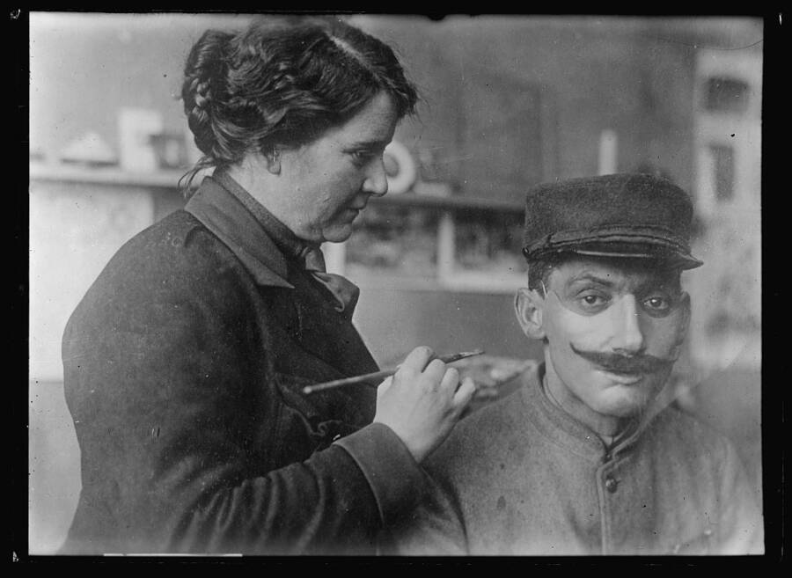
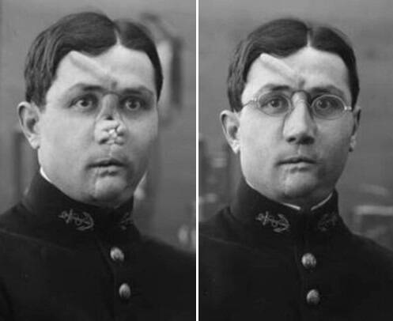
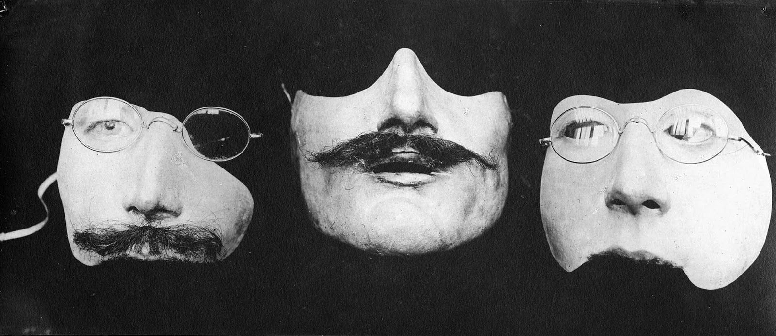
Prosthetic work of US artist
Anna Coleman Ladd
(1878–1939)

Slide 12
“To place (…) the body-object hybrids of Dada collage and photomontage next to war-time prosthetic devices, (…) is to glimpse the wider cultural field where the modern body was fragmented, altered, and re-imagined” (Garner, 2007: 507).
Qtd. in Ferrando

Slide 13
Dada
“Dada was an art movement formed during the First World War in Zurich in negative reaction to the horrors and folly of the war. The art, poetry and performance produced by dada artists is often satirical and nonsensical in nature.” (Tate)

Slide 14
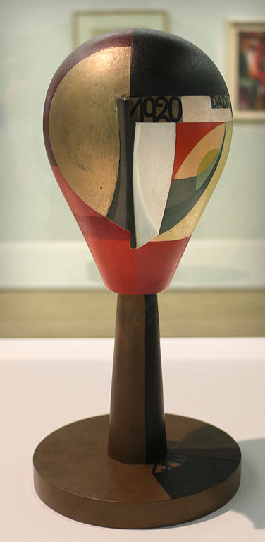
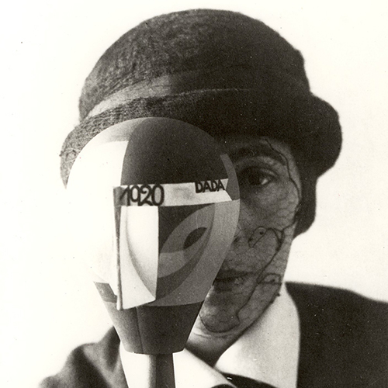
Sophie Taeuber-Arp
Portrait with Dada Head
&
Dada Head (1920)

Slide 15
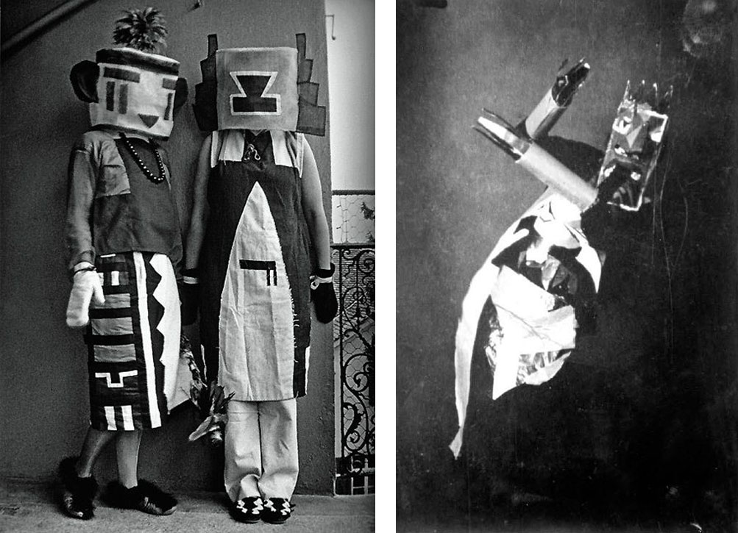
Sophie Taeuber-Arp
Photo with sister 1921-22
Sophie Taeuber, Zurich, 1916-17

Slide 16
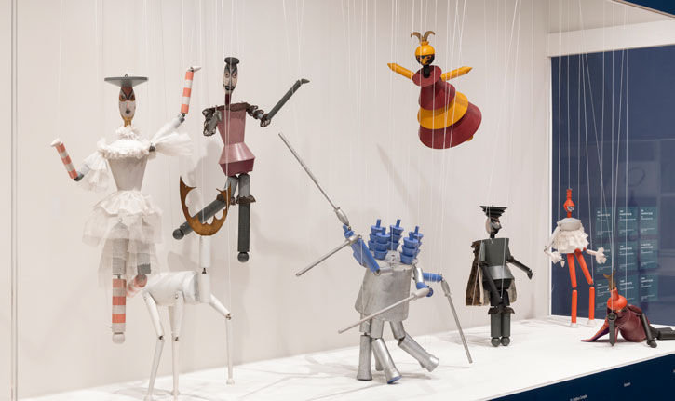
Sophie Taeuber-Arp
Installation at Tate Modern (2021)

Slide 17
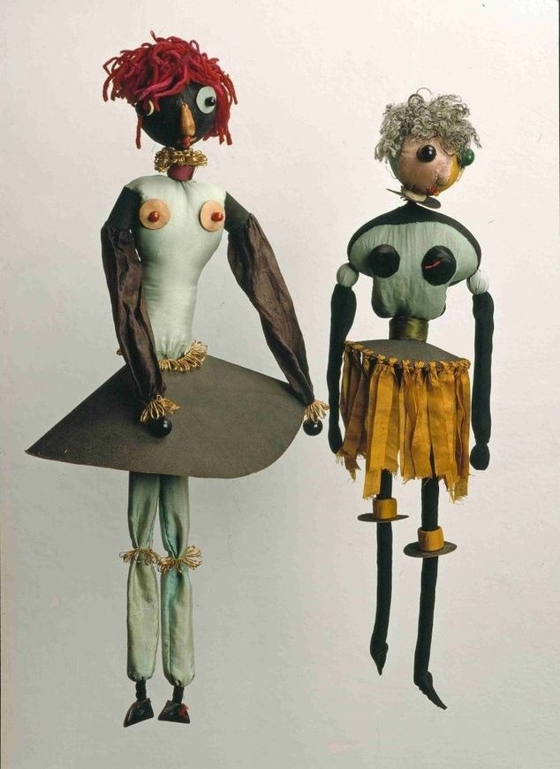
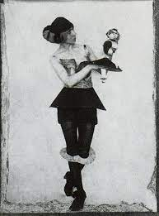
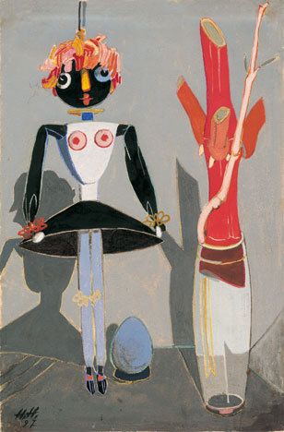
Hannah Höch (1889–1978)
Hannah Höch, Two Dada-puppets, 1916 /Hannah Höch and Dada doll, 1925/The Puppet Balsamine, 1927

Slide 18
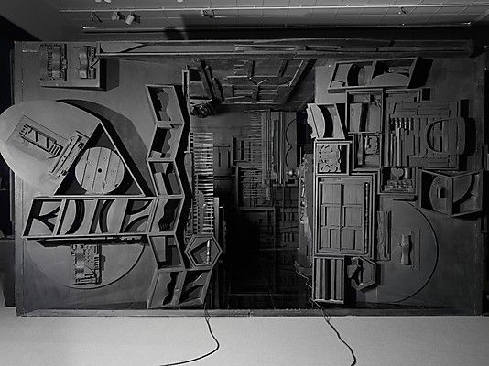
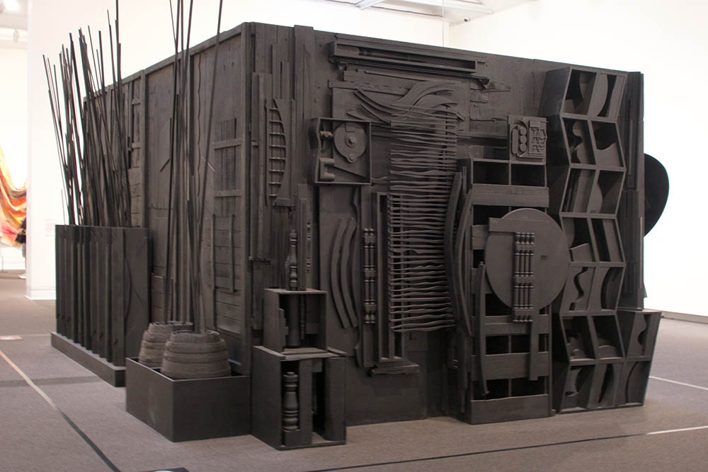
Louise Nevelson
Mrs. N's Palace, The Metropolitan Museum of Art, 1964-1977

Slide 19
Surrealism
“A twentieth-century literary, philosophical and artistic movement that explored the workings of the mind, championing the irrational, the poetic and the revolutionary” (Tate)

Slide 20
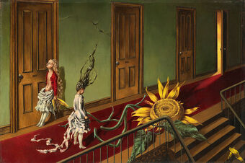
Dorothea Tanning,
Eine Kleine Nachtmusik,
1943

Slide 21
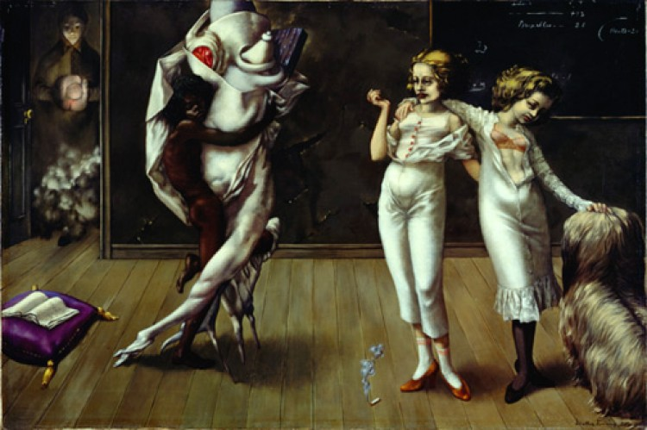
Dorothea Tanning,
Interior with Sudden Joy, 1951

Slide 22
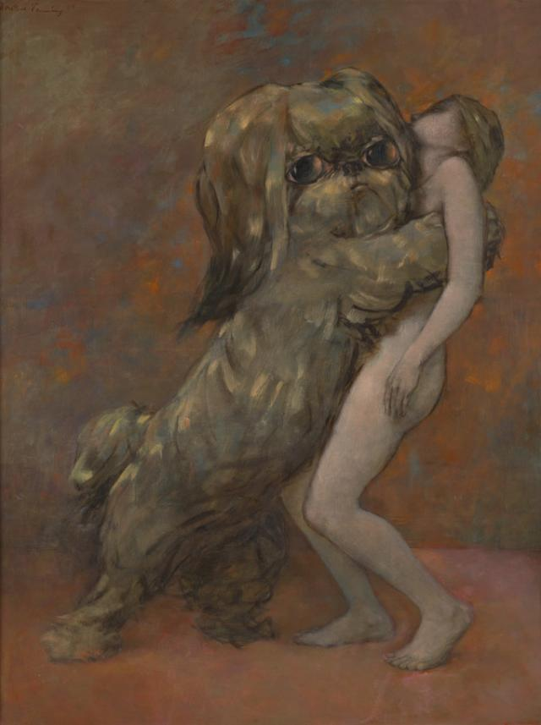
Dorothea Tanning,
Tableau Vivant, 1954

Slide 23
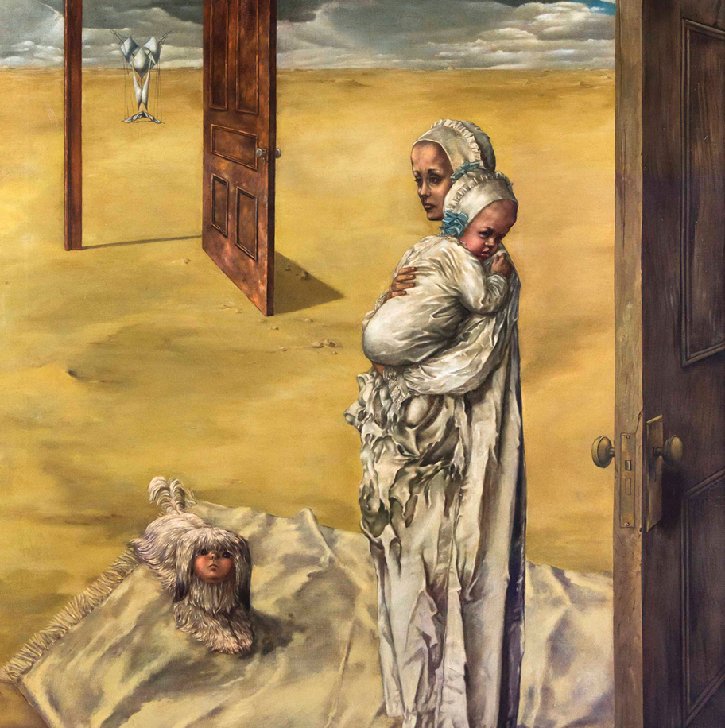
Dorothea Tanning, Maternity (Detail),
1947

Slide 24
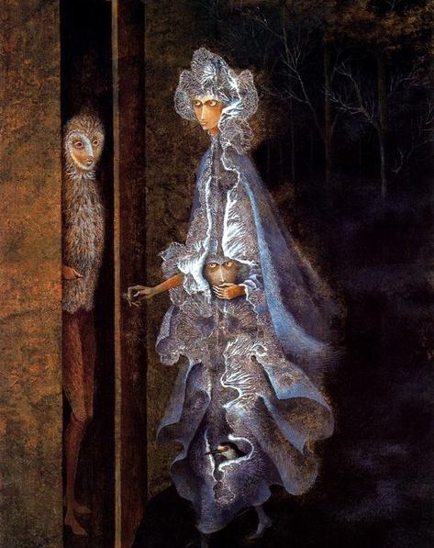
Remedios Varo Uranga (1908- 1963),
The Meeting,
Date not Found

Slide 25
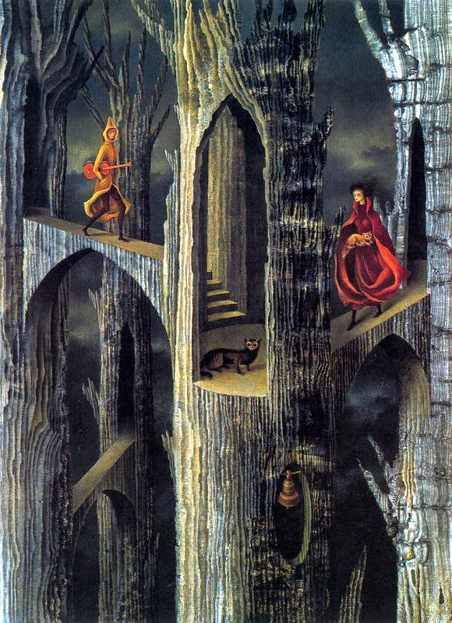
Remedios Varo Uranga,
Plant Architecture, 1962

Slide 26
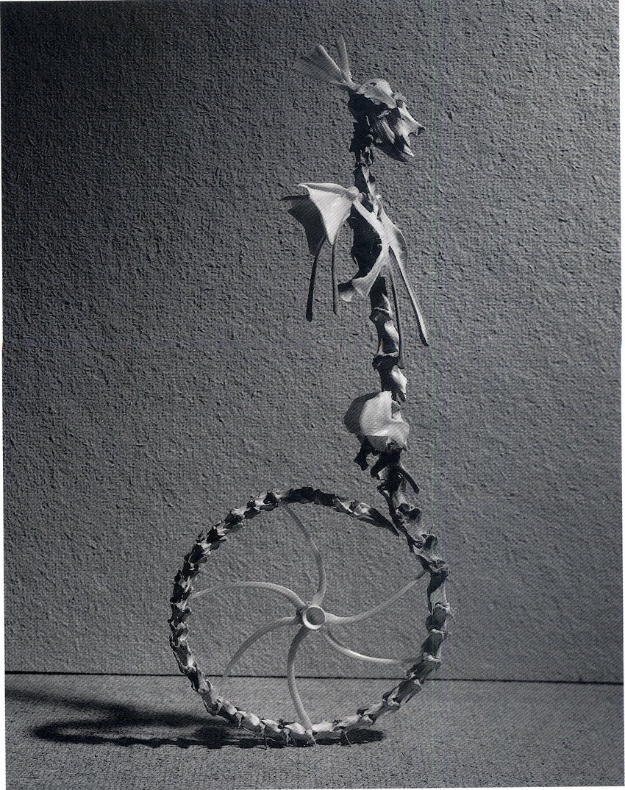
Remedios Varo Uranga,
Homo Rodans,
1959

Slide 27
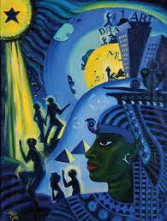
Lois Mailou Jones
(1905-1998),
The Ascent of Ethiopia,
1932

Slide 28
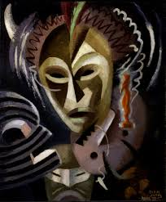
Lois Mailou Jones
(1905-1998),
Les Fetiches, 1938

Slide 29
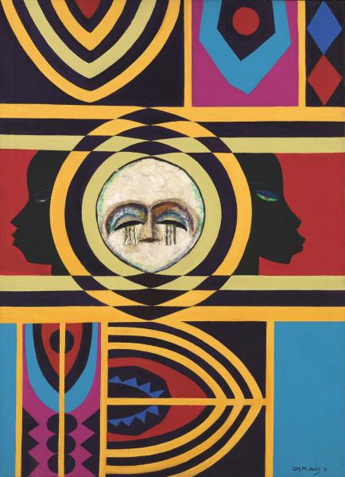
Lois Mailou Jones,
Moon Masque, 1971

Slide 30
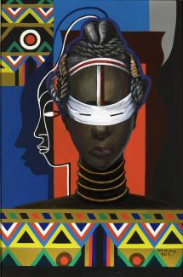
Lois Mailou Jones
Initiation, Liberia
1983

Slide 31
Prosthetics
Frida Kahlo

Slide 32
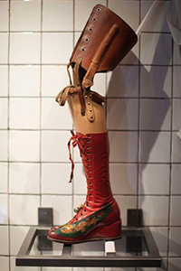
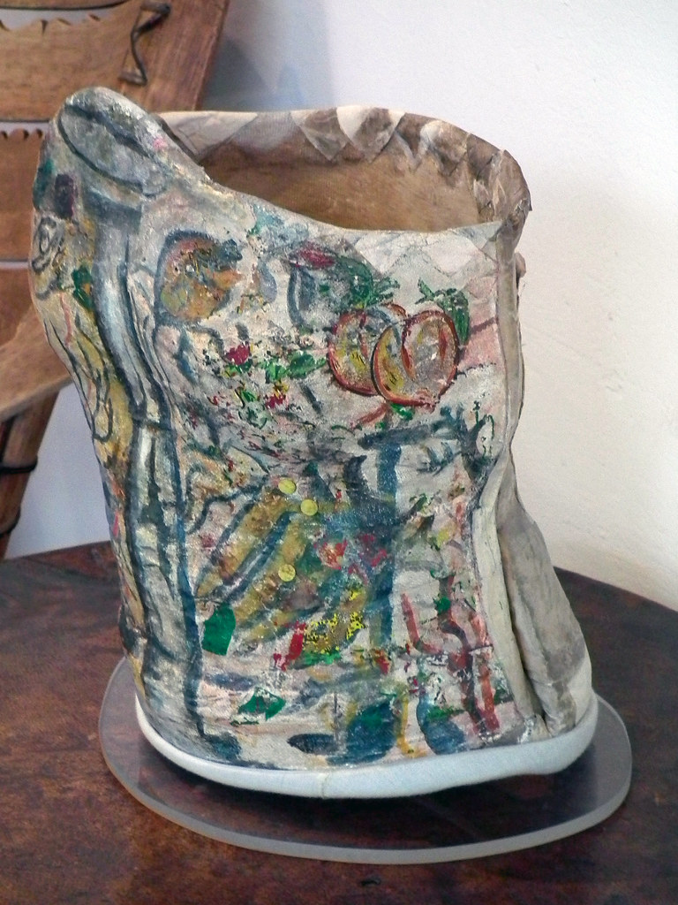
Frida’s prosthetic leg (1953-54) & Back Corset

Slide 33
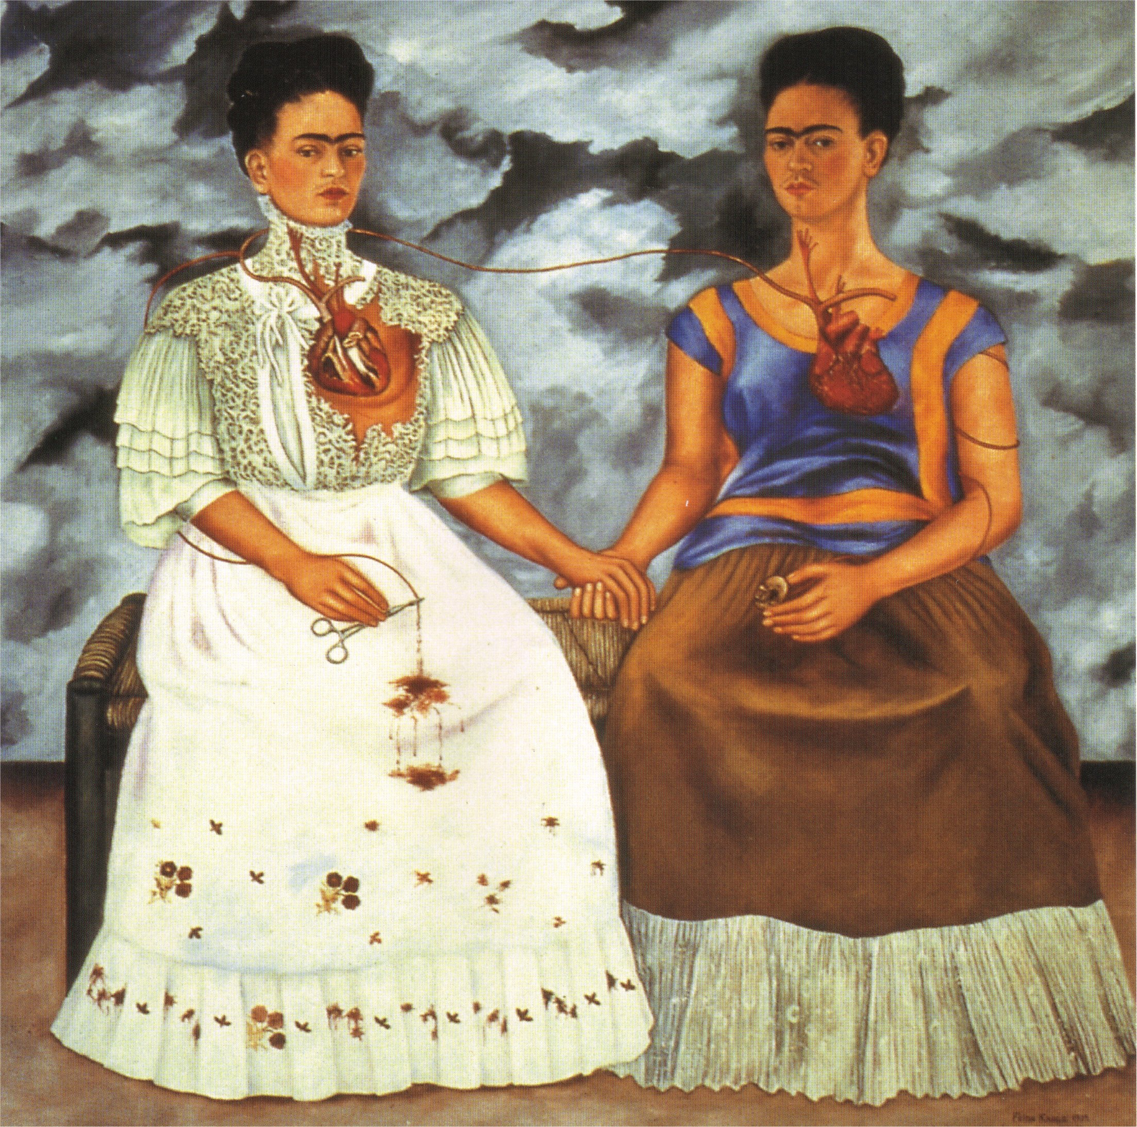
Frida Kahlo, The Two Fridas,
1939

Slide 34
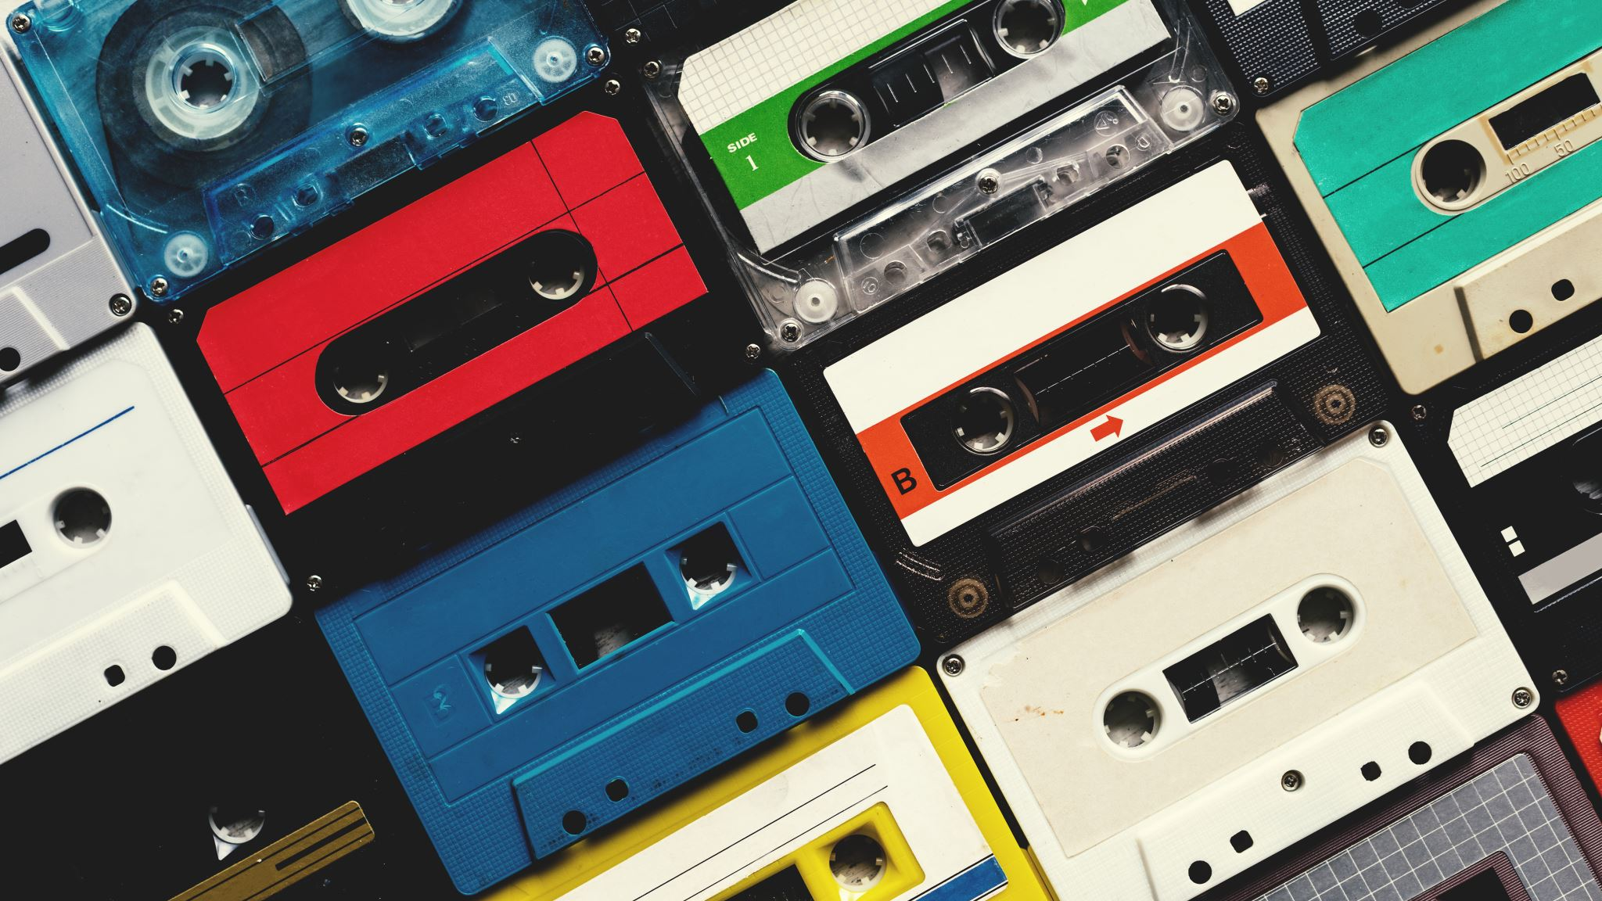
1970s- 1990s

Slide 35
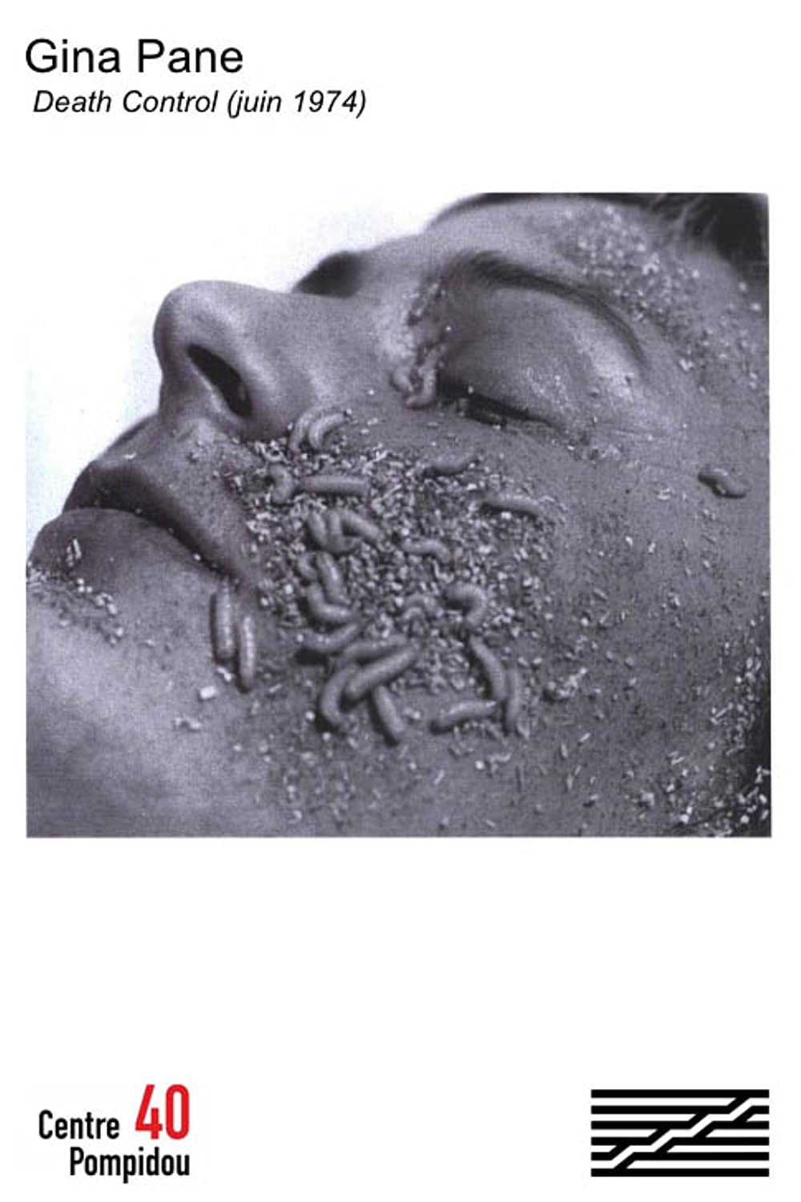
Gina Pane (1935–1990),

Slide 36
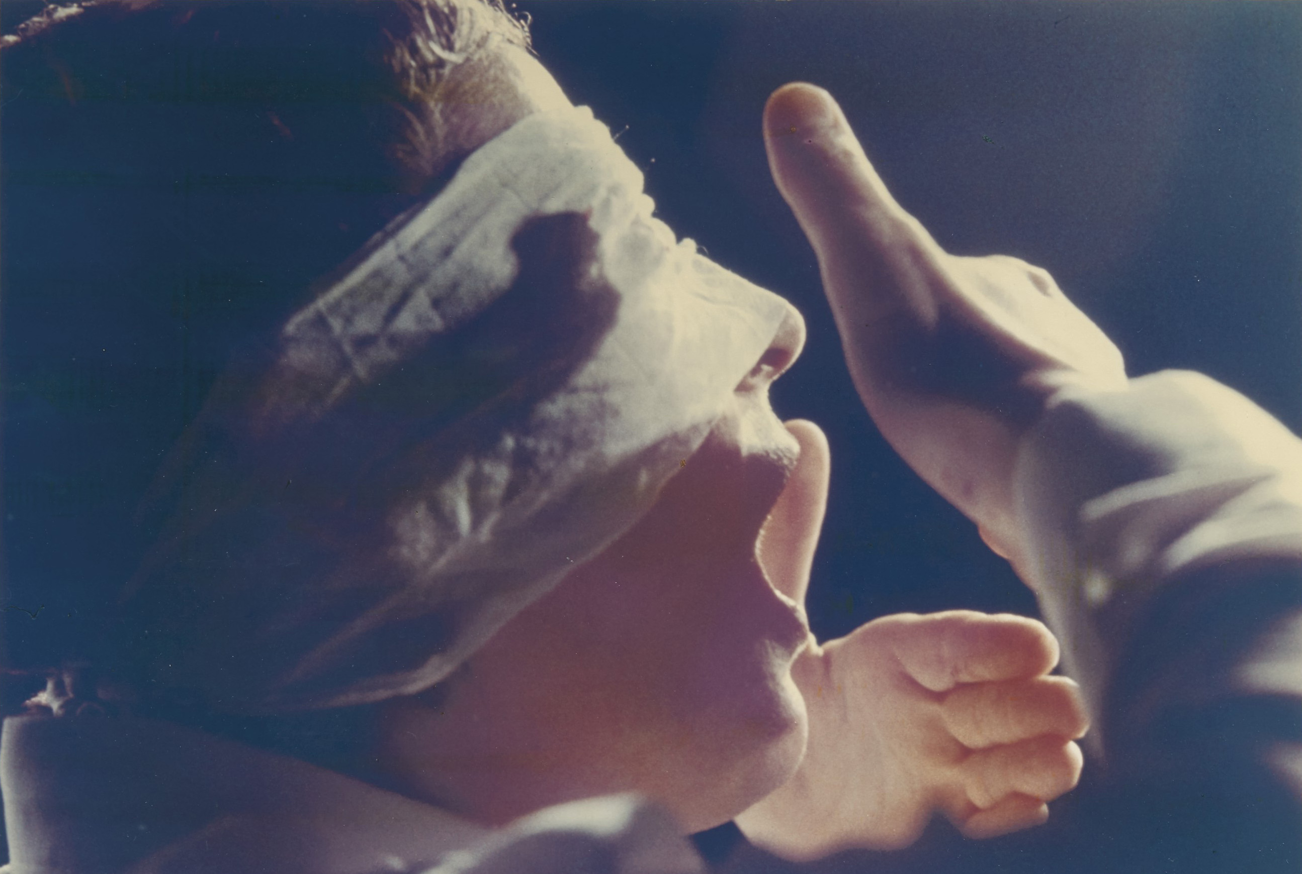
Gina Pane (1935–1990),
Action Psyche, 1973

Slide 37
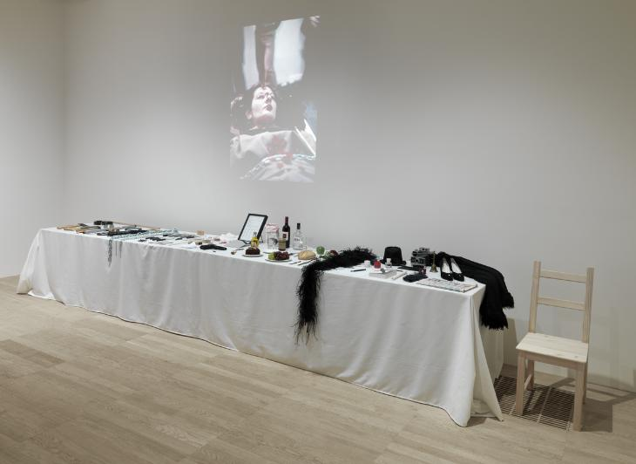
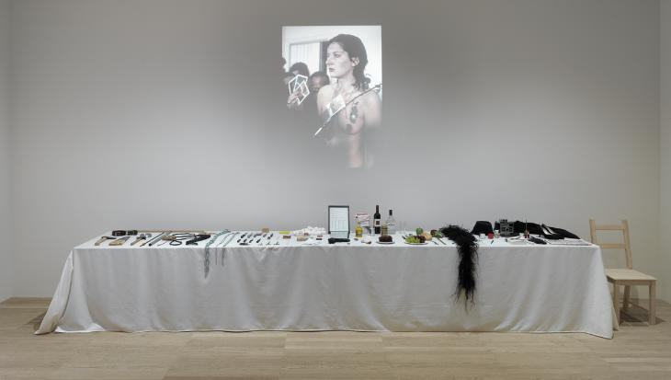
Marina Abramovic, Rhythm 0, 1974

Slide 38
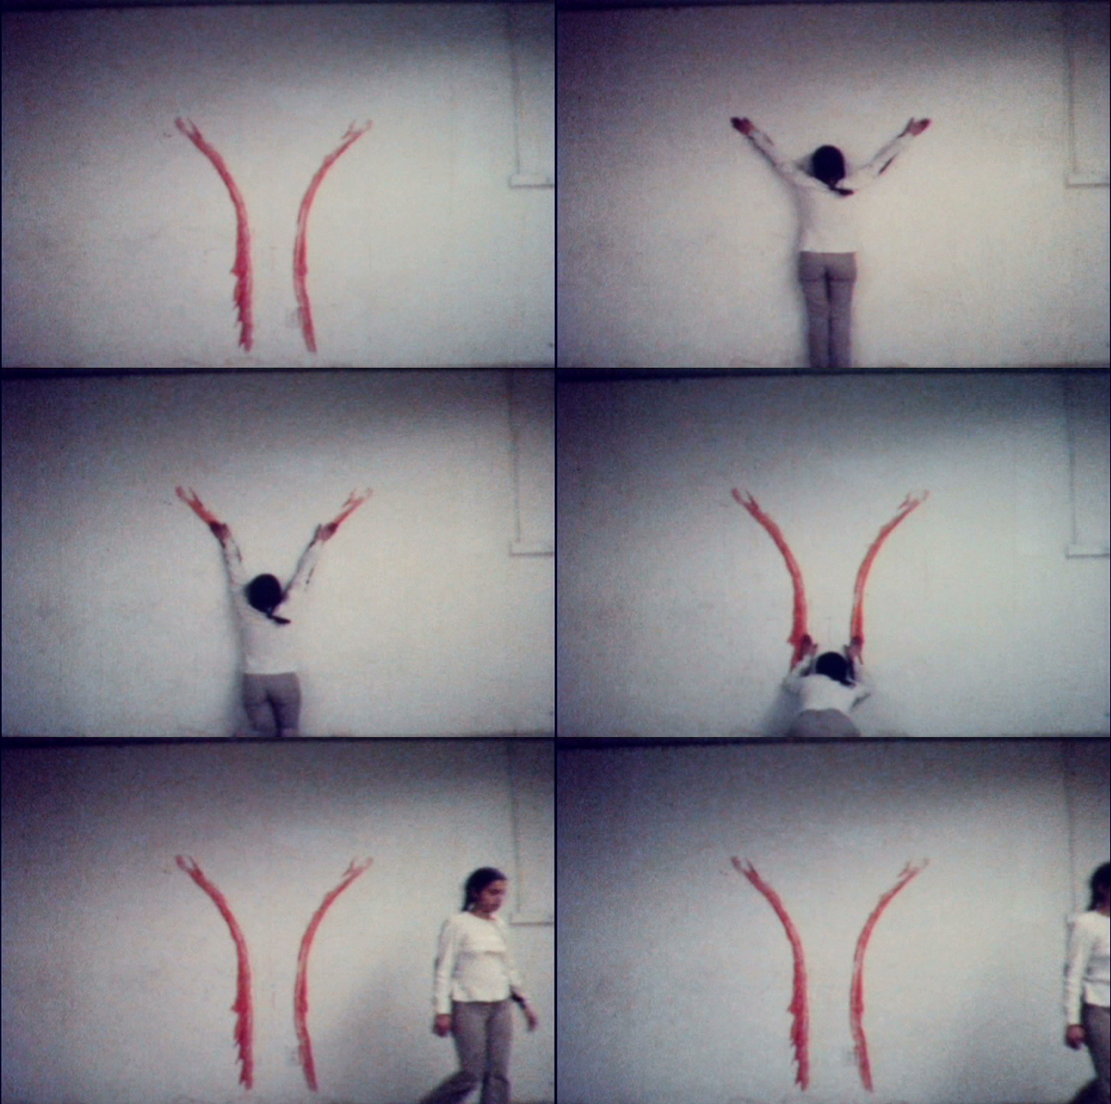
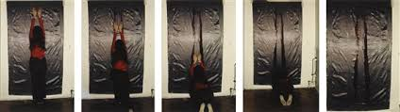
Ana Mendieta, Body Tracks, 1974 & 1982

Slide 39
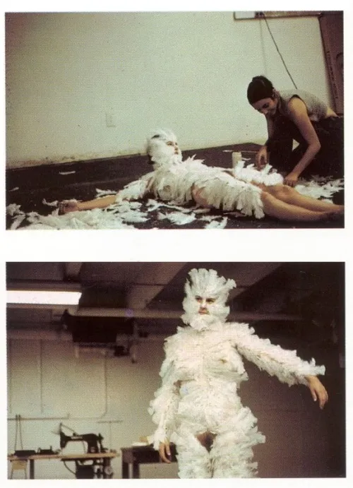
Ana Mendieta,
Bird Transformation, 1972

Slide 40
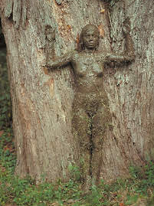
Ana Mendieta (1948–1985), Tree of Life, 1976

Slide 41
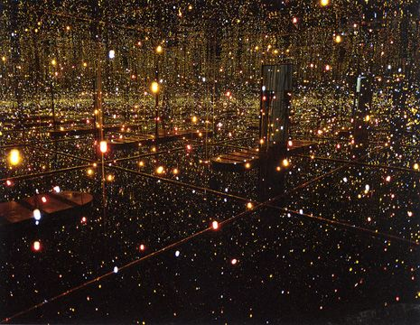
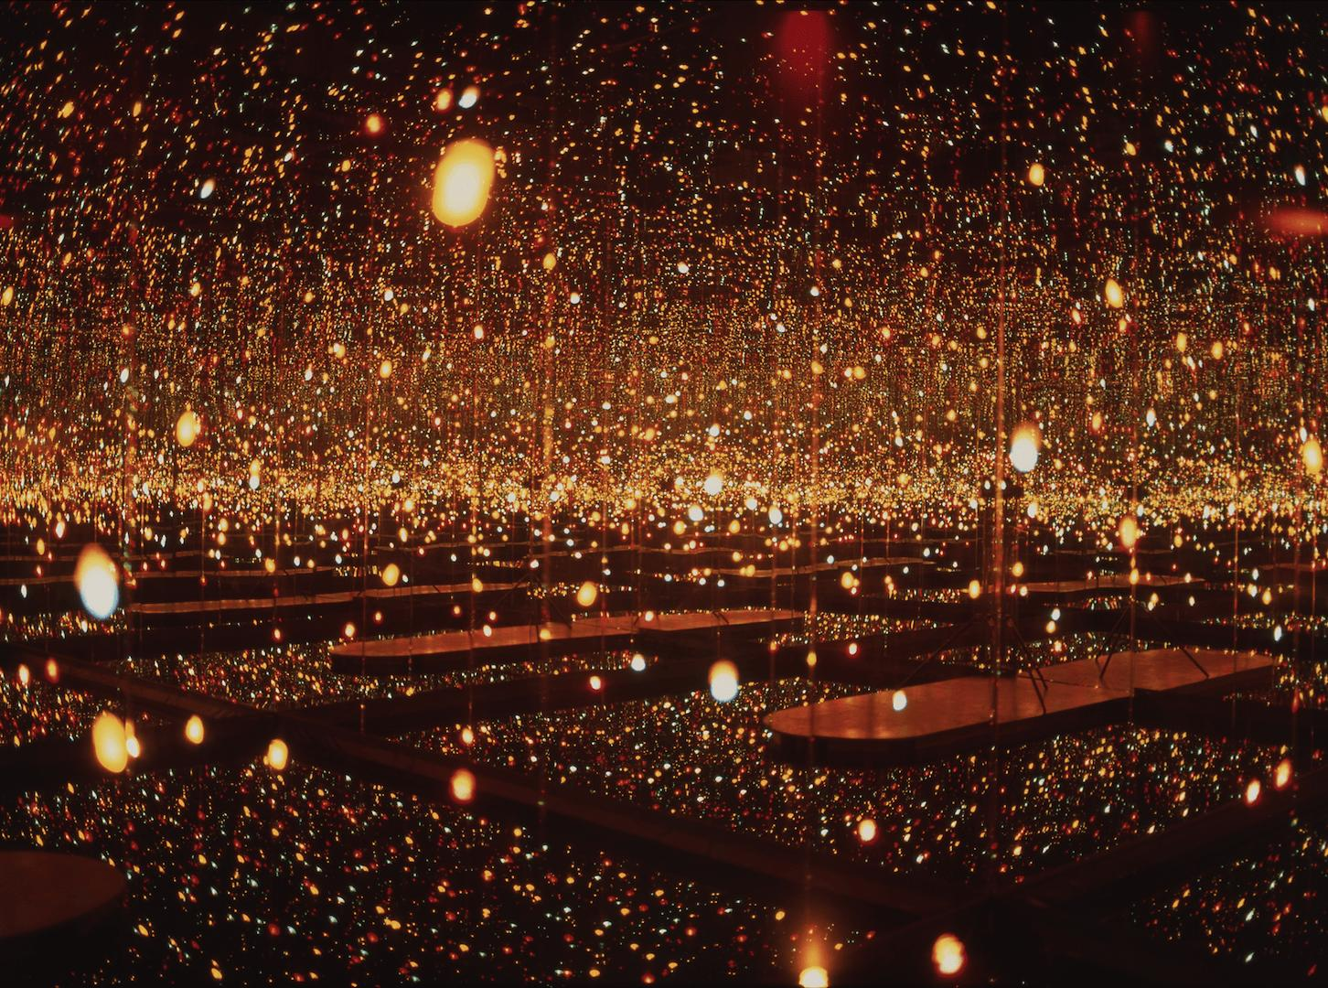
Yayoi Kusama (b. 1929).
Fireflies on the Water, Installation

Slide 42
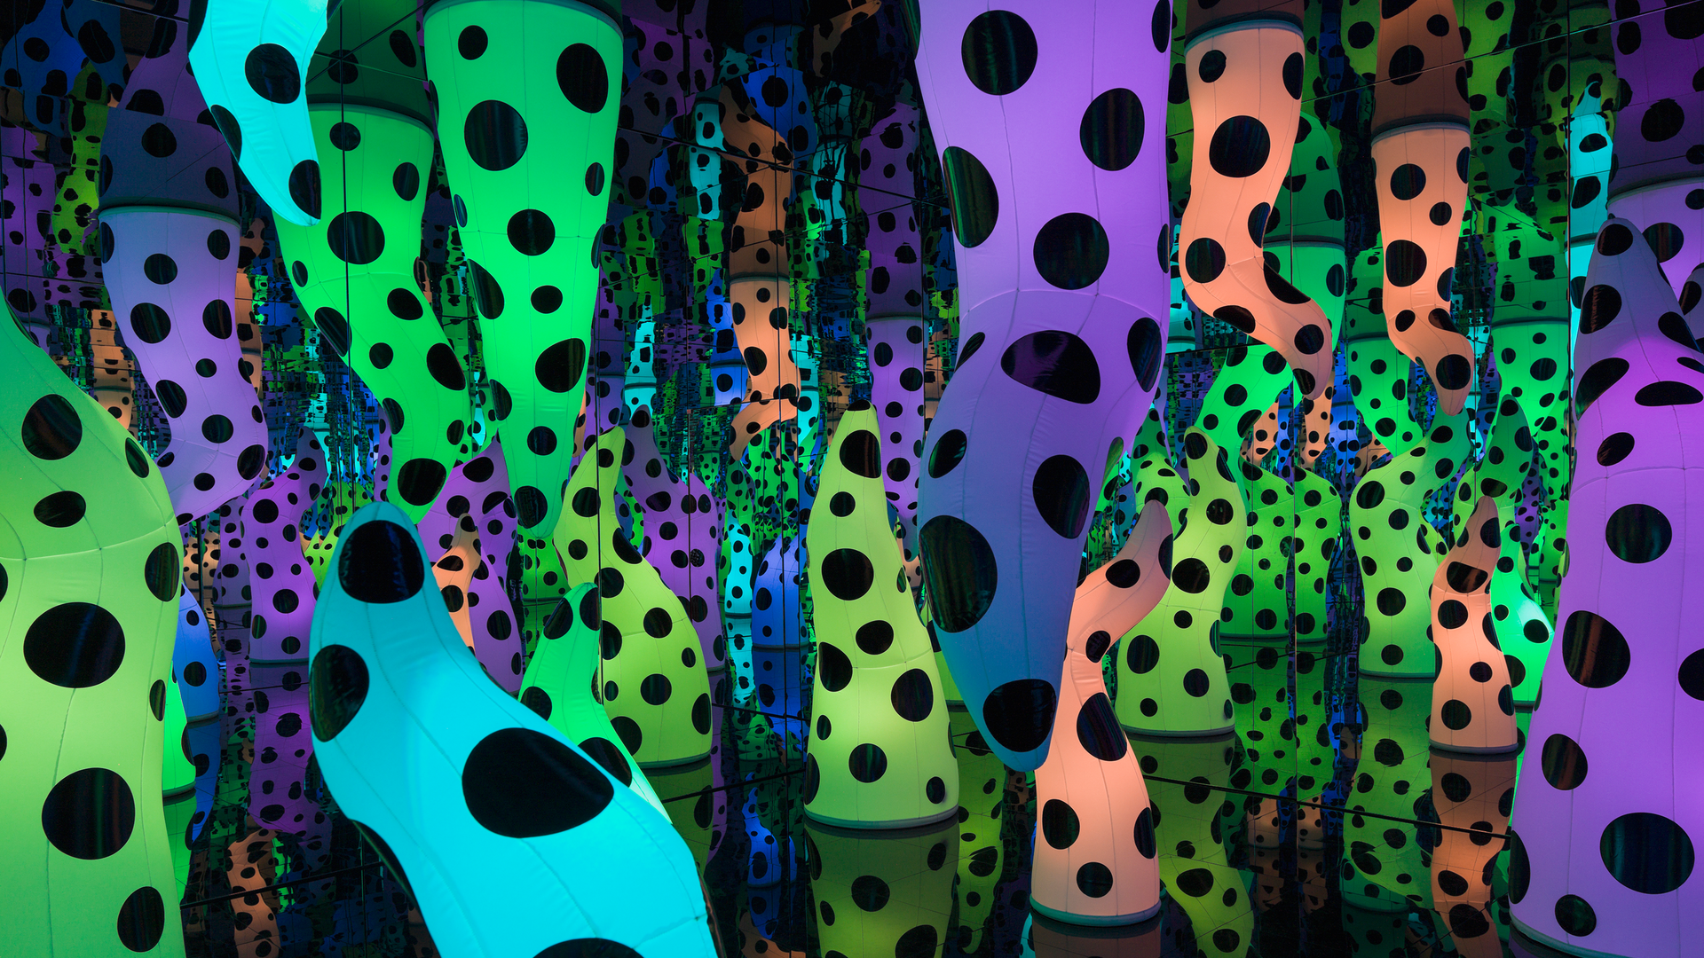
Yayoi Kusama
Love is Calling, Installation

Slide 43
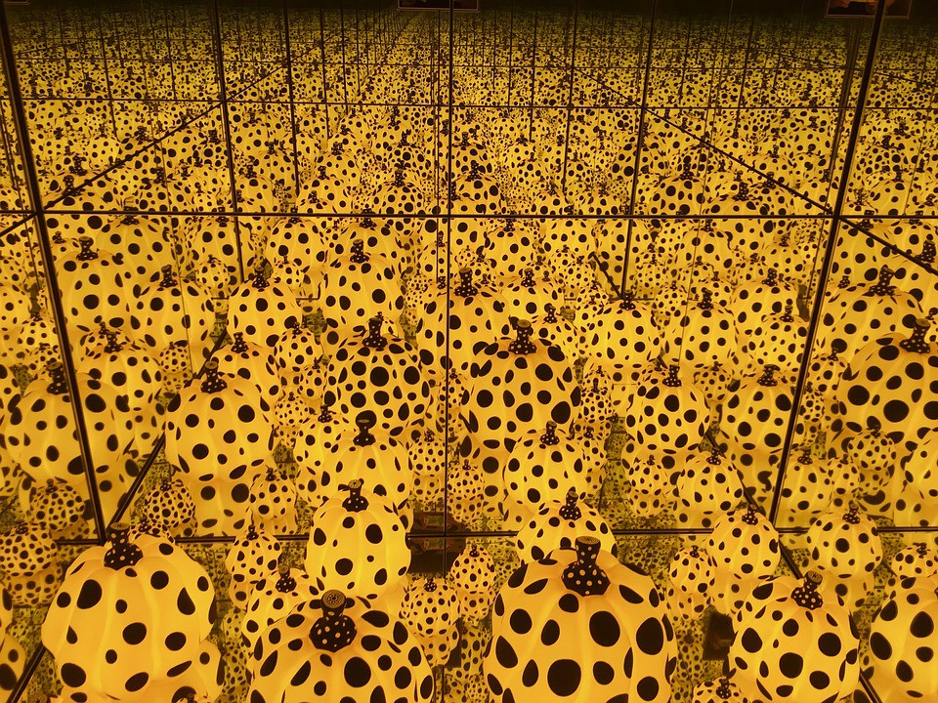
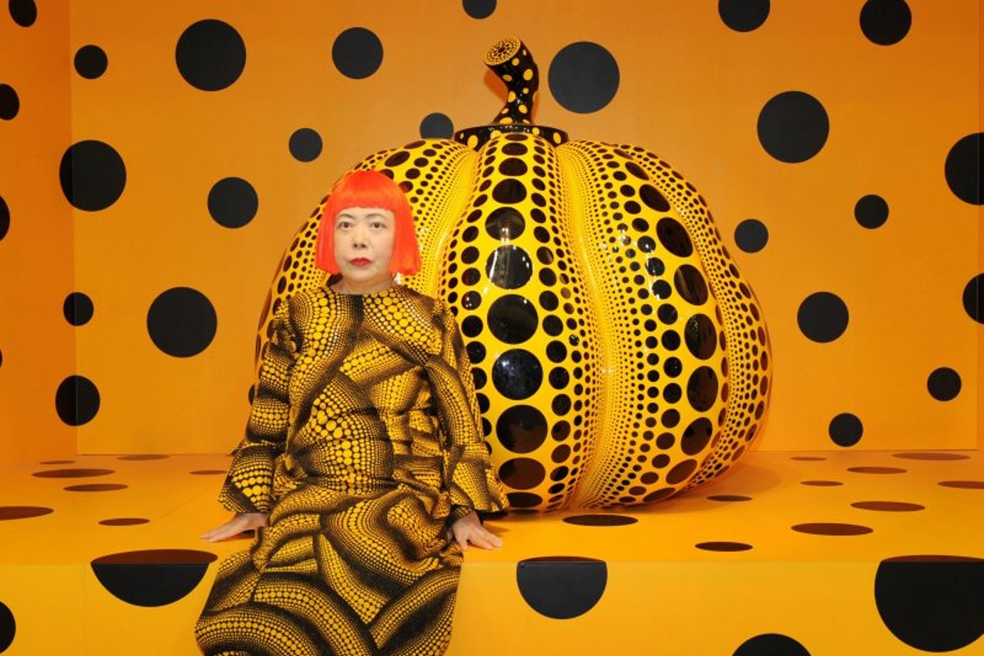
Yayoi Kusama
Infinity Mirrors, Installation & Photo with Yellow Pumpkin

Slide 44
To be continued…
We’ll save the rest for the week you bring in your AI generated art

