Slide 1

“Exhalation”
Ted Chiang

Slide 2
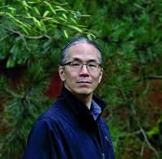
Brief Bio
An American speculative fiction writer.
Graduated from Brown University in Computer Science
Works as a technical writer in the software industry
A graduate of the Clarion Writers Workshop (1989). Chiang has to date won a string of prestigious speculative fiction awards for his works:
a Nebula Award for "Tower of Babylon" (1990), the John W. Campbell Award for Best New Writer in 1992, a Nebula Award and the Theodore Sturgeon Memorial Award for "Story of Your Life" (1998), a Sidewise Award for "Seventy-Two Letters" (2000), a Nebula Award, Locus Award and Hugo Award for his novelette "Hell Is the Absence of God" (2002), a Nebula and Hugo Award for his novelette "The Merchant and the Alchemist's Gate" (2007), and a British Science Fiction Association Award, a Locus Award, and the Hugo Award for Best Short Story for "Exhalation" (2009) (Goodreads)

Slide 3

Interview

Slide 4
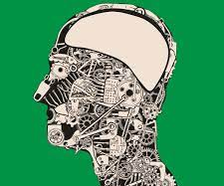
Character
Describe the Narrator.

Slide 5
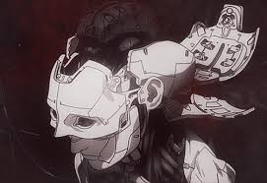
Character
The narrator is a scientist whose specialty is anatomy. What are some of the reasons he gives for his people’s lack of knowledge of their own physiology?

Slide 6
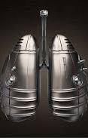
Setting
Chiang presents readers with a world utterly different from our own, and inhabitants of that world who more closely resemble Asimov’s robots than they do organic human beings. Even the most apparently familiar elements in the world are unfamiliar and unexpected.
What, for instance, are the “filling stations” referred to by the narrator?
What are some other significant features of this world?

Slide 7
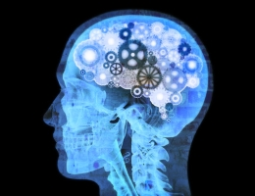
Consciousness
This story asks us to consider the power of the conscious mind to understand the world it in inhabits, even if it cannot overcome the forces in that universe that threaten to destroy it.
How is this narrative developed in “Exhalation” ?
Can we relate this to Browning’s Caliban? Or Le Guin’s John Kaph Chow?

Slide 8
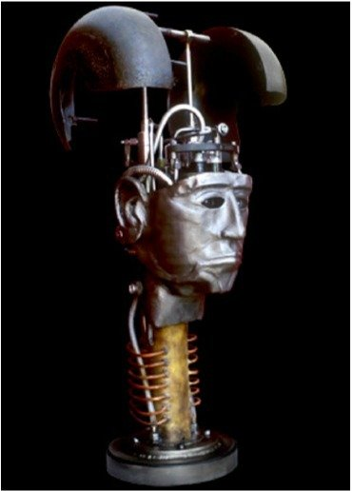
Metaphor
Unpack the literalization of the metaphor “body as machine” in “Exhalation”

Slide 9

2nd Person
Who is the reader for whom the narrator is writing down his story?

Slide 10
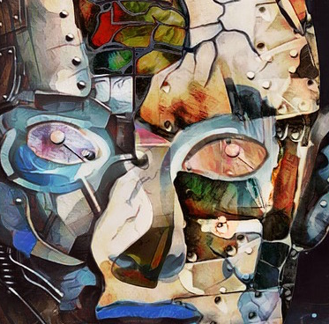
More Human than a Human
What does ‘Exhalation” have to say about what it means to be human?
For instance, where is the dividing line between human and non-human: animal, machine, artificial intelligence, created being, alien, clone, etc.
What are the ethical, philosophical, and/or moral implications the work raises concerning these issues?
How are these questions relevant in metaphorical terms to the world we live in?

Slide 11
Looking Forward & Backward
Asimov’s Laws
First Law
A robot may not injure a human being or, through inaction, allow a human being to come to harm.
Second Law
A robot must obey the orders given it by human beings except where such orders would conflict with the First Law.
Third Law
A robot must protect its own existence as long as such protection does not conflict with the First or Second Law.
(“Runaround,” 1942)

