Slide 1
DNA structure

Slide 2
The structure of DNA
nucleotide: monomeric unit of DNA
a nucleotide contains:
  sugar (deoxyribose)
  phosphate
  base (T, A, C, G)
Notes:
2

Slide 3
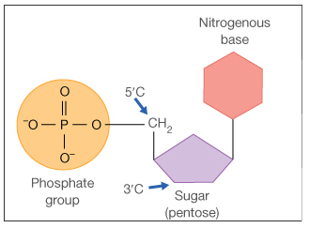
The structure of DNA
nucleotide: monomeric unit of DNA
a nucleotide contains:
  sugar (deoxyribose)
  phosphate
  base (T, A, C, G)
Notes:
3

Slide 4
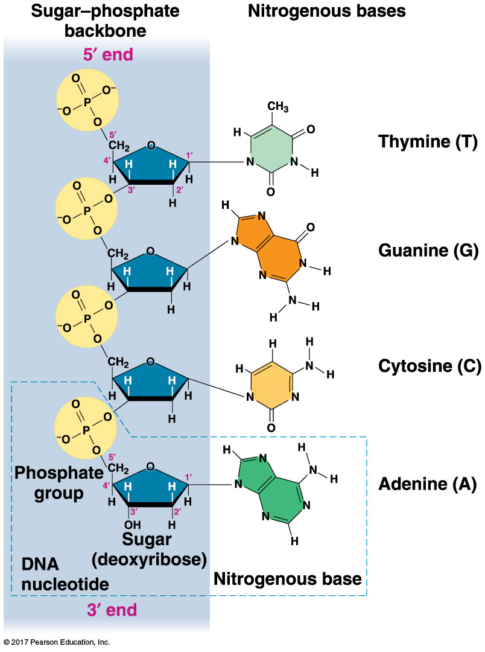
The structure of DNA
nucleotide: monomeric unit of DNA
a nucleotide contains:
  sugar (deoxyribose)
  phosphate
  base (T, A, C, G)
Campbell, Figure 16-5
Notes:
4

Slide 5
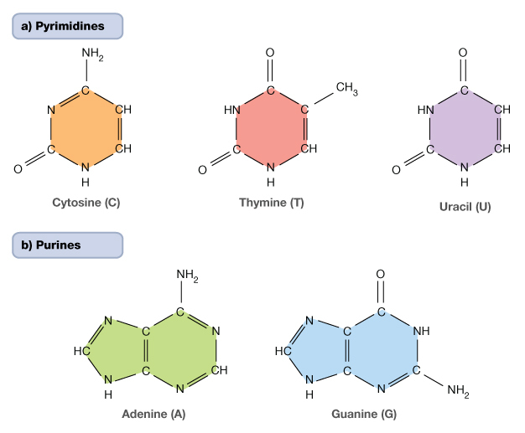
Structure of DNA bases
Principles of Biology unit 12, Figure 2

Slide 6
Chargaff’s rules about DNA
each species has a characteristic ratio of the DNA bases
organism % A % T % G % C
E. coli 24.7 23.6 26.0 25.7
yeast 31.3 32.9 18.7 17.1
maize 26.8 27.2 22.8 23.2
grasshopper 29.3 29.3 20.5 20.7
humans 29.3 30.0 20.7 20.0
Notes:
6

Slide 7
Chargaff’s rules about DNA
each species has a characteristic ratio of the DNA bases
organism % A % T % G % C
E. coli 24.7 23.6 26.0 25.7
yeast 31.3 32.9 18.7 17.1
maize 26.8 27.2 22.8 23.2
grasshopper 29.3 29.3 20.5 20.7
humans 29.3 30.0 20.7 20.0
ratio of A:T = 1, ratio of G:C = 1
Chargaff’s rules
Notes:
7

Slide 8
DNA: a double helix

Slide 9
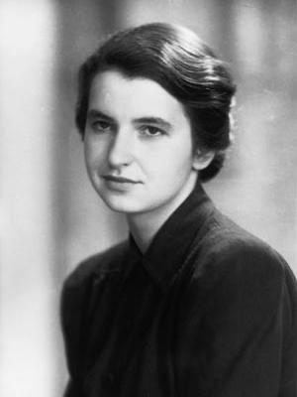
Rosalind Franklin (1920-1958)
BA in Physical Chemistry from Newnham College (Cambridge University), 1941
PhD, Cambridge University, 1945
analysis of x-ray diffraction images led to conclusion that cellular DNA is helical
further crystallography studies determined viral structures
had begun analysis of polio virus structure at time of death
for more info about Rosalind Franklin, see:
http://profiles.nlm.nih.gov/KR/Views/Exhibit/narrative/dna.html

Slide 10
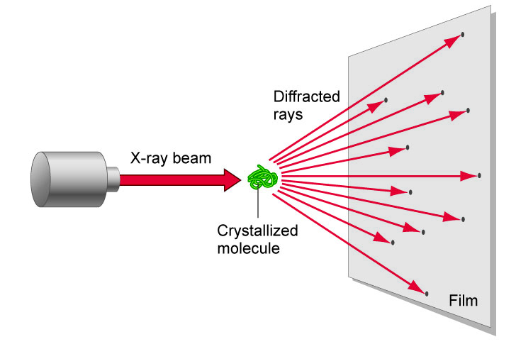
X-ray diffraction image led to the solving of the structure of DNA
X-ray diffraction data generated by Rosalind Franklin (1952)
Notes:
10

Slide 11
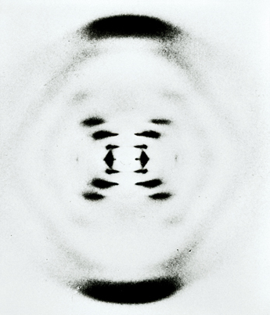
X-ray diffraction image led to the solving of the structure of DNA
X-ray diffraction data generated by Rosalind Franklin (1952)
data interpreted by James Watson and Francis Crick (1953)
Principles of Biology unit 44, Figure 7
Notes:
11

Slide 12
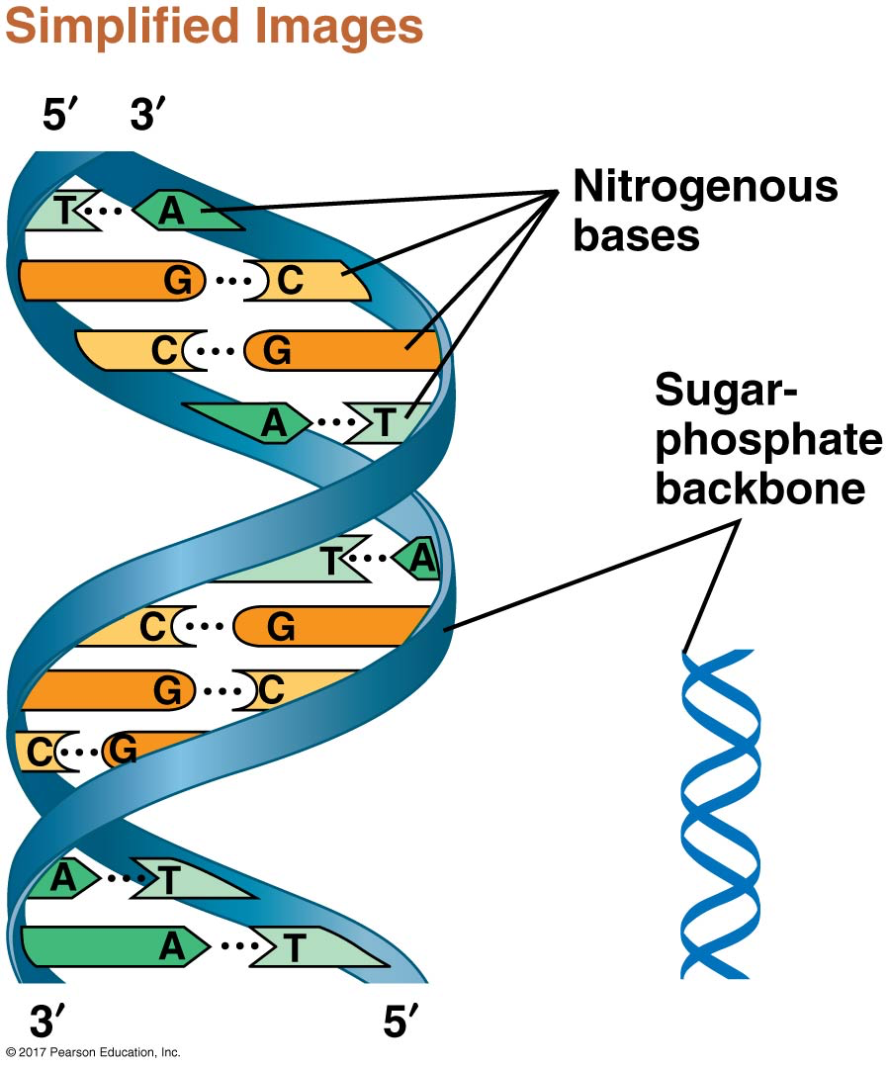
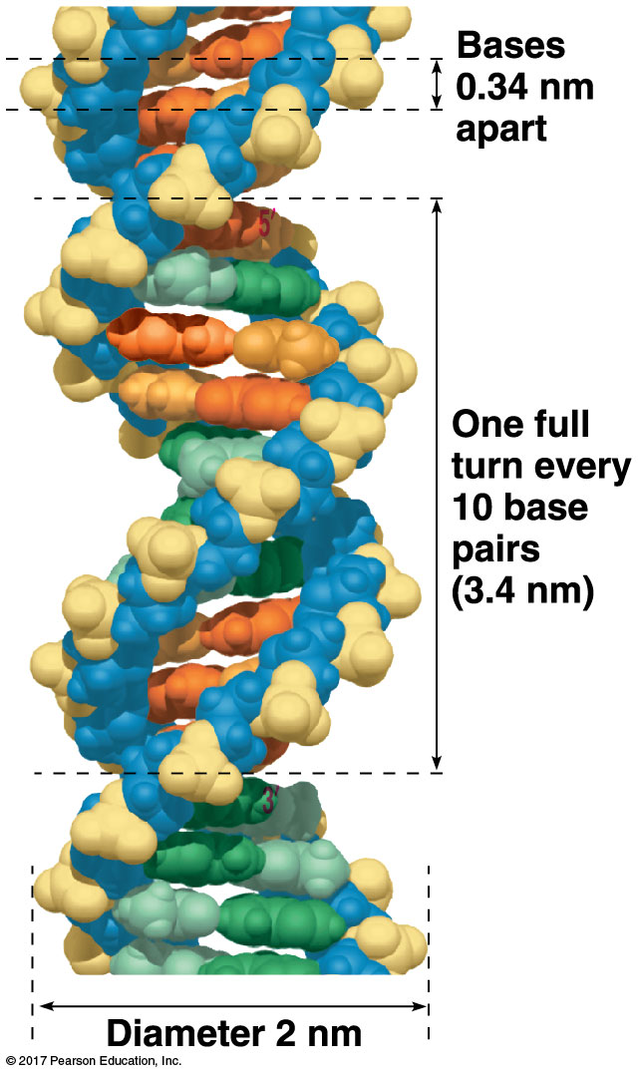
Interpretation of X-ray diffraction data
Campbell, Figure 16-7
Notes:
12

Slide 13
Interpretation of X-ray diffraction data
Campbell, Figure 16-7
helical shape
  hydrophobic bases inside, hydrophilic sugar-phosphate backbone outside
antiparallel orientation
uniform width - 2 nm
  purines pair with pyrimidines
Notes:
13

Slide 14
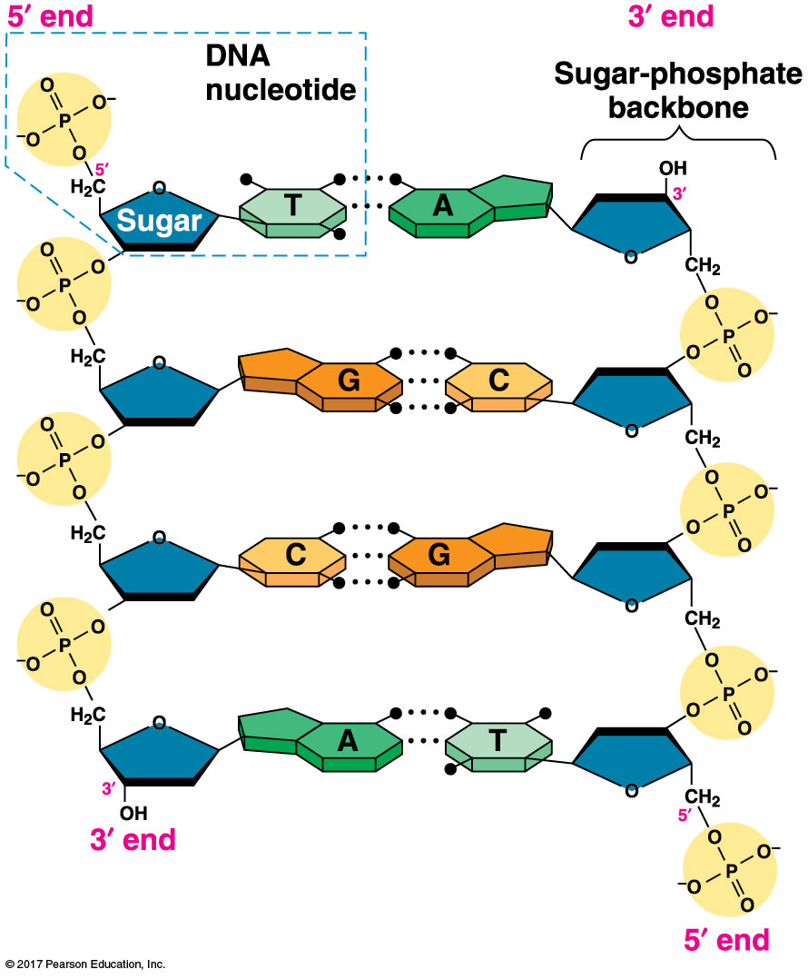
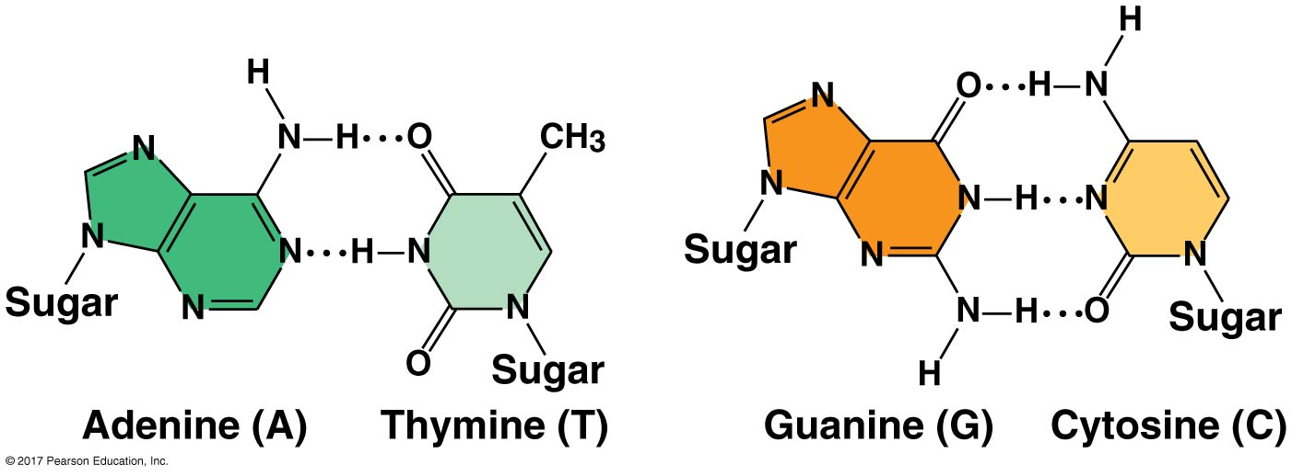
DNA base pairing
An A-T base pair has two hydrogen bonds.
A G-C base pair has three hydrogen bonds.
Campbell,
Figures 16-7 & 16-8
Notes:
14

