Slide 1


Self-employment 101
A step-by-step guide

Slide 2
Immigration reform & control Act (irca) 1986
Requires employers to attest to their employees’ immigration status.
It made it illegal to knowingly hire or recruit undocumented immigrants.

Slide 3
Employees vs. contractors
The IRCA requires employers to verify employment authorization for all its employees more so than independent contractors, sporadic domestic workers, or workers hired through other legal entities.

Slide 4
Adverse impact
Federal Statute 8 U.S. Code 1324a(a)(4) prohibits an individual or entity from knowingly engaging an unauthorized individual to provide services as a contractor.
Engaging in unauthorized employment may adversely impact the ability for one to adjust their immigration status. However, legal experts have consulted with Immigrants Rising representatives and they couldn’t “imagine a scenario in which prior unauthorized work caused an additional adverse impact to adjustment beyond the adverse impact of having been present without authorization”

Slide 5
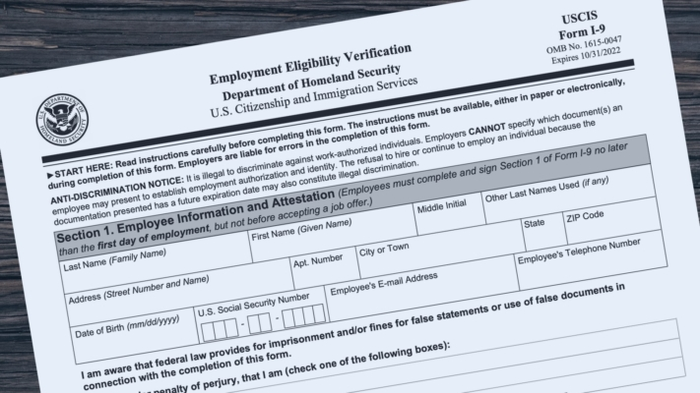
The i-9 system
A two-part Federal Employment Verification system:
Complete the Employment Eligibility Verification I-9 Form – used to verify whether someone is “authorized” to work in the U.S.
Submit original documentation that is listed under the “Acceptable Documents” list (ex. U.S. passport, Permanent Resident Card, Employment Authorization Document, etc.)
There are exceptions to the I-9 System:
An individual or entity is NOT required to obtain Form I-9 from independent contractors or sporadic domestic workers

Slide 6
Getting started
The person or company that pays will require to inquire for a Social Security Number (SSN) or Individual Taxpayer Identification Number (ITIN) to commence work.
ITINs are automatically created for an individual if they are claimed as a dependent on one’s tax return. Otherwise, one may apply for an ITIN by completing and submitting the W-7 ITIN Form.
Important Notes –
DACAmented individuals must use the SSN provided to them NOT their ITIN
ITINs expire after 10 years and must be renewed

Slide 7
Liability & taxes
Independent Contractors receive all profits and liable for all losses and debts. It is recommended that contactors consider getting General Liability Insurance (GLI) to protect them from a variety of claims including bodily injury, property damage, personal injury and others
Independent Contractors must complete the Self-Employment Tax and 1040NR U.S. Nonresident Income Tax forms when filing taxes. An ITIN may be used to file and pay taxes instead of an SSN.

Slide 8
Contract agreement
Document justifying your working relationship, outline your services, fees and duration of contract, and protect your intellectual property

Slide 9
W-9 request tax identification number form
The W-9 is filled out at the start of work by an independent contractor and kept on record by the payer.
Note that if, in one calendar year, an independent contractor is paid anything less than $600 then the
payer does not need to request a W-9 Form

Slide 10
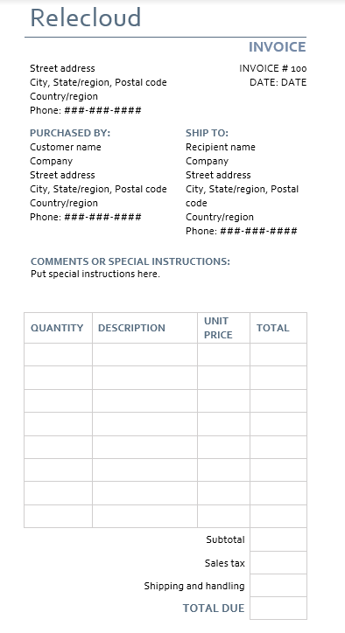
invoice
A bill issued to the employer for the services you have completed to get paid

Slide 11
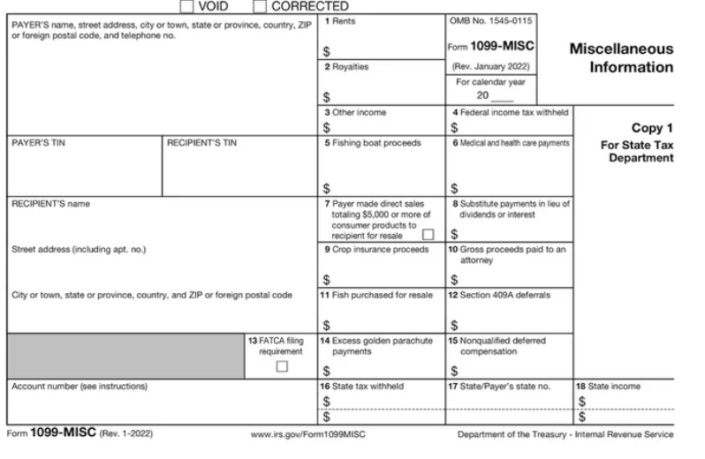
1099 msc. form
The IRS requires that payers use Form 1099 to record the total amount of money paid to independent contractors in any given calendar year.
A payer must file a 1099 for each independent contractor paid $600 or more.

Slide 12
1040NR U.S. Nonresident income tax return
You may need to file Form 1040-NR if you:
Were a nonresident alien* engaged in a trade or business in the United States.
Represented a deceased person who would have had to file Form 1040-NR.
Represented an estate or trust that had to file Form 1040-NR.

Slide 13



1040NR Schedules
Schedule a
Itemized deductions
Schedule nec
Tax on income not connected with a u.s. trade or business
Schedule oi
Other information
If you file Form 1040-NR, use Schedule OI (Form 1040-NR) to provide additional information not directly entered on Form 1040-NR including whether you are claiming a benefit under a tax treaty.
If you file Form 1040-NR, use Schedule A (Form 1040-NR) to figure your itemized deductions.
If you file Form 1040-NR, use Schedule NEC (Form 1040-NR) to figure your tax on income that is not effectively connected with a U.S. trade or business and to figure your capital gains and losses from sales or exchanges of property that is not effectively connected with a U.S. business.

Slide 14
Self-employment (SE) tax form
Use Schedule SE (Form 1040) to figure the tax due on net earnings from self-employment.
The Social Security Administration uses the information from Schedule SE to figure your benefits under the social security program.
This tax applies no matter how old you are and even if you are already getting social security or Medicare benefits.

Slide 15
Tax guides
U.S. Tax Guide for Aliens* – Will help determine your status and give you information you will need to file your U.S. tax return
Withholding of Tax on Nonresident Aliens* & Foreign Entities – Guide on how much tax to withhold from earnings
Tax Guide for Small Businesses – Information on federal tax laws that apply to you if you are a self-employed person or a statutory employee. This publication has information on business income, expenses, and tax credits that may help you, as a small business owner, file your income tax return.

Slide 16
references
“About Form 1040-NR, U.S. Nonresident Alien Income Tax Return.” Internal Revenue Service, 4 Oct. 2022, https://www.irs.gov/forms-pubs/about-form-1040-nr.
“About Schedule SE (Form 1040), Self-Employment Tax.” Internal Revenue Service, 5 Oct. 2022, https://www.irs.gov/forms-pubs/about-schedule-se-form-1040.
“Working for Yourself (Guide).” IMMIGRANTS RISING, https://immigrantsrising.org/resource/working-for-yourself-guide/.

