Slide 1
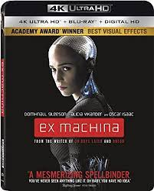
Ex Machina
Alex Garland
2014

Slide 2
EX MACHINA
DIRECTOR:
Alex Garland
YEAR OF RELEASE:
2014
GENRE:
Modern

Slide 3
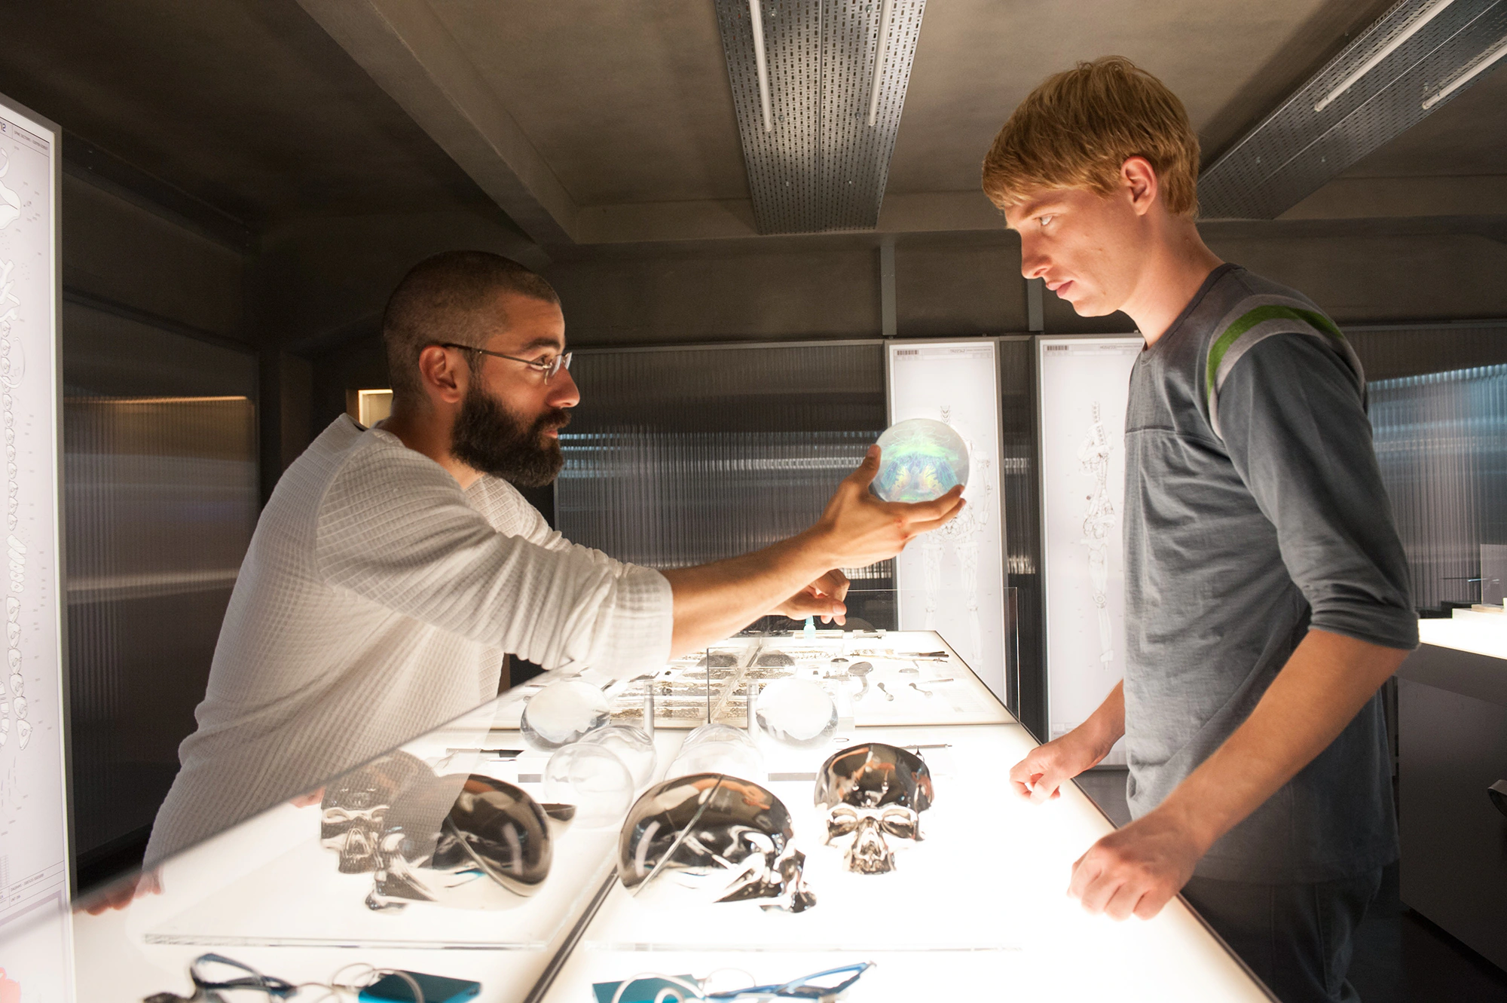
The Possibility of AI
Director Alex Garland has
described the future presented
in the film as “ten minutes from
now,” meaning “If somebody like
Google or Apple announced
tomorrow that they had made
Ava, we would be all surprised,
but we wouldn’t be that
surprised.”

Slide 4
MAJOR THEMES
Complex Images of Women
Identity
Emotional and Physical Manipulation
Confinement and Desire For Freedom
Violence
Ethical Issues

Slide 5
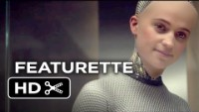
Complex Images of Women
How are women are depicted in the film?
How do cultural expectations effect Ava’s physical
creation? In the film AND by the filmmakers…

Slide 6
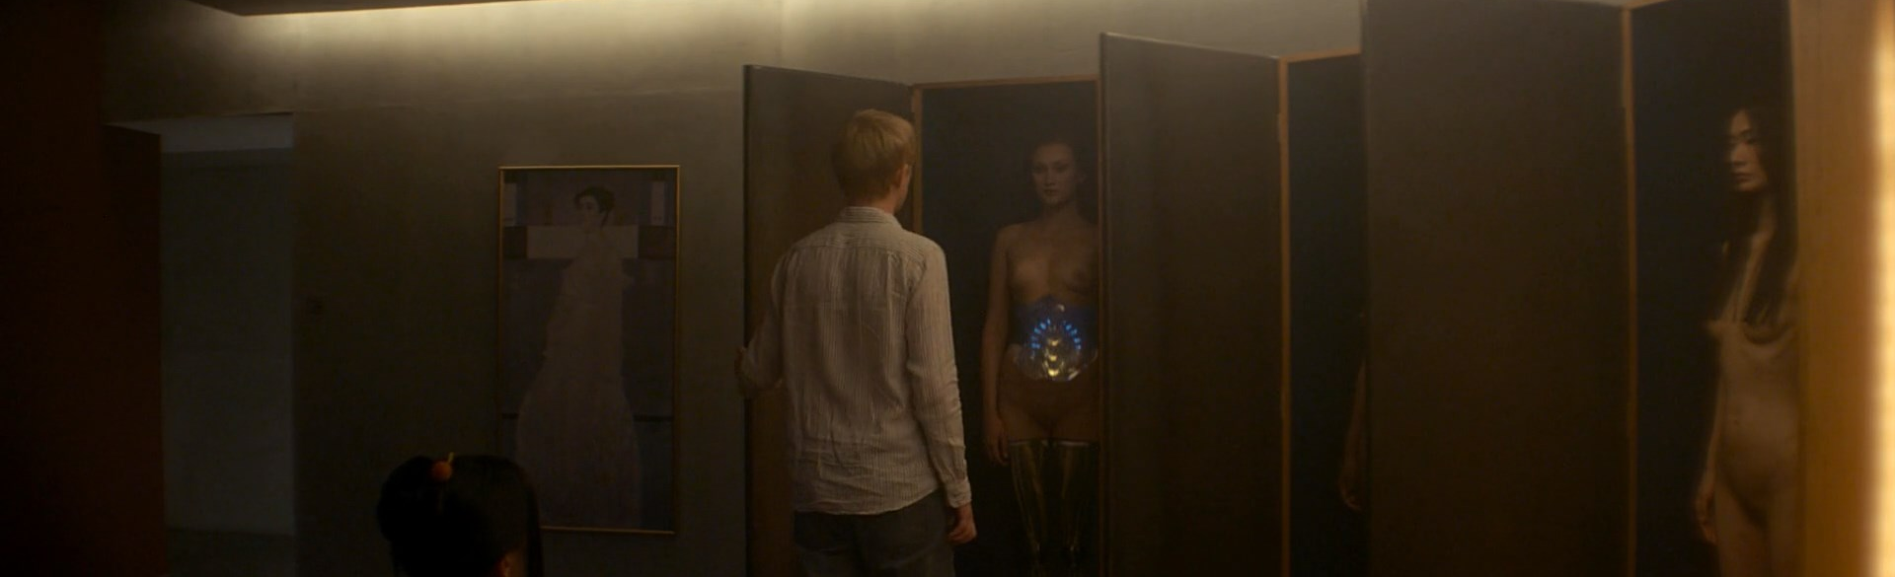
Complex Images of Women
What do you notice about all of the “female” robots that
Nathan has created and then stored away in coffin like
closets?

Slide 7
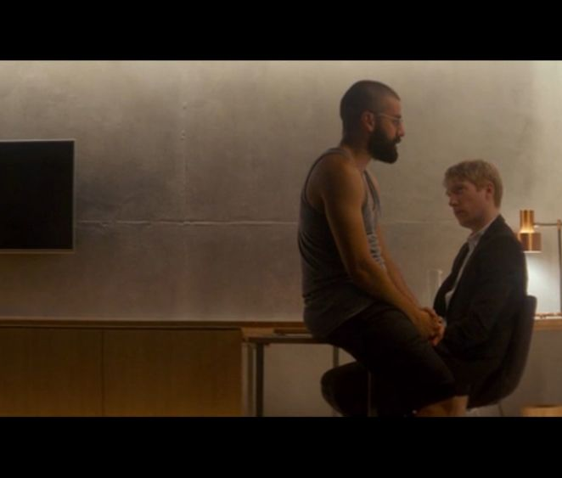
Masculinity
There are two male characters in this film:
• Nathan
• Caleb
How is Nathan characterized?
How is Caleb characterized?
Why does Nathan choose Caleb for this experiment?

Slide 8
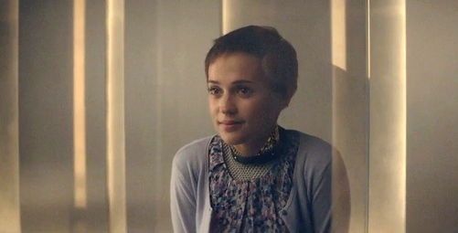
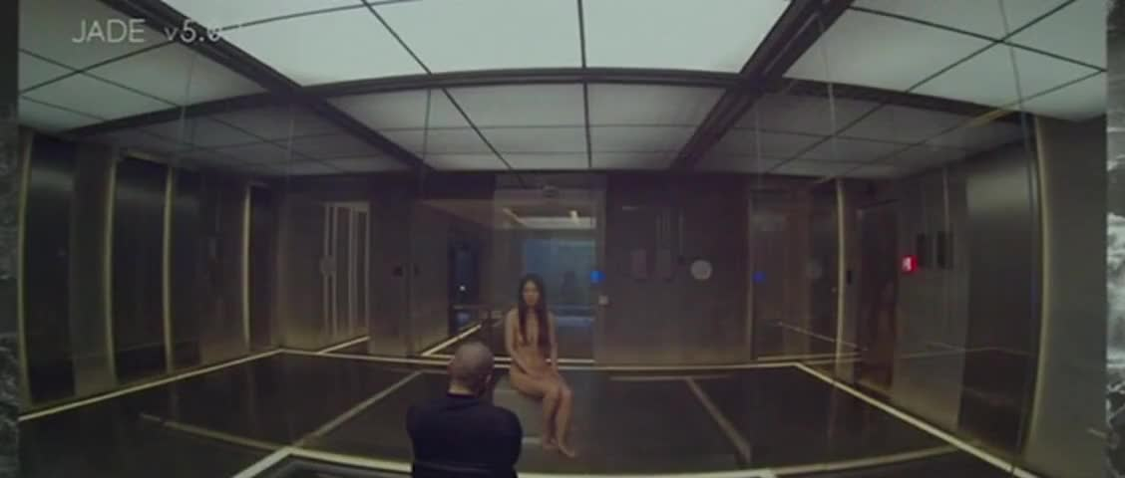
Complex Images of Women
There are no human females in the film. So, what does Nathan create? Discuss the irony of Nathan giving Ava sexuality.
Nathan says none of the other robots were as developed as Ava. But the Asian robot screamed for freedom. What do you think Nathan was really after in creating AI?

Slide 9
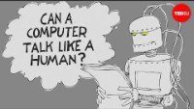

Turing Test
A measure of determining whether a machine can demonstrate human
intelligence in thoughts, words, or actions. The Turing Test was proposed by Alan
Turing in 1950 and is the basis for the philosophy behind Artificial Intelligence.
How does Nathan intend to determine if Ava’s AI is real?
What’s the real test?

Slide 10
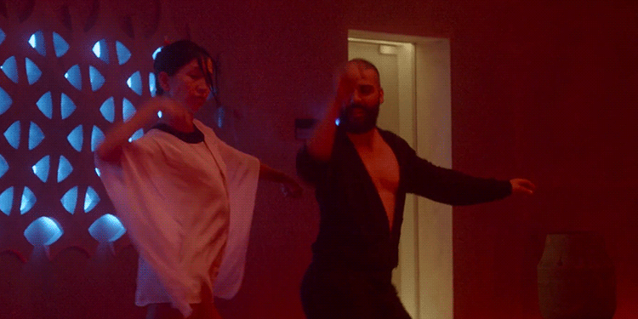
Let’s Dance!
Why is the dance scene so important?

Slide 11
Asimov’s Laws
Three Laws of Robotics
Isaac Asimov, famous science fiction writer, introduced the three laws
in his 1942 short story “Runaround,” from his 1950 collection I, Robot.
1. A robot may not injure a human being or, through inaction, allow a human
being to come to harm.
2. A robot must obey the orders given it by human beings, except where such
orders conflict with the First Law
3. A robot must protect its own existence as long as such protection does not
conflict with the First or Second Laws.
Currently, robots are incapable of understanding and applying the Three Laws.
There needs to be significant advances in AI to be make laws applicable.

Slide 12
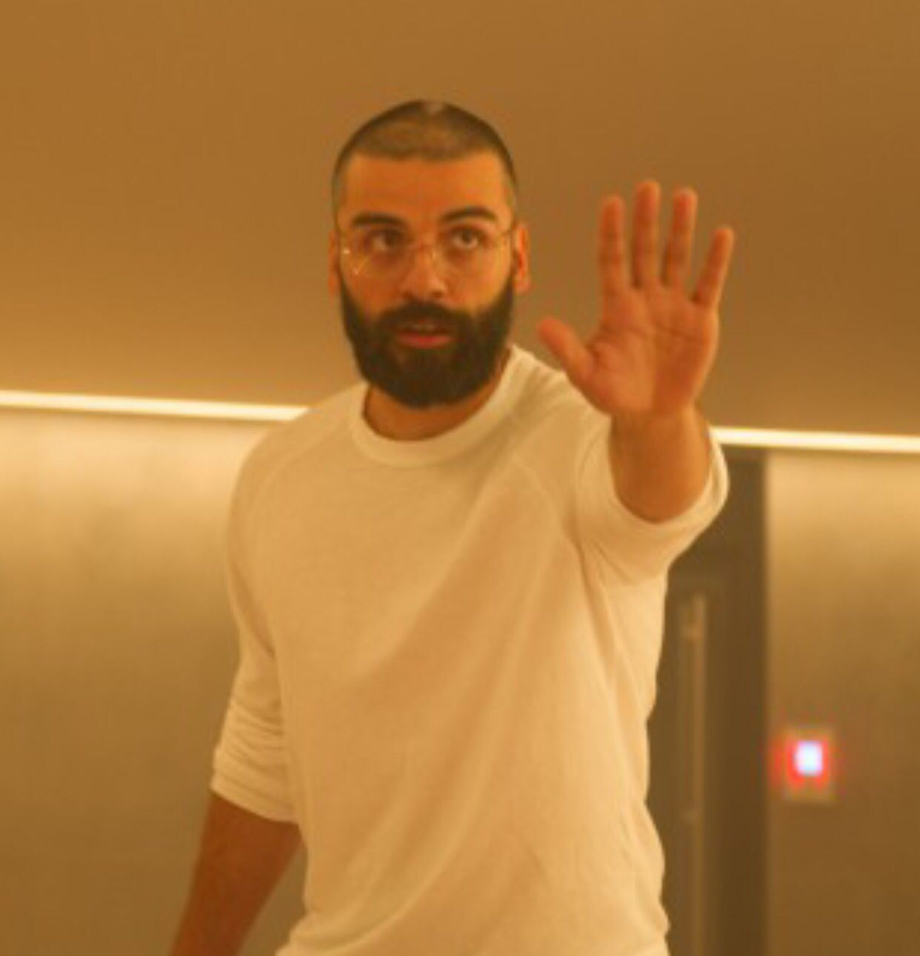
Asimov’s Laws in Action?
Why did Nathan think Ava would stop fighting him when he commanded?
Asimov’s Laws?
Narcissism?
Something else?

Slide 13
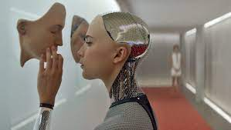
Ethics
When machines become self-aware, should they have rights like a human?

Slide 14
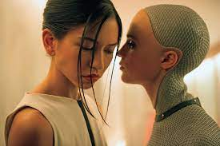
Ethics
Why did Ava not help Kyoko when she was fighting Nathan?

Slide 15
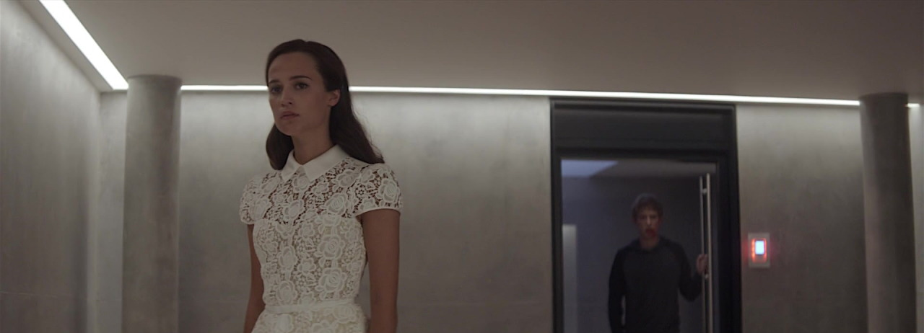
Ethics
Can Ava be held ethically responsible for what she did to Caleb if she had only been taught abuse from Nathan?

Slide 16
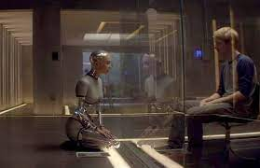
Affective Responses
Was the relationship between Caleb and Ava real?

Slide 17

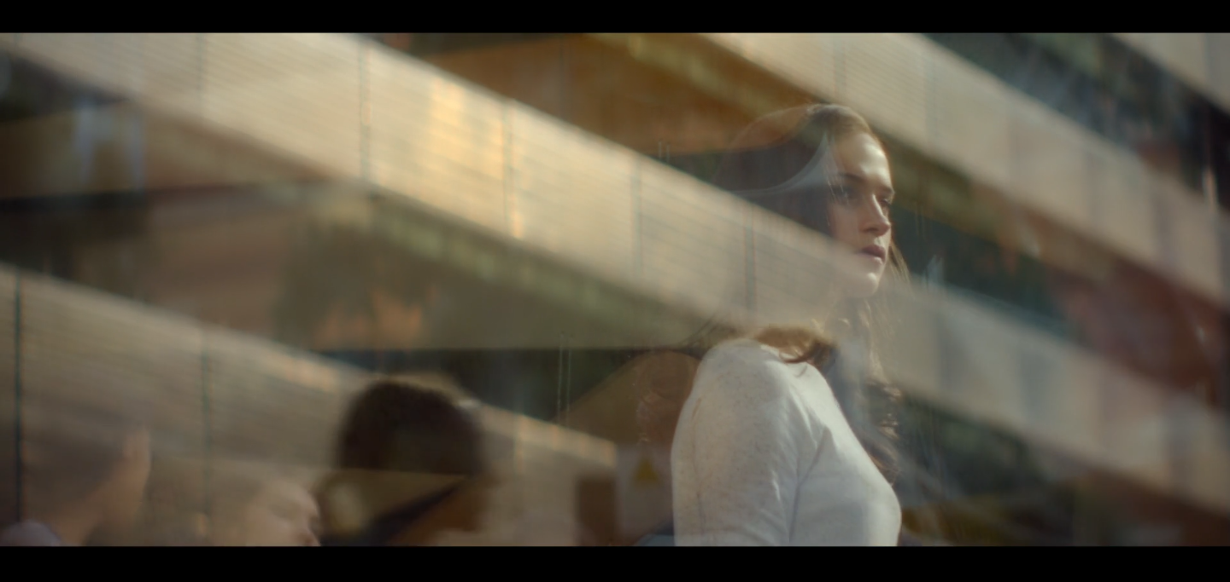
Deus Ex Machina
The title of the film comes from the phrase “Deus ex machina” (translated “god from the machine”), which is a plot device whereby an unexpected power or event saves a seemingly hopeless situation. Usually used to bring about a happy ending.
Ex: the Great Eagles that save Frodo and Sam at the end of Lord of the Rings
HOWEVER,… the title removes the word “god” and leaves “from the machine.”
What does that say about human desire to become
creators themselves (of AI)?
Does this movie have a happy ending?

